Slide 1
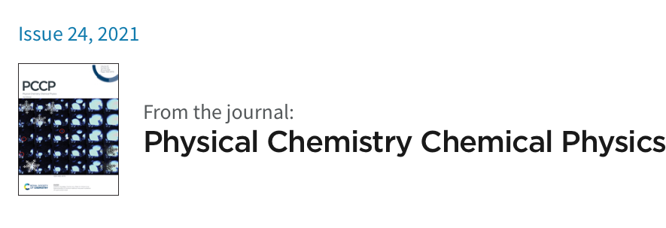
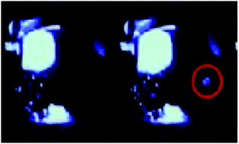

Basic Energy-
Threshold
Modeling for
Snowball Chambers
PUBLICATION : https://pubs.rsc.org/en/content/articlelanding/2021/cp/d1cp01083b
(first tests: 20 mL)
Prof. Matthew Szydagis UAlbany SUNY August 27, 2024
Also available on arXiv https://arxiv.org/pdf/1807.09253.pdf

Slide 2
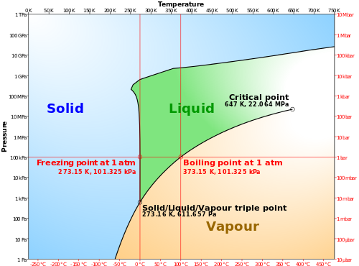
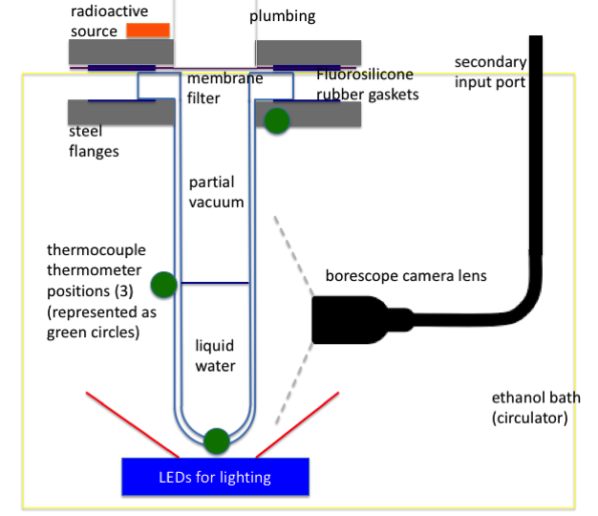
What is a Snowball Chamber?
done before, but only with betas and gammas, most recently by Varshneya (Nature, 1971)
Physics Dept., Univ. of Roorkee, India
The snowball chamber is analogous to the bubble & cloud chambers
  It also relies on a phase transition
  But it is a new instrument in nuclear & particle physics
Supercooling of pure water in clean, smooth containers
  Although, as with bubble chambers almost any other liquid should be usable
  A liquid such as water can be cooled below its normal freezing point. Metastability
CO-INVENTED w/ _Prof Cecilia Levy

Slide 3
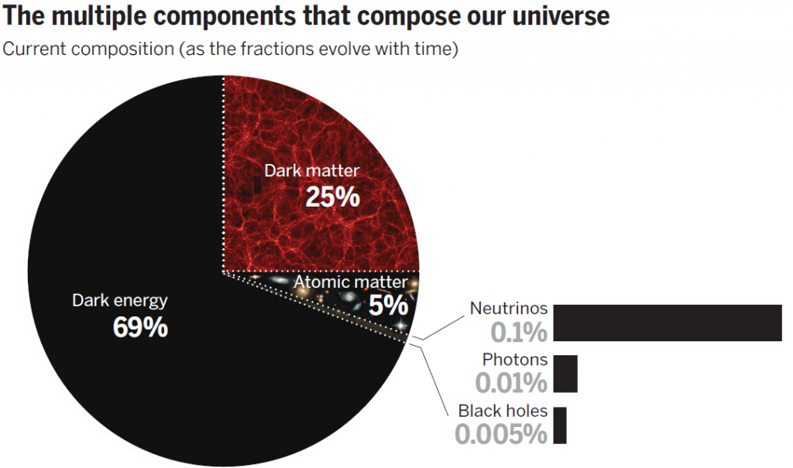

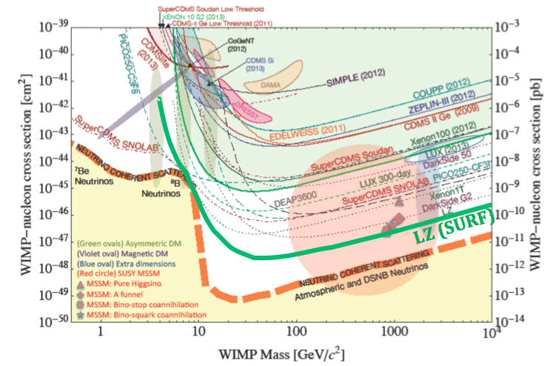
Dark Matter: A Lamppost Effect
(or, streetlight)
Snowmass 2013
(older version chosen on purpose)
WIMPs (Weakly Interacting Massive Particles) still well motivated

Slide 4
The Advantages and The Merits
Scalability: ν project examples (H₂O Cherenkov detectors)
  Either in bulk or modular (many small tubes) OR in droplet form
Purity: water is cheap and easy to purify. Done regularly
  We’ve used a 20nm filter. Can upgrade to 5 but also try 100 (speed)
No cryogenics (-30 °C isn’t very cold) nor high voltage necessary
  In general, excellent safety: no superheated liquid for instance
The lightest possible element to search for the lightest dark matter still producing nuclear recoils: Hydrogen
  Plus sensitivity to medium-mass dark matter with Oxygen
  Possible recoil differentiation with AI/ML (more on this later)
Lower “neutrino fog” for hydrogen than other elements
Directionality, the holy grail of dark matter direct detection
  In the bulk of a liquid, not in gas. For rejecting solar νs
Energy reconstruction: last summer we demonstrated the supercooling of WbLS (water-based liquid scintillator). A first!
WHY possible? H bonding
https://www.mdpi.com/2218-1997/10/2/81

Slide 5
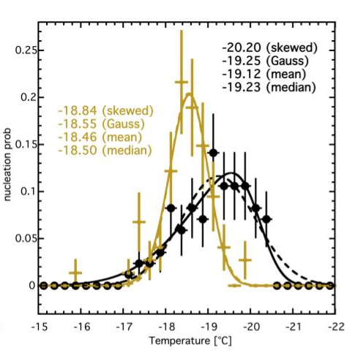
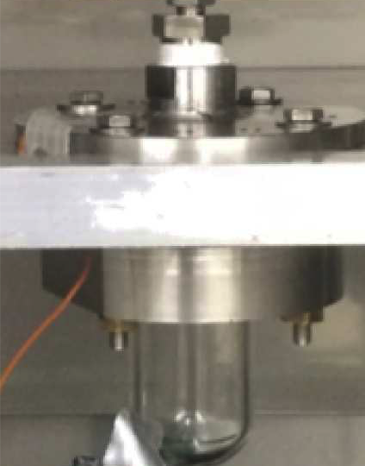
Critical Proof of Concept (2018)
Neutrons (²⁵²Cf) are able to freeze supercooled water
  A world first. Made the journal cover (see slide 1)
Yet another advantage: neutrons will multiply scatter in water (with a few-cm mean free path)
  Won’t mistake for WIMP
  Observed in cam (slide 1)
Our first results are consistent with keV-scale energy threshold
  Theory papers suggest sub-keV very possible
Cf corroborated by AmBe
higher temp (AND shorter time)
Shift does NOT seem to happen with gammas
Cf-252
Control
arXiv:2401.15064
20 g

Slide 6
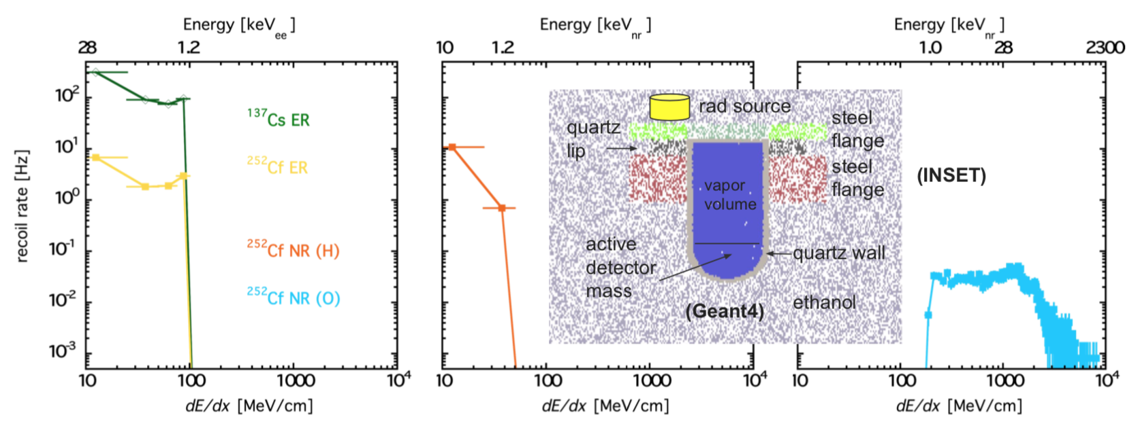
Comparison of (Geant4) Simulations with the Data
Stopping power spectra for each possible type of recoil. Corresponding initial species Es for which this is the mean dE/dx are along upper x-axes. A ∼100 MeV/cm threshold assumption explains a lack of discernible response from a γ source
(Inset) Geant4 geometry: cross-sectional view

Slide 7
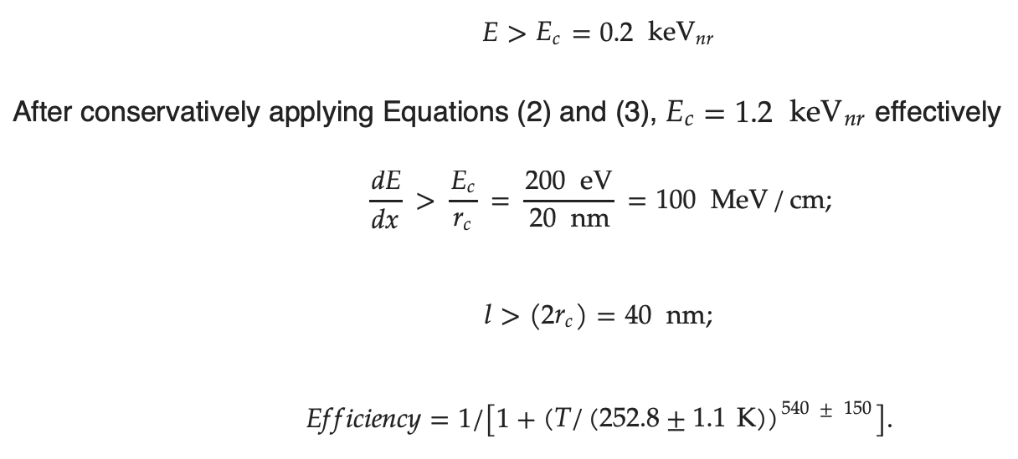
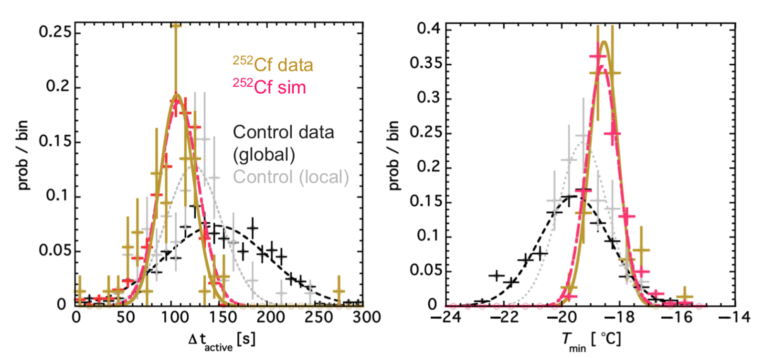
Critical Energy and Radius
(1)
(2)
(3)
(4)

Slide 8
What are the Backgrounds?
Promises of dark matter search results without an understanding of backgrounds cannot be trusted.
Cosmic-ray muons: minimize flux by going underground and adding shielding (either active or passive)
Neutrons: covered (neutrinos also covered)
Beta and gammas (e- recoils): adjust temperature to avoid them, and make experiment out of low-background materials
Alphas: purify water, use timing as in PICO, use piezo-electric acoustic sensors as in PICO, adjust temperature to avoid (so we have plans A, B, C, D). Colder = lower energy, dE/dx thresholds
The Wall: fiducialization, smooth vessels sourced from same suppliers as used for bubbler chambers, hydrophobic materials, super-hydrophobic coatings (again, multiple backup plans)
Spontaneous bulk nucleation: perhaps no such thing! But!! optimize T just in case (Goldilocks). Go modular. Vibration iso

Slide 9
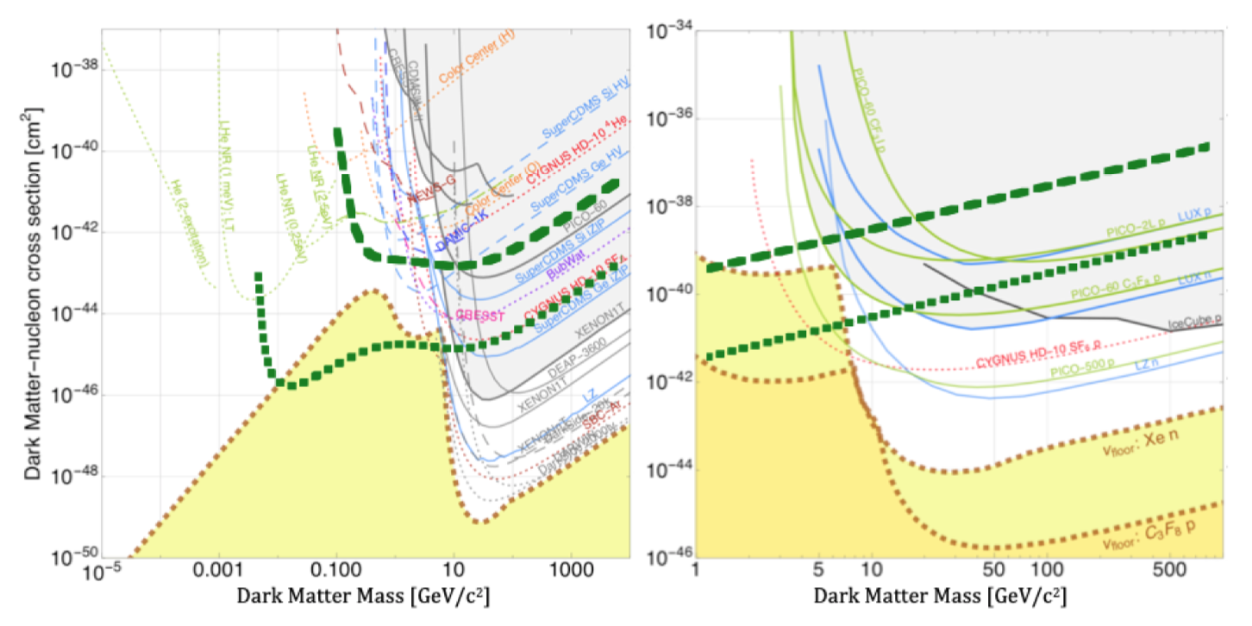
Projected WIMP Sensitivities
plots from DoE Cosmic Visions Report (arXiv:1707.04591) with our own curves overlaid. No directionality assumed
No past, present, future (planned) experiment has comparable sensitivity at 1 GeV for WIMP-proton coupling (spin-dependent)
  That is true even if the energy threshold is > 1 keV_{nr} not lower value
Readiness: need O(4) yr. at least for calibrations + optimizations
Conservative = 1 kg-year live exposure -> e.g. only 1 kg for 1 year underground!
Aggressive =
100 kg-years
SI (left) spin-independent
SD-proton spin-dependent (right plot)
Conservative
Aggressive

Slide 10
➔ The Future
Calibrate with mono-energetic neutron beam (e.g. TUNL, but UAlbany also has beam) at different Ts, n fluxes, n Es, etc.
Goal: become the first dark matter experiment to deploy 2 detectors, one in the Northern and one in the Southern Hemisphere, to study annual modulation and disprove false positives trivially
While scale up would be nice, already competitive at O(1 kg) scale, so emphasis on LONG-TERM stable running
  If underground and away from cosmic rays, we will not even need to solve major challenge from surface of the melting time
Made it into Snowmass reports (and P5/HEPAP spoke highly of small-project funding)
AGILE!

Slide 11
Concluding with Sample Videos
The snowball chamber captures the imagination like few other experiments can *PUBLIC ENGAGEMENT*
These are the most recent videos, from BNL (sabbatical)
  FLIR (low FPS) and high-speed camera (6,000 FPS example)
FLIR.mov ~15 second start
Evt14BNL.mp4 (both too large to embed) ~half-way through

