Slide 1


particle acceleration & neutrino production in PNS outflows
Outline
Why study neutrino emission? Plausible astrophysical sources
Protomagnetars as multi-energy neutrino sources
Properties of neutrino-driven PNS winds
Impact of stellar progenitor on EM observables
Detectability of TeV neutrinos from magnetized PNS outflows
Summary, model limitations & scope of future work
Mukul Bhattacharya
SCEECS Postdoc @ UW-Madison
Collaborators:
Jose Carpio (U. Nevada, Las Vegas)
Kohta Murase (Penn State)
Nick Ekanger (Virginia Tech, Tohoku)
Shunsaku Horiuchi (Virginia Tech)
TeVPA 2024, University of Chicago
August 29, 2024

Slide 2
Outline
Why study neutrino emission? Plausible astrophysical sources
Protomagnetars as multi-energy neutrino sources
Properties of neutrino-driven PNS winds
Impact of stellar progenitors on observables
Detectability of TeV neutrinos from magnetized PNS outflows
Summary, model limitations & scope of future work
Notes:
Properties of neutrino driven PNS winds:
outflow structure
nucleosynthesis
particle acceleration
survival

Slide 3
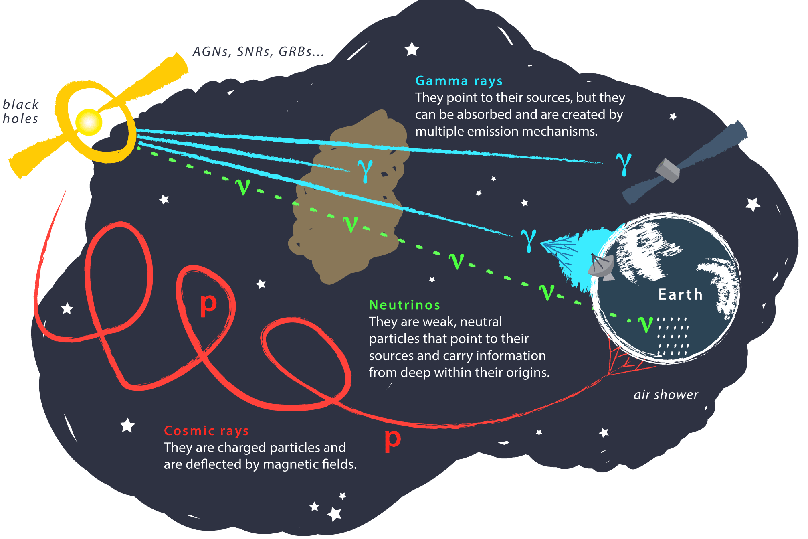

Why study neutrino emission?
Advantages:
N$o charge→$ not deflected by magnetic fields $→$ point back to the source
U$ndergo weak interaction→$ escape the source unimpeded; not absorbed by dust, CMB, EBL
Challenges:
Require huge detectors, have low statistics
Large atmospheric background
Credits: Juan Antonio Aguilar & Jamie Yang. IceCube/WIPAC
Notes:
After the big bang, as Universe began to cool, neutrons and protons were formed at about the same ratio. As it continued to cool, more protons than neutrons were formed since they are slightly lighter. Further, some neutrons decayed into protons, leaving a final Ye of 7/8. Vast majority of the remaining neutrons formed into He nuclei and so at the end of the BBN era, 75% of the mass was synthesized into H and 25% into He. There were also much smaller amounts of deuterium, lithium, and others, but these make up a very small portion of the nuclei synthesized.
Majority of elements heavier than H, He, and Li are made in stars through fusion. To simplify complex fusion cycles that occurs in stars, what happens in these very hot and dense regions is H and He nuclei combine into heavier and heavier elements until they form Fe. After which, it is no longer energetically viable to fuse heavier stuff. Through mass loss events like flares, pulsations, and supernovae, stars enrich the universe with elements up to Fe.

Slide 4
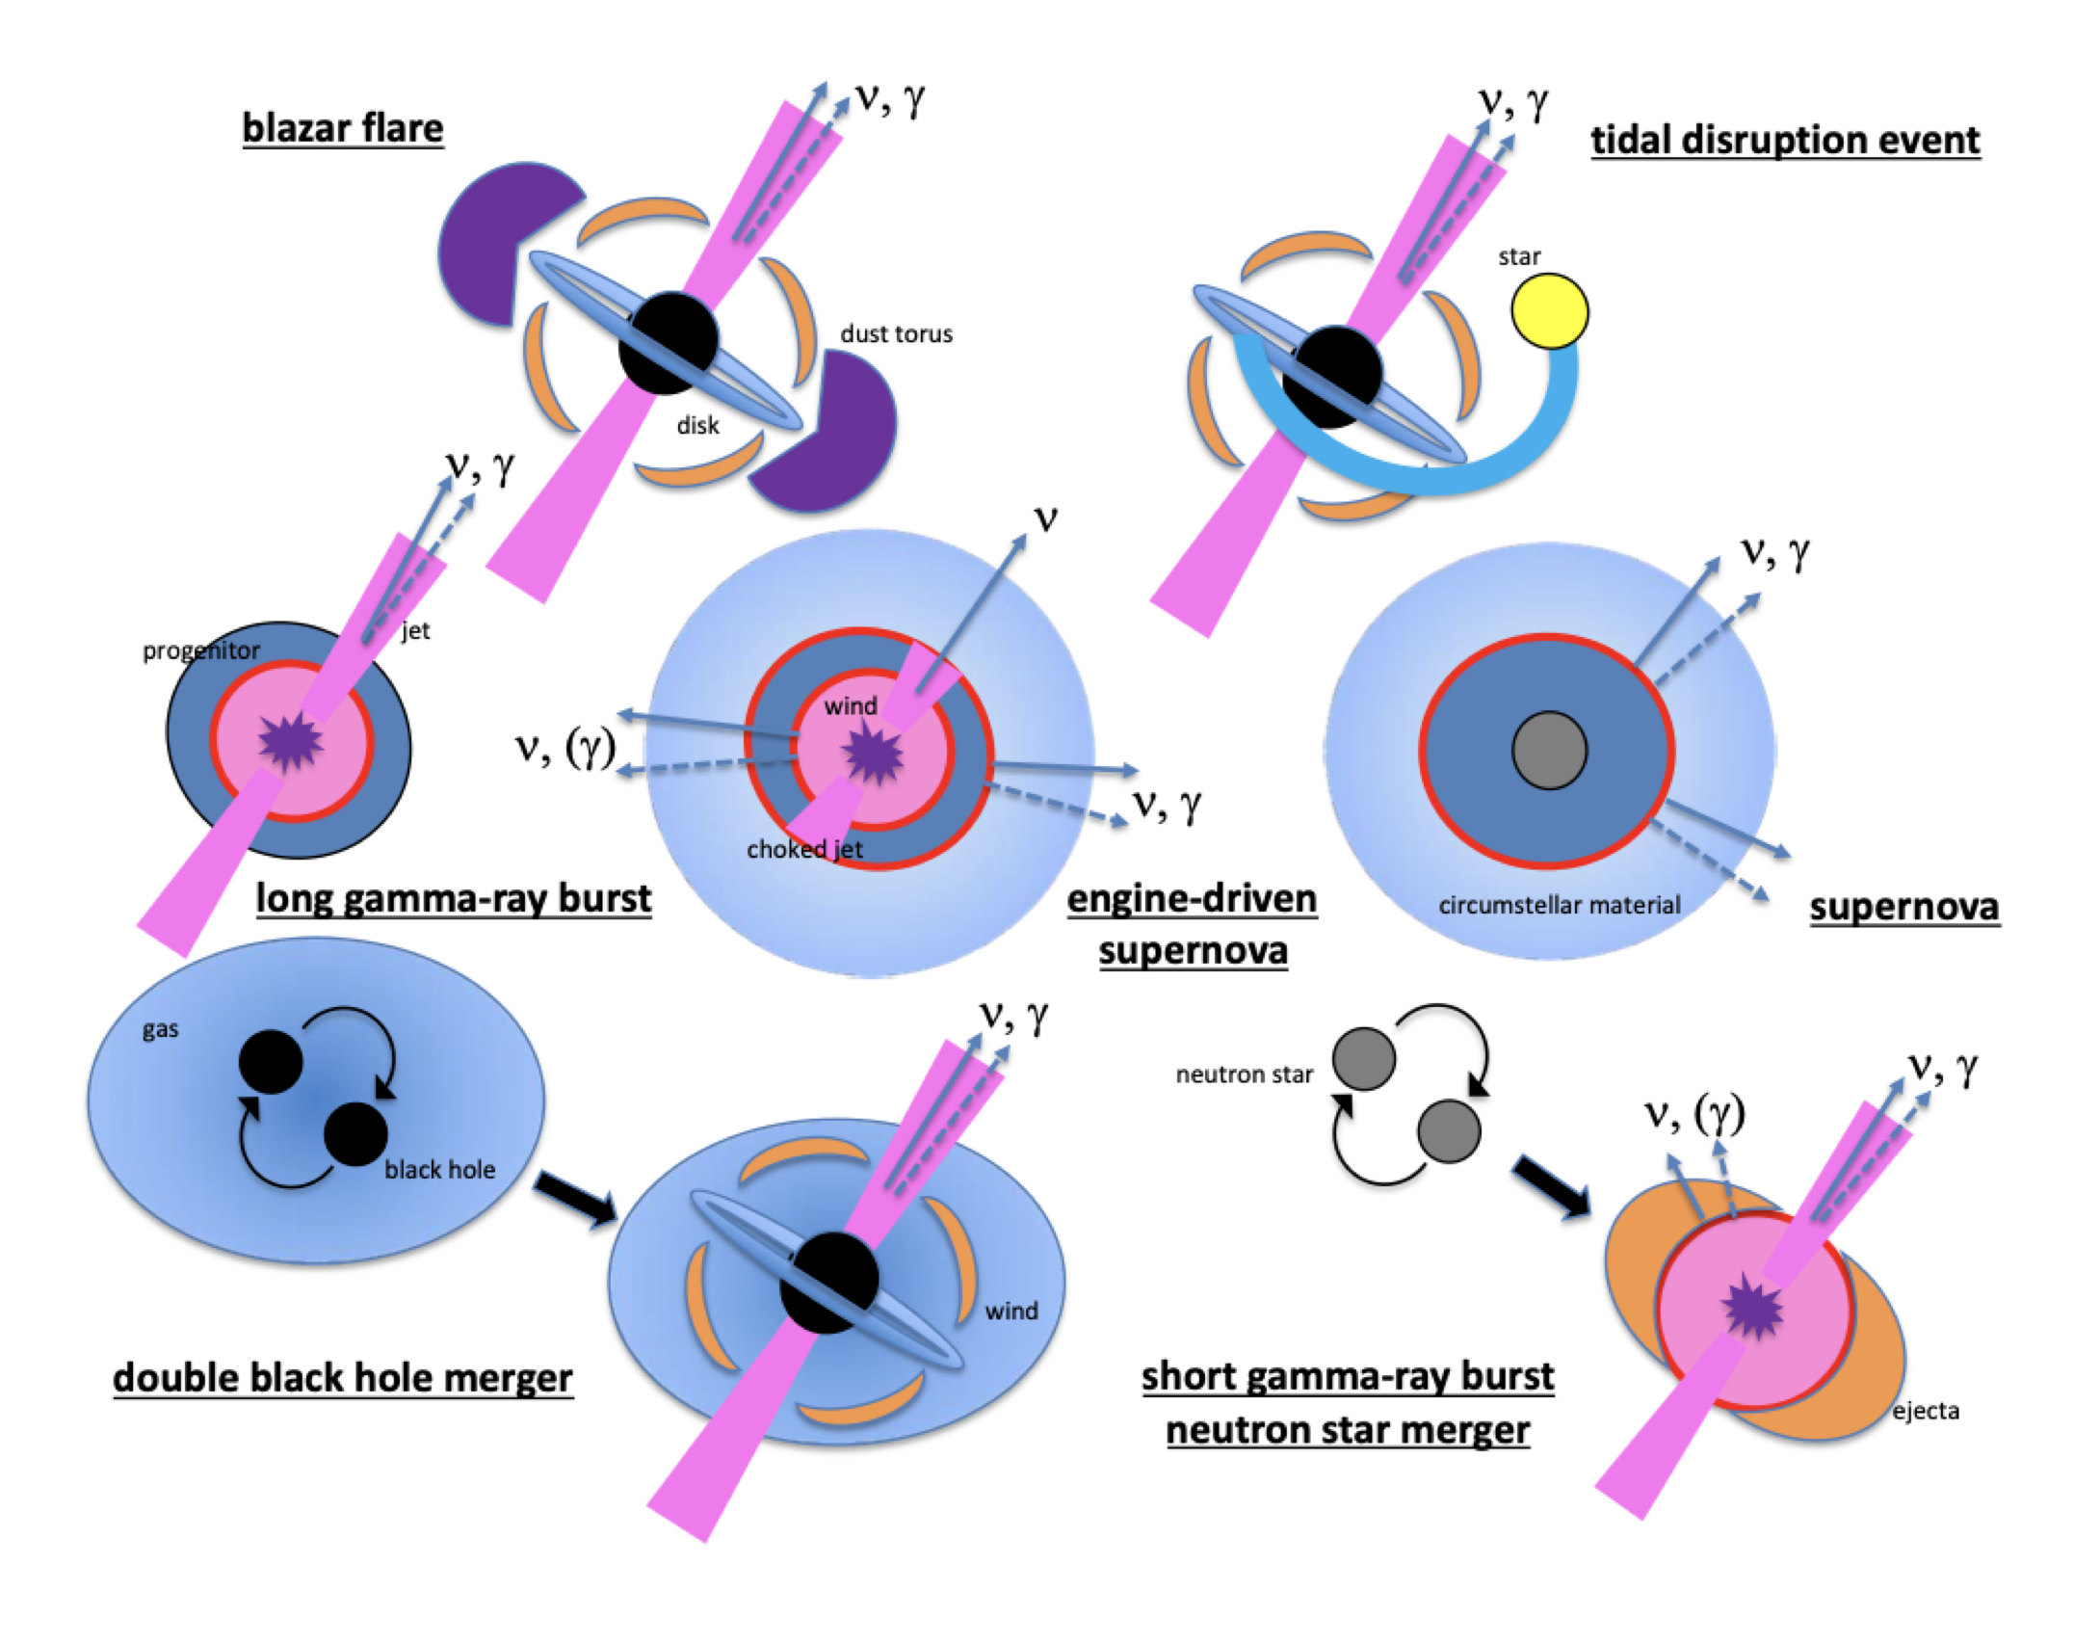
Astrophysical sources
Neutrino transient candidates can also be:
Cosmic ray accelerators (see talks by Abhishek, Jose, Shiqi, Luca, …)
Gamma-ray emitters (see talks by Regina, Ke, Eduardo, Silvia, …)
Accompanied by GWs (see talks by Justin, Maya, Mainak, …)
Bartos & Murase (2019)
Notes:
After the big bang, as Universe began to cool, neutrons and protons were formed at about the same ratio. As it continued to cool, more protons than neutrons were formed since they are slightly lighter. Further, some neutrons decayed into protons, leaving a final Ye of 7/8. Vast majority of the remaining neutrons formed into He nuclei and so at the end of the BBN era, 75% of the mass was synthesized into H and 25% into He. There were also much smaller amounts of deuterium, lithium, and others, but these make up a very small portion of the nuclei synthesized.
Majority of elements heavier than H, He, and Li are made in stars through fusion. To simplify complex fusion cycles that occurs in stars, what happens in these very hot and dense regions is H and He nuclei combine into heavier and heavier elements until they form Fe. After which, it is no longer energetically viable to fuse heavier stuff. Through mass loss events like flares, pulsations, and supernovae, stars enrich the universe with elements up to Fe.

Slide 5
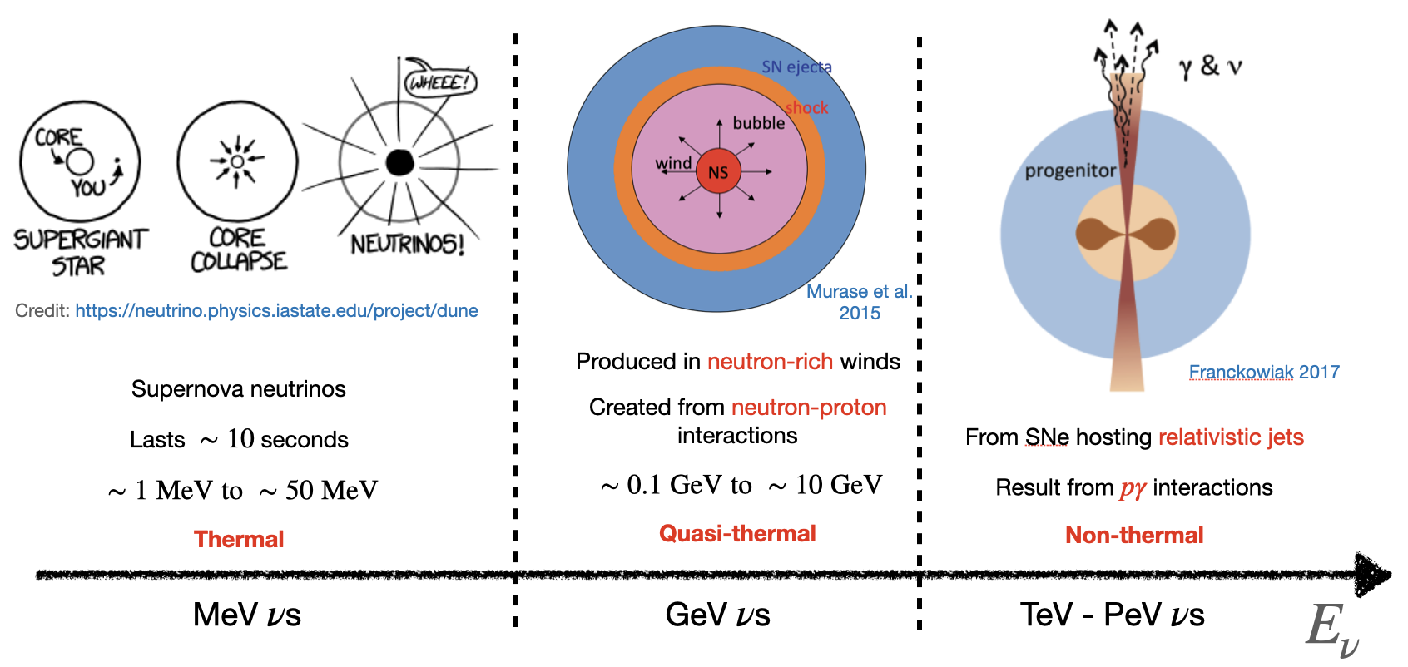
PNS as multi-energy neutrino sources
Credit: Jose Carpio
Will focus on protomagnetars as the sources of high-energy (TeV-PeV) neutrinos
Notes:
After the big bang, as Universe began to cool, neutrons and protons were formed at about the same ratio. As it continued to cool, more protons than neutrons were formed since they are slightly lighter. Further, some neutrons decayed into protons, leaving a final Ye of 7/8. Vast majority of the remaining neutrons formed into He nuclei and so at the end of the BBN era, 75% of the mass was synthesized into H and 25% into He. There were also much smaller amounts of deuterium, lithium, and others, but these make up a very small portion of the nuclei synthesized.
Majority of elements heavier than H, He, and Li are made in stars through fusion. To simplify complex fusion cycles that occurs in stars, what happens in these very hot and dense regions is H and He nuclei combine into heavier and heavier elements until they form Fe. After which, it is no longer energetically viable to fuse heavier stuff. Through mass loss events like flares, pulsations, and supernovae, stars enrich the universe with elements up to Fe.

Slide 6
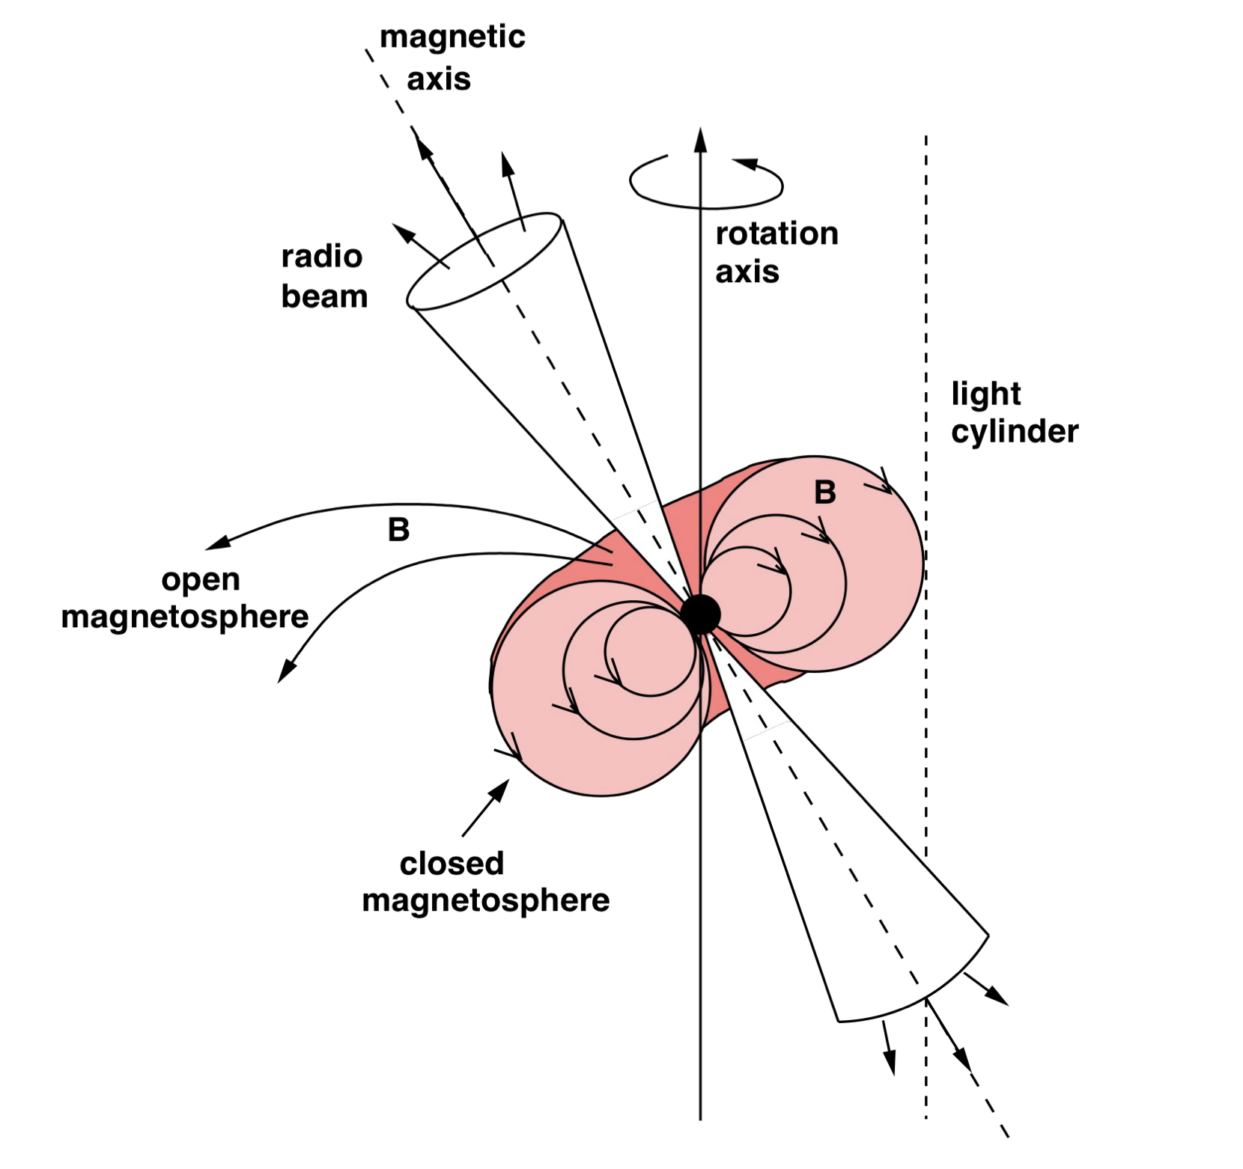
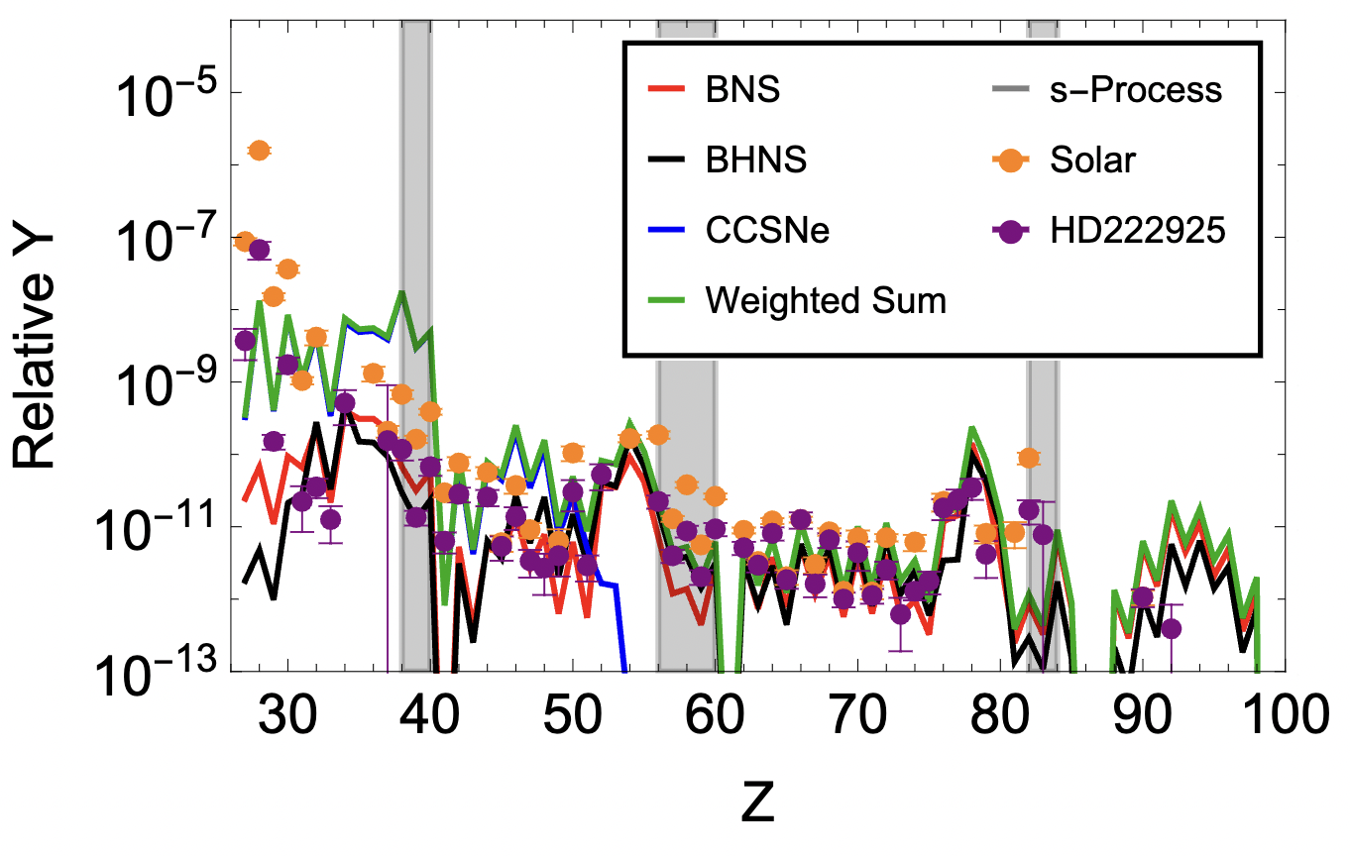
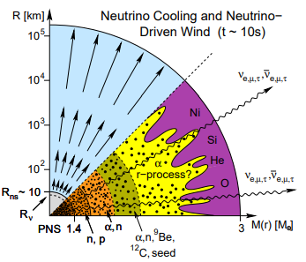
Nuclei in neutrino-driven PNS winds
Credit: Dafne Guetta
Janka+2008
Once neutrinos revive shock wave, p and n are carried outwards and r-process nucleosynthesis occurs.
Open magnetic field lines can transport and accelerate nuclei outwards, these can eventually escape as CRs
Magnetized CCSNe outflows can generate Fe-like nuclei but not heavier nuclei (likely to come from BNS/BHNS mergers)
Notes:
After neutrinos revive the shock wave, protons and neutrons are carried in outflows away from the star. In these outflows, nucleosynthesis can occur and it is at this point that r process may happen. The figure on the right shows a schematic for where nucleosynthesis occurs as a function of radius or mass enclosed.
Since the protons and neutrons in the outflow are irradiated by neutrinos, the electron fraction likely approaches an equilibrium value of ~0.5. However, there may be times or regions in the outflow where it is less than 0.5, or neutron rich. In these situations, some amount of heavy element nucleosynthesis could occur.
*Good simulation video: https://www.youtube.com/watch?v=oxGajNoPz8c

Slide 7
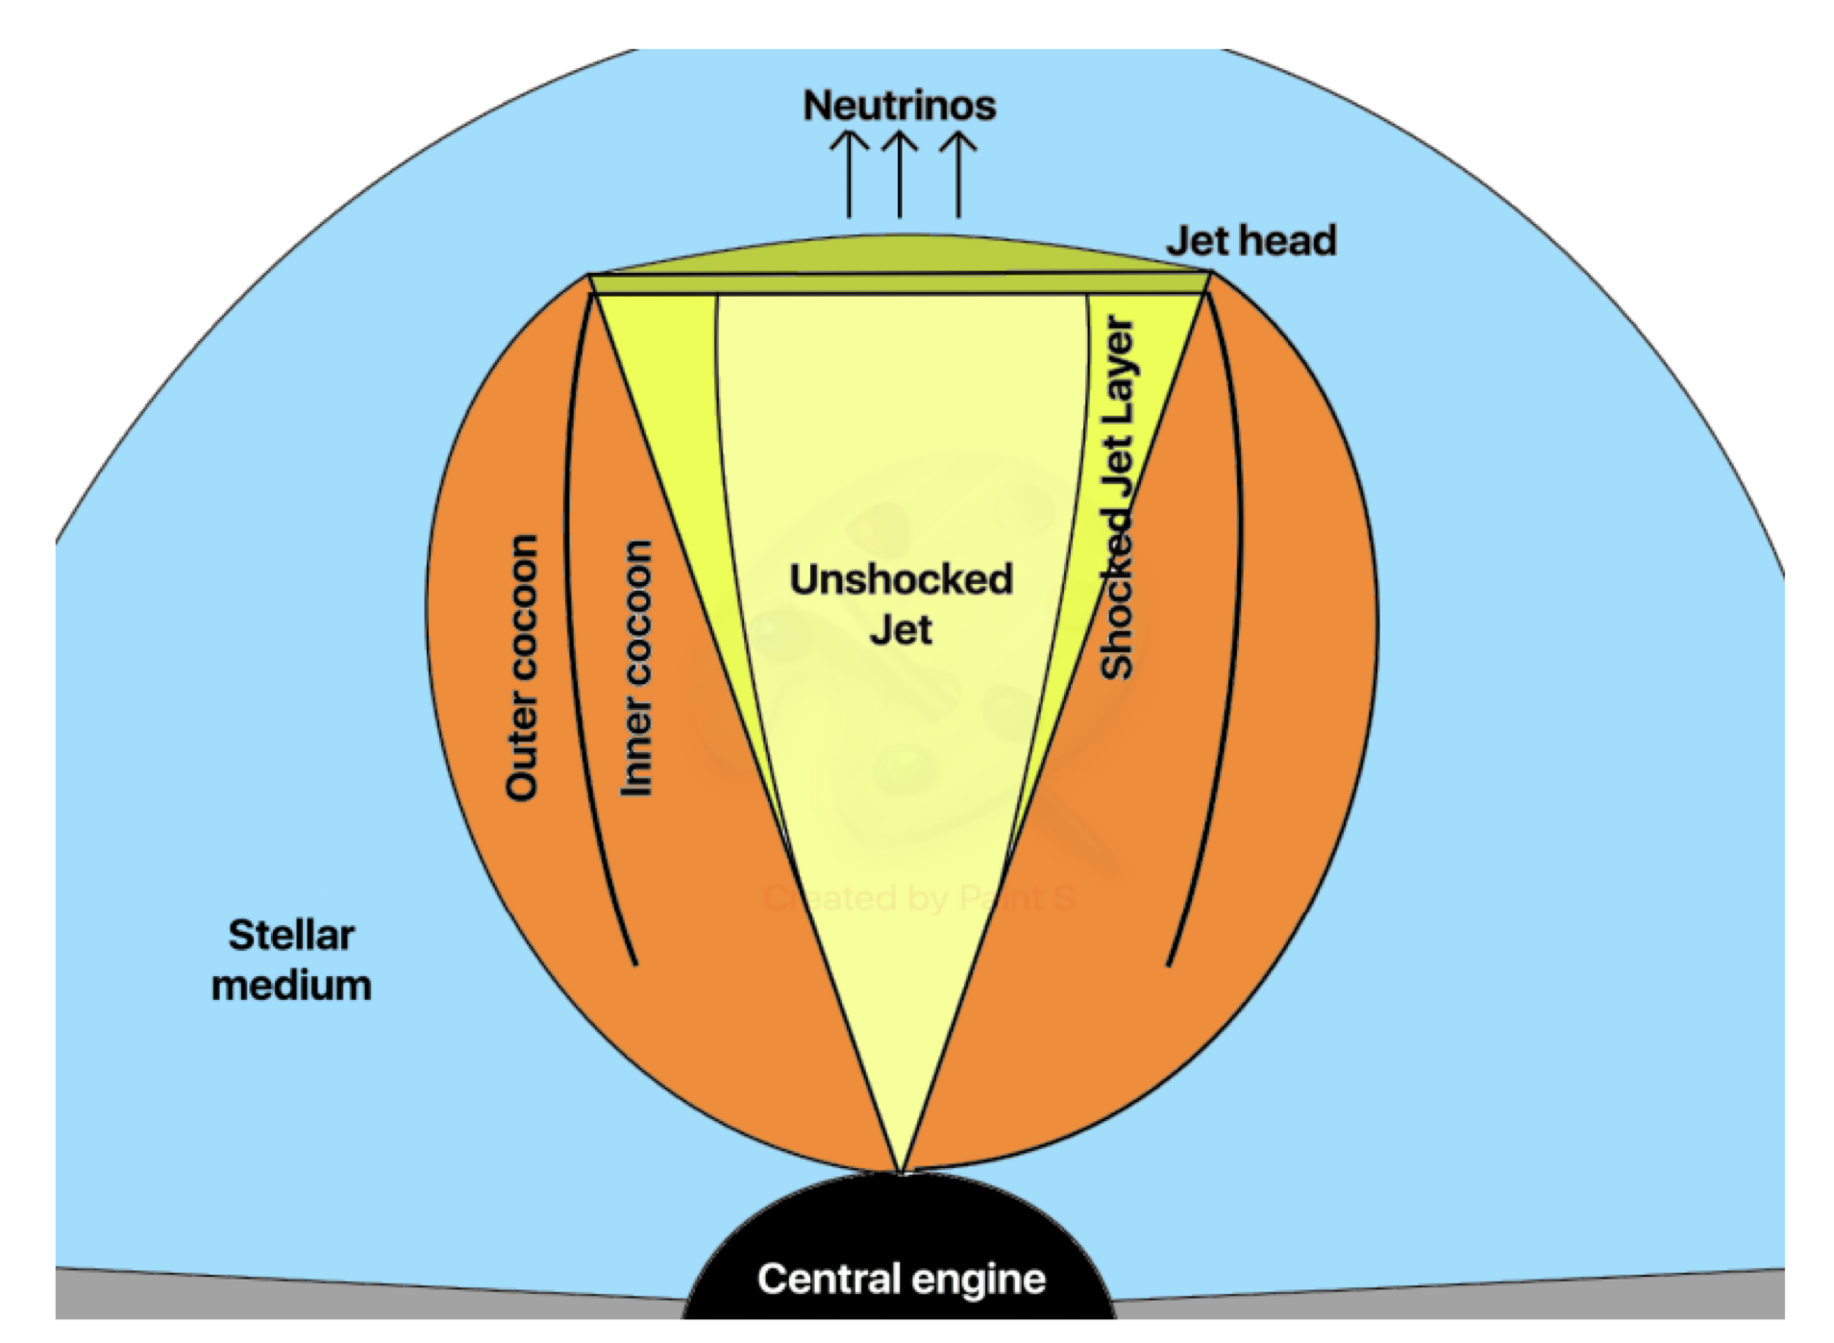
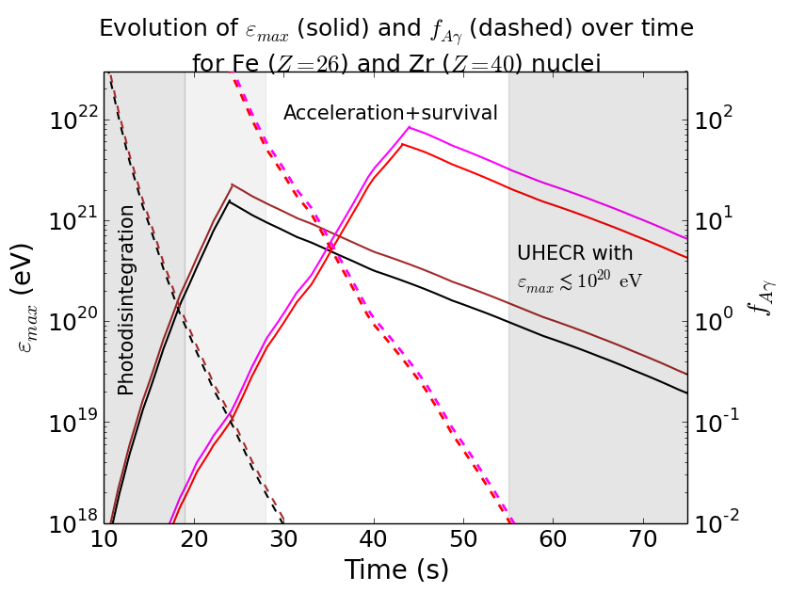
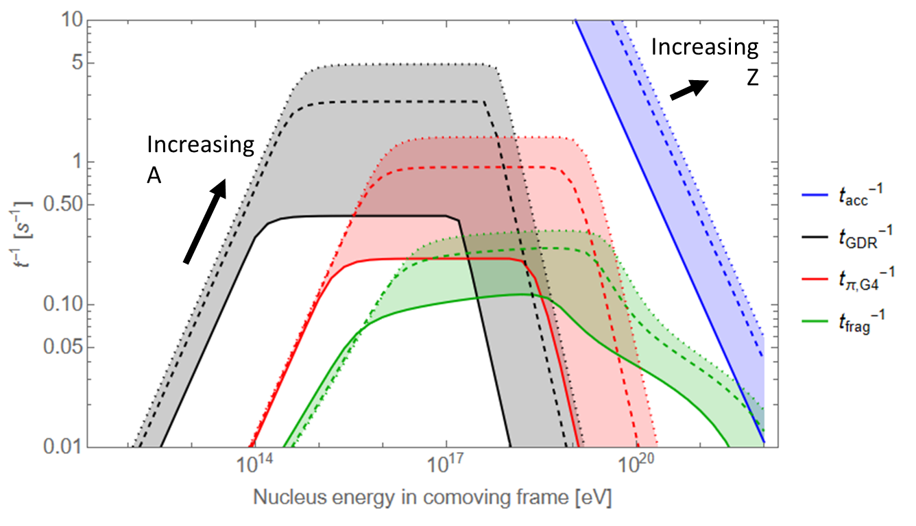
Nuclei acceleration & survival
Particles in jet are accelerated via magnetic reconnection
Solid: (Z,A) = (7,14), dashed: (Z,A) = (26,56), dotted: (Z,A) = (38,87)
Intermediate phase (σ₀ ~ 10²-10³, t ~ 20-50 sec): nuclei synthesized in PNS outflow are capable of reaching ε_{max} > 10²⁰ eV and are not photodisintegrated by the high-energy GRB photons (τ_{Aɣ} < 1)
MB, Horiuchi & Murase 2022
Notes:
As the PNS gradually cools, the outflow becomes increasingly B-dominated and relativistic, with sigma0 ~ 10^2-3 and t ~ 20-50 sec. Conditions during this intermediate phase are ideal for both accelerating UHECRs and producing gamma-ray emission.
t_{acc} = 2*pi*η_{acc} (E/ZeBc), t_{exp} = R_{mag}/Γc, t_{cool} = 0.4 sec (A/Z)⁴ Edot_{iso,52}⁻¹ Γ₁₀₀³ E₂₀⁻¹ r₁₃²
Photodisintegration via GDR is most important, spallation is negligible. t_{exp}⁻¹ ~ 0.1 sec⁻¹, t_{spall}⁻¹ ~ 10⁻³ sec⁻¹

Slide 8
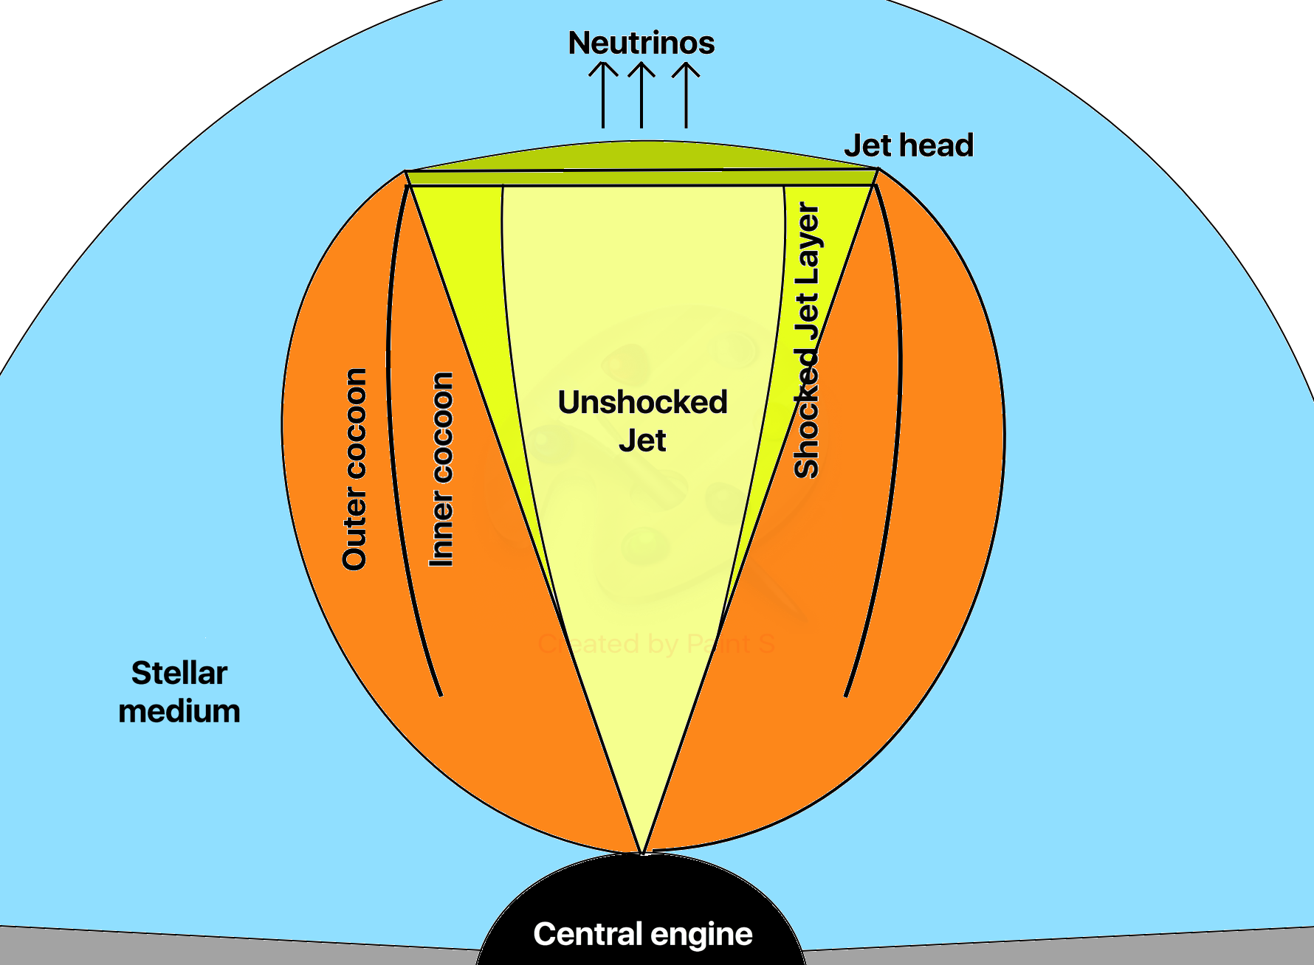
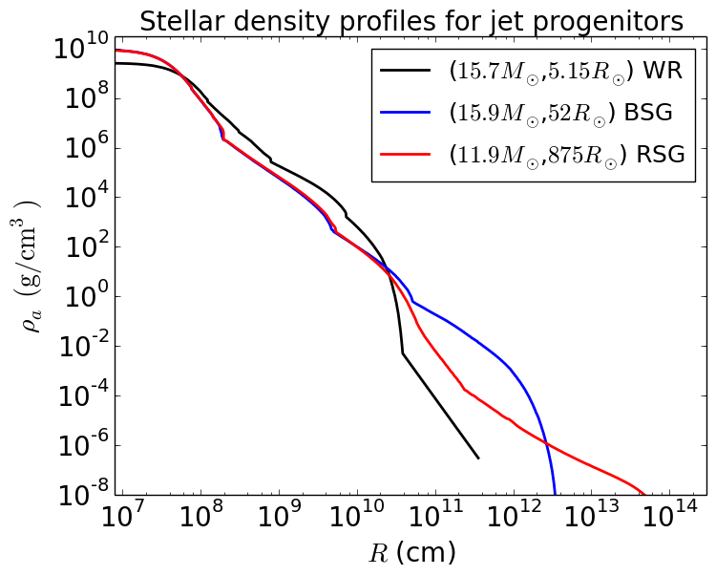
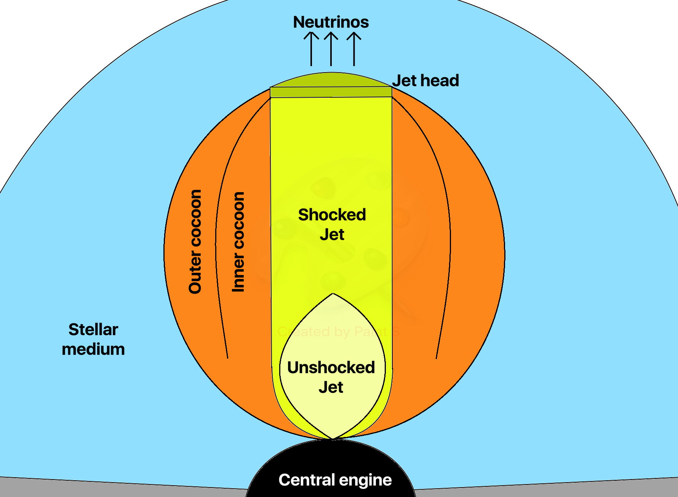
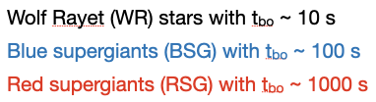
Effect of stellar progenitor on observables
Uncollimated jet
Collimated jet
Nature of the stellar progenitor decides the outcome for jet breakout and collimation, and therefore, also the observability of EM and neutrino signals
More energy is deposited into the cocoon for BSG and RSG compared to WR progenitors, due to longer t_{bo}
E_{j,iso}/E_{ej} ∝ θ_{j}⁻⁴: outflows from protomagnetars with B_{dip} < 10¹⁵ G can get choked inside WR stars
Notes:
As the PNS gradually cools, the outflow becomes increasingly B-dominated and relativistic, with sigma0 ~ 10^2-3 and t ~ 20-50 sec. Conditions during this intermediate phase are ideal for both accelerating UHECRs and producing gamma-ray emission.
t_{acc} = 2*pi*η_{acc} (E/ZeBc), t_{exp} = R_{mag}/Γc, t_{cool} = 0.4 sec (A/Z)⁴ Edot_{iso,52}⁻¹ Γ₁₀₀³ E₂₀⁻¹ r₁₃²
Photodisintegration via GDR is most important, spallation is negligible. t_{exp}⁻¹ ~ 0.1 sec⁻¹, t_{spall}⁻¹ ~ 10⁻³ sec⁻¹

Slide 9
Propagation of highly magnetised jets
In addition to promising UHECR sources, relativistic jets from protomagnetars are also potential candidates for long duration GRBs.
Consider propagation through Wolf-Rayet star and blue/red supergiants
Uncollimated jet
Collimated jet
MB, Carpio, Murase & Horiuchi 2022
Notes:
Surface layers of both BSG and RSG models predominantly consist of H and He, whereas WR surface is already stripped off its lighter elements prior to core-collapse
(Un)collimated jets are distinguished by jet luminosity, initial opening angle and density of the surrounding medium. Jet is divided into shocked and unshocked parts by the CS, inner and outer regions of the cocoon are separated by the contact discontinuity.
Low-power jets with smaller σ₀ are easier to get collimated before breakout

Slide 10
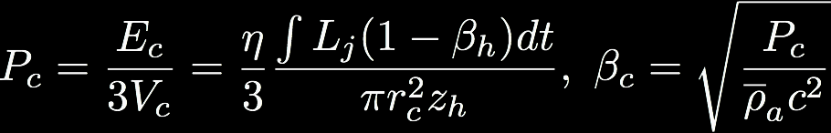
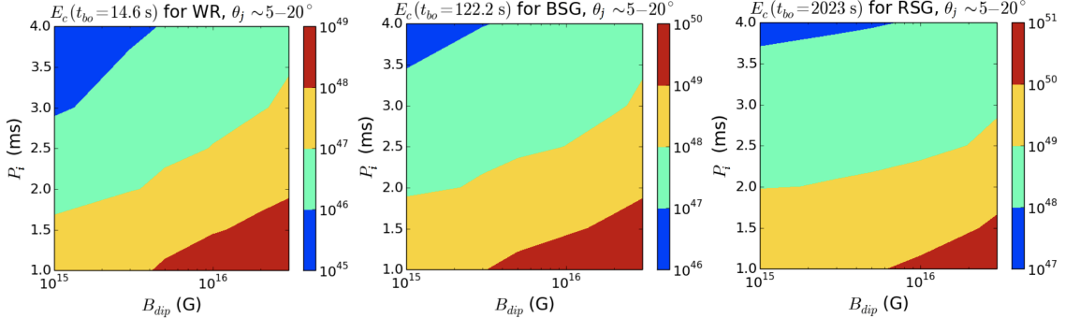
Jet-cocoon interaction & breakout
Jet cocoon interaction determines energy deposited onto cocoon and jet breakout criterion.
More energy is deposited into the cocoon for BSG and RSG compared to WR, due to longer t_{bo}
Notes:
Consider a magnetised jet with luminosity L_{j} injected with opening angle θ_{j} into a medium of density ρ_{a}(z).
As jet propagates through stellar envelope, it forms a bow shock around jet-head which dissipates jet energy onto the cocoon. The mildly relativistic cocoon, in turn, exerts pressure on the jet to potentially collimate it and thereby changing its propagation velocity.
Velocity of the jet-head is determined by ram pressure balance between shocked jet and shocked envelope.
η ~ 0-1 represents fraction of energy that flows into the jet head and deposits into the cocoon.
Jets originating with stronger B_{dip} and rapid P₀ deposit more energy into the cocoon. More energy deposited into cocoon for BSG and RSG compared to WR, due to larger R* and longer t_{bo}.

Slide 11
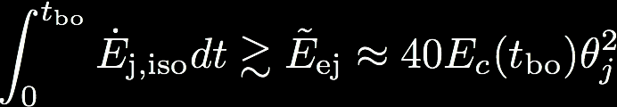
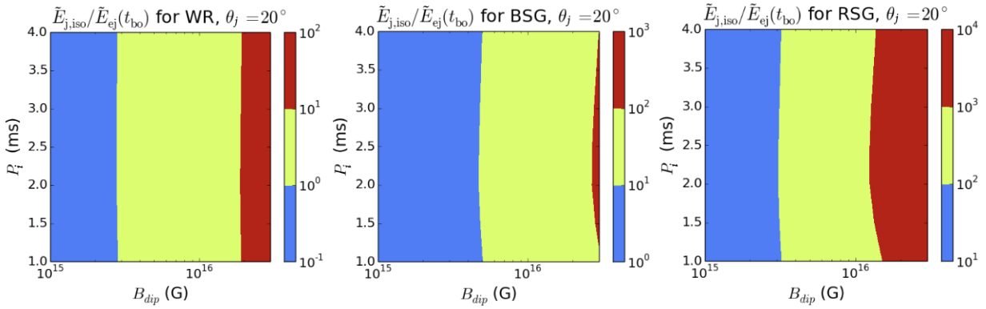
Jet choking criteria
Central engine has to be active for at least t_{eng} > t_{th} = t_{bo} – R*/c. The jet can get choked if: (a) engine stops at t < t_{th} before jet exits star, OR (b) jet power is less than minimum requirement
Gottlieb & Nakar (2021) derived jet breakout criterion:
E_{j,iso}/E_{ej} ∝ θ_{j}⁻⁴, outflows from protomagnetars with B_{dip} < 3x10¹⁵ G can get choked inside WR stars
Notes:
Observed jet duration is the difference between engine’s operation time (t_eng) and jet’s breakout time (t_bo). For successful jet breakout, central engine has to be active for atleast threshold activity time t_th = t_bo – R_*/c.
For choked jets, the cocoon is the only component that breaks out from the star and spreads quasi-spherically
E_{j,iso}/E_{ej} ∝ θ_{j}⁻⁴, breakout criterion has a weak dependence on P₀, outflows from PNS with B_{dip} < 3x10¹⁵ G can get choked inside WR stars.

Slide 12
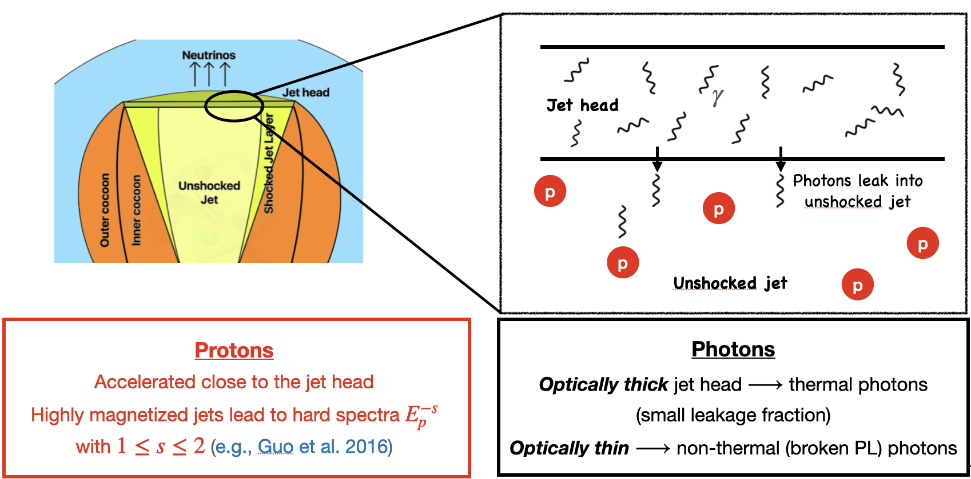
CR acceleration and neutrino production
Credit: Jose Carpio
Notes:
As the PNS gradually cools, the outflow becomes increasingly B-dominated and relativistic, with sigma0 ~ 10^2-3 and t ~ 20-50 sec. Conditions during this intermediate phase are ideal for both accelerating UHECRs and producing gamma-ray emission.
t_{acc} = 2*pi*η_{acc} (E/ZeBc), t_{exp} = R_{mag}/Γc, t_{cool} = 0.4 sec (A/Z)⁴ Edot_{iso,52}⁻¹ Γ₁₀₀³ E₂₀⁻¹ r₁₃²
Photodisintegration via GDR is most important, spallation is negligible. t_{exp}⁻¹ ~ 0.1 sec⁻¹, t_{spall}⁻¹ ~ 10⁻³ sec⁻¹

Slide 13
Neutrino production in magnetised outflows
As dominant fraction of outflow energy is magnetic, particles accelerated by magnetic dissipation
Large particle temperature → nuclei completely dissociated into protons
Protons interact with ambient photons escaping from termination shock (TS) to generate pions
τ >> 1 at TS → photons thermalised
High-energy neutrinos with E_{ν} > 1 TeV are produced via pɣ interactions
Credits: Juan Antonio Aguilar & Jamie Yang. IceCube/WIPAC
Notes:
Shocks can be collisionless in the presence of large magnetic fields but the dominant fraction of the outflow energy is magnetic, so we consider magnetic reconnection (MR) as the plausible energy dissipation mechanism. MR is no longer efficient once σ₀ ~ 1 and the jet stops accelerating.
Large particle temperature —> nuclei are completely dissociated into protons within the outflow which are accelerated to … spectrum. Max proton energy is determined by balance between acceleration and cooling times
Protons interact with ambient photons escaping from the TS to generate pions. Subsequently leads to the production of high-energy neutrinos with E_{ν} > 1 TeV via pɣ interactions

Slide 14
High-energy neutrino spectra
Neutrino propagation is simulated using nuSQuIDS, propagation discontinued once neutrinos reach R*. Neutrino flux computed for source distance D=100 Mpc.
Stronger fields and rapid rotation rates lead to larger neutrino flux
Spectral break at higher energies is caused by jet LF (RSG > BSG > WR)
Exponential suppression of flux most prominent in RSG progenitors
MB, Carpio, Murase & Horiuchi 2022
Notes:
Neutrino propagation is simulated using nuSQuIDS, neutrino oscillation parameters are fixed to best fit values provided by NuFIT 2021, propagation is discontinued once the neutrinos reach R_*.
Neutrino flux computed for source distance D=100 Mpc, the neutrino fluence is the time integral of neutrino flux until t=t_bo
Both BSG and RSG progenitors are more common than WR stars. But the occurrence of relativistic jets in these supergiants remain highly uncertain. As jets from these supergiants are harder to detect electromagnetically, their potential as neutrino sources is worth exploring.

Slide 15
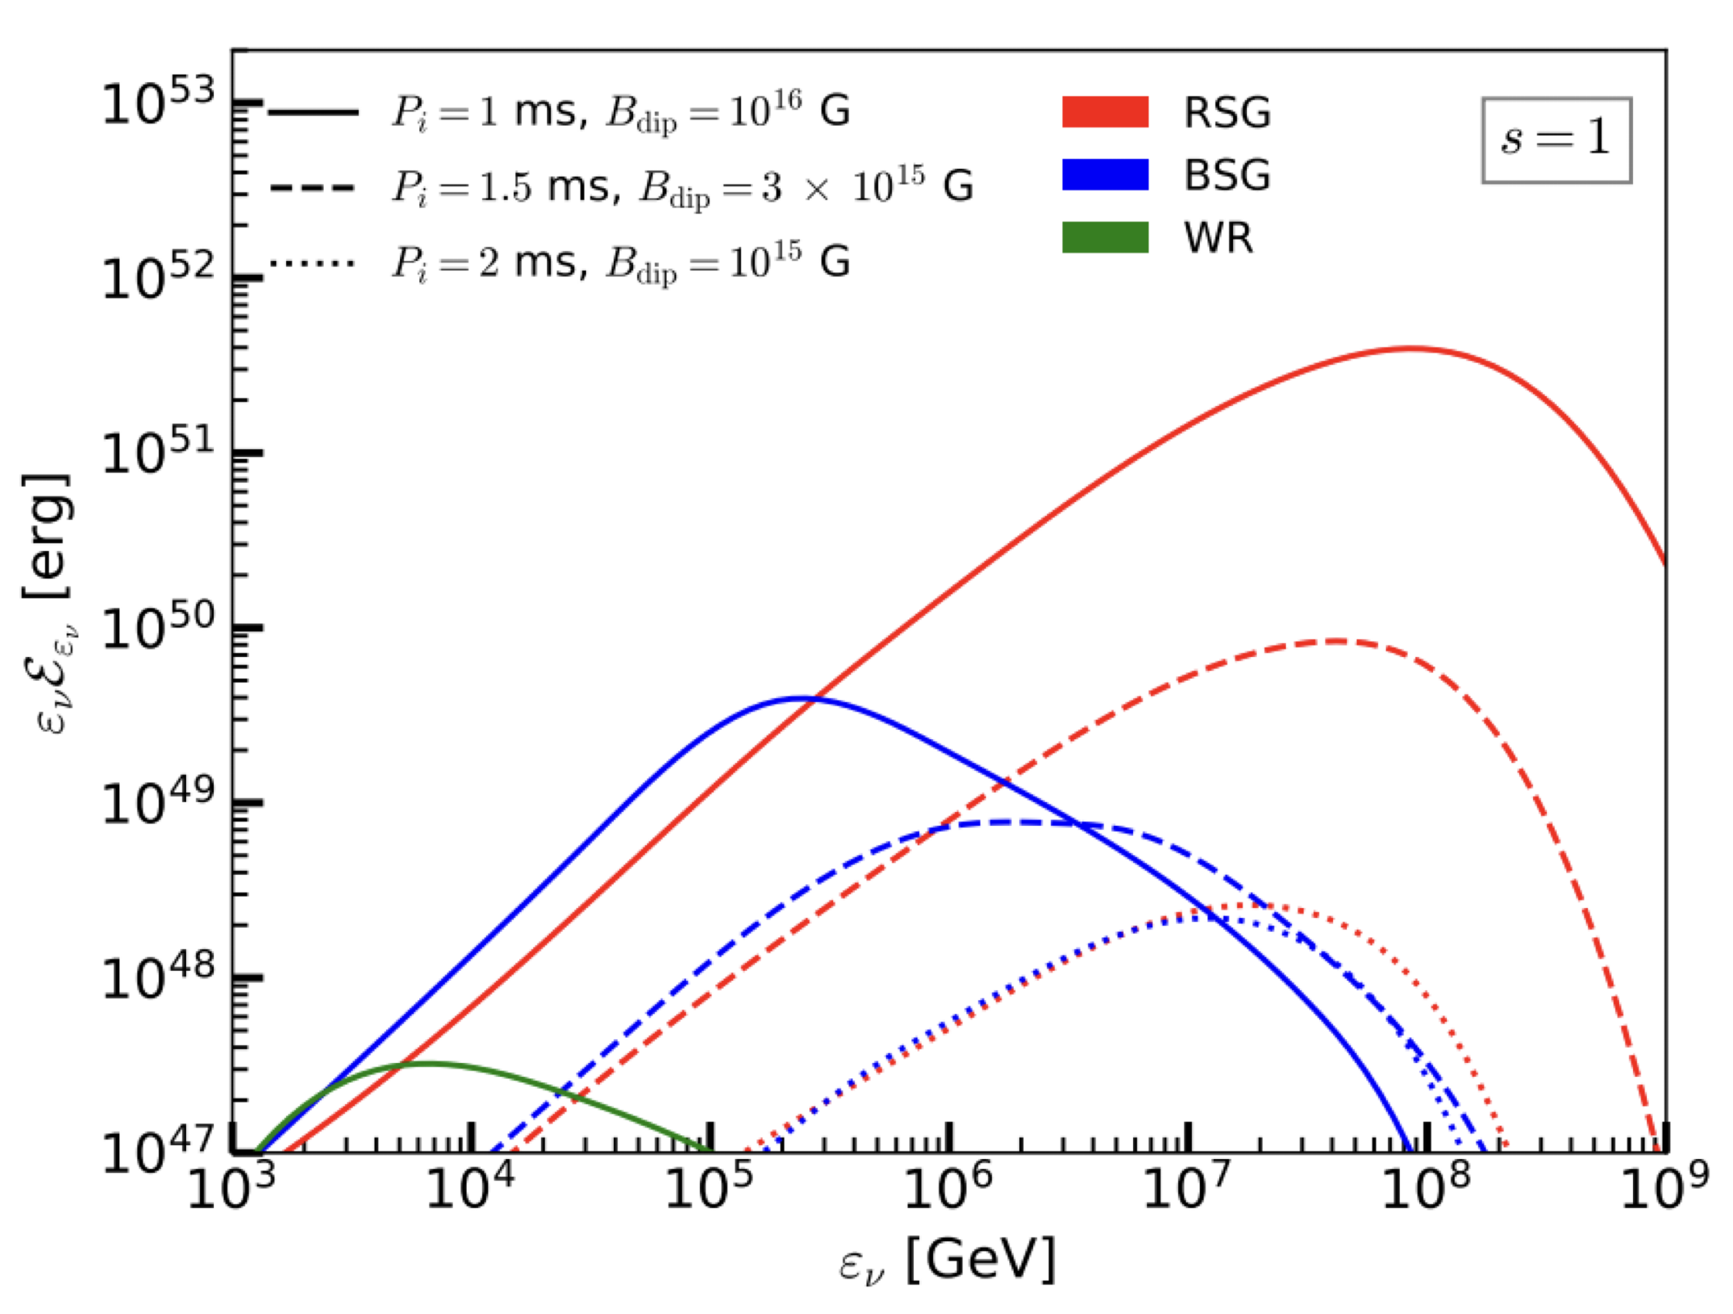
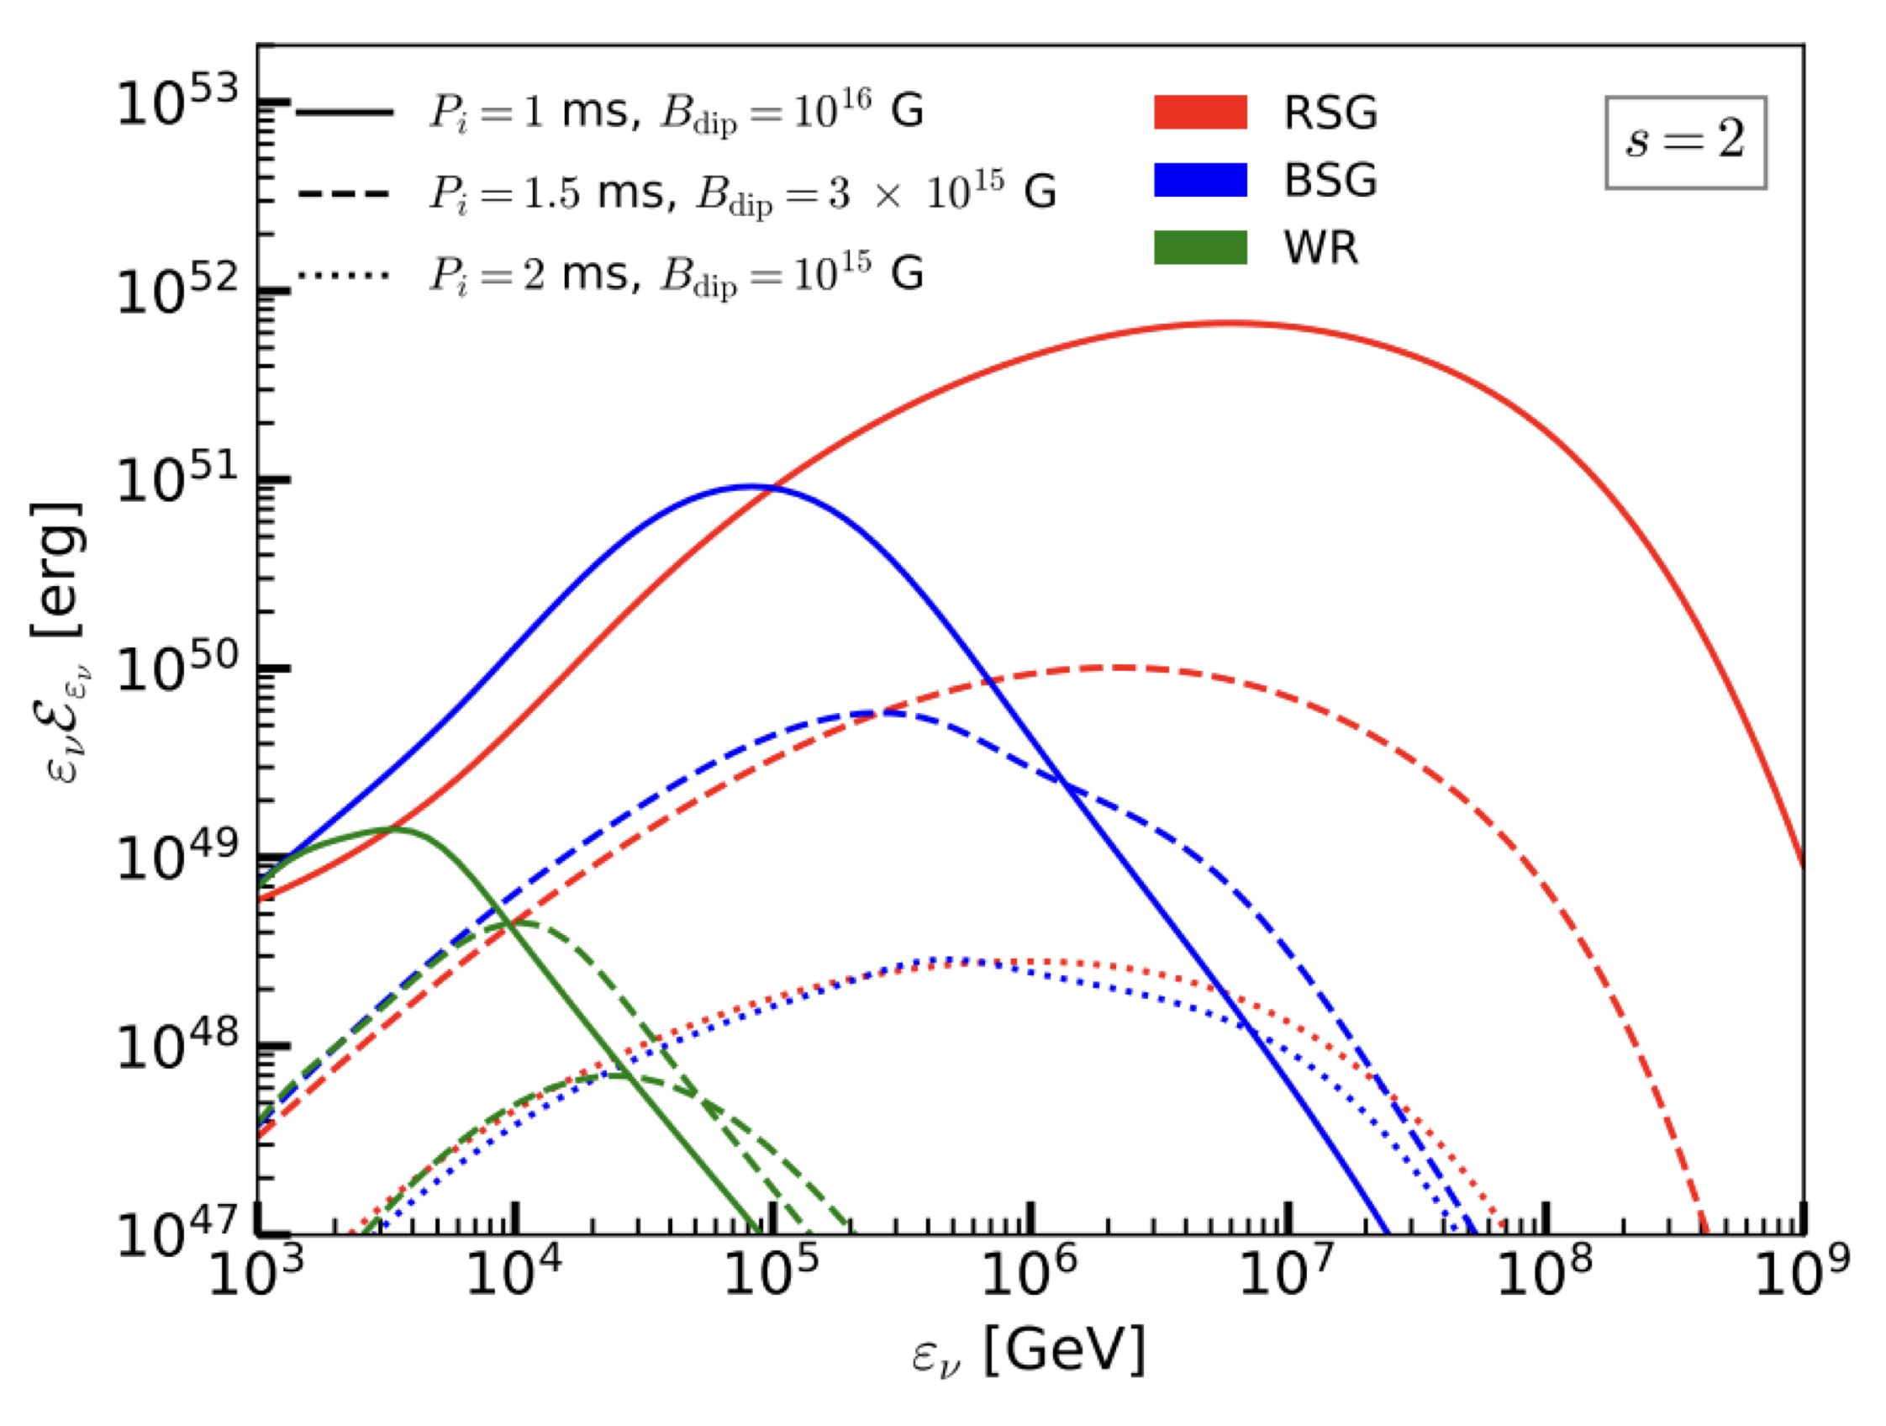
Detectability of neutrinos
High jet luminosities in RSGs and BSGs present most promising detection scenario
WR: neutrinos with E_{ν} > 1 TeV scarce due to strong IC cooling/attenuation at breakout/earlier times. Fluence too small for detectable signal.
Supergiants: neutrino spectra can reach ~0.1 PeV/~10 PeV for BSG/RSG. Larger R* → less attenuation at late times.
  Neutrinos detectable for optimistic BSG scenarios, RSG most promising.
More high-energy photons → neutrino
spectra peak at higher energies with
more pronounced high-energy tails
MB, Carpio, Murase & Horiuchi 2023
Notes:
Neutrino fluence is the time integrated neutrino flux until the breakout time
High L and large LF for magnetised jets propagating in RSG present the most promising scenario for the detection of N > few x 10 events above 10 TeV with IceCube-Gen2.
For WR: neutrinos with E > 10 TeV are scarce due to strong IC cooling at breakout times and strong neutrino attenuation at earlier times, fluence too small to yield observable neutrino signal
For BSG and RSG progenitors with larger radii, observed neutrino fluence is a result of late time emission when attenuation is negligible.

Slide 16
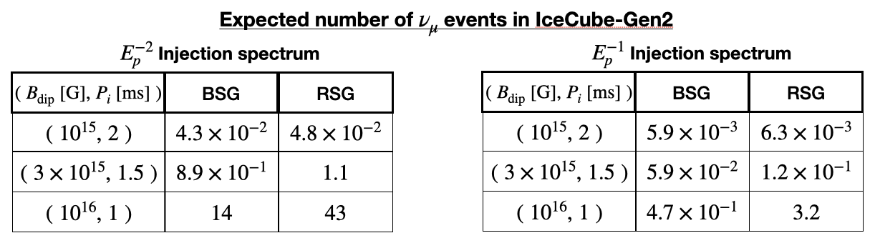

Detectable events with IceCube-Gen2
High luminosities and large LF for magnetised jets propagating in BSGs and RSGs present most promising scenario for detection with ~few - 10 events above 1 TeV
E_{ν} > 1 TeV neutrinos for D=100 Mpc
A_{eff}: neutrino effective area
ɸ_{ν,μ}: muon neutrino flux
BSG: neutrinos detectable only for most energetic PNS outflows
RSG: most optimistic scenario with ~few-10s neutrino events detectable above 1 TeV
Notes:
High L and large LF for magnetised jets propagating in RSG present the most promising scenario for the detection of N > few x 10 events above 10 TeV with IceCube-Gen2.
1 TeV as the minimum detectable neutrino energy.

Slide 17
Summary
Nuclei in magnetized PNS outflows (B_{dip} ~ 10¹⁴ - 10¹⁶ G, P ~ 1 - 10 ms) can interact with jet photons to generate TeV-PeV neutrinos.
Conditions during intermediate phase (σ₀ ~ 10²⁻³, t ~ 20-50 sec) ideal for survival of nuclei, acceleration to UHECR energies and production of gamma-ray emission.
E_{ν} > 1TeV neutrinos produced by pɣ interactions in magnetised jets: ~few-10s events can be detected with IceCube-Gen2 for BSG/RSG sources at D ~ 100 Mpc, WR not as promising.
Future work
GRMHD/PIC simulations to model: particle acceleration, jet structural stability, baryon loading/mixing, time evolution of ejecta properties (also see Eduardo’s talk later in this session).
Impact of neutrinos oscillations on high-energy spectra and detectability from distant sources.
GW-triggered multi-messenger search strategies for high-energy neutrinos as well as EM emission (also see Mainak’s talk later in this session).
Role of neutrinos from PNS outflows as probes to understand GRB-SNe connection.
Notes:
Here, I summarise the main results of our work.

Slide 18


Thank you!
$$ν$$
$$ν$$
NS
BH
Notes:
With that, I thank you all for your time and I’m happy to take any questions.

Slide 19
BACKUP SLIDES

Slide 20
Jet-cocoon interaction & breakout
Jet cocoon interaction determines energy deposited onto cocoon and jet breakout criterion.
More energy is deposited into the cocoon for BSG and RSG compared to WR, due to longer t_{bo}
Notes:
Consider a magnetised jet with luminosity L_{j} injected with opening angle θ_{j} into a medium of density ρ_{a}(z).
As jet propagates through stellar envelope, it forms a bow shock around jet-head which dissipates jet energy onto the cocoon. The mildly relativistic cocoon, in turn, exerts pressure on the jet to potentially collimate it and thereby changing its propagation velocity.
Velocity of the jet-head is determined by ram pressure balance between shocked jet and shocked envelope.
η ~ 0-1 represents fraction of energy that flows into the jet head and deposits into the cocoon.
Jets originating with stronger B_{dip} and rapid P₀ deposit more energy into the cocoon. More energy deposited into cocoon for BSG and RSG compared to WR, due to larger R* and longer t_{bo}.

Slide 21
Jet choking criteria
Central engine has to be active for at least t_{eng} > t_{th} = t_{bo} – R*/c. The jet can get choked if: (a) engine stops at t < t_{th} before jet exits star, OR (b) jet power is less than minimum requirement
Gottlieb & Nakar (2021) derived jet breakout criterion:
E_{j,iso}/E_{ej} ∝ θ_{j}⁻⁴, outflows from protomagnetars with B_{dip} < 3x10¹⁵ G can get choked inside WR stars
Notes:
Observed jet duration is the difference between engine’s operation time (t_eng) and jet’s breakout time (t_bo). For successful jet breakout, central engine has to be active for atleast threshold activity time t_th = t_bo – R_*/c.
For choked jets, the cocoon is the only component that breaks out from the star and spreads quasi-spherically
E_{j,iso}/E_{ej} ∝ θ_{j}⁻⁴, breakout criterion has a weak dependence on P₀, outflows from PNS with B_{dip} < 3x10¹⁵ G can get choked inside WR stars.

Slide 22
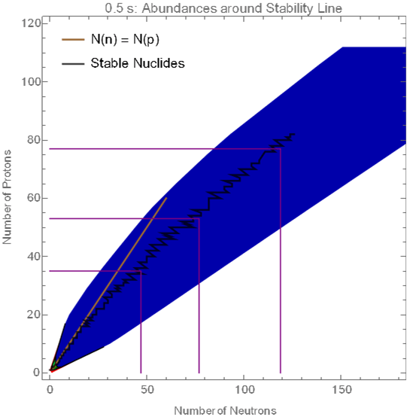
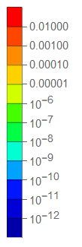




Heavy nuclei: r-process
Abundance:
$$Y_{i}=N_{i}/N_{tot}$$
Rapid neutron capture process
Seed nuclei quickly capture neutrons before decays occur
  ~100 n-captures per second (r-process)
  vs ~few per 10-100 years (s-process)
3rd peak
# protons
2nd peak
1st peak
$$Y_{e}=\frac{N_{p}}{N_{n}+N_{p}}$$
$$p+{\overline{ν}}_{e}↔n+e^{+}$$
$$n+ν_{e}↔p+e^{−}$$
# neutrons
Rapid n-capture to seed nuclei, followed by n→p decay
Image credit: Nick Ekanger
Notes:
Second n-capture process (main subject for remainder of this talk) is rapid neutron capture (r-process), responsible for creating other half of heavy elements. Similar in spirit to s-process, but happens much quicker as name implies. In r-process, seed nuclei rapidly acquire neutrons so that they reach very high ‘A’. Whereas in s-process, only a few neutrons were captured over 10-100 years; in r-process, 100 neutron captures occur every second. The newly formed – very neutron rich – nuclei, however, are unstable and undergo a series of decays into stable nuclei.
This process can be visualized through the animation on the right. Here, the colors correspond to abundance (relative amount), so the further away from blue you get, the more you have of a particular nucleus. The x-axis corresponds to the number of neutrons in a nucleus and the y-axis corresponds to the number of protons.
As you watch the animation, you will first see that the colors are first going to the right of the diagram as many neutrons are captured quickly onto the seed nuclei. In the last few frames, the colors then move up and to the left. This up-left movement comes from decay of unstable nuclei – in other words, neutrons decay into protons to become more stable.

Slide 23


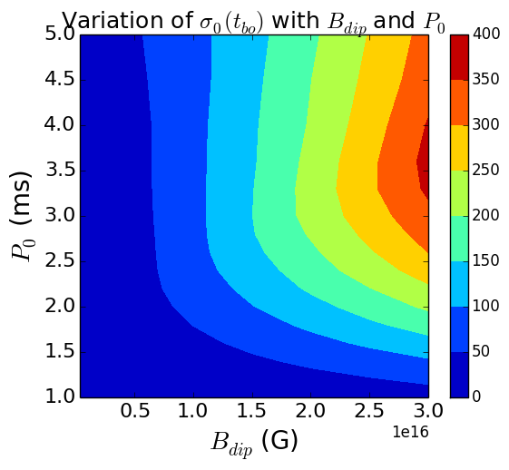
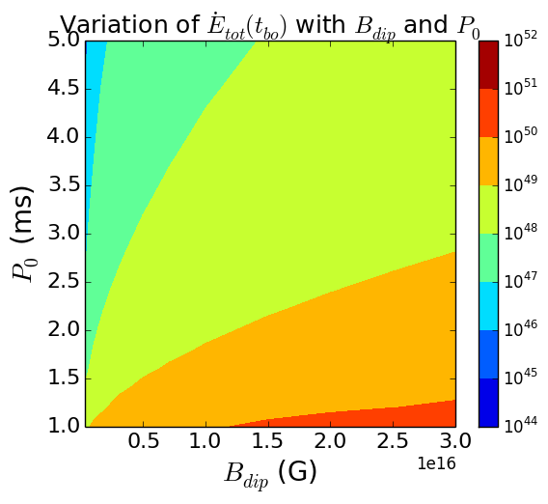
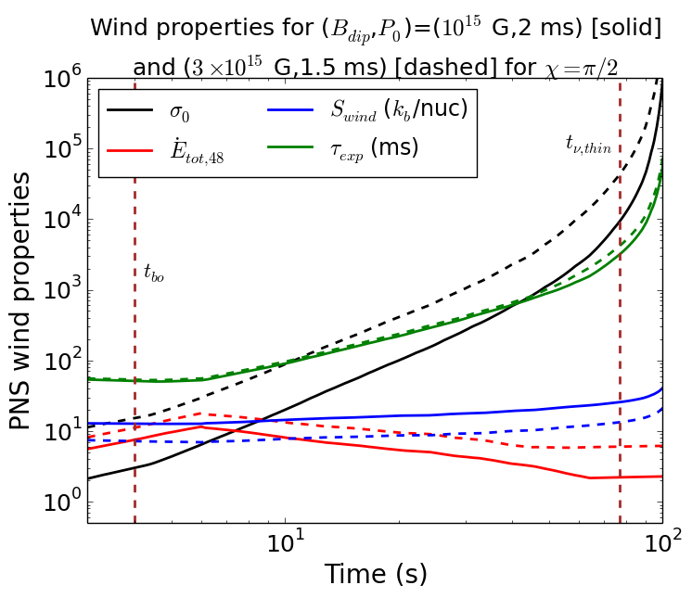
Protomagnetar wind properties
σ₀ is suppressed significantly due to enhanced mass loss aided by magneto-centrifugal slinging for rapid rotation
Feasibility of successful jets turns out to be much higher in outflows with B_{dip} > 10¹⁶ G and P₀ < 2 ms
Synthesis of heavier nuclei through r-process is facilitated by combination of low S_{wind} and τ_{exp} in magnetised outflows
MB, Horiuchi & Murase 2021
Notes:
While weakly magnetised outflows with B_{dip} < 3x10¹⁵ G are non-relativistic at breakout, outflows with B_{dip} > 1.5x10¹⁶ G and P₀ > 2.5ms result in highly relativistic jets.
Wind power Edot_{tot} is dominated by magnetic power Edot_{mag} for outflows with large magnetisation
Stronger magnetic fields and faster rotation rates both assist in elevating Edot_{tot}
S_{wind} stays roughly constant over PNS cooling phase as increase in value of S(Ω=0) is compensated by the exponential suppression factor. At late times t ~ t_{thin}, t_{exp} becomes comparable to the timescale over which the wind magnetisation changes.

Slide 24


SkyNet: Nuclear reaction network
Inputs are astrophysical environment data:
  Density (t)
  Temperature (t)
  Electron fraction
Provided $ρ\left(t\right)$ and $T\left(t\right)$ are sufficiently high, nucleosynthesis yields are primarily determined by $Y_{e}$
~8,000 nuclei with library of ~100,000 reactions
Can make precise predictions for elemental abundance distributions
Notes:
A nuclear reaction network is a tool that solves the set of coupled differential reaction rate equations to calculate how the abundances of nuclei change over time. SkyNet has data for around 8,000 species and includes a library of around 100,000 reactions. In order to solve this set of equations,
SkyNet needs the density, temperature, and electron fraction information as a function of time for the astrophysical environment of interest. As long as the density and temperature are sufficiently high, the nucleosynthesis yields are primarily determined by the electron fraction.
With so many nuclear species and so many reactions, we can make very precise predictions for the abundance distributions from our r process candidate sites.

Slide 25
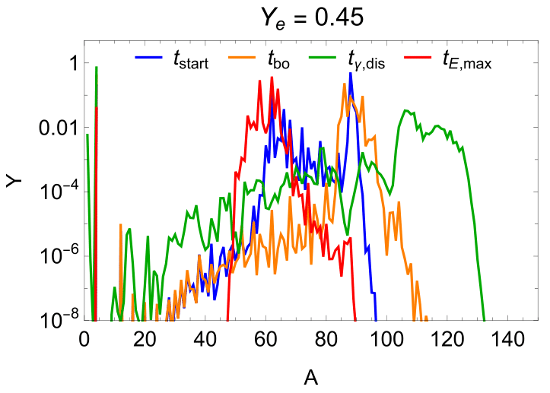
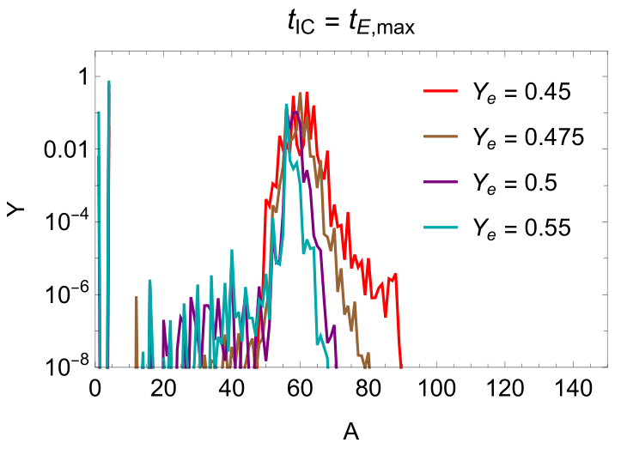

Protomagnetar wind nucleosynthesis
$ρ\left(t\right), T\left(t\right), Y_{e}$ for SkyNet are calculated from initial model conditions
~Fe, Ni-like, peak
~Sr, Y, peak
~Fe, Ni-like, peak
Mo, Ru
t_{start}=0.5 sec, t_{bo}: breakout time, t_{ɣ,dis}: time when τ_{Aɣ}~1, t_{E,max}: time when nuclei attain max energy ~ 10²¹⁻²² eV
Protomagnetars can undergo some amount of heavy element nucleosynthesis or a ‘weak’ r-process (1st + 2nd peak)
Ekanger, MB & Horiuchi 2022
Notes:
The different colors are calculated assuming different initial densities and temperatures.
There are two notable peaks visible in this figure:
The first is a peak around Fe-like elements but the second occurs near the first r-process peak. There are also some configurations like the one in green where heavier nuclei are synthesized close to the second r-process peak, but in much lower relative abundances. The main takeaway from this result is that protomagnetars can undergo some amount of heavy element nucleosynthesis or a ‘weak’ r process.

Slide 26
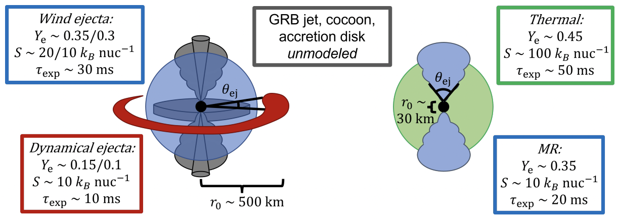
Ejecta properties from NR simulations
BNS/BHNS mergers
CCSNe: thermal/MR
Ekanger, MB, Horiuchi 2023
Notes:
Distributions of ejected mass for BNS vs BHNS vs CCSNe MR vs CCSNe neutrino cases
On the left, distributions for dynamical ejecta of a typical BNS and BHNS scenario are shown in red and black. Results are the same qualitatively, but BHNS case ejects more mass. It also happens less frequently, however. So from a nucleosynthesis analysis alone it suggests that there are multiple sites of robust r-process nucleosynthesis.
On the right I am showing the distributions for the wind ejecta from both mergers as well as the neutrino-driven and magnetorotational supernovae. These scenarios eject relatively large amounts of first peak elements.
BNS: dynamical Y_{e} ~ 0.15, wind Y_{e} ~ 0.35 (clear production of 1st – 3rd peak + actinides)
Dynamical ejecta of BNS mergers robustly produces elements in 3rd r-process peak + actinides.
Wind ejecta produces a distribution similar to that found in magnetorotational CCSNe.
BHNS: dynamical Y_{e} ~ 0.1, wind Y_{e} ~ 0.3 (slightly more production of 1st – 3rd peak + actinides)
When BHNS merger successfully produces ejecta, the results are very similar to the BNS case.
Main difference is that BHNS outflows are slightly more neutron rich. We again see robust production of 1st, 2nd, and 3rd r-process peaks along with the actinides.

Slide 27
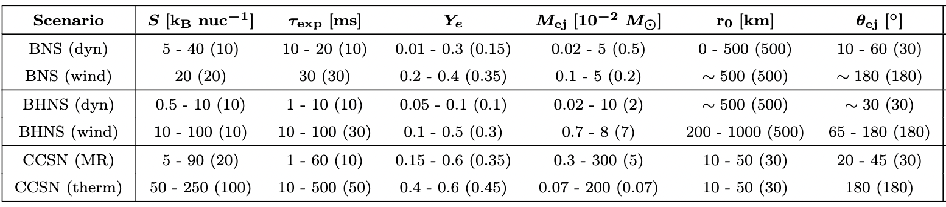
Ejecta properties from NR simulations
BNS: Just+2015, Lippuner & Roberts 2015, Radice+2018, Zhu+2021, Combi & Siegel 2023, Kiuchi+2022, …
BHNS: Korobkin+2012, Roberts+2017, Bhattacharya+2019, Fujibayashi+2020, Kyutoku+2021, …
MR CCSN: Vlasov+2017, Halevi & Mosta 2018, Reichert+2021, Desai+2022, Reichert+2023, …
Thermal CCSN: Qian & Woosley 1996, Goriely & Janka 2016, Bliss+2018, Witt+2021, Psaltis+2022

Slide 28
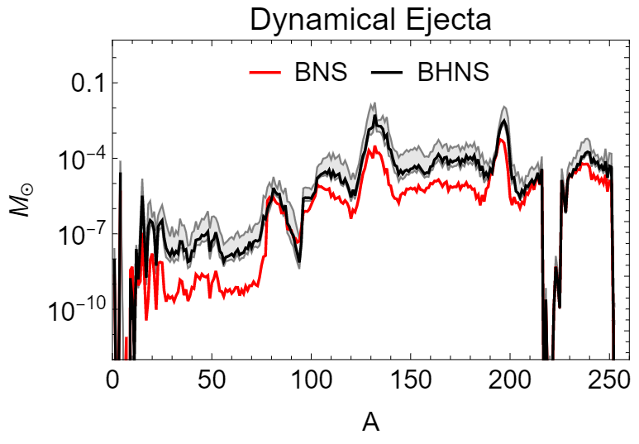
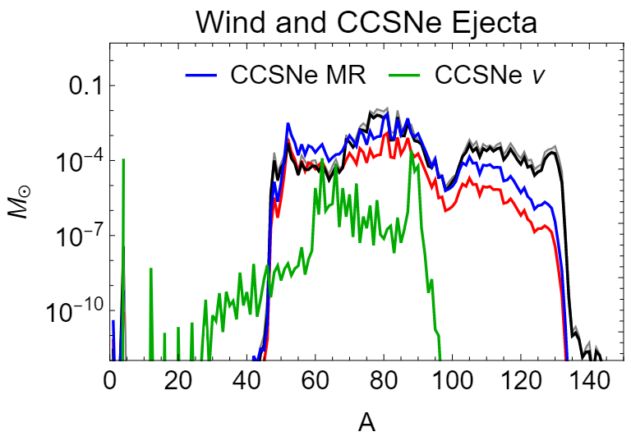
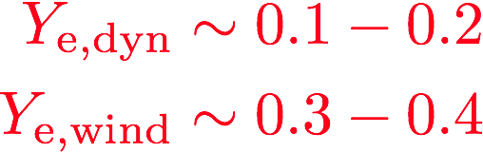
Comparing nucleosynthesis yields
Dynamical ejecta and wind in BHNS mergers tend to be slightly more neutron rich compared to BNS mergers. Both can robustly produce 1st, 2nd and 3rd r-process peak elements + actinides, whereas CCSNe primarily generate 1st peak elements.
1st – 3rd peak elements + actinides, marginally more mass in BHNS
Predominantly 1st peak elements
Ekanger, MB, Horiuchi 2023
Notes:
Distributions of ejected mass for BNS vs BHNS vs CCSNe MR vs CCSNe neutrino cases
On the left, distributions for dynamical ejecta of a typical BNS and BHNS scenario are shown in red and black. Results are the same qualitatively, but BHNS case ejects more mass. It also happens less frequently, however. So from a nucleosynthesis analysis alone it suggests that there are multiple sites of robust r-process nucleosynthesis.
On the right I am showing the distributions for the wind ejecta from both mergers as well as the neutrino-driven and magnetorotational supernovae. These scenarios eject relatively large amounts of first peak elements.
BNS: dynamical Y_{e} ~ 0.15, wind Y_{e} ~ 0.35 (clear production of 1st – 3rd peak + actinides)
Dynamical ejecta of BNS mergers robustly produces elements in 3rd r-process peak + actinides.
Wind ejecta produces a distribution similar to that found in magnetorotational CCSNe.
BHNS: dynamical Y_{e} ~ 0.1, wind Y_{e} ~ 0.3 (slightly more production of 1st – 3rd peak + actinides)
When BHNS merger successfully produces ejecta, the results are very similar to the BNS case.
Main difference is that BHNS outflows are slightly more neutron rich. We again see robust production of 1st, 2nd, and 3rd r-process peaks along with the actinides.

Slide 29
Rate-weighted abundance distributions
Comparing solar and metal-poor star HD222925 abundance data with event-rate-weighted BHNS+BNS nucleosynthesis yields.
Yields are rescaled to match solar lanthanide (dysprosium, Z=66) abundances.
Ekanger, MB, Horiuchi 2023
Notes:
Distributions of ejected mass for BNS vs BHNS vs CCSNe MR vs CCSNe neutrino cases
On the left, distributions for dynamical ejecta of a typical BNS and BHNS scenario are shown in red and black. Results are the same qualitatively, but BHNS case ejects more mass. It also happens less frequently, however. So from a nucleosynthesis analysis alone it suggests that there are multiple sites of robust r-process nucleosynthesis.
On the right I am showing the distributions for the wind ejecta from both mergers as well as the neutrino-driven and magnetorotational supernovae. These scenarios eject relatively large amounts of first peak elements.
BNS: dynamical Y_{e} ~ 0.15, wind Y_{e} ~ 0.35 (clear production of 1st – 3rd peak + actinides)
Dynamical ejecta of BNS mergers robustly produces elements in 3rd r-process peak + actinides.
Wind ejecta produces a distribution similar to that found in magnetorotational CCSNe.
BHNS: dynamical Y_{e} ~ 0.1, wind Y_{e} ~ 0.3 (slightly more production of 1st – 3rd peak + actinides)
When BHNS merger successfully produces ejecta, the results are very similar to the BNS case.
Main difference is that BHNS outflows are slightly more neutron rich. We again see robust production of 1st, 2nd, and 3rd r-process peaks along with the actinides.

Slide 30
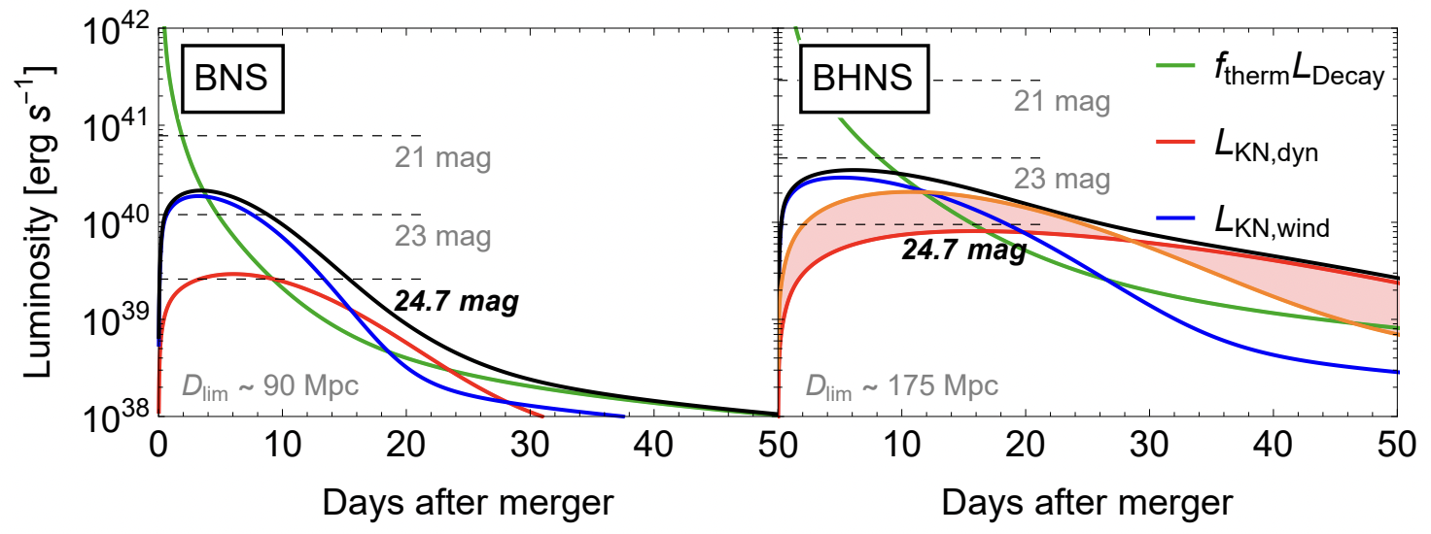
Kilonova light curves
BHNS mergers show characteristically brighter and longer-lasting emission compared to BNS
Ekanger, MB, Horiuchi 2023
Notes:
Distributions of ejected mass for BNS vs BHNS vs CCSNe MR vs CCSNe neutrino cases
On the left, distributions for dynamical ejecta of a typical BNS and BHNS scenario are shown in red and black. Results are the same qualitatively, but BHNS case ejects more mass. It also happens less frequently, however. So from a nucleosynthesis analysis alone it suggests that there are multiple sites of robust r-process nucleosynthesis.
On the right I am showing the distributions for the wind ejecta from both mergers as well as the neutrino-driven and magnetorotational supernovae. These scenarios eject relatively large amounts of first peak elements.
BNS: dynamical Y_{e} ~ 0.15, wind Y_{e} ~ 0.35 (clear production of 1st – 3rd peak + actinides)
Dynamical ejecta of BNS mergers robustly produces elements in 3rd r-process peak + actinides.
Wind ejecta produces a distribution similar to that found in magnetorotational CCSNe.
BHNS: dynamical Y_{e} ~ 0.1, wind Y_{e} ~ 0.3 (slightly more production of 1st – 3rd peak + actinides)
When BHNS merger successfully produces ejecta, the results are very similar to the BNS case.
Main difference is that BHNS outflows are slightly more neutron rich. We again see robust production of 1st, 2nd, and 3rd r-process peaks along with the actinides.

Slide 31
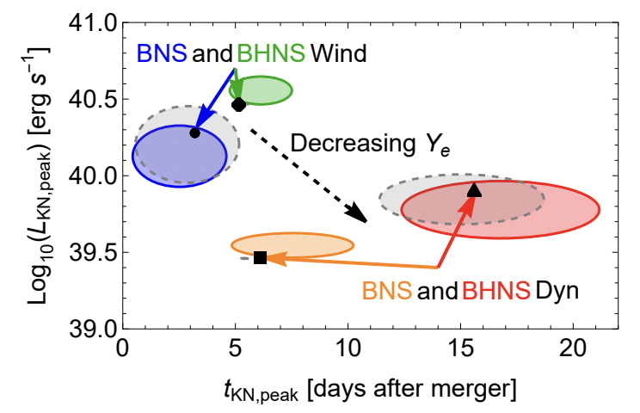
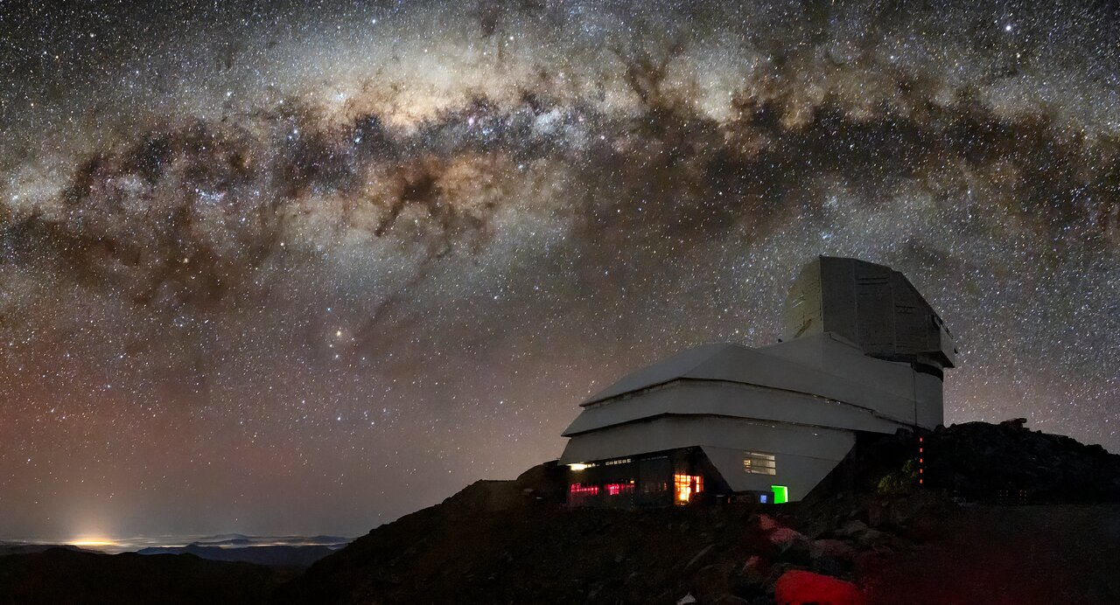
Kilonova observability with LSST
LIGO O4 (May 2023) + LSST (~mid 2024) can detect KN signatures from BHNS/BNS.
~7 BNS and ~2 BHNS events/year
Vera C. Rubin Observatory: https://noirlab.edu/public/images/iotw2207a/
Notes:
Distributions of ejected mass for BNS vs BHNS vs CCSNe MR vs CCSNe neutrino cases
On the left, distributions for dynamical ejecta of a typical BNS and BHNS scenario are shown in red and black. Results are the same qualitatively, but BHNS case ejects more mass. It also happens less frequently, however. So from a nucleosynthesis analysis alone it suggests that there are multiple sites of robust r-process nucleosynthesis.
On the right I am showing the distributions for the wind ejecta from both mergers as well as the neutrino-driven and magnetorotational supernovae. These scenarios eject relatively large amounts of first peak elements.
BNS: dynamical Y_{e} ~ 0.15, wind Y_{e} ~ 0.35 (clear production of 1st – 3rd peak + actinides)
Dynamical ejecta of BNS mergers robustly produces elements in 3rd r-process peak + actinides.
Wind ejecta produces a distribution similar to that found in magnetorotational CCSNe.
BHNS: dynamical Y_{e} ~ 0.1, wind Y_{e} ~ 0.3 (slightly more production of 1st – 3rd peak + actinides)
When BHNS merger successfully produces ejecta, the results are very similar to the BNS case.
Main difference is that BHNS outflows are slightly more neutron rich. We again see robust production of 1st, 2nd, and 3rd r-process peaks along with the actinides.

Slide 32
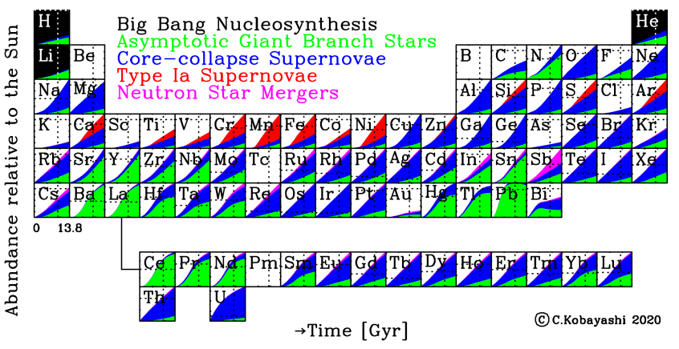
A holistic approach: Galactic chemical evolution
Accounting for nucleosynthesis yields and event rates of transient phenomena, GCE provides a holistic view of nucleosynthesis (including r-process) that has occurred over our Galaxy’s evolution
Notes:
In GCE studies, the event rates and nucleosynthesis yields as a function of galaxy evolution timescales are put together for all kinds of transient phenomena. This presents a holistic view of the nucleosynthesis – r process included – that has occurred over our galaxy’s evolution.
GCE models want to:
explain the entire periodic table,
population study of all sources to explain solar abundances
Table shows the abundance evolution of each element as a function of time and astrophysical site. In each subpanel, the x-axis is time since the Big Bang and y-axis shows the abundance relative to the Sun. If we look at Ni, for example, in the present day, about two thirds of the nickel is synthesized in Type 1a SNe and the rest comes from CCSNe and AGB stars.
This analysis results in a story of the heavy elements that is somewhat different from our analysis – the main result is that magneto-rotational SNe provide the majority of the r-process elements instead of merger scenarios.

Slide 33
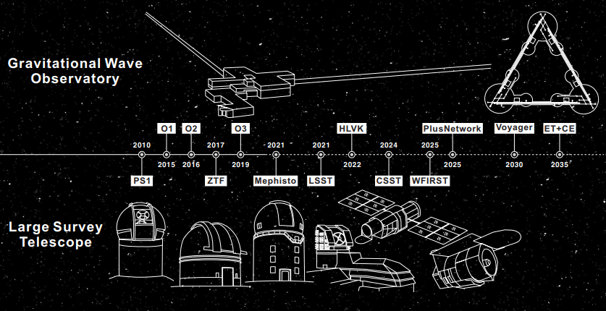
Prospects are optimistic!
[1] Zhu et al. 2021
[1]
Notes:
The prospects for further observations, however, are very optimistic. In the coming decades, more powerful gravitational wave and light surveys will come online and be able to see many more mergers. The LIGO O4 run with LSST is a particularly intriguing combination for discovering the signatures of the r process.

Slide 34
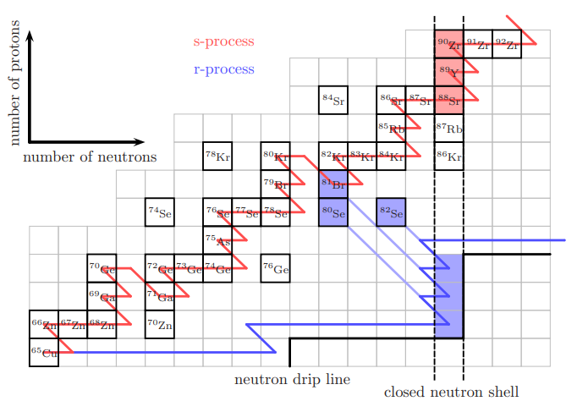
Why are r/s –process peaks where they are?
[1] J. Lippuner Thesis, 2018.
Neutron capture cross section drops off at closed neutron shell locations (N = 50 for first peak, magic number)
In s- these species are necessarily stable
In r- they are unstable, and decay from N = 50 shell back to stable line
At each peak there is this feature
[1]
Astro Seminar 10/17/22
BACKUP
51
Notes:
Magic numbers – closed nuclear shells also at N=50, 82, 126 for first, second, third peaks

Slide 35
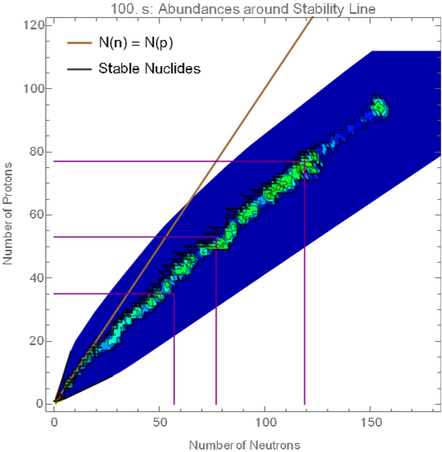


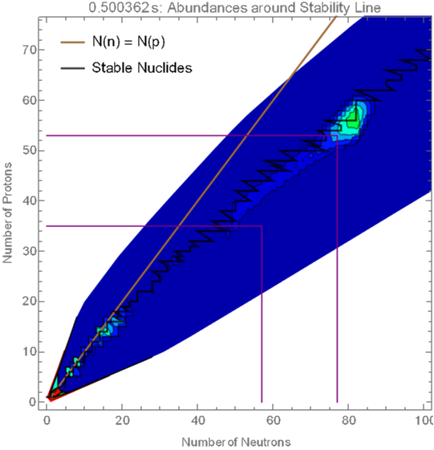
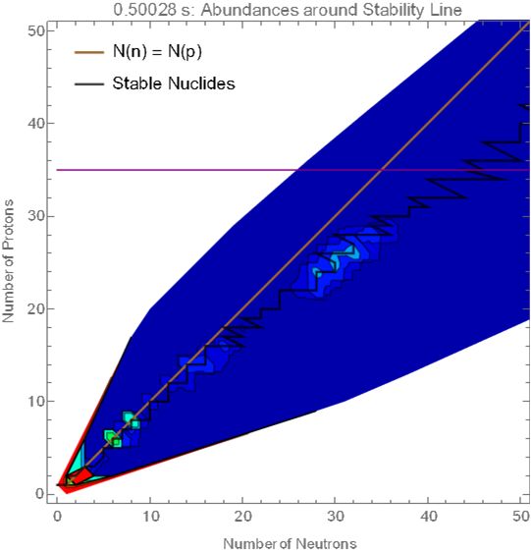
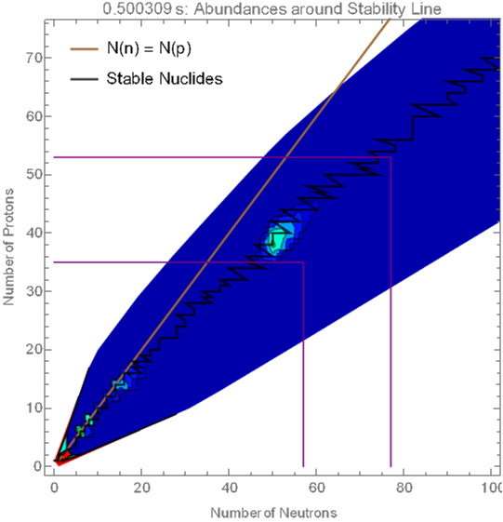
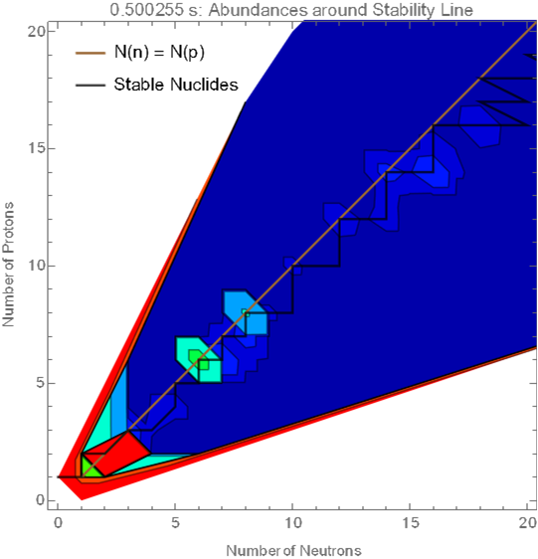
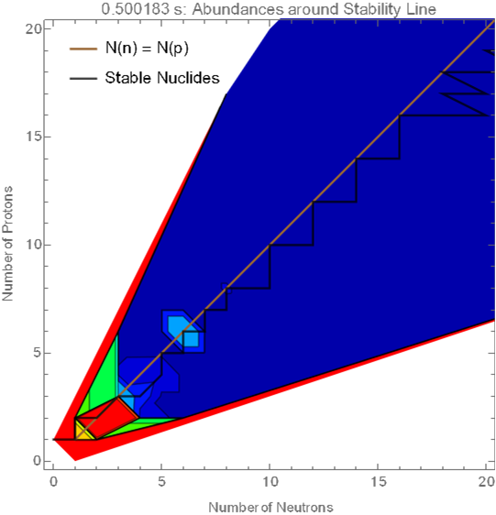
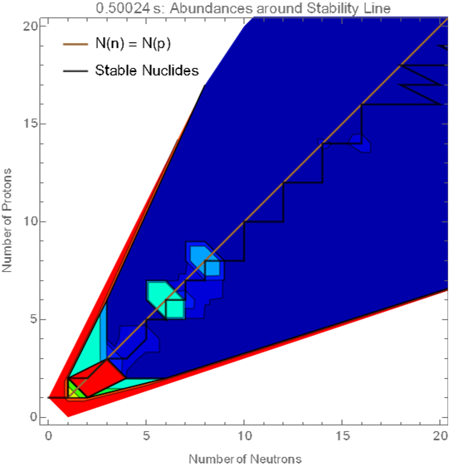
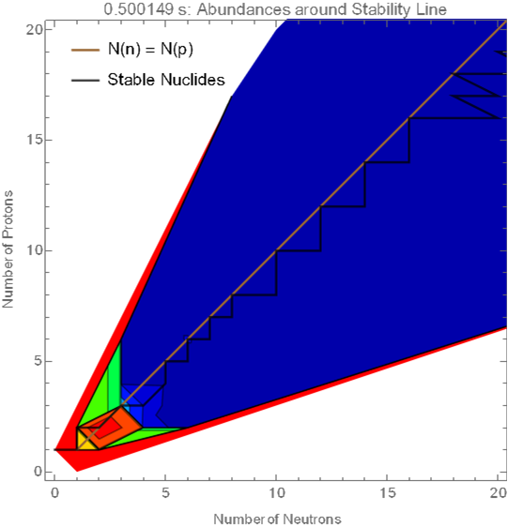




Detailed r-process
Rapid neutron capture
O
O
Back-to-back $α$ particle captures
Seeds for heavier nuclei to capture many neutrons up to peaks
Beta decay back to stability
C
C
C
Seeds
Seeds
$α$-group
Seeds
He
He
He
$β$-decay back to stable!
Ne, Mg, Si
~2nd Peak
~1st Peak
Actinides
~3rd Peak
Numerical
artifact
Fe-group
Astro Seminar 10/17/22
BACKUP
52

Slide 36
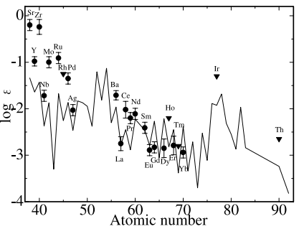
Two populations?
[1] Honda et al. 2007
Extra relative enrichment for the ‘weak’ r-process elements compared to solar/higher peak elements
Two components:
>1st r process peak elements from mergers
‘Weak’ ~1st r process peak elements from CCSNe
Mergers: robust r-process
CCSNe: weak r-process
[1]
Astro Seminar 10/17/22
BACKUP
53

Slide 37
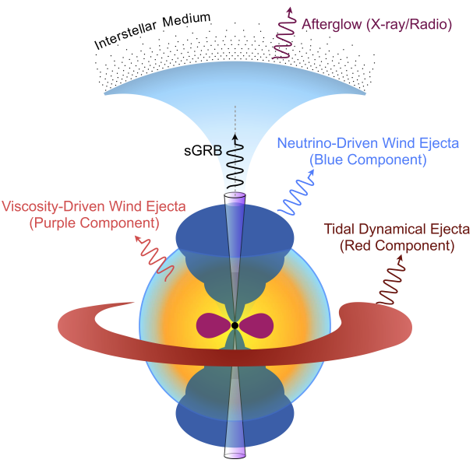

[1] Zhu et al. 2020
[2] Vieira et al. 2022
[1]
[2]
Astro Seminar 10/17/22
BACKUP
55

Slide 38



[1] Siegel et al. 2018
[2] Grichener et al. 2022
[3] Kobayashi et al. 2020 -> Kobayashi and Tominaga (in prep?)
Additional scenarios
[2]
Common envelope jet supernovae
[1]
Collapsar accretion disks
[3]
Failed supernovae
Astro Seminar 10/17/22
BACKUP
56

Slide 39

Timescales
CCSNe collapse timescale: $10 Myr →\sim 1s$
Merger timescale: $>Gyr →\sim 100s$
Rates:
  CCSNe – $1∗{10}^{5} {Gpc}^{−3}{yr}^{−1}$
  BNS – $10−1700 {Gpc}^{−3}{yr}^{−1}$
  BHNS – $7.8−140 {Gpc}^{−3}{yr}^{−1}$
Astro Seminar 10/17/22
BACKUP
59

Slide 40

Typical values
[1] Ekanger, Bhattacharya, Horiuchi (in prep)
[1]
Astro Seminar 10/17/22
BACKUP
60

