Slide 1
Characterization of the Diffuse Astrophysical Neutrino Spectrum with IceCube All-Flavor Starting Events
TeV Particle Astrophysics Chicago 2024
Vedant Basu and Aswathi Balagopal V. On behalf of the IceCube Collaboration

Slide 2
Outline
The Medium Energy Starting Event (MESE) event selection
Measurement of the Diffuse Astrophysical Neutrino Flux
Measurement of the Astrophysical Neutrino Flavor Composition
IC190331:The Highest Energy IceCube Event
Summary

Slide 3
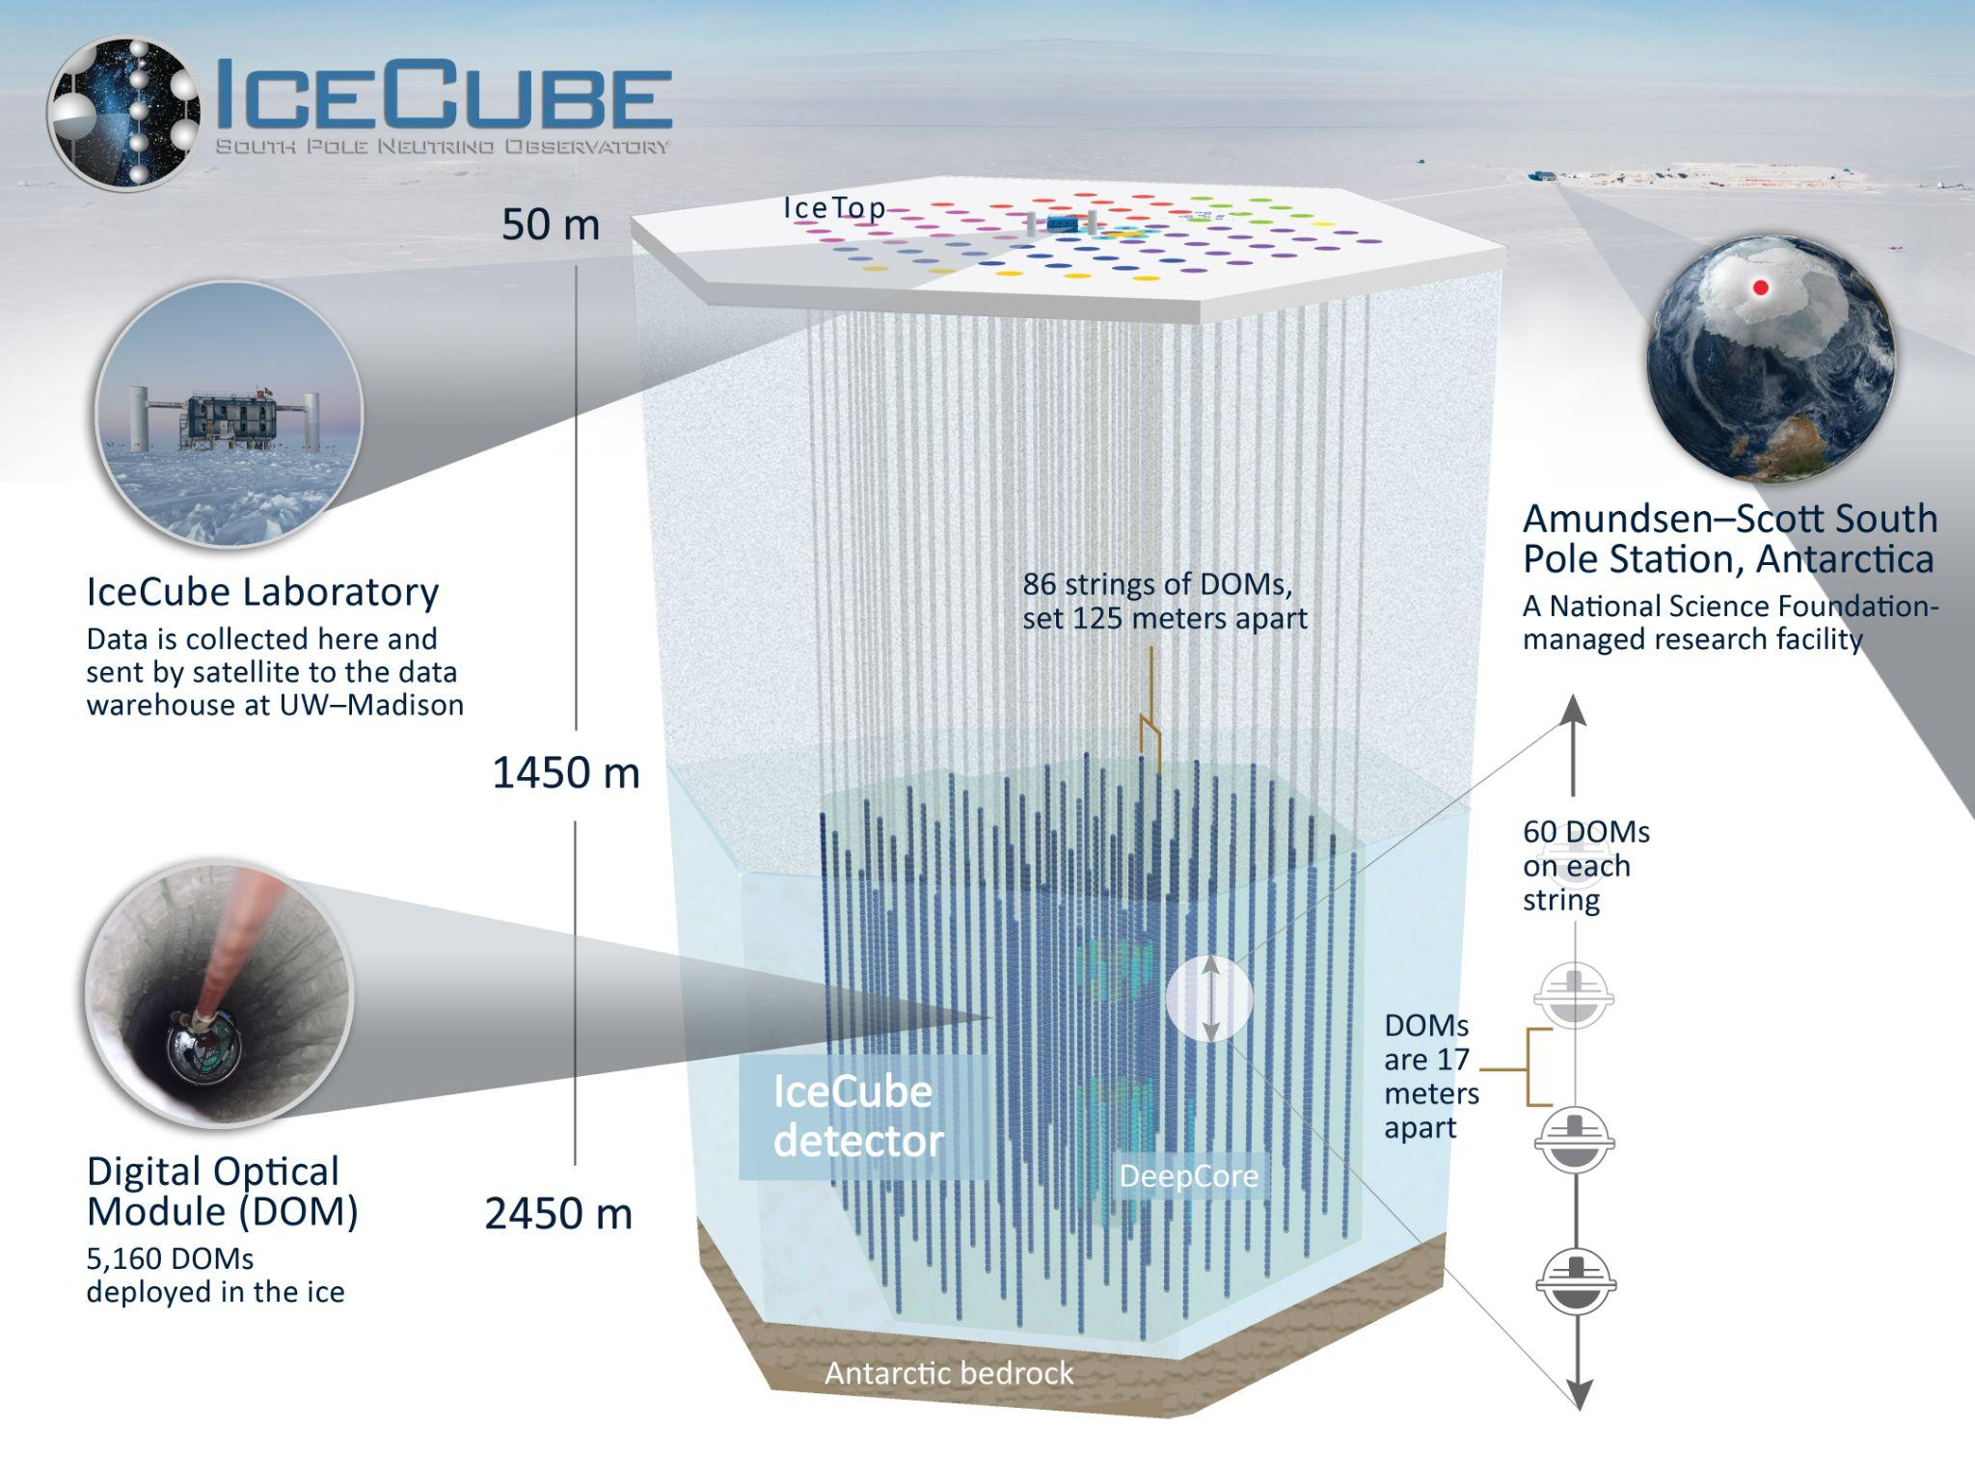
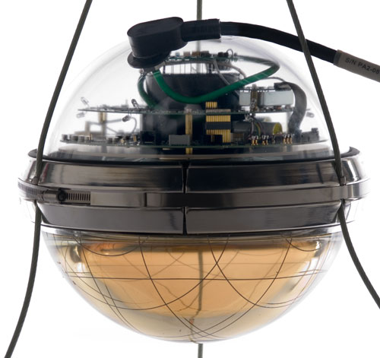
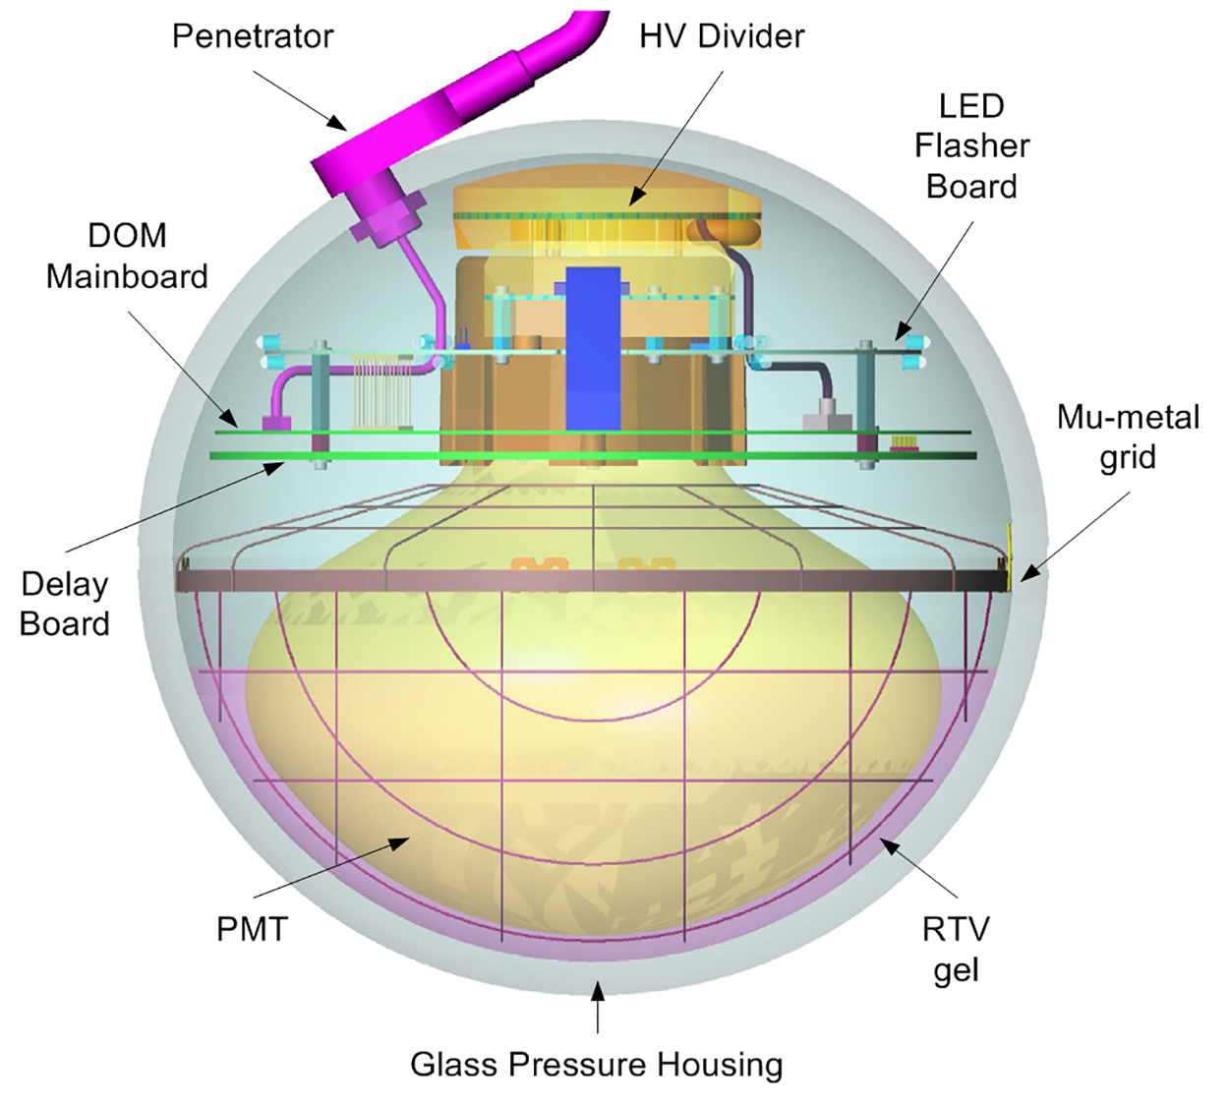
Digital Optical Module
Notes:
Dust Layer: depths between 1970 m and 2100 m

Slide 4
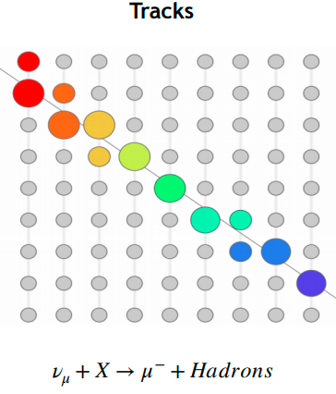
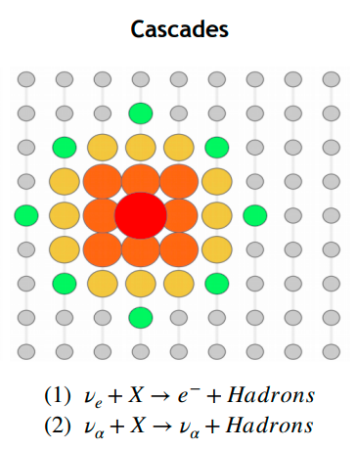
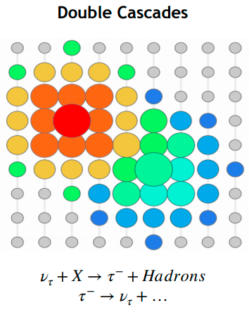
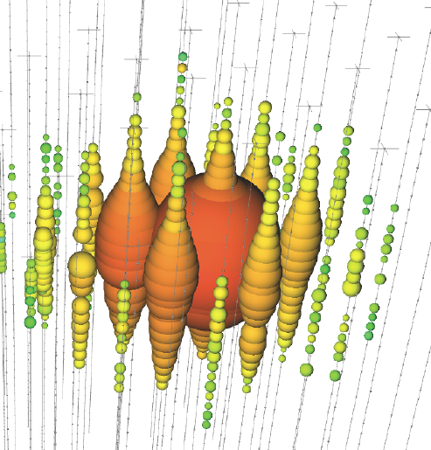
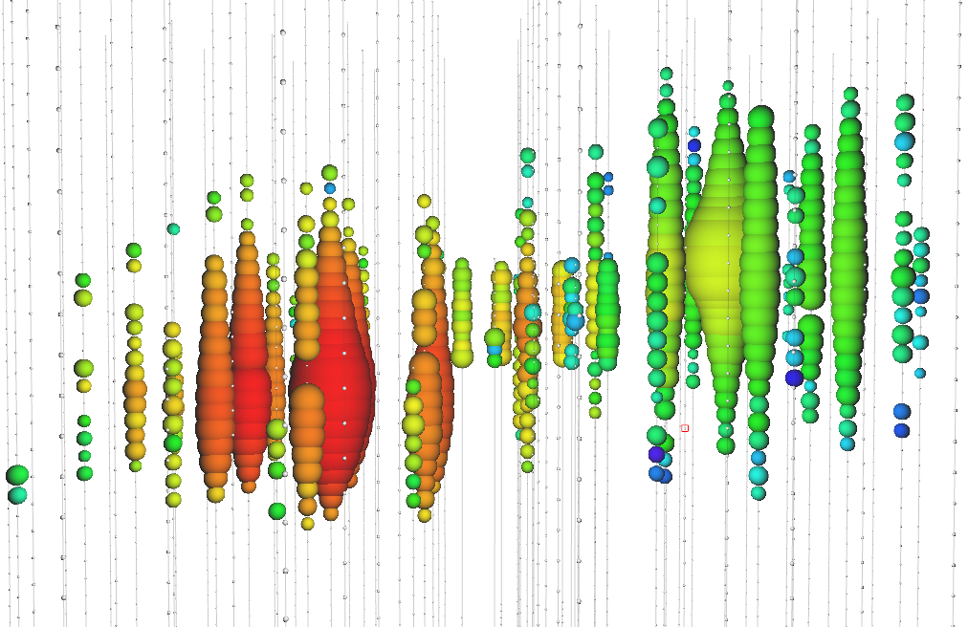
IceCube Event Morphologies
Ref.
Notes:
Size of circle is proportional to charge deposited SPEND MORE TIME
You have different fonts here. Keep it the same —Aswathi Find out how energy resolutions are measured . Be specific about resolutions
Tracks:Due to the relatively long muon lifetime, cherenkov emission along the outgoing muon path shows up as a linear track Cascades: in a NC interaction the out-going products are a neutrino and a recoiling hadron. We don't see the daughter neutrino, and the hadronic recoil is what becomes the cascade, because hadronic products tend to feature short lifetimes and short interaction lengths. They also readily produce electrons in the shower, which don't decay but also have short interaction lengths Double Cascades: Secondary signal from Tau decay product. A second cascade is resolvable starting at Tau energies of around 1 PeV, when the decay length is ~50m (comparable to 0.5*string spacing 125m). Depending on the Tau decay channel, other topologies such as a ‘lollipop’ (where tau decays to a muon) may also occur

Slide 5
IceCube Starting Events
Identify neutrinos with interaction vertex contained within the detector (Starting Events)
Sensitive to all neutrino flavours with different event topologies, from the entire sky
Published analyses using starting events include HESE (High Energy Starting Events) and ESTES (Enhanced Starting Track Event Selection)
VETO LAYER

Slide 6
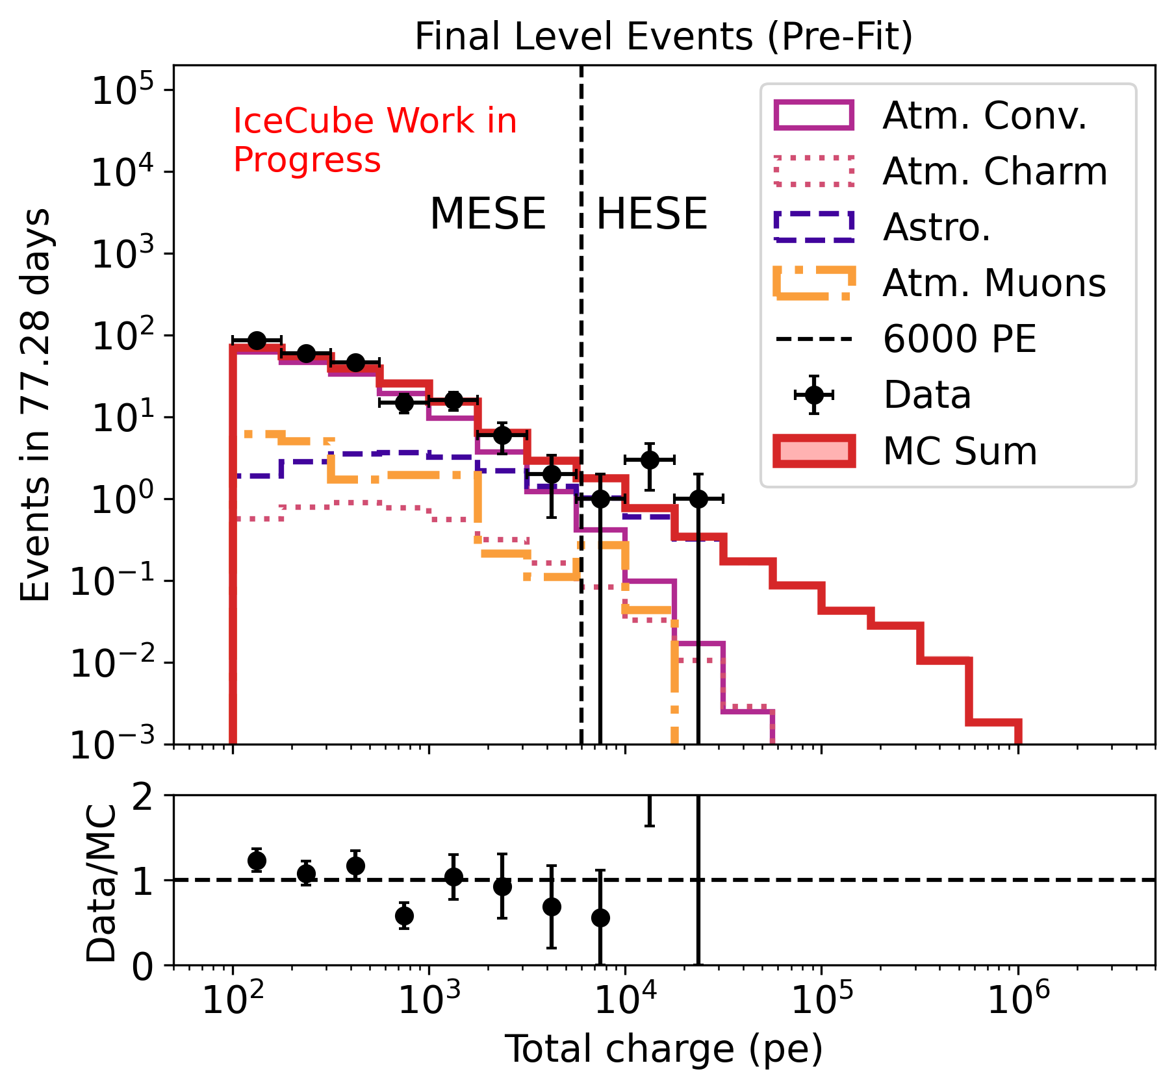
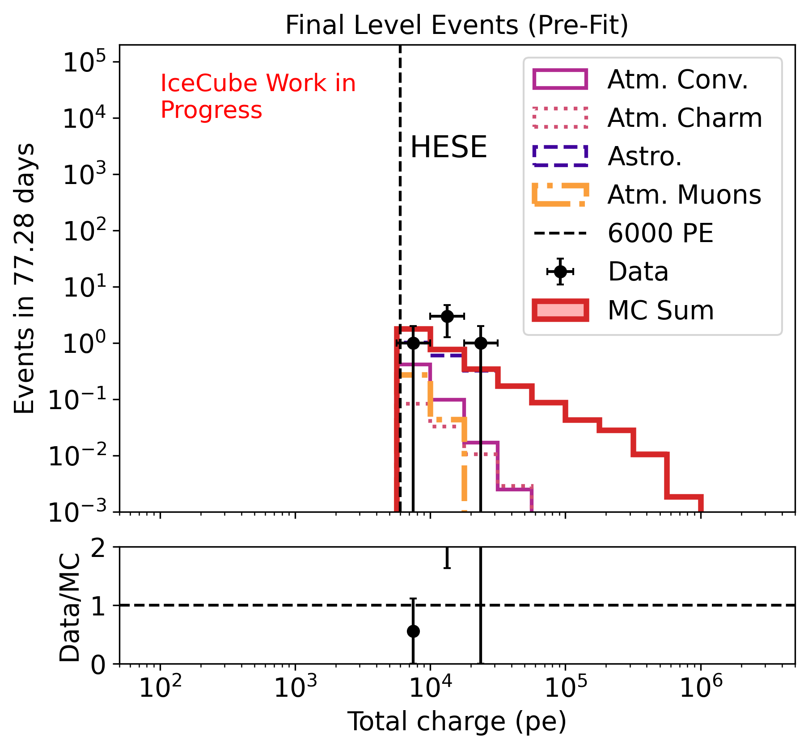
Medium Energy Starting Events (MESE)
Extend HESE concept to lower energies, while retaining high signal purity, with additional veto steps
Neutrinos of all flavors and the whole sky included in this dataset with events having energy > 1 TeV
Use the dataset to measure astrophysical neutrino spectrum and astrophysical flavor ratio

Slide 7
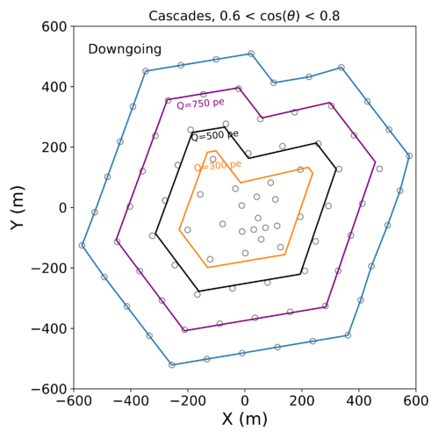
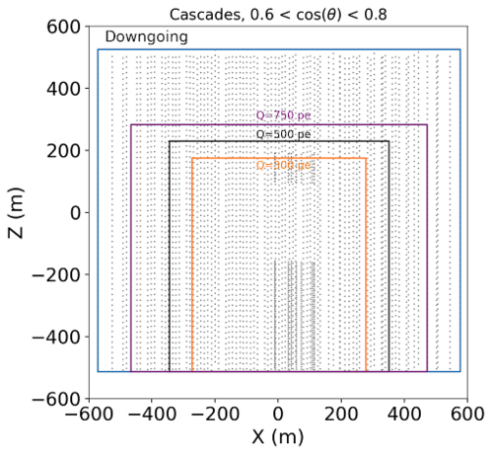
Event Selection
L4: Downgoing Track Veto, link isolated hits with muon hypotheses
Fitted Track
L5: Fiducial Volume Scaling for dim events, veto hits closer to the reconstructed vertex.
L3: Outer Layer Veto, reject atmospheric muons starting outside detector
True Muon Track
Notes:
Rate of muons lower for the cascades-only portion of the event selection Most retained muons are low energy and misreconstructed as upgoing

Slide 8
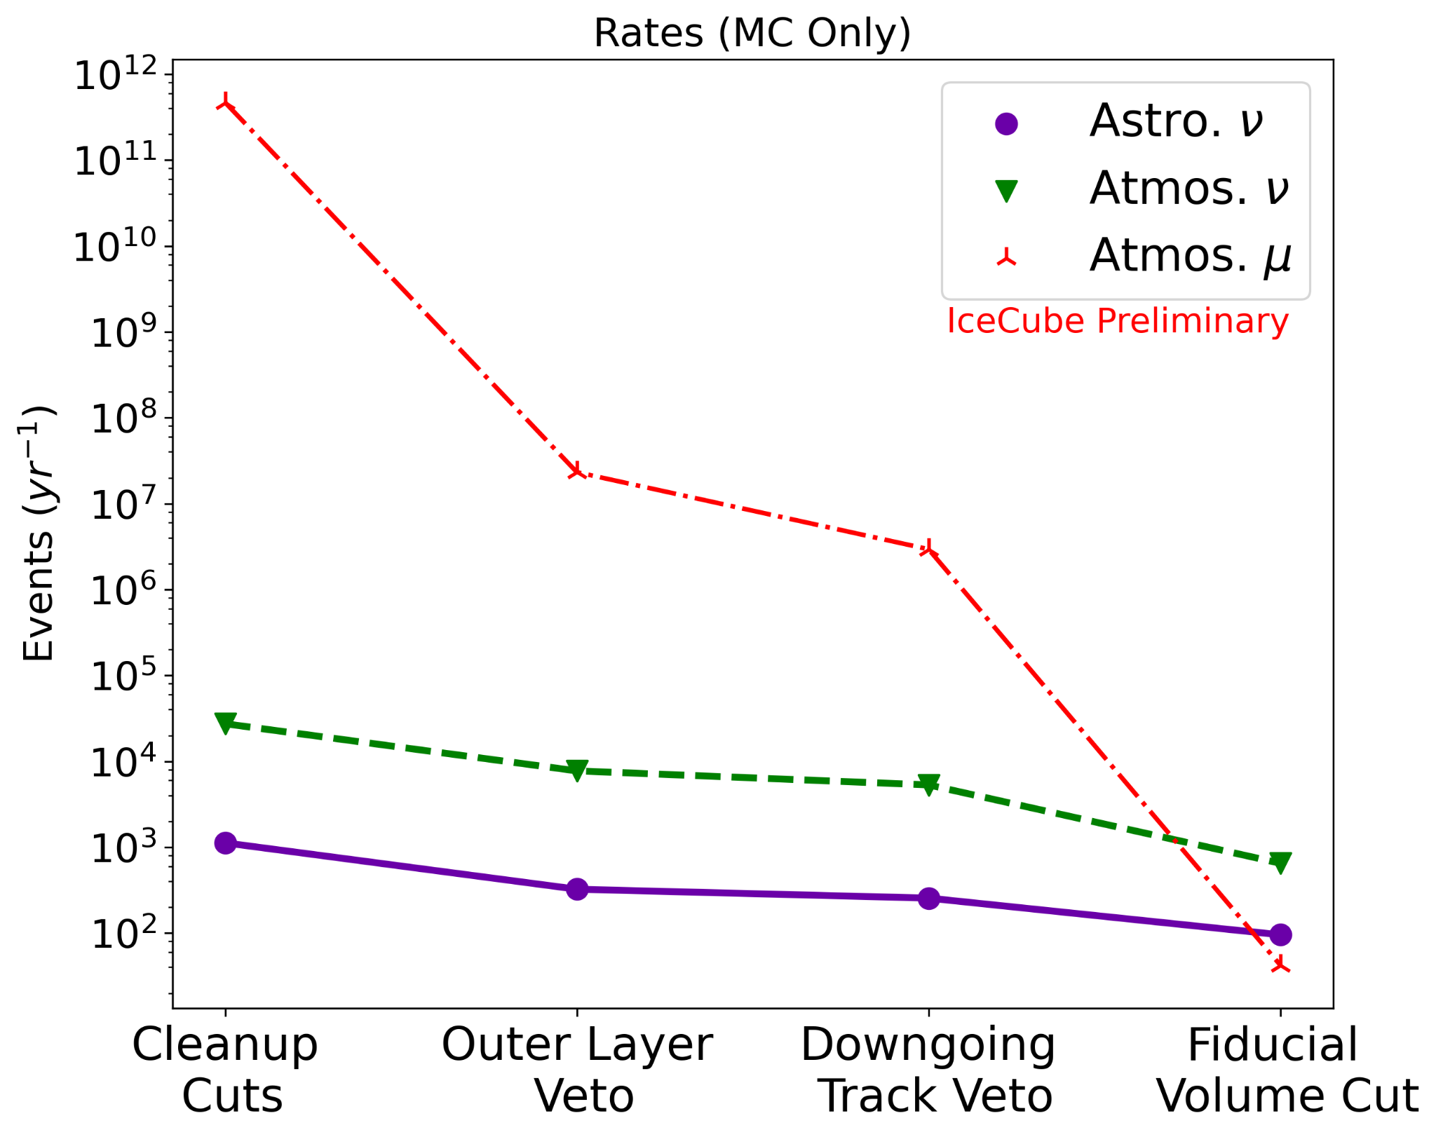
Expected Rates
Astro Flux model: Φ_{astro,}=2.06, γ_{astro}= 2.46 (from 2-year MESE analysis) Atm. Flux model: GaisserH4a +SIBYLL 2.3
Rates (yr⁻¹) (MC) | Astro. ν | Atm. ν | Atm. μ
Total | 95.3 | 644.3 | 40.9
Notes:
Rate of muons lower for the cascades-only portion of the event selection Most retained muons are low energy and misreconstructed as upgoing

Slide 9
Outline
The Medium Energy Starting Event (MESE) event selection
Measurement of the Diffuse Astrophysical Neutrino Flux
Measurement of the Astrophysical Neutrino Flavor Composition
IC190331:The Highest Energy IceCube Event
Summary

Slide 10
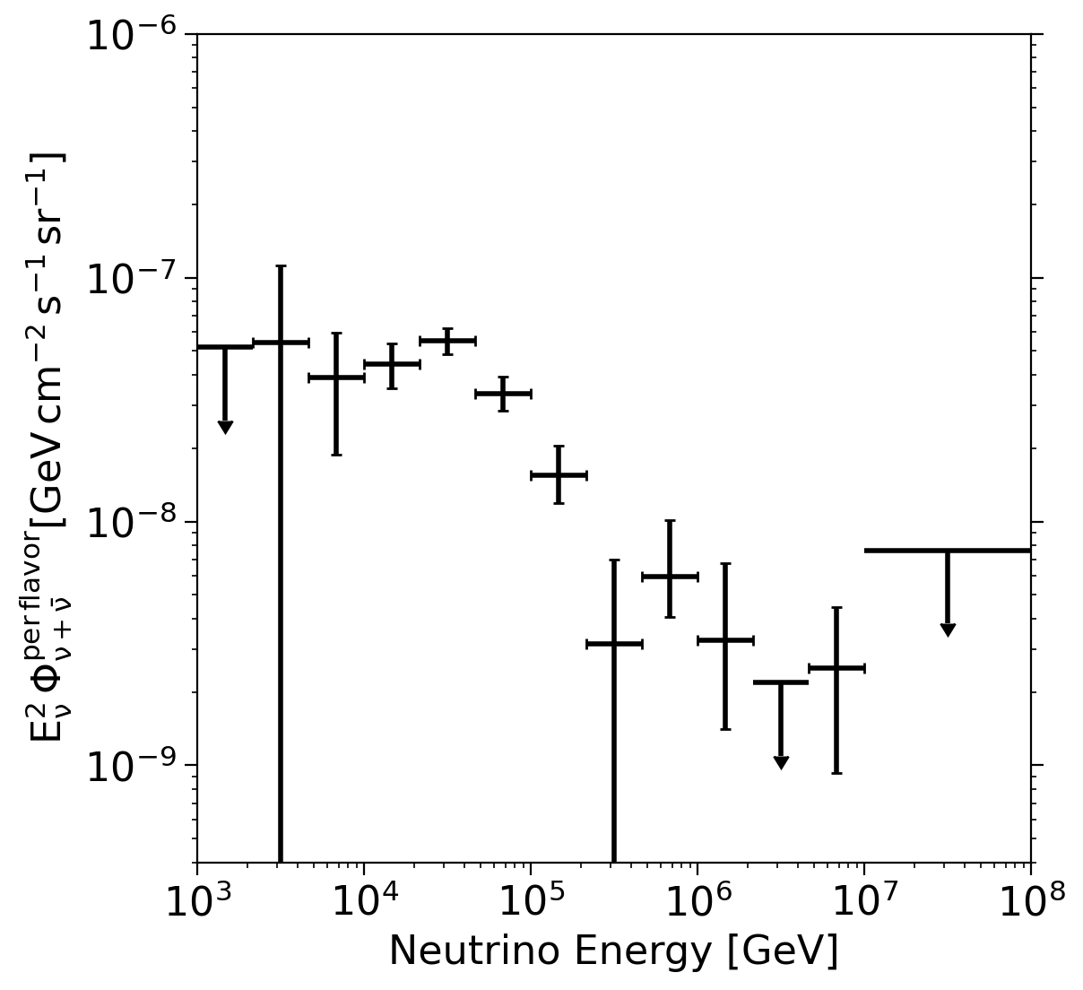
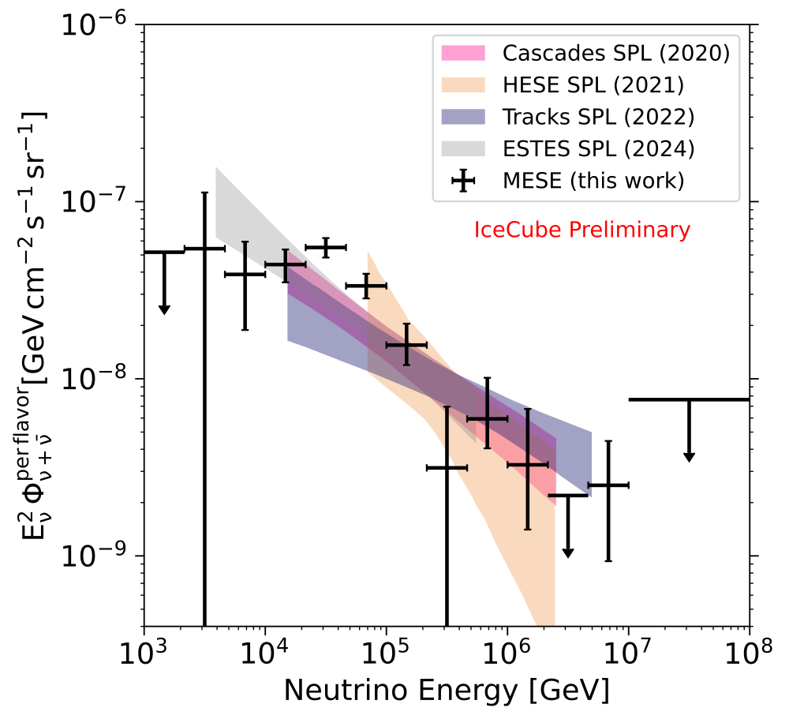
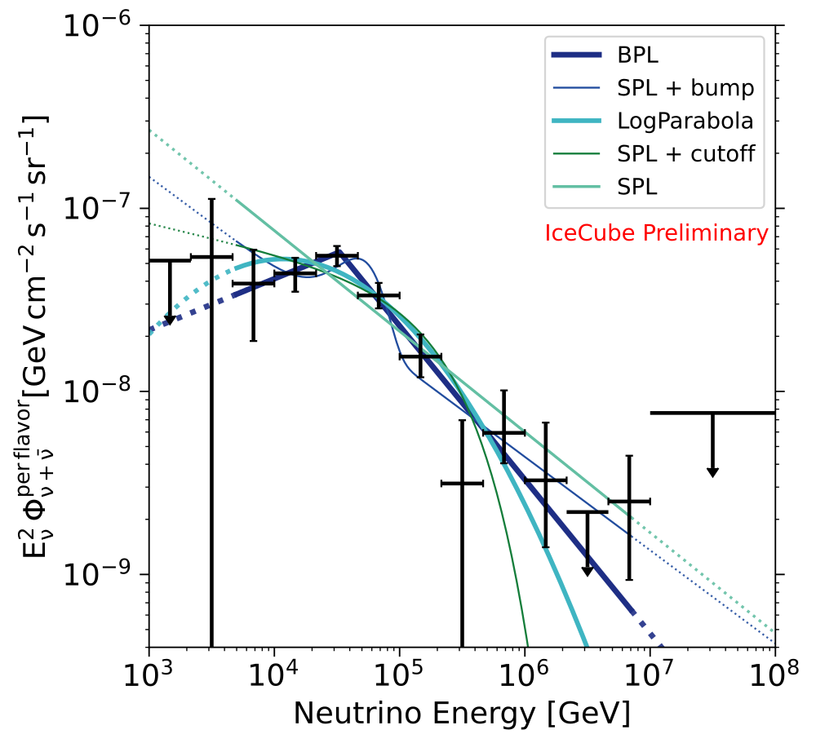
Observed neutrino spectrum
Best fit model: Broken Power Law, followed by SPL+ Bump and then LogParabola. We reject SPL with respect to BPL with 4.7σ with MESE

Slide 11
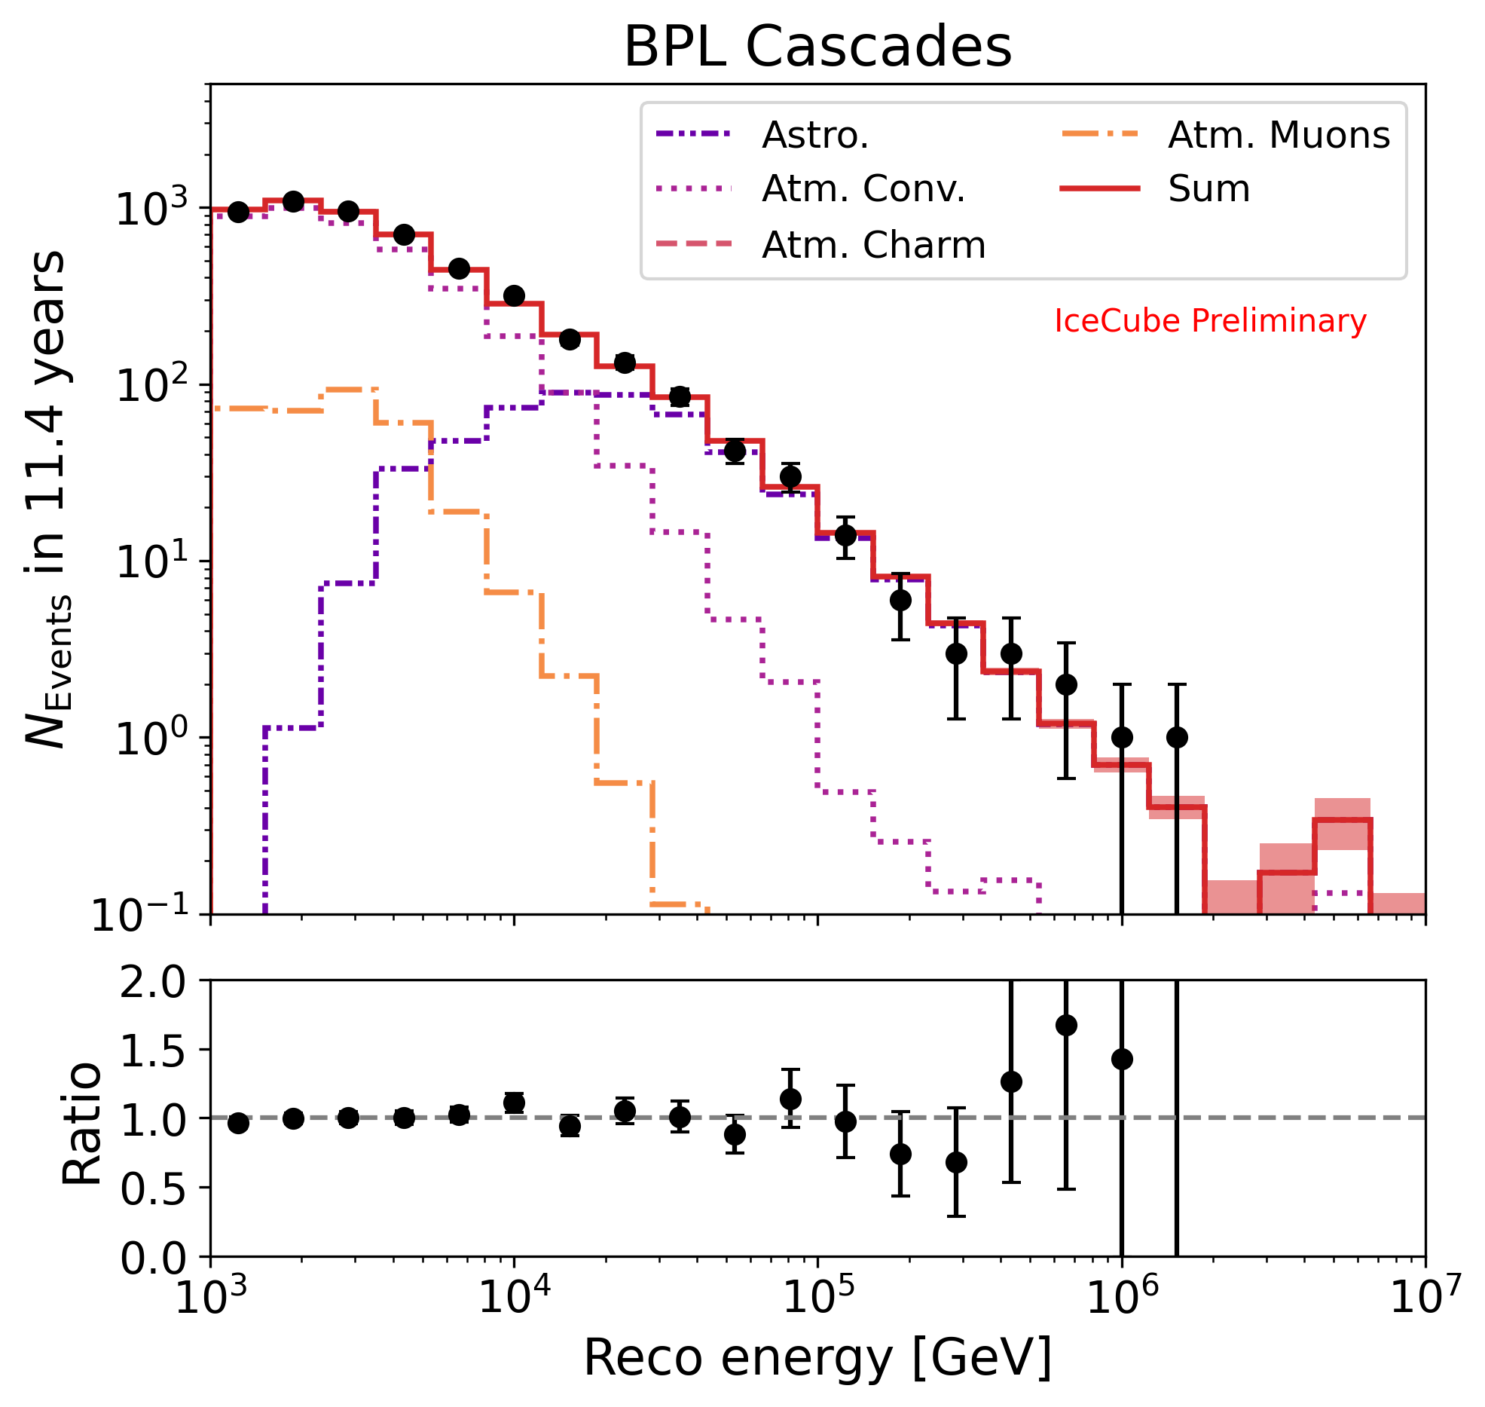
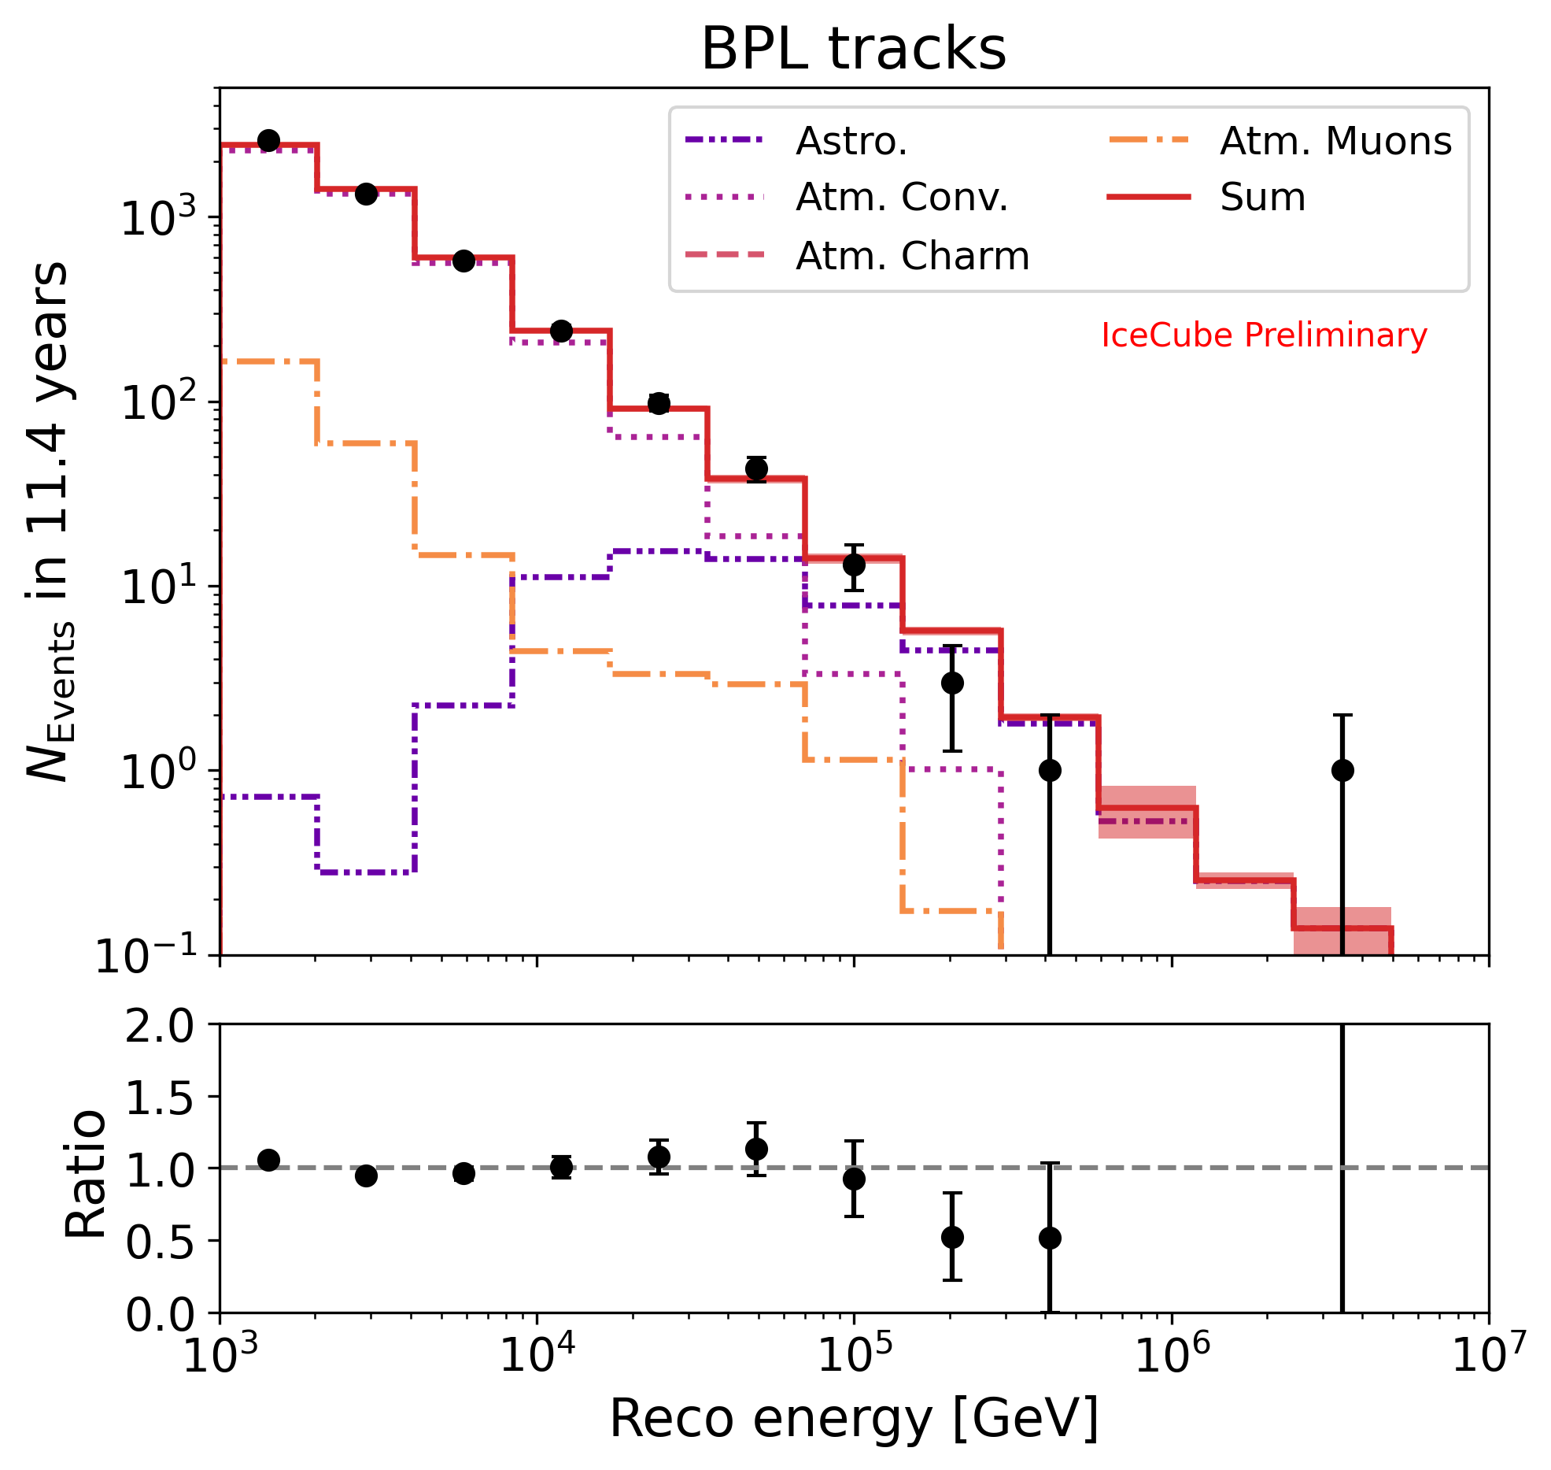
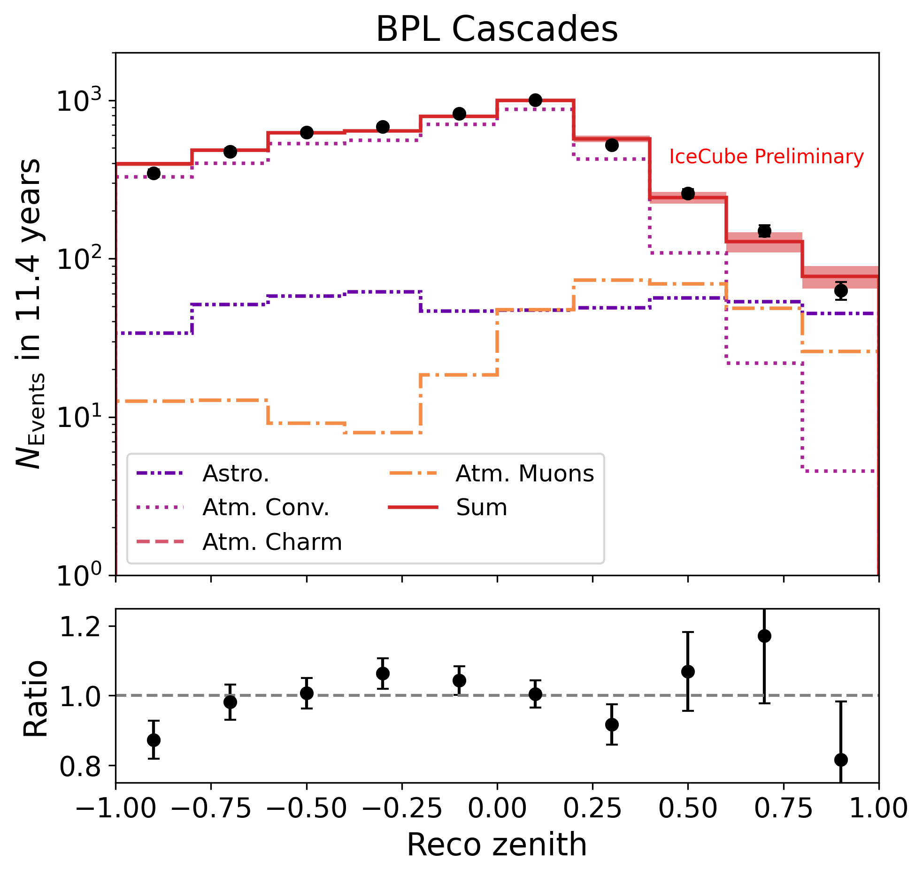
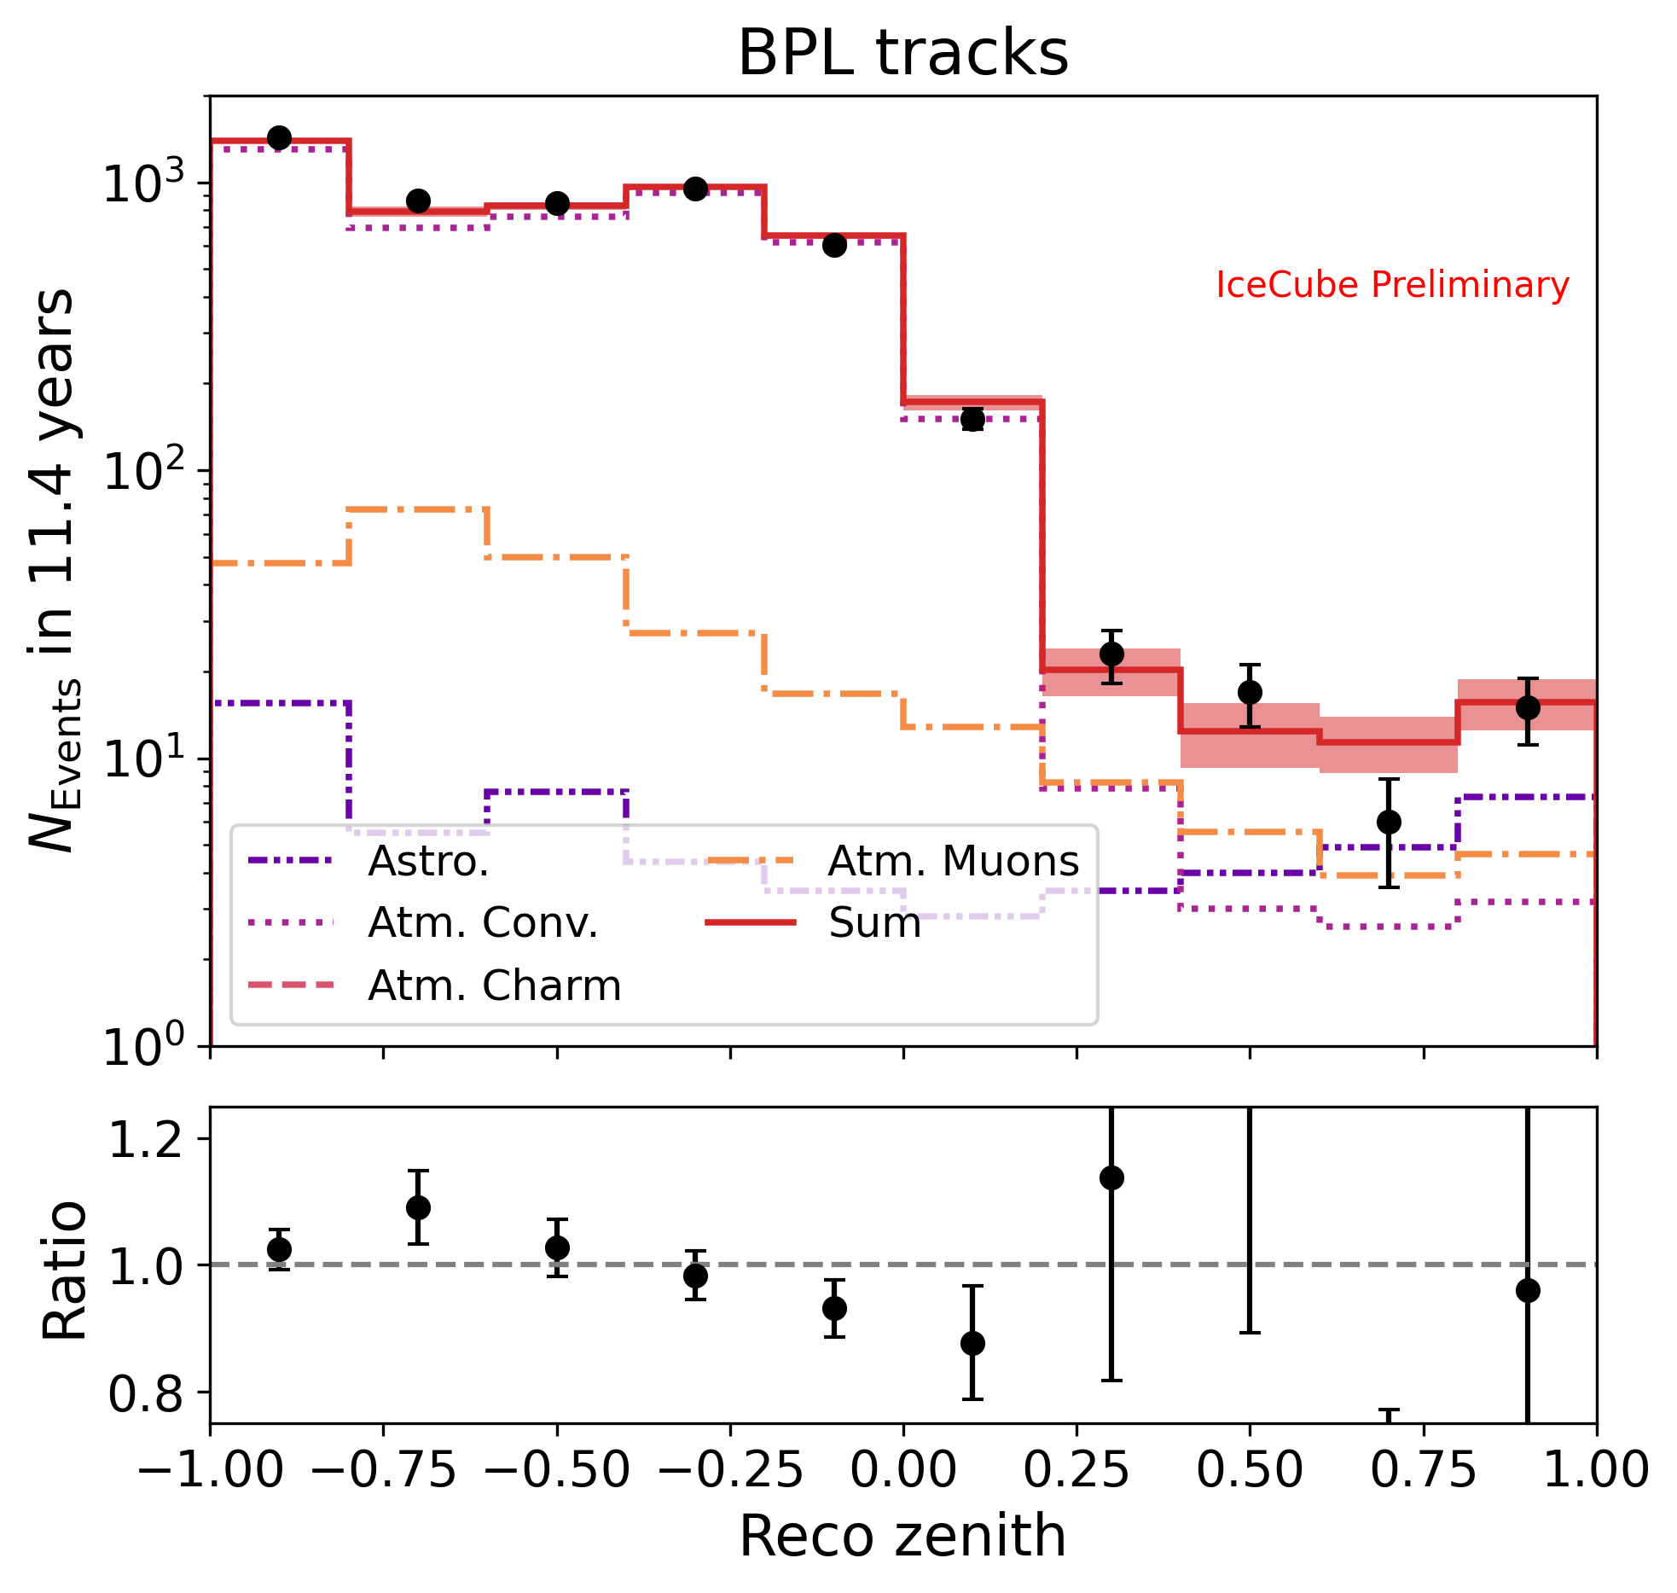
Data-MC comparison
Event Counts (11.4 yr) | Expected | Data
Cascades | 4947.7 | 4949
Tracks | 4859.9 | 4908
Total | 9807.6 | 9857

Slide 12
Outline
The Medium Energy Starting Event (MESE) event selection
Measurement of the Diffuse Astrophysical Neutrino Flux
Measurement of the Astrophysical Neutrino Flavor Composition
IC190331:The Highest Energy IceCube Event
Summary

Slide 13
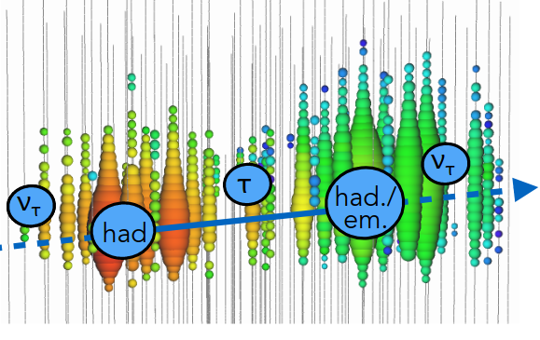
Tau neutrino identification
Selection strategy focused on double-cascade identification
Perform likelihood-based reconstruction
Additional cuts to select double cascades based on reconstructed energy in both cascades and their relative magnitudes
Retain events that pass the cuts with tau-decay length > 10 m and energy > 30 TeV as double cascades
Remaining events are cascades or tracks (based on a DNN)

Slide 14
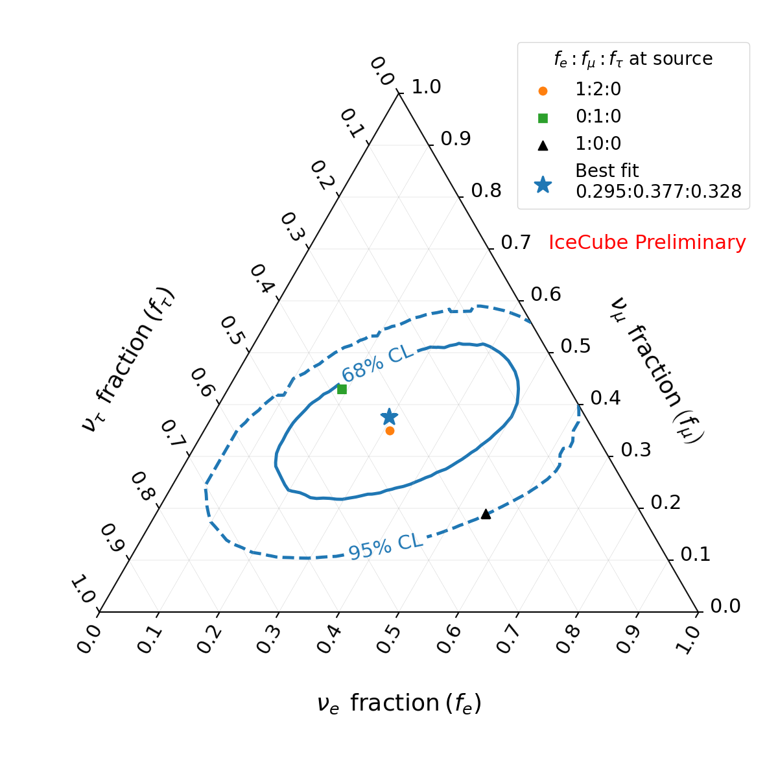
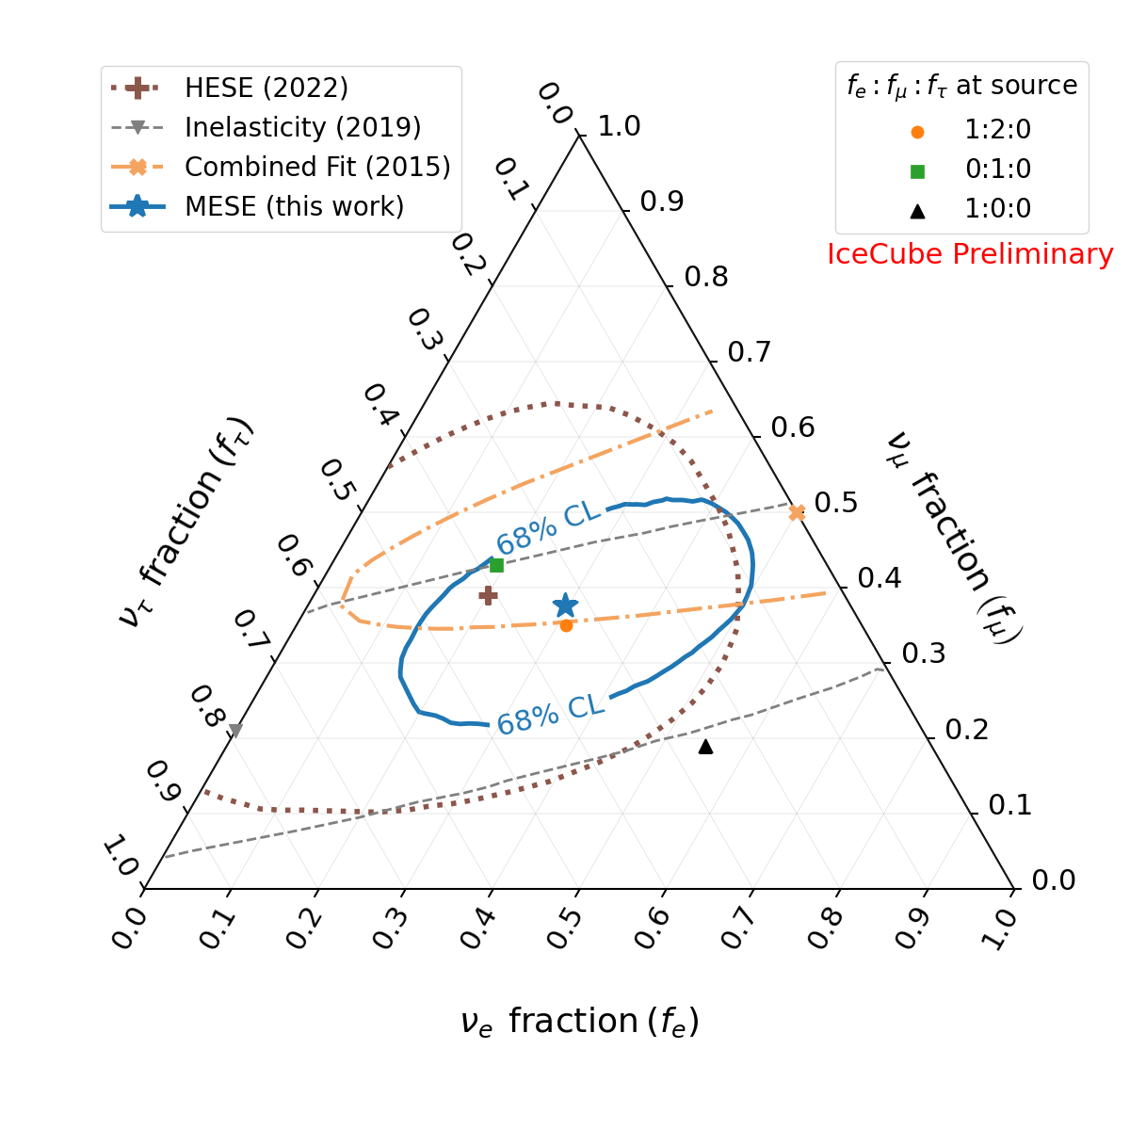
Measurement of the flavor ratio
BPL assumed as the flux model for the measurement of the flavor ratio
IceCube obtains a closed 1σ contour for the first time
𝜈_{e}-only at source (neutron decay) excluded with 94.8% CL
Comparison of MESE results with previous IC results

Slide 15
Outline
The Medium Energy Starting Event (MESE) event selection
Measurement of the Diffuse Astrophysical Neutrino Flux
Measurement of the Astrophysical Neutrino Flavor Composition
IC190331:The Highest Energy IceCube Event
Summary

Slide 16
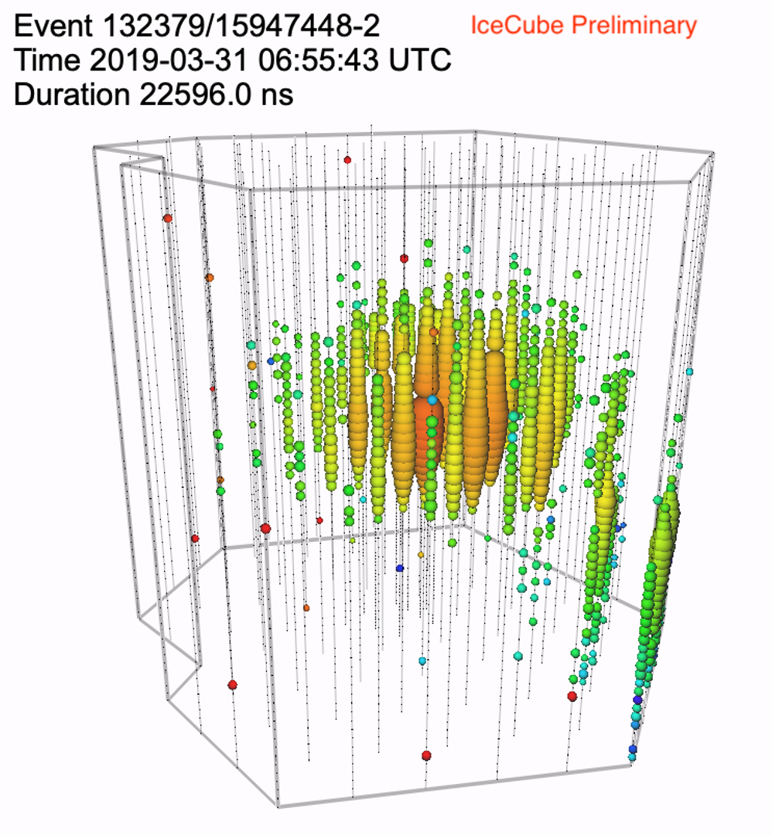
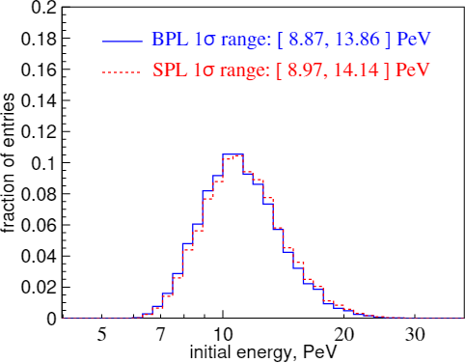
IceCube’s Highest Energy Event
Starting Track in MESE sample, reconstructed energy 4.8 PeV
Primary neutrino energy*:11.4 PeV
*Most probable neutrino energy when assuming a BPL spectrum (𝛄₁ ,𝛄₂)=(1.72,2.84) [Data Release]

Slide 17
Outline
The Medium Energy Starting Event (MESE) event selection
Measurement of the Diffuse Astrophysical Neutrino Flux
Measurement of the Astrophysical Neutrino Flavor Composition
IC190331:The Highest Energy IceCube Event
Summary

Slide 18
Summary
A study of starting events with 11.4 years of IceCube data reveals evidence for features in the spectrum of astrophysical neutrinos beyond the single power law.
IceCube observes a steeper spectrum at higher energies, while below ~30 TeV a harder spectrum is measured.
Flavor ratio of extragalactic neutrinos measured to be consistent with SM, with a closed contour at 68% CL. We reject production of cosmic neutrinos via neutron-decay with 94.8% CL.
In addition, a muon neutrino with energy 11. 4 PeV has been observed, IceCube’s highest energy event to date

Slide 19
Backup

Slide 20
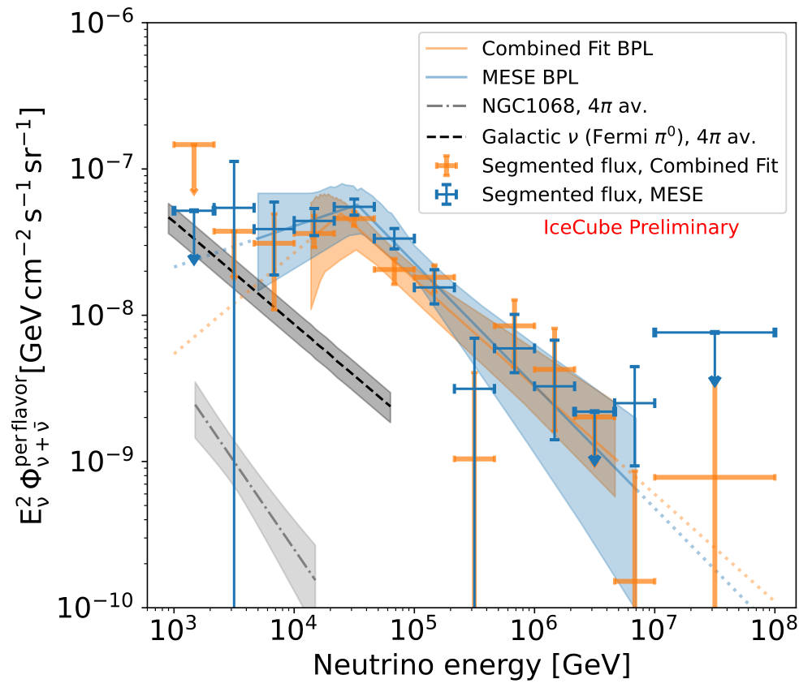
IceCube Fits

Slide 21
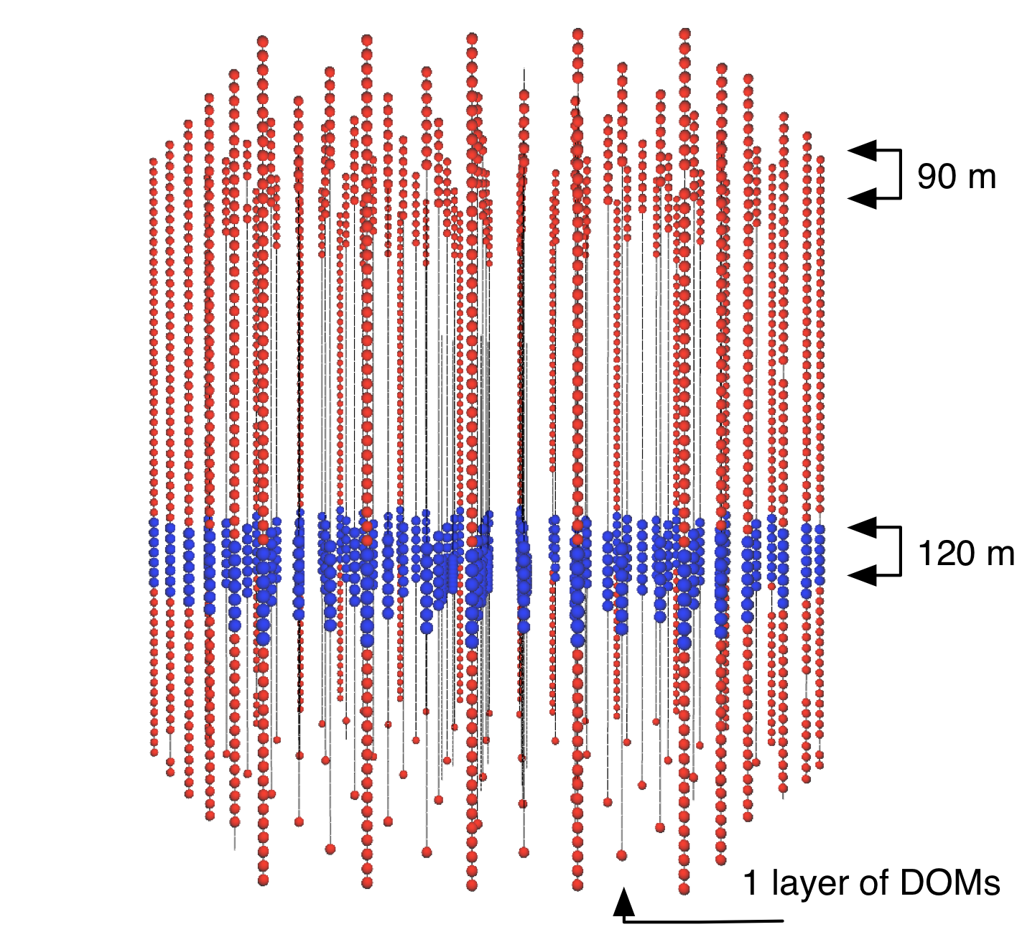
L3: Outer Layer Veto
Outer Layer Veto helps reject events starting outside detector, mostly background muons
Notes:
Show event views emphasizing deposits of typical events t least 6000 PE
MESE events are rejected if any coincident hits are detected in the veto region.
To include the HESE sample, a high energy cut is defined for events which are brighter than a threshold value. Such events are rejected if they deposit at least 3 hits in the veto region

Slide 22
L4: Downgoing Track Veto
Post outer-layer veto, muon background dominated by lower energy muons sneaking through veto layer
Try to associate isolated boundary hits with track hypotheses to veto dim muons
Fitted Track
True Muon Track
Notes:
Rate of muons lower for the cascades-only portion of the event selection Most retained muons are low energy and misreconstructed as upgoing

Slide 23
L5: Fiducial Volume Scaling
Downgoing track veto less efficient as muon energy decreases
For dim events, search for hits closer to the reconstructed vertex
Zenith and morphology dependent cuts

Slide 24
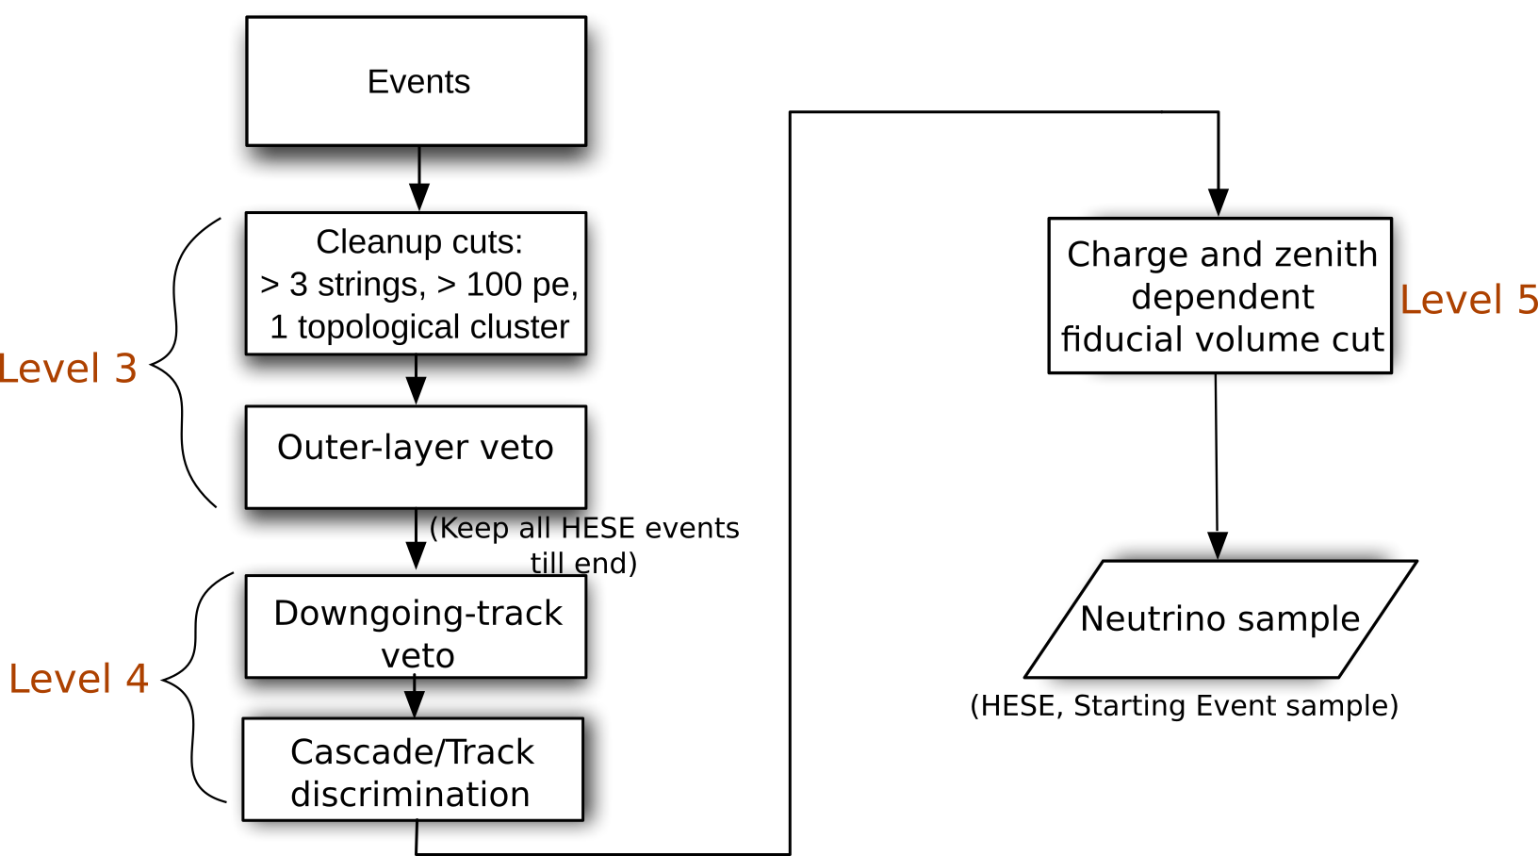
Event Selection
We select starting cascades and starting tracks from the whole sky and with energies above 1 TeV

Slide 25
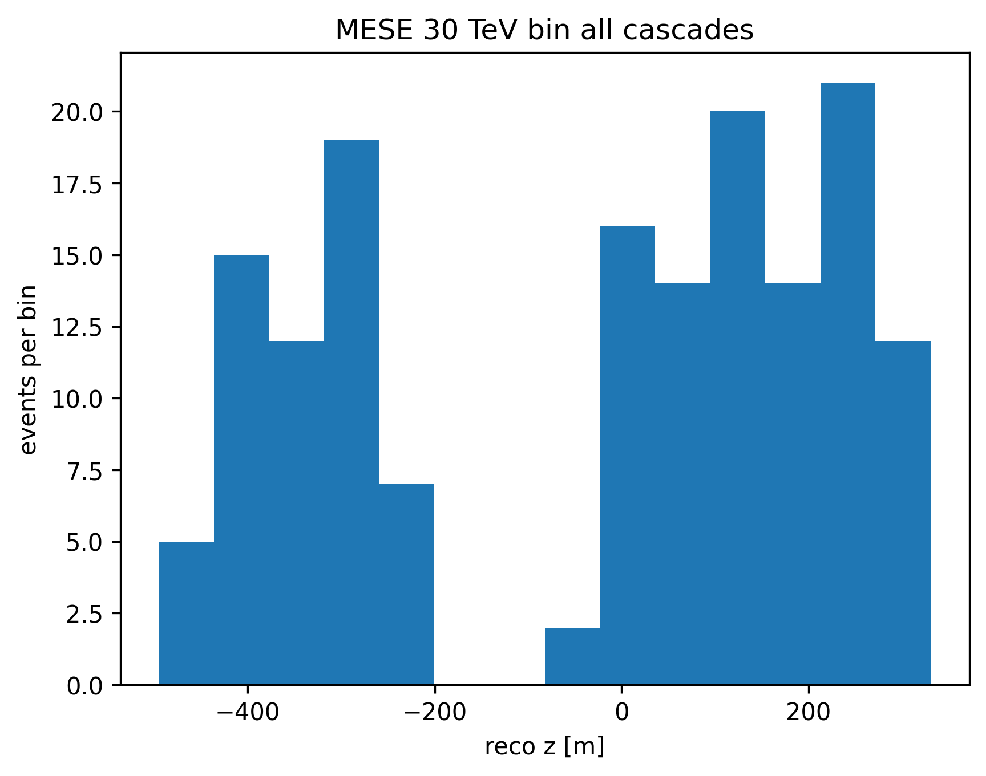
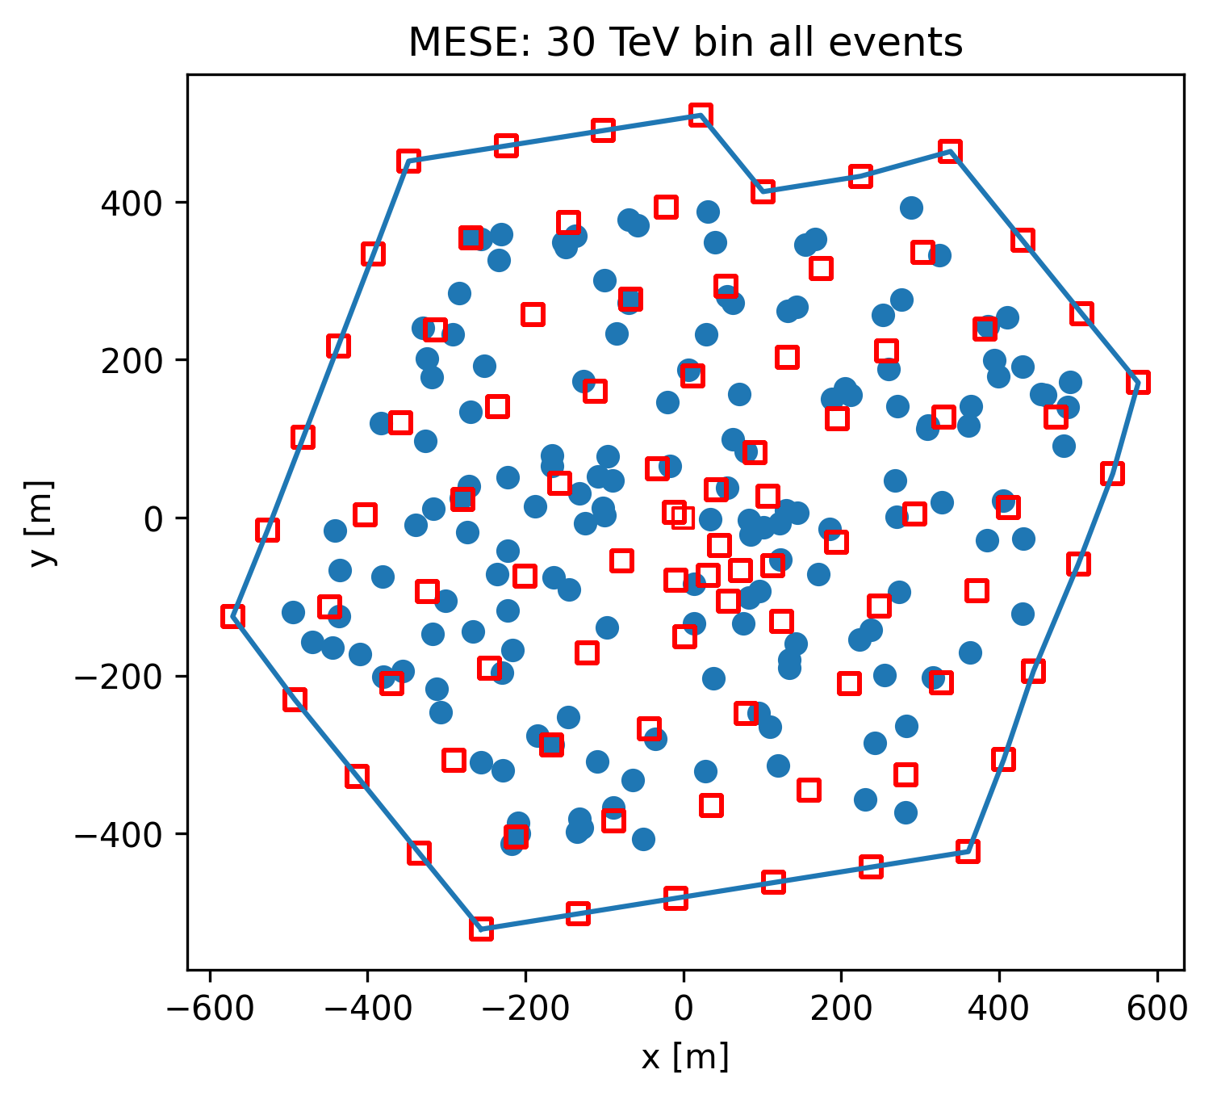
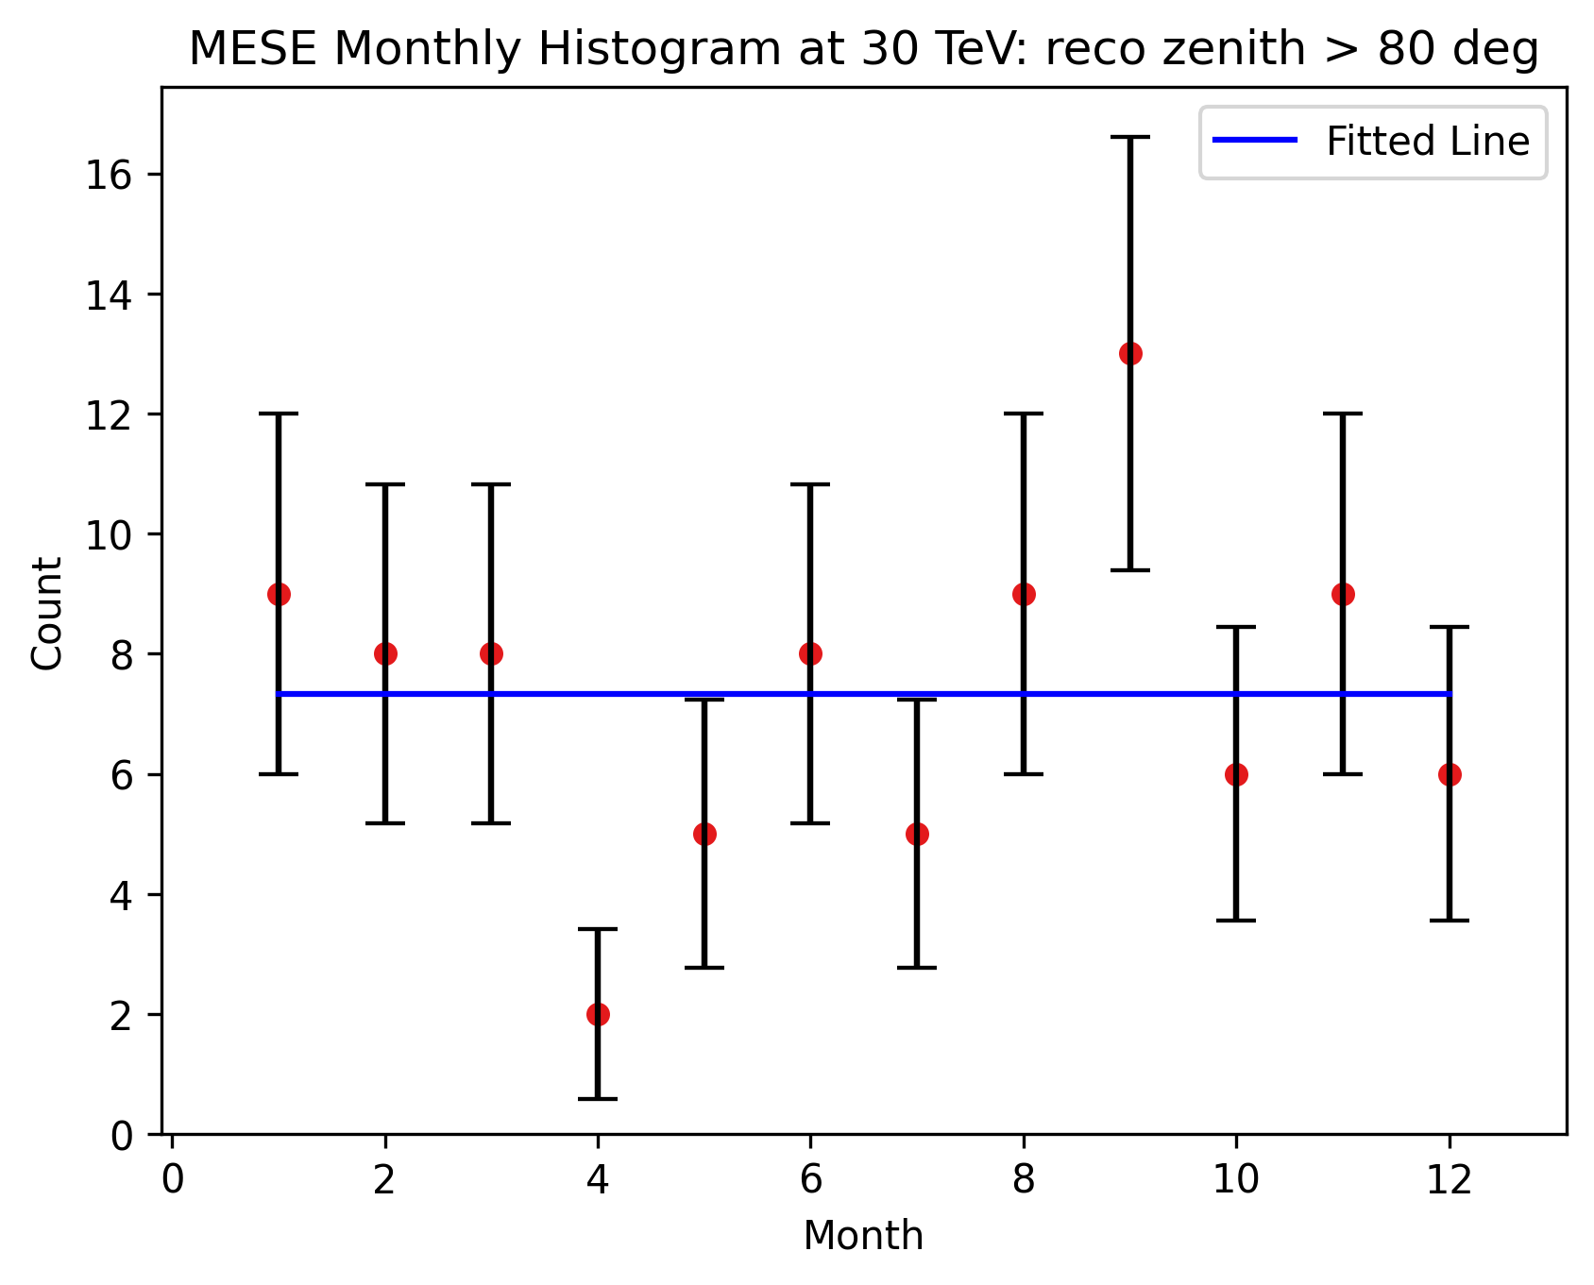

Slide 26
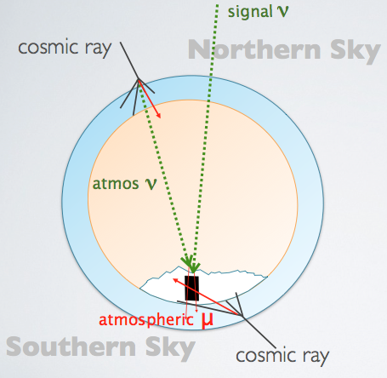
Event Selections
Atmospheric Background
Cascades
Starting Tracks
Throughgoing Tracks
θ
Notes:
An advantage of this approach is that we accept neutrinos from all directions in the sky, and are sensitive to different neutrino flavours

Slide 27
Cosmic Messengers
Fig: J. Aguilar and J. Yang for the IceCube Collaboration
Notes:
Neutral → pointing
Low cross section → not absorbed by intermediate matter Maybe open with this and then go to cosmic rays?

Slide 28
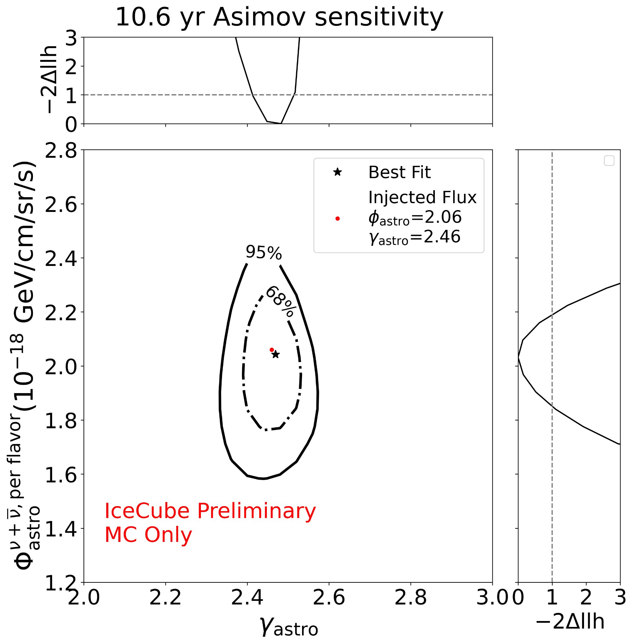
Single Power Law (SPL) Sensitivity
Physics parameters: Assuming Single Power Law Flux (SPL)
Φ_{astro,}γ_{astro}: The normalization and spectral index
Φ_{μ:} : Scaling factor for the atmospheric muon flux assuming GaisserH4a + SIBYLL2.3c
Φ_{conv} ,Φ_{prompt} : Atmospheric neutrino flux normalisation
Systematics modelled using the SnowStorm method (M.G. Aartsen et al JCAP10(2019)048)

Slide 29
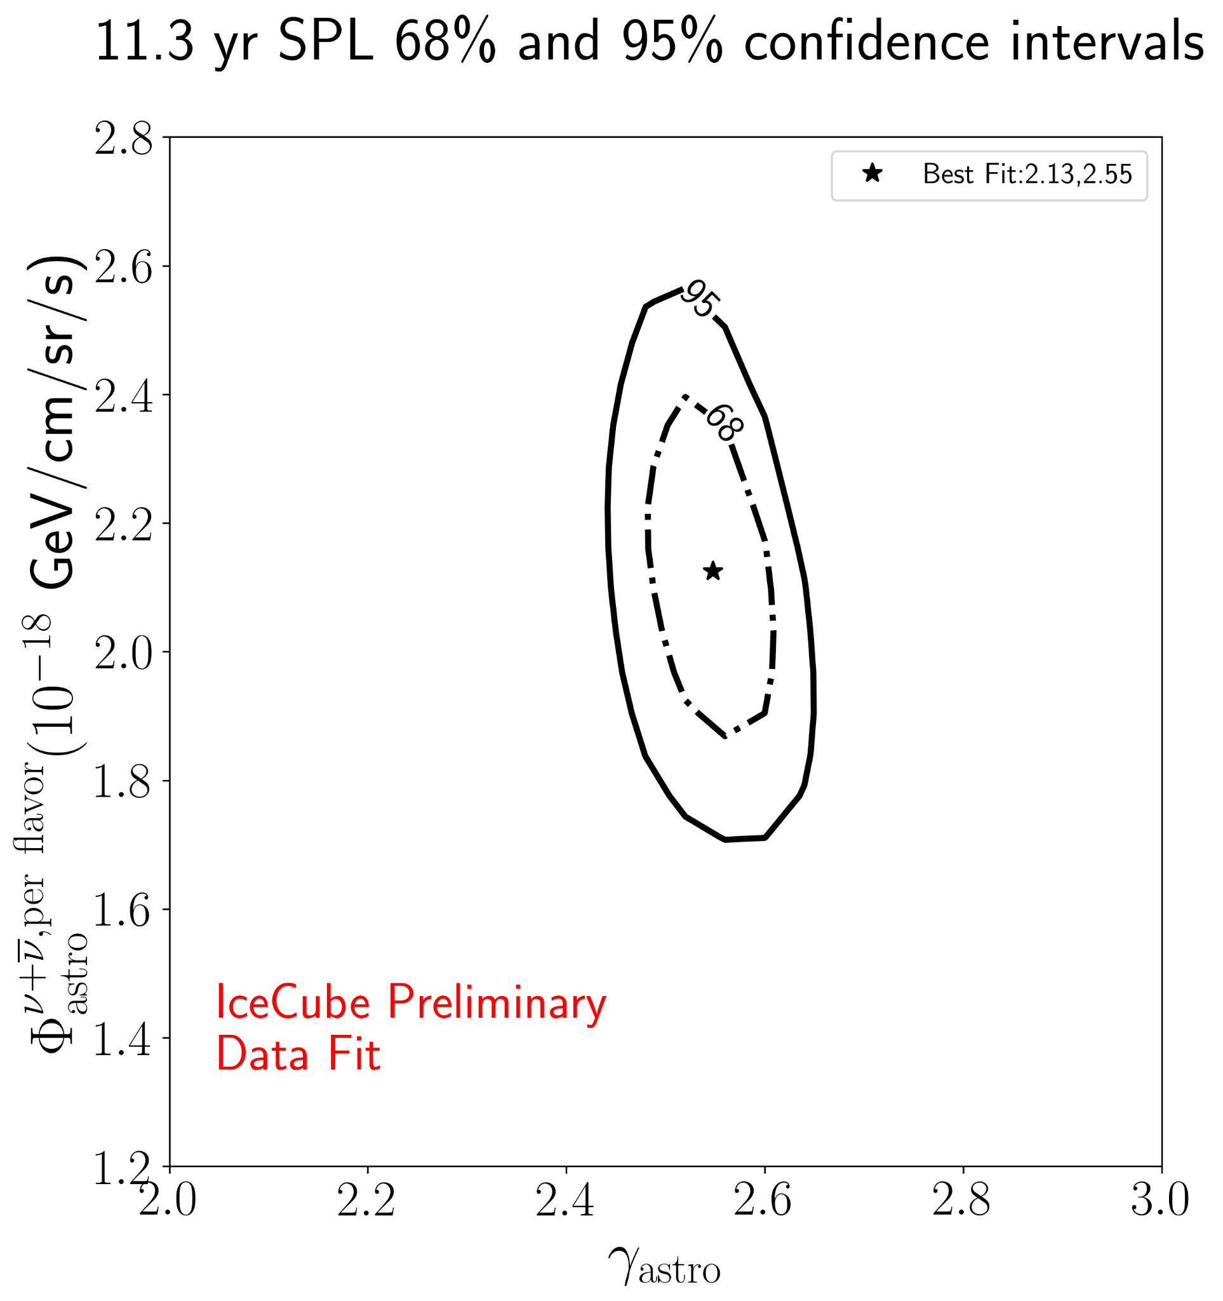
SPL Fit Contour

Slide 30
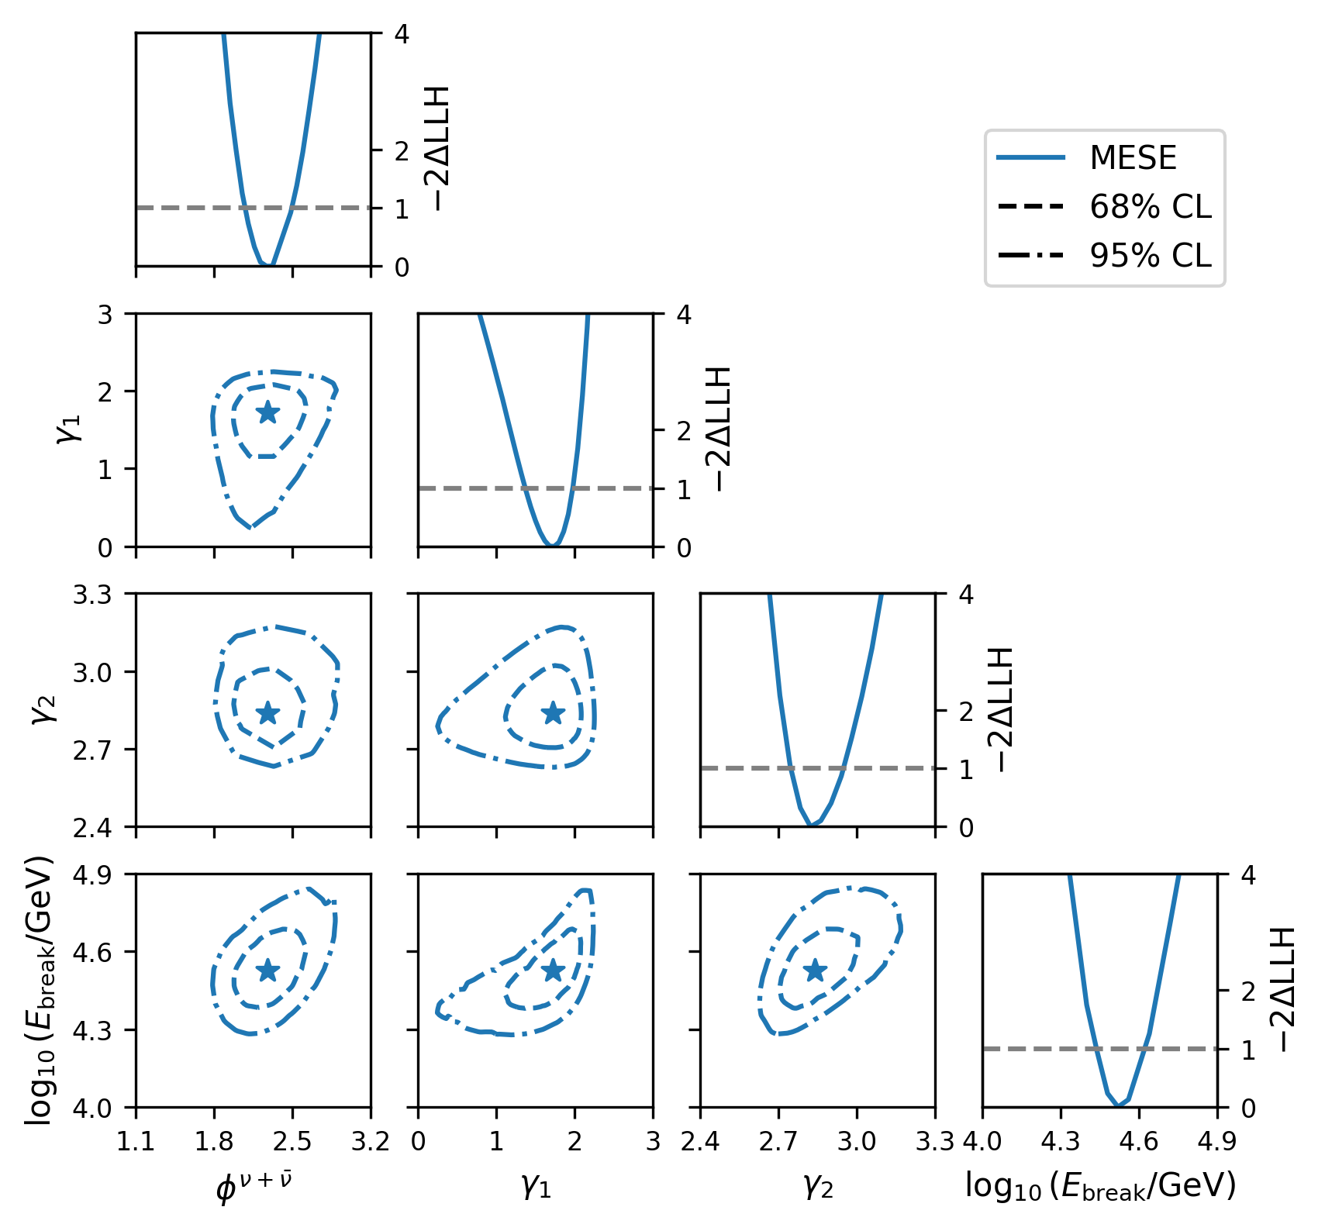
BPL Spectral Indices

Slide 31
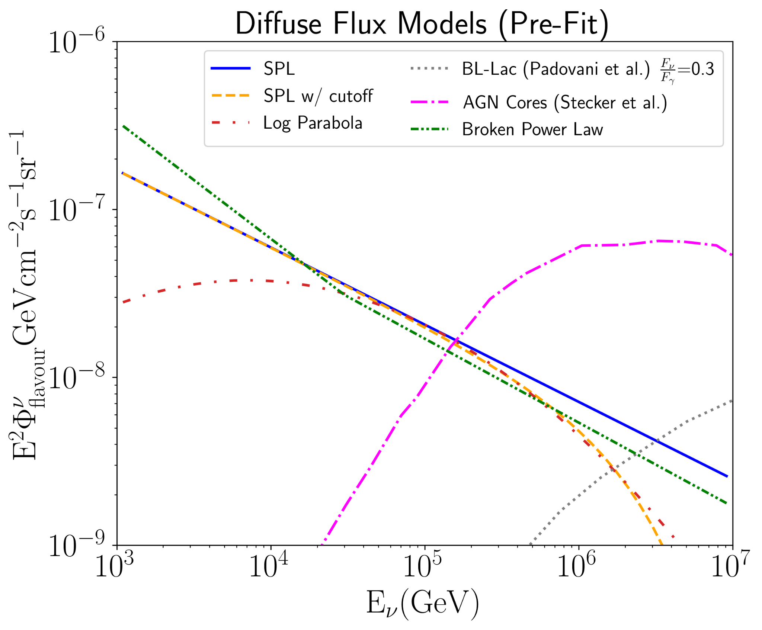
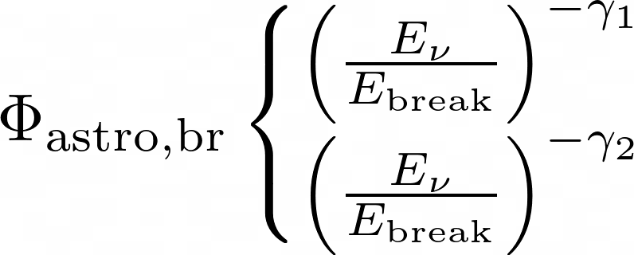
Models tested
Astrophysical Flux Models:
Single Power Law (SPL):
Broken Power Law (BPL):
Log-parabola:
SPL+Cutoff:
AGN core neutrino emission
Neutrino emission from BLLac objects

Slide 32
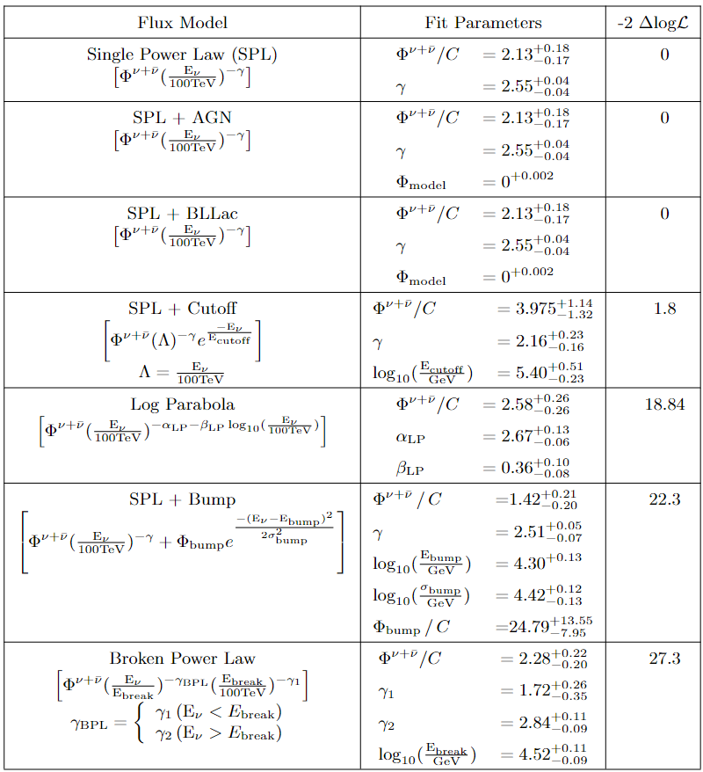
Fit results
Broken Power Law is the best fit model, followed by SPL+ Bump and then Log Parabola flux.
We reject single power law by 4.7σ with MESE

Slide 33
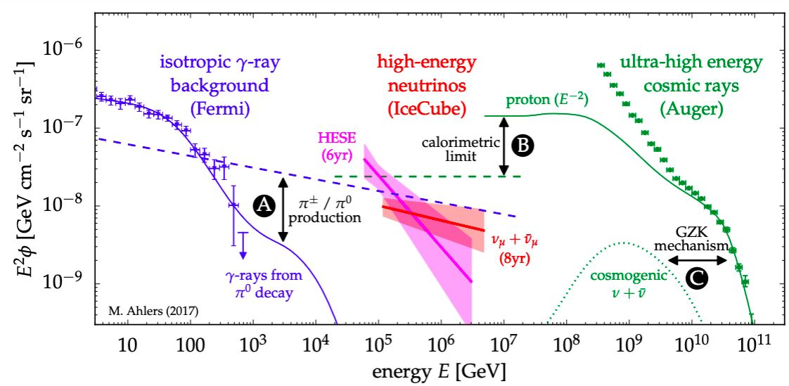
Energy density of high energy neutrinos similar to γ-ray flux, and Ultra High Energy Cosmic Rays (UHECRs) -> could indicate related production mechanisms
Ref: M. Ahlers, and F. Halzen (arXiv:1805.11112, 2018)
Notes:
. For extragalactic scenarios, this gamma-ray emission is not directly observed because of strong absorption of photons by e +e − pair production in the extragalactic background light (EBL) and CMB. The leptons initiate electromagnetic showers of repeated inverse-Compton scattering and pair production in the CMB that eventually yield photons that contribute to the Fermi γ-ray observations in the GeV-TeV range
focus on mismatch in fluxes as we extend to 1 TeV in energy. HESE will technically surpass the calorimetric limit if you extrapolate but the numu analysis doesn’t and unfortunately doesn’t have sensitivity to lower energies. this is why mese is so important.
Calorimetric limit: UHE CR sources can be embedded in environments that act as “storage rooms” for cosmic rays with energies far below the
“ankle” (ECR 1EeV). This energy-dependent trapping can be achieved via cosmic ray diffusion in magnetic fields. While these cosmic rays are trapped, they can produce γ-rays and neutrinos via collisions with gas. If the conditions are right, this mechanism can be so efficient that the
total energy stored in low-energy cosmic rays is converted to that of γ-rays and neutrinos
The same cosmic ray model predicts the emission of cosmogenic neutrinos from the collision with cosmic background photons (GZK mechanism) Talk about production mechanisms, see if this measurement has resulted in a model re-evaluation: https://arxiv.org/pdf/2007.12706.pdf Revisiting AGN as the Source of IceCube’s Diffuse Neutrino Flux Waxmann, ahlers papers
two complementary measurements were performed, don’t say HESE and diffuse NuMu Start with UHECRs, need to be accelerated. Similar energy density to gamma rays and neutrinos

Slide 34
Expected Rates
Astro Flux model: Φ_{astro,}=2.28, γ₁= 1.72, γ₂= 2.84, Log(E_{break}/GeV)= 4.52 (Best Fit Flux Model) Atm. Flux model: GaisserH4a +SIBYLL 2.3
Rates (yr⁻¹) | Astro. ν | Atm. ν | Atm. μ
Cascades | 58.87 | 367.68 | 28.52
Tracks | 12.83 | 412.21 | 21.91
Total | 71.71 | 779.89 | 50.43
Notes:
Rate of muons lower for the cascades-only portion of the event selection Most retained muons are low energy and misreconstructed as upgoing

Slide 35
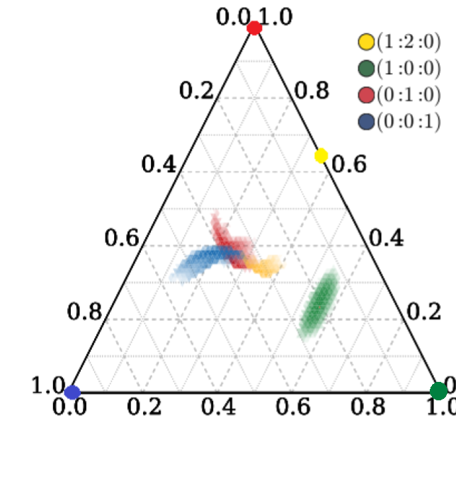
Motivation: Flavour Studies
With tracks, cascades and tau discrimination, we can study the flavour composition of cosmic neutrinos.
These observations help constrain the source production mechanisms and possible new physics
Pion decay
neutron decay
muon-damping
Tau dominated
Fraction of ν_{τ}
Fraction of ν_{μ}
Fraction of ν_{e}
Notes:
C.A. Argüelles, T. Katori, J. Salvado (Phys. Rev. Lett. 115, 161303) Oscillate between lepton flavors as they propagate macroscopic distances. This is due to the fact that the neutrino propagation eigenstates are not the eigenstates of the charged current weak interaction. In presence of a dense medium the decoherent scattering interactions are important [26], but in this paper we assume vacuum propagation
Possible applications for flavour studies, reasons for the band Conditions for each ratio:https://link.springer.com/article/10.1140/epjc/s10052-019-7018-7

Slide 36
Expected Rates
Astro Flux model: Φ_{astro,}=2.06, γ_{astro}= 2.46 (from 2-year MESE analysis) Atm. Flux model: GaisserH4a +SIBYLL 2.3
Rates (yr⁻¹) | Astro. ν | Atm. ν | Atm. μ
Cascades | 80.2 | 321.1 | 24.3
Tracks | 15.05 | 323.2 | 16.6
Total | 95.25 | 644.3 | 40.9
Notes:
Rate of muons lower for the cascades-only portion of the event selection Most retained muons are low energy and misreconstructed as upgoing

Slide 37
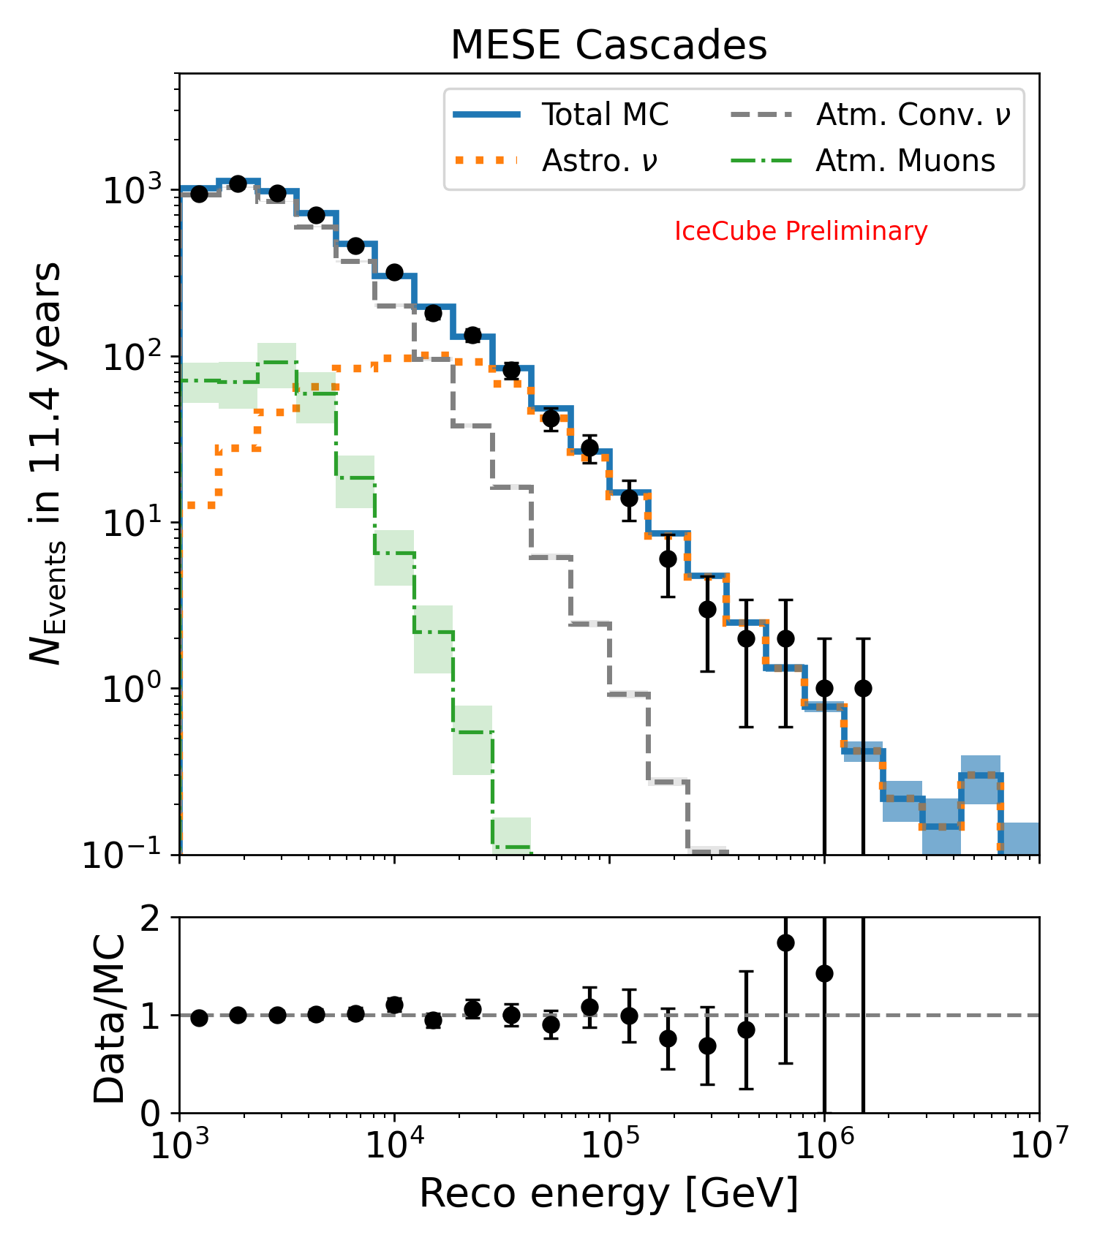
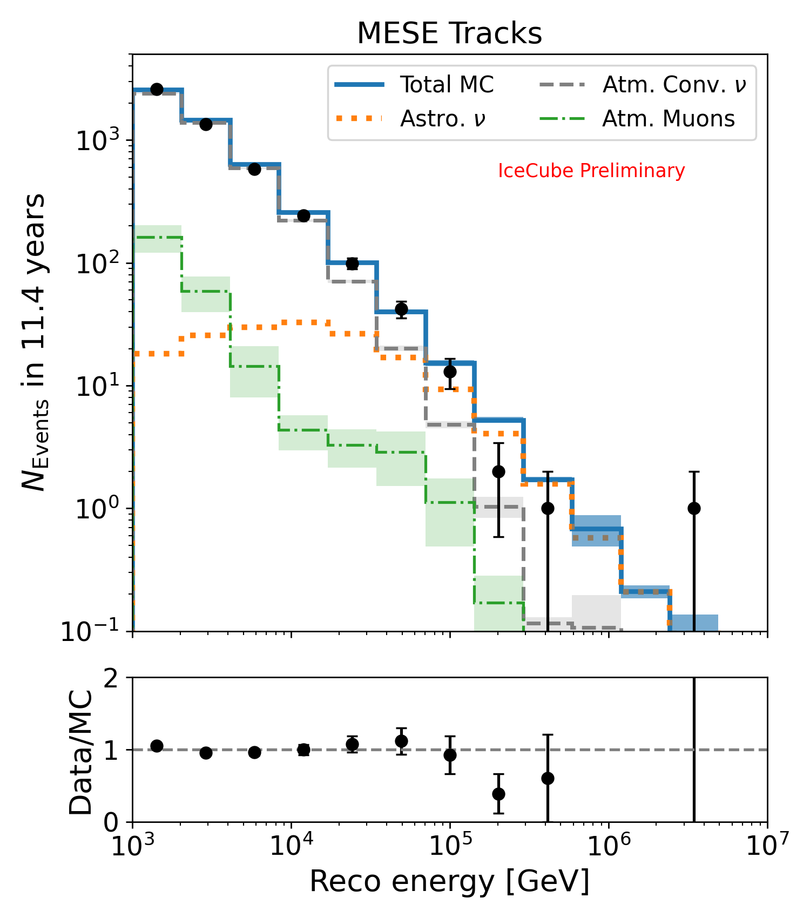
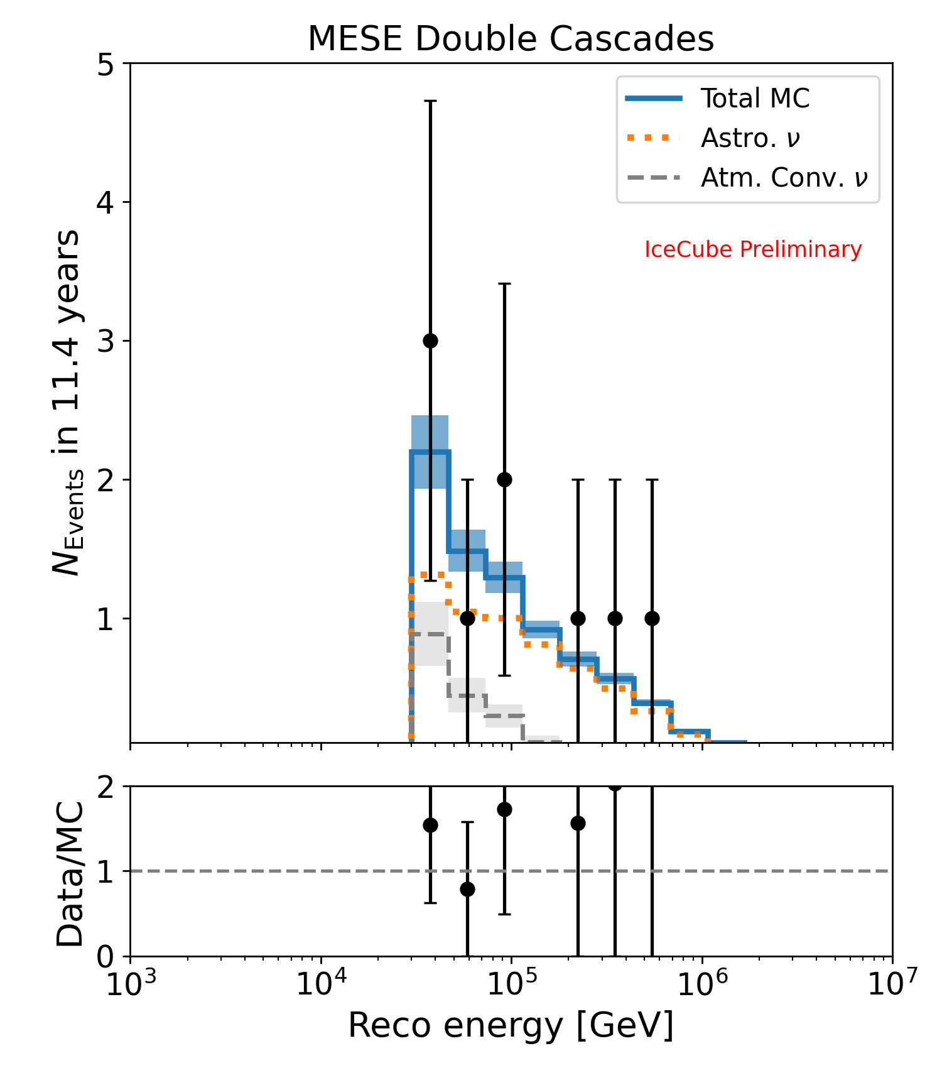
Energy distributions
Selected 4960 cascades, 4919 tracks and 9 double cascades
MC expectations with best fit BPL model
Shown here: distributions for the flavor measurement*
*cascade and track distributions for spectral measurement looks similar

