Slide 1
Disruption of Dark Matter Minihalos by Successive Stellar Encounters
Ian DSouza
University of Canterbury
PhD advisor: Dr. Chris Gordon
Collaboration with Dr. John Forbes
PHYSICAL REVIEW D 109, 123035 (2024)
+ Ongoing work

Slide 2
Axion Minihalo
QCD axions solve the Strong CP problem and are a candidate for cold dark matter.
During the matter-radiation equality, isocurvature axion density fluctuations decouple from Hubble flow and collapse to form a virialized gravitational structure called the axion minihalo.
Primordial axion minihalos undergo hierarchical merging.
Axion minihalos can affect the chances for direct dark matter detection.

Slide 3
Axion minihalos – NFW Profile
Simulations show that the minihalos have a spherically symmetric Navarro–Frenk–White (NFW) density profile: $ρ(r)=\frac{ρ_{s}}{(r/r_{s}{)\left(1+r/r_{s}\right)}^{2}}$
$ρ_{s}$ is the scale density and $r_{s}$ is the scale radius.
Concentration parameter is defined as $c≡r_{\text{vir} }/r_{s}$ .

Slide 4
Model of mass disruption due to stellar encounters
Kavanagh et al. (PRD 104, 063038) (K2021) proposed an analytical model of mass loss using the phase-space distribution of axions in the minihalo.
Our improvements:
Sequential stripping model: Outer shells are stripped off first before an inner shell is stripped off. This affects the gravitational potential of each axion.
After stellar interaction, the remnant minihalo is assumed (based on numerical simulations) to gravitationally relax into a Hernquist density profile:
$$ρ(r)=\frac{ρ_{1}}{(r/r_{1}){\left(1+r/r_{1}\right)}^{3}}$$

Slide 5
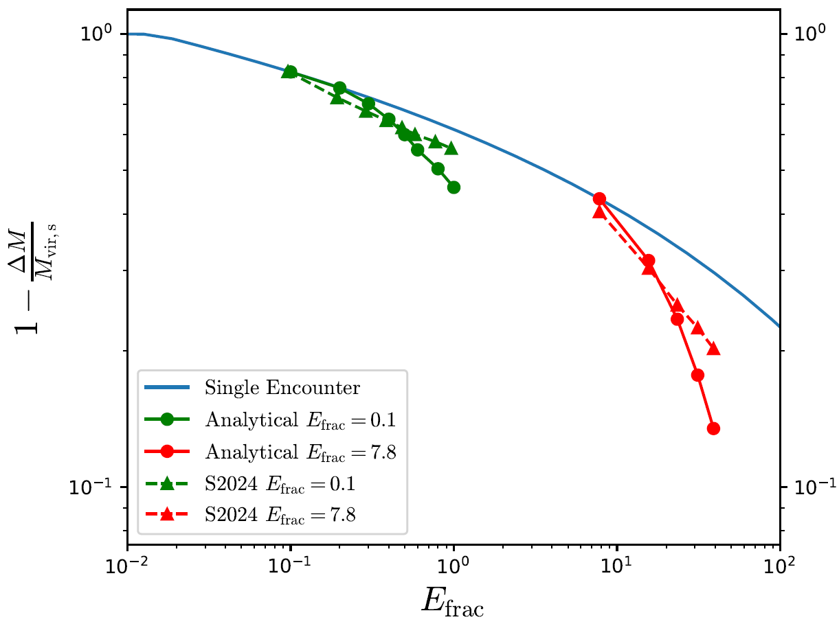
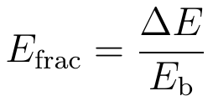
Successive Stellar Encounters
Shen et al - APJ 962:9 (25pp) – (S2024)

Slide 6
Code to Evolve Minihalo Trajectory
lbparticles is a Python implementation of an epicyclic orbit solver proposed by Lynden-Bell (2015) for bound orbits in a spherically symmetric potential.
Given the initial state (position and velocity) of the minihalo, and a known potential, lbparticles derives a set of coefficients that can be used to evaluate the minihalo’s state at an arbitrary time in the future.

Slide 7
Energy injection during a disk pass
For a single disk pass, the energy injection parameter is (S2024):
is the stellar surface density for one disk pass.

Slide 8
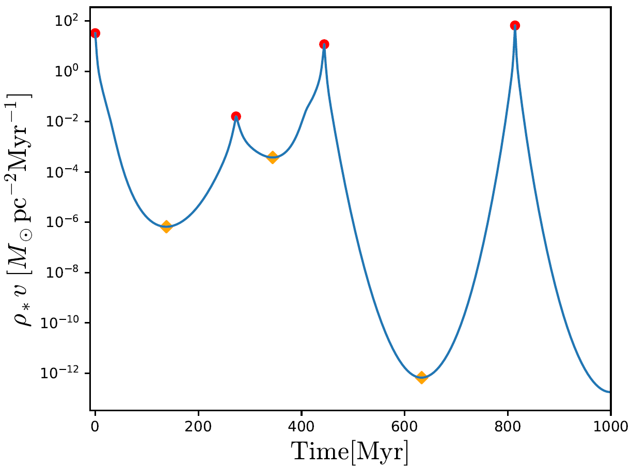
Energy injection during a disk pass
- stellar volume density
- central surface density
- scale height
- scale length
McMillan (2011) – MNRAS 414, 2446–2457

Slide 9
Effective energy injection
Stücker et al. proposed a formula for effective energy injection in the multiple disk passes:
S2024 assumed p=2. They did not take into account the density profile changes in the minihalo, in between disk passes.
Given enough time for relaxation in between disk passes, we found that p~1. Thus, multiple disk passes incur more mass loss (higher E_{frac,eff}) than simply adding the energy injection parameters. A qualitatively similar result was reported by Delos (2019).

Slide 10
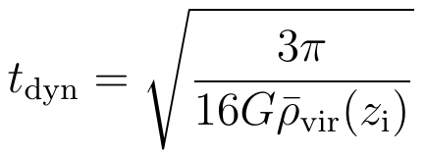
Summing energy injection for multiple disk passes
Time scale of relaxation (post-encounter) for a minihalo is called the dynamical time:
If time between consecutive disk passes < dynamical time, energy injection parameters are added up linearly (p=2):
If time between consecutive disk passes > dynamical time, energy injection parameters are added non-linearly (p=1):

Slide 11
Mass today after stellar disruption
To find the mass contained in minihalos in the Milky Way galaxy:
We compute the mass in minihalos both in the presence of stellar disruption (M_{surv}) and separately without considering stellar disruption (M_{ori}). We compute the percentage of minihalo mass that survives today as:
S2024 finds this value ~ 58%
Our result ~ 30%

Slide 12
Conclusion
We improved upon the K2021 analytical model by introducing the sequential stripping method, and minihalo relaxation.
We explored successive encounters and found the mass loss is more severe than simply adding up the energy injection parameters, given enough time for minihalo relaxation.
We developed a new code to evolve the minihalo orbit.
We compared the time between consecutive stellar disk passes to the dynamical time, to more accurately add energy injection parameters.
We found that the percentage of minihalo mass that survives today is significantly smaller than that reported in the literature.

Slide 14
Mass Function of Minihalos
Primordial adiabatic perturbations of axion collapse to form large adiabatic halos which become hosts to galaxies.
For a population of minihalos, the mass function tells us the number density of minihalos in a unit mass interval (S2024, Xiao et al - PRD 104, 023515).
adiabatic
isocurvature

Slide 15
m_\kappa is the characteristic mass of the most effective disruptor. It is derived from the present-day stellar mass function.
It is unlikely that we would be inside a minihalo. So, lower the value of M_{surv}/M_{ori}(> 1e-12 MSolar), the more likely that dark matter will be detected in direct detection experiments because the mass that has been disrupted ends up becoming part of the background dark matter density.

Slide 16
Compare to K2021

Slide 17
Compare to S2024

