Slide 1
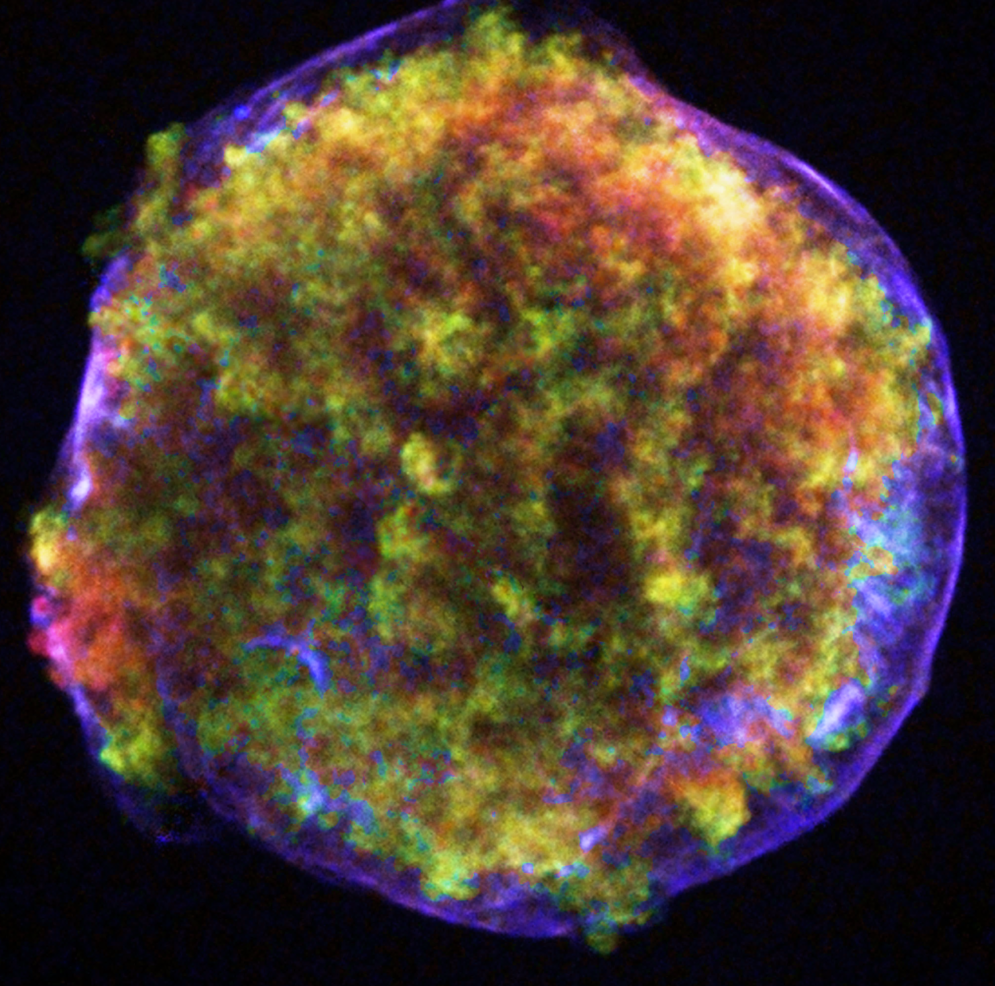
From microphysical theory to multi-messenger observations:
a semi-analytic approach to COSMIC RAY acceleration
Rebecca Diesing
TeVPA | August 27, 2024

Slide 2

The Standard paradigm of SHOCK acceleration
Protons and electrons are accelerated via diffusive shock acceleration (DSA).*
u₂
u₁
Downstream (ρ₂)
Upstream (ρ₁)
For strong shocks, R = 4.
*Fermi54, Krymskii77, Axford+77, Bell78, Blandford+78

Slide 3
The Standard paradigm of galactic CR acceleration
DSA predicts power law distributions of particles.*
For strong shocks, q = 2.
*Fermi54, Krymskii77, Axford+77, Bell78, Blandford+78

Slide 4
The Standard paradigm of SHOCK acceleration

Slide 5
The problem with DSA
Observations point toward CR acceleration with spectra steeper than E⁻² (i.e., q > 2).

Slide 6
The problem with DSA
Observations point toward CR acceleration with spectra steeper than E⁻² (i.e., q > 2).
ɣ-ray emission from Galactic SNRs suggest 2.2 ≲ q ≲ 2.6.
  e.g., Caprioli11, Giordano+12, Saha+14, Aharonian+19

Slide 7
The problem with DSA
Observations point toward CR acceleration with spectra steeper than E⁻² (i.e., q > 2).
ɣ-ray emission from Galactic SNRs suggest 2.2 ≲ q ≲ 2.6.
  e.g., Caprioli11, Giordano+12, Saha+14, Aharonian+19
Radio emission from young extragalactic SNe (radio SNe) suggest q ≈ 3.
  e.g., Chevalier+06, Chevalier+17, Soderberg+10, Soderberg+12, Kamble+16, Terreran+19

Slide 8
The problem with DSA
Observations point toward CR acceleration with spectra steeper than E⁻² (i.e., q > 2).
ɣ-ray emission from Galactic SNRs suggest 2.2 ≲ q ≲ 2.6.
  e.g., Caprioli11, Giordano+12, Saha+14, Aharonian+19
Radio emission from young extragalactic SNe (radio SNe) suggest q ≈ 3.
  e.g., Chevalier+06, Chevalier+17, Soderberg+10, Soderberg+12, Kamble+16, Terreran+19
Observations of Galactic CRs require 2.3 ≲ q ≲ 2.4.
  e.g., Evoli+19

Slide 9
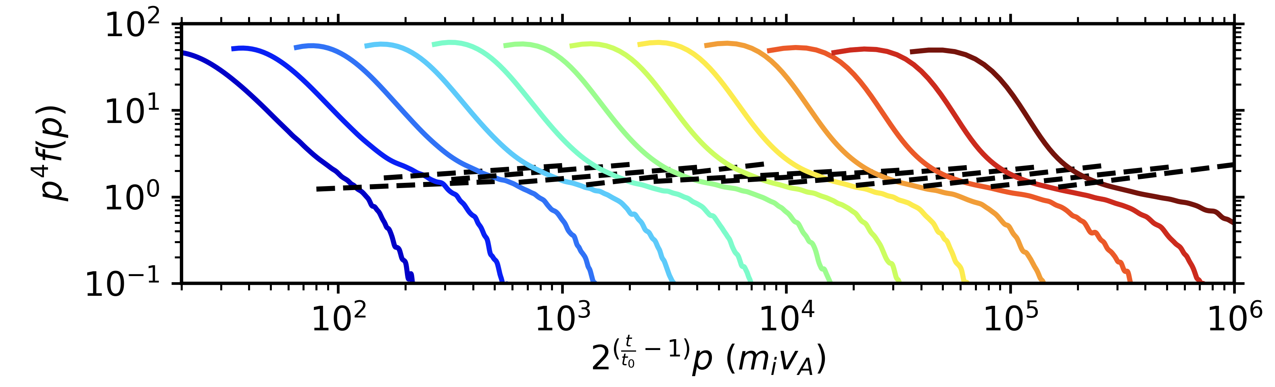
Steep spectra in simulations
Kinetic simulations performed in Haggerty+20 and Caprioli+20 naturally reproduce steep spectra.
Caprioli+20
Simulated particle spectra (color scale denotes time)
Nonlinear DSA prediction

Slide 10
the “postcursor”
Magnetic fluctuations generated by cosmic rays (CRs) in the upstream retain their inertia over a non-negligible distance when advected into the downstream.
ũ₂ = u₂ + v_{A, 2}
u₁
Fluctuations drift at the local Alfvén speed relative to the plasma.

Slide 11
the “postcursor”
Magnetic fluctuations generated by cosmic rays (CRs) in the upstream retain their inertia over a non-negligible distance when advected into the downstream.
ũ₂ = u₂ + v_{A, 2}
u₁
Fluctuations drift at the local Alfvén speed relative to the plasma.
CRs isotropize these magnetic fluctuations → a postcursor of drifting magnetic fluctuations and CRs enhances escape from the acceleration region, raising the fluid compression ratio while steepening the CR spectrum.

Slide 12
Modeling CR acceleration
Calculate the CR proton spectrum by solving the Parker transport equation.
Assume a fraction η of particles crossing the shock are injected into DSA.
Advection
Diffusion
Adiabatic compression
Injection
Notes:
Rewrite injection assumption as eta
”We span efficient and inefficient shocks”
Parameterizing the fraction of particles that become CRs

Slide 13
Modeling CR acceleration
Calculate the CR proton spectrum by solving the Parker transport equation.
To include a postcursor, we consider ũ(x), the velocity of magnetic scattering centers.
Advection
Diffusion
Adiabatic compression
Injection
Notes:
Specifically, we solve the Parker equation for the transport of CRs, which includes terms for advection, diffusion, adiabatic compression and injection.
To include the effect of the postcursor, we consider tilde u(x), the velocity of magnetic scattering centers, rather than the fluid velocity.
Higher order terms can make spectra steeper (Bell+11)

Slide 14
Modeling CR acceleration
Use a semi-analytic model of non-linear DSA which self-consistently accounts for particle acceleration and magnetic field amplification.
P_{CR}(x)
Solve a transport equation for magnetic turbulence.
See also Amato+06, Caprioli+10; Caprioli12.

Slide 15
Modeling CR acceleration
Use a semi-analytic model of non-linear DSA which self-consistently accounts for particle acceleration and magnetic field amplification.
P_{CR}(x)
Solve a transport equation for magnetic turbulence.
P_{CR}(x) + P_{B}(x)
Solve equations for conservation of mass, energy, and momentum.
See also Amato+06, Caprioli+10; Caprioli12.

Slide 16
Modeling CR acceleration
Use a semi-analytic model of non-linear DSA which self-consistently accounts for particle acceleration and magnetic field amplification.
P_{CR}(x)
Solve a transport equation for nonthermal particles.
Solve a transport equation for magnetic turbulence.
u(x)
P_{CR}(x) + P_{B}(x)
Solve equations for conservation of mass, energy, and momentum.
See also Amato+06, Caprioli+10; Caprioli12.

Slide 17
Modeling CR acceleration
Use a semi-analytic model of non-linear DSA which self-consistently accounts for particle acceleration and magnetic field amplification.
P_{CR}(x)
Solve a transport equation for nonthermal particles.
Solve a transport equation for magnetic turbulence.
This model calculates the instantaneous proton spectrum, f(x,p), at each timestep. These spectra can be converted to electron spectra and weighted to account for energy losses.
u(x)
P_{CR}(x) + P_{B}(x)
Solve equations for conservation of mass, energy, and momentum.
See also Amato+06, Caprioli+10; Caprioli12.

Slide 18
Magnetic field amplification
We model magnetic field amplification by assuming contributions from both the resonant streaming instability* and the non-resonant (Bell) instability.**
P_{CR}(x
Solve a transport equation for nonthermal particles.
Solve the transport equation for magnetic turbulence.
For fast shocks characteristic of SNRs, the Bell instability dominates
u(x)
P_{CR}(x) + P_{B}(x)
Solve equations for conservation of mass, energy, and momentum.
*e.g., Kulsrud+69, Skilling75, Bell78, Lagage+83; **Bell04

Slide 19
Magnetic field amplification
We model magnetic field amplification by assuming contributions from both the resonant streaming instability* and the non-resonant (Bell) instability.**
P_{CR}(x
Solve a transport equation for nonthermal particles.
Solve the transport equation for magnetic turbulence.
For fast shocks characteristic of SNRs, the Bell instability dominates
u(x)
P_{CR}(x) + P_{B}(x)
Solve equations for conservation of mass, energy, and momentum.
fast shocks → steep spectra
*e.g., Kulsrud+69, Skilling75, Bell78, Lagage+83; **Bell04

Slide 20
A Typical Proton Spectrum
Diesing+21
For a Tycho-like SNR with an initial energy of 10⁵¹ erg injecting 1 M☉ into a medium with particle density 1 cm⁻³, we reproduce spectra that are consistently steeper than E⁻².
q = 2.34

Slide 21
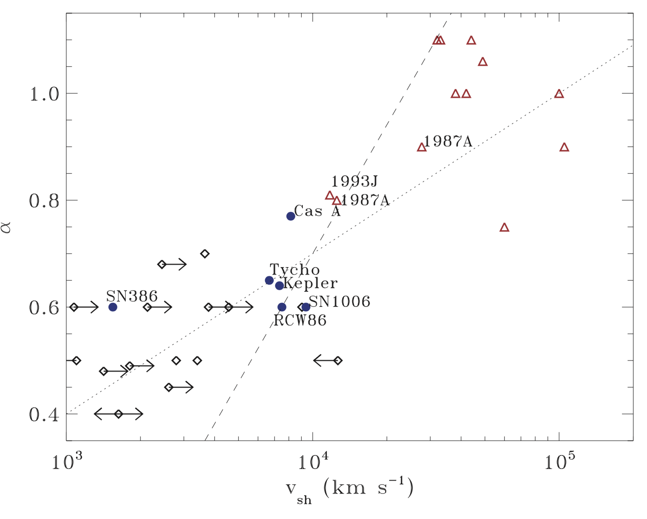
RADIO Supernovae
q = 3
Modeled Radio SN
Young, fast supernovae are inferred to have very steep spectra (q ~ 3).*
Our toy-model radio supernova (i.e., a young, fast SNR expanding into a dense wind) yields a spectrum ∝ E⁻³, consistent with observations.*
*e.g., Chevalier+06, Chevalier+17, Soderberg+10, Soderberg+12, Bell+11 Kamble+16, Terreran+19
q = 2
Bell+11
Notes:
Add point to this based on radio Sne result

Slide 22
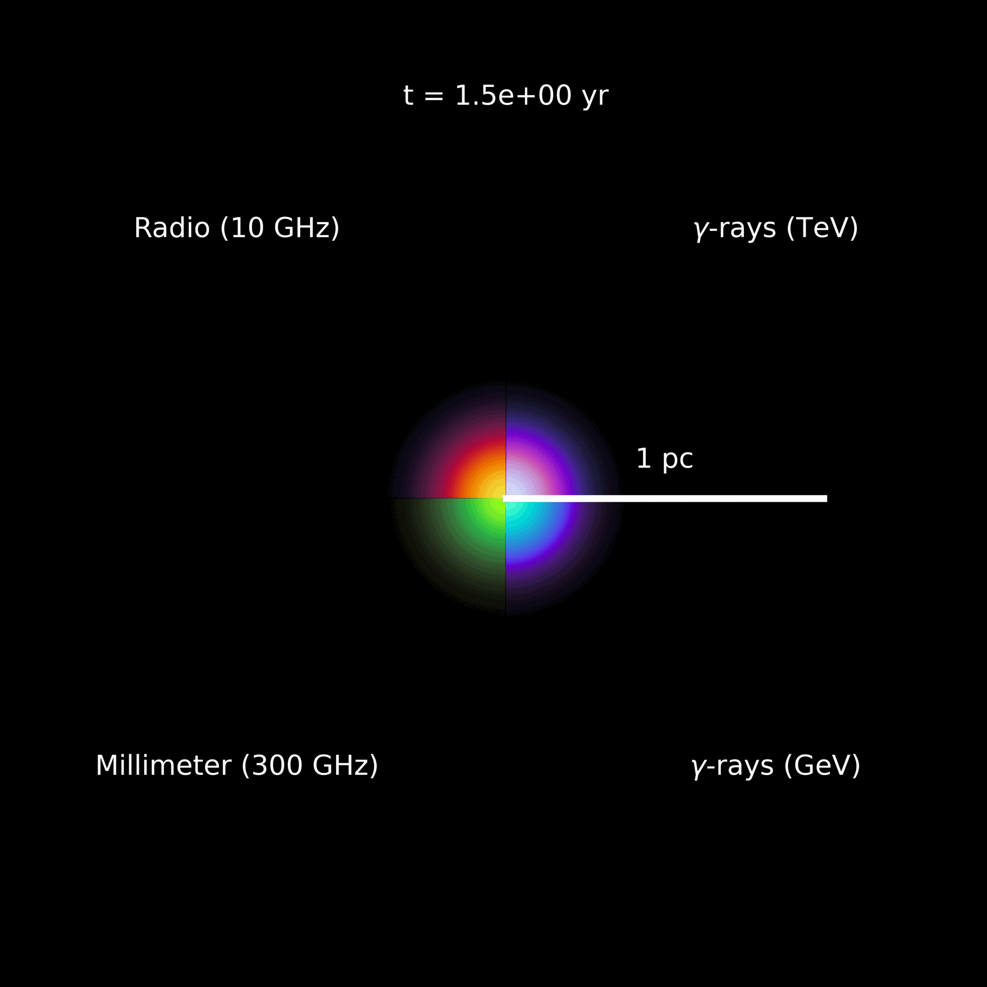
From Particle Acceleration to Multi-Wavelength Emission

Slide 23
Radiative supernova remnants
Hydrodynamic models predict the formation of a dense shell near the end of an SNR’s life (after a few tens of thousands of years). This shell formation gives rise to observable nonthermal signatures, including a significant rebrightening.
Diesing+24 (in review)
Without shell formation
With shell formation

Slide 24
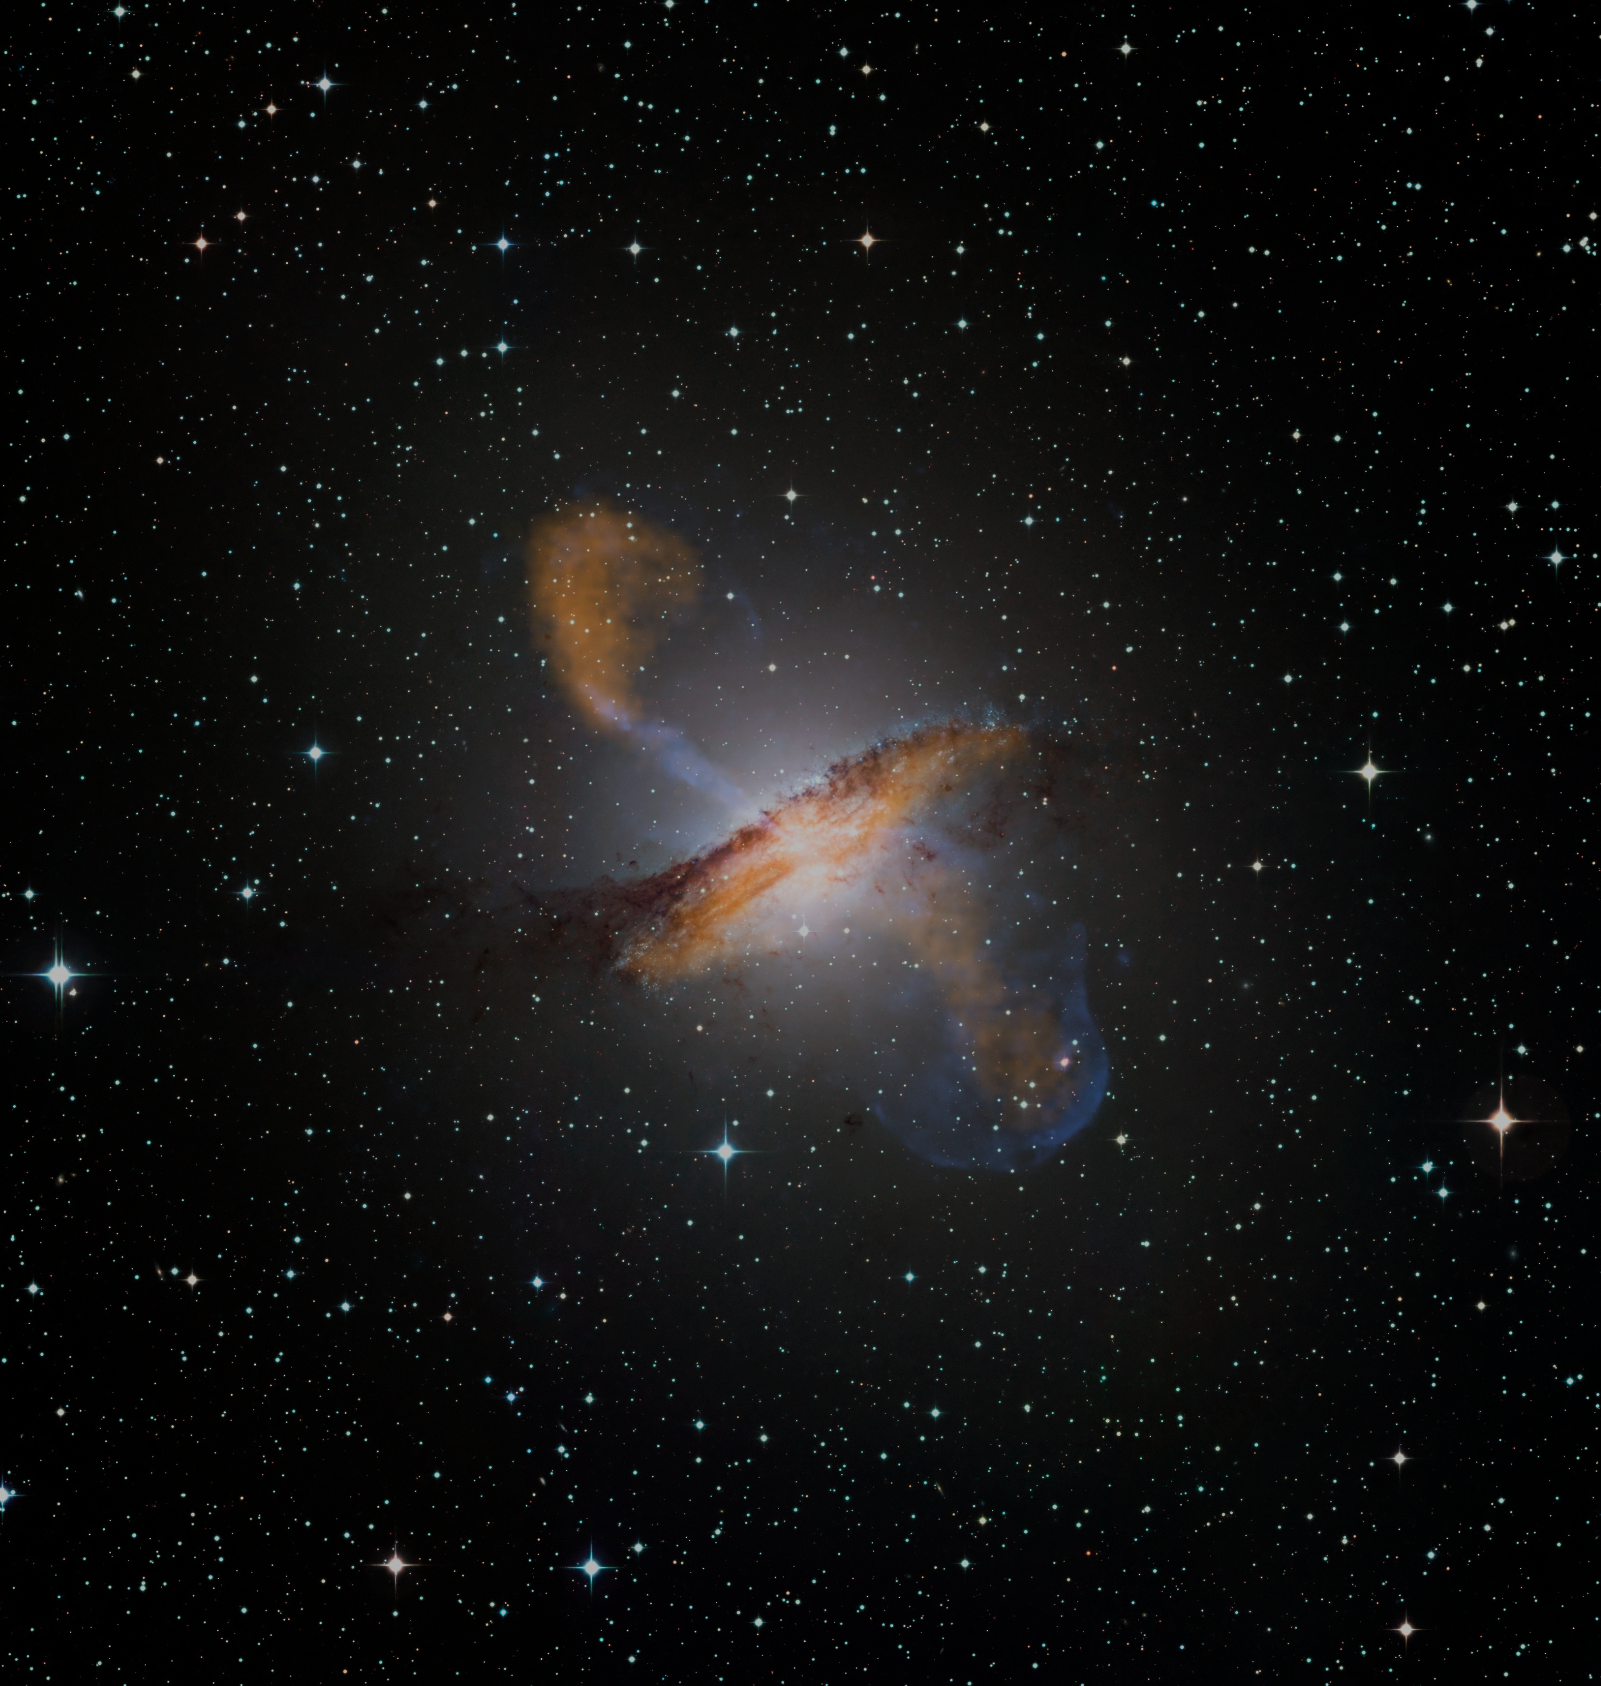


AGN Winds
Fermi-LAT detected ɣ-rays from a stacked sample of AGN winds (Fermi-LAT collab.+Diesing+21). These outflows may also be a source of neutrinos.
Hot bubble
p (CR)
π₀
$$\text{ɣ}$$
$$\text{ɣ}$$
Credit: ESO/WFI; MPFIR/ESO/APEX/A. Weiss et al. ; NASA/CXC/CFA/R. Kraft et al.

Slide 25
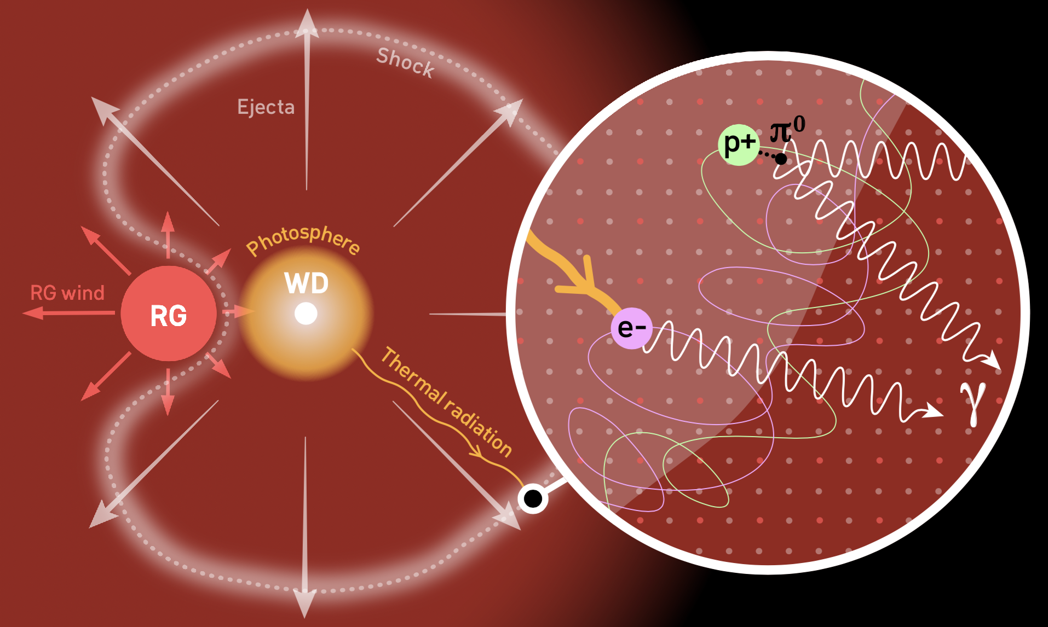
NOVAE
A self-consistent model for particle acceleration requires multiple shock components to fit the gamma-ray data from RS Ophiuchi.
Diesing+23
Credit: MAGIC22

Slide 26

SUMMARY
  We developed a fast, multi-zone framework for particle acceleration, including microphysical effects such as magnetic field amplification and shock modification.
  The inclusion of these effects (e.g., the postcursor) may resolve key tensions between theory and observations.
  Proper modeling of cosmic ray acceleration can reveal the evolution and environments surrounding supernova remnants, novae, winds blown by supermassive black holes, and more.

