Slide 1

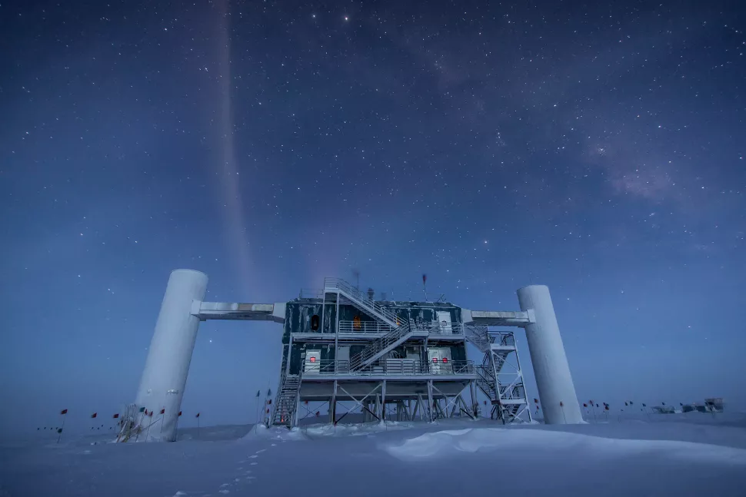


IceCube searches for neutrinos from gravitational wave sources
Justin Vandenbroucke (UW – Madison)
for the IceCube Collaboration
TeVPA, August 27, 2024

Slide 2
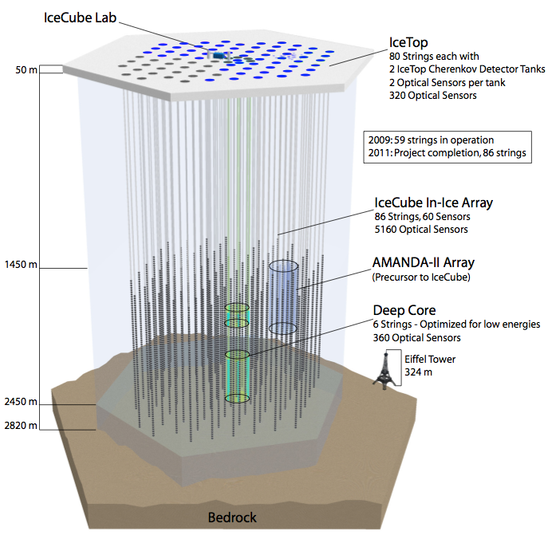
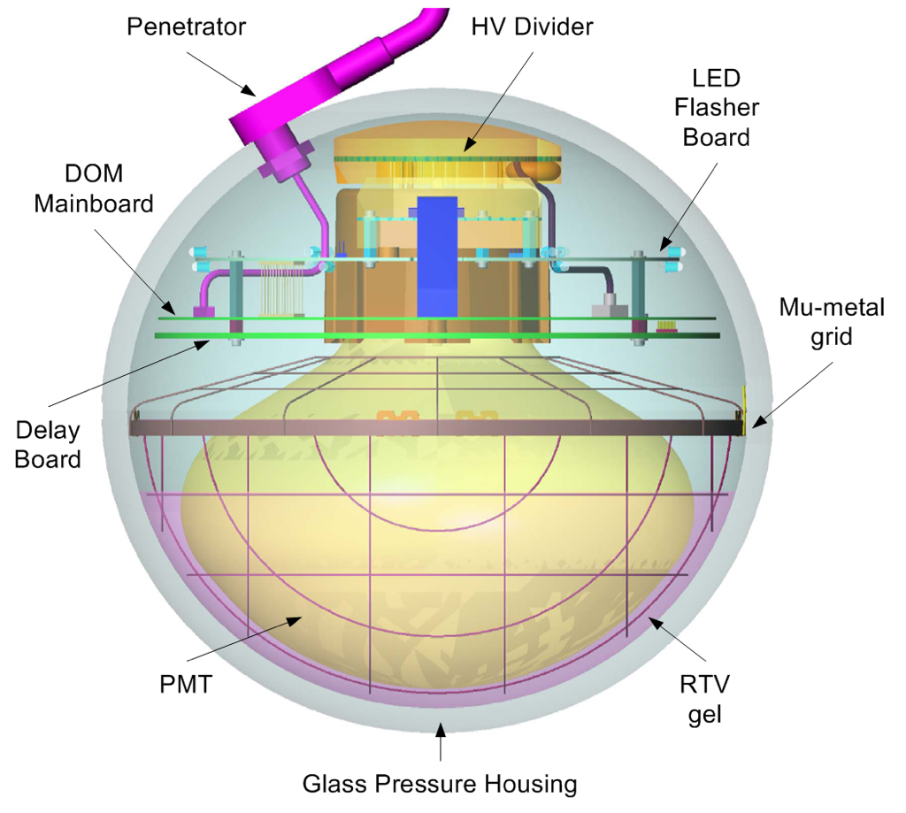
The IceCube Neutrino Observatory
Sensitive to neutrinos at MeV, GeV, TeV, PeV, EeV scales
>99% up time
Full sky (both hemispheres) capability
Better sensitivity in North than South (at TeV scale)
Tracks and cascades

Slide 3
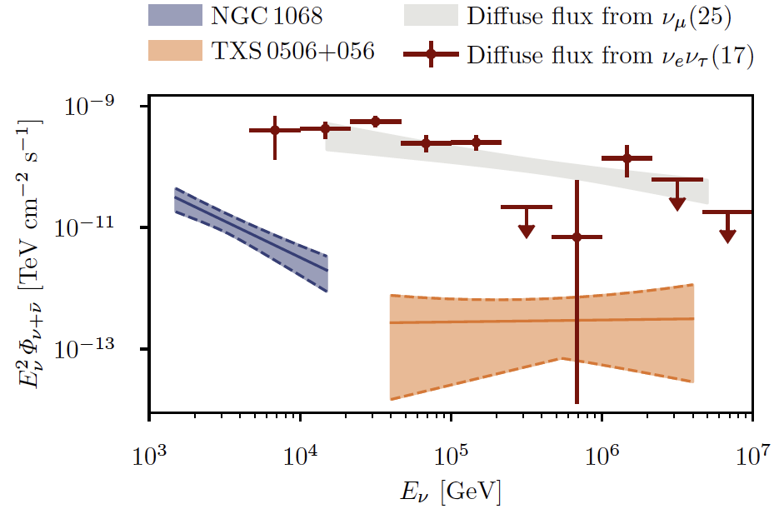
Extragalactic neutrinos in a nutshell
(1) discovery of a bright extragalactic neutrino signal, mostly unresolved
IceCube, Science 378, 538-543 (2022)
(3) evidence for neutrinos from Seyfert NGC 1068 (M77)
(2) evidence for neutrinos from blazar TXS 0506+056

Slide 4
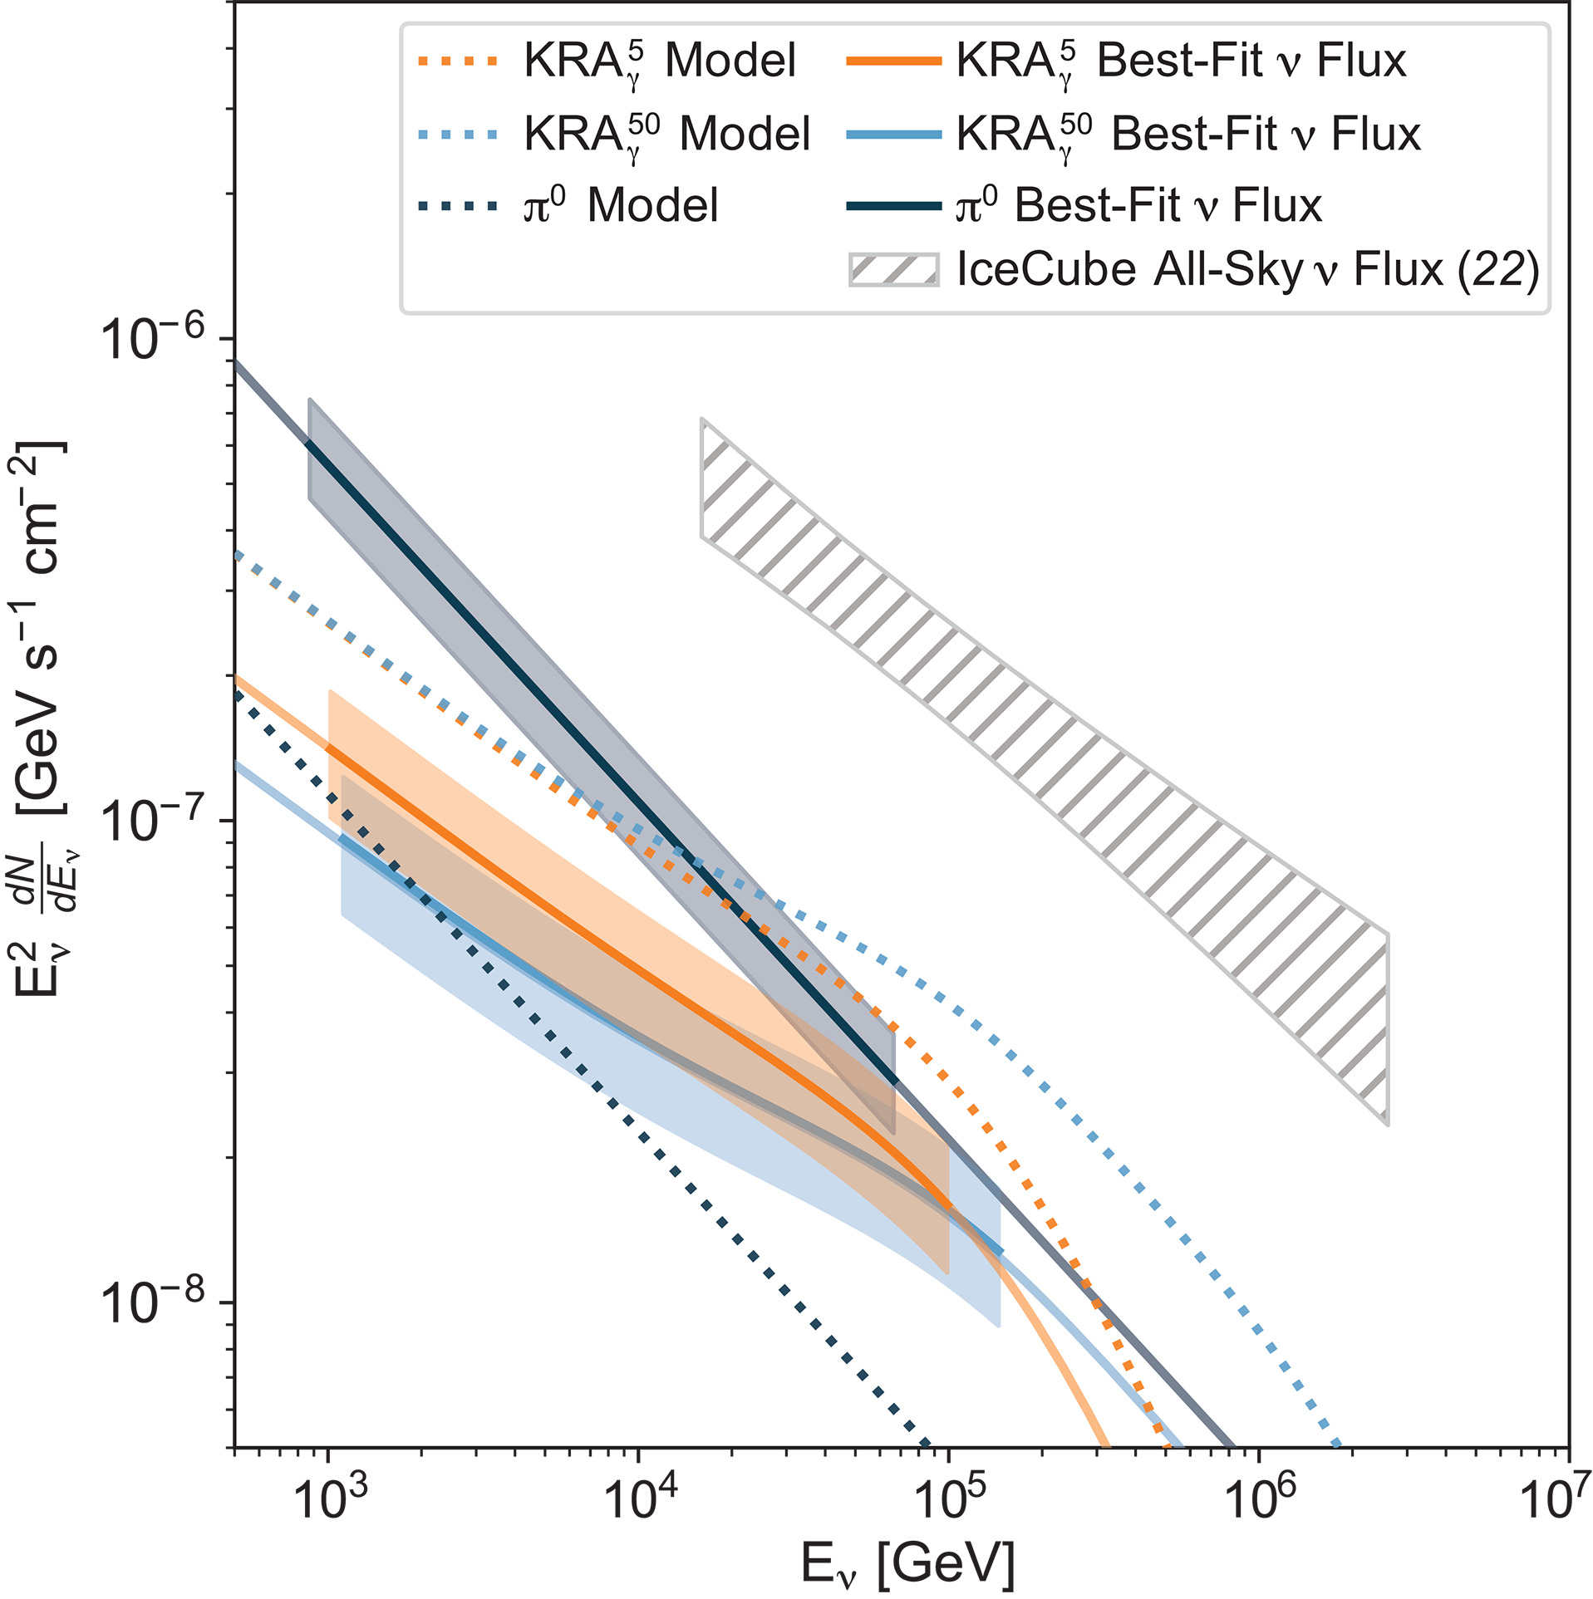
About 10% of astrophysical neutrinos are Galactic
Total
Galactic
IceCube, Science 380, 1338-1343 (2023)
4
Notes:
Fig. 5. Energy spectra for each of the Galactic plane models.
Energy-scaled, sky-integrated, per-flavor neutrino flux is shown as a function of neutrino energy (E_{v}) for each of the Galactic plane models. Dotted lines are the predicted values for the π⁰ (dark blue), KRA5𝛾KRAγ5 (orange), and KRA50𝛾KRAγ50 (light blue) models. Solid lines are our best-fitting flux normalizations from the IceCube data. Shaded regions indicate the 1σ uncertainties; they extend over the energy range that contributes to 90% of the significance. These results are based on the all-sky (4π sr) template and are presented as an all-sky flux. For comparison, the gray hatching shows the IceCube total neutrino flux (22), scaled to an all-sky flux by multiplying by 4π, with its 1σ uncertainty.

Slide 5
Why search for neutrino counterparts of gravitational wave sources, especially in real time?
Models predict particle acceleration (with hadrons at some level) by mergers involving a neutron star (BNS or NSBH)
Even for BBH, neutrino emission can occur if embedded in sufficient medium, e.g. if BBH occur preferentially within accretion disks of SMBH
Neutrino localization area is 10³ times smaller than GW sky localization
Publishing candidate neutrino coincidences in real time enables observers to search the small neutrino localization area

Slide 6
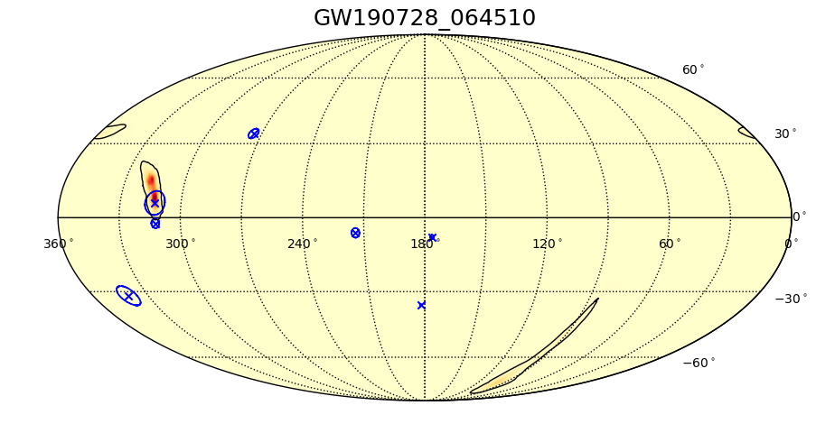
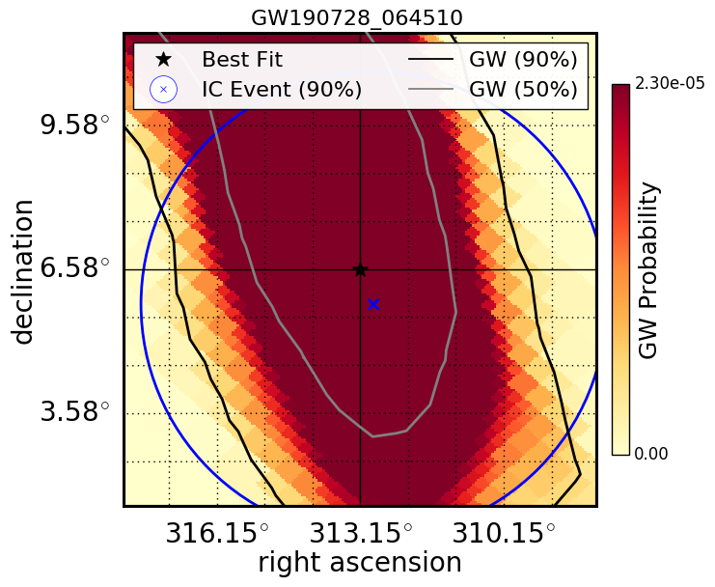
An example GW analyzed in real time during O3
IceCube, ApJ Letters 898 (2020) L10
IceCube, ApJ 944:80 (2023)
7 neutrinos
within +/- 500 seconds
p-value = 0.010 Bayesian, 0.016 Frequentist
for this GW alone (pre-trials)
Coincident neutrino information published in real time
Followed up by Swift and others
Notes:
https://physicstoday.scitation.org/doi/10.1063/PT.3.4090
The rate of change of the frequency depends only on one parameter: the chirp mass. Once you know ℳℳ, you know how quickly the frequency is changing at any point in the evolution of the binary system. All binaries with the same ℳℳ will have, to leading order, the same chirping sweep from low frequency to high, although the corrections to equation 3 do introduce a dependence on the individual masses of the stars. The chirp time, 𝐺ℳ/𝑐3Gℳ/c3, characterizes how rapidly ΩΩ changes due to gravitational-wave emission.
Abstract
Using the IceCube Neutrino Observatory, we search for high-energy neutrino emission coincident with compact binary mergers observed by the LIGO and Virgo gravitational-wave (GW) detectors during their first and second observing runs. We present results from two searches targeting emission coincident with the sky localization of each GW event within a 1000 s time window centered around the reported merger time. One search uses a model-independent unbinned maximum-likelihood analysis, which uses neutrino data from IceCube to search for pointlike neutrino sources consistent with the sky localization of GW events. The other uses the Low-Latency Algorithm for Multi-messenger Astrophysics, which incorporates astrophysical priors through a Bayesian framework and includes LIGO-Virgo detector characteristics to determine the association between the GW source and the neutrinos. No significant neutrino coincidence is seen by either search during the first two observing runs of the LIGO-Virgo detectors. We set upper limits on the time-integrated neutrino emission within the 1000 s window for each of the 11 GW events. These limits range from 0.02 to 0.7 . We also set limits on the total isotropic equivalent energy, E _{iso}, emitted in high-energy neutrinos by each GW event. These limits range from 1.7 × 10⁵¹ to 1.8 × 10⁵⁵ erg. We conclude with an outlook for LIGO-Virgo observing run O3, during which both analyses are running in real time.
S190405ar was retracted
S190421ar: 3% Terrestrial (1e-8 Hz FAR)
S190426c: 24% MassGap, 14% terrestrial, 13% NSBH
S190510g: 42% BNS
S190513bm: 5% MassGap
S190517h: 2% MassGap
S190518bb: 25% Terrestrial (1e-8 Hz FAR)
S190518bb was retracted (28±15 Mpc BNS 75%)
S190519bj: 4% Terrestrial
S190521g 3% Terrestrial
1e-8 Hz * 3e7 sec = 0.3 false alarms per year = 1 false alarm every 3-4 months
2 total retractions
Using distances from LAL Inference when available, otherwise bayestar
As of May 21:
51 days / 13 GW = one every 4 days
13/51 days

Slide 7
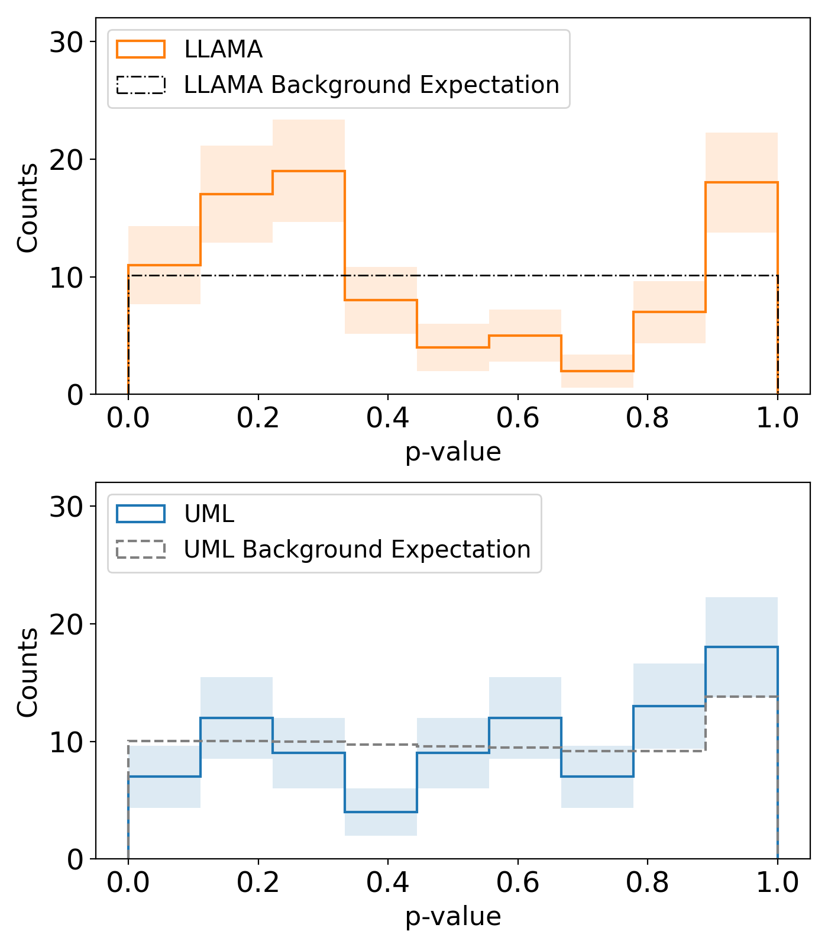
Through end of observing run O3: no significant neutrino association with 91 GW events
Two analyses each search +/- 500 s around merger time
Low-Latency Algorithm for Multi-messenger Astrophysics (LLAMA): Bayesian
Un-binned Maximum Likelihood (UML): frequentist
Bayesian
Frequentist
p-value distributions consistent with background expectations
IceCube, ApJ Letters 898 (2020) L10
IceCube, ApJ 944:80 (2023)
Notes:
https://physicstoday.scitation.org/doi/10.1063/PT.3.4090
The rate of change of the frequency depends only on one parameter: the chirp mass. Once you know ℳℳ, you know how quickly the frequency is changing at any point in the evolution of the binary system. All binaries with the same ℳℳ will have, to leading order, the same chirping sweep from low frequency to high, although the corrections to equation 3 do introduce a dependence on the individual masses of the stars. The chirp time, 𝐺ℳ/𝑐3Gℳ/c3, characterizes how rapidly ΩΩ changes due to gravitational-wave emission.
Abstract
Using the IceCube Neutrino Observatory, we search for high-energy neutrino emission coincident with compact binary mergers observed by the LIGO and Virgo gravitational-wave (GW) detectors during their first and second observing runs. We present results from two searches targeting emission coincident with the sky localization of each GW event within a 1000 s time window centered around the reported merger time. One search uses a model-independent unbinned maximum-likelihood analysis, which uses neutrino data from IceCube to search for pointlike neutrino sources consistent with the sky localization of GW events. The other uses the Low-Latency Algorithm for Multi-messenger Astrophysics, which incorporates astrophysical priors through a Bayesian framework and includes LIGO-Virgo detector characteristics to determine the association between the GW source and the neutrinos. No significant neutrino coincidence is seen by either search during the first two observing runs of the LIGO-Virgo detectors. We set upper limits on the time-integrated neutrino emission within the 1000 s window for each of the 11 GW events. These limits range from 0.02 to 0.7 . We also set limits on the total isotropic equivalent energy, E _{iso}, emitted in high-energy neutrinos by each GW event. These limits range from 1.7 × 10⁵¹ to 1.8 × 10⁵⁵ erg. We conclude with an outlook for LIGO-Virgo observing run O3, during which both analyses are running in real time.
S190405ar was retracted
S190421ar: 3% Terrestrial (1e-8 Hz FAR)
S190426c: 24% MassGap, 14% terrestrial, 13% NSBH
S190510g: 42% BNS
S190513bm: 5% MassGap
S190517h: 2% MassGap
S190518bb: 25% Terrestrial (1e-8 Hz FAR)
S190518bb was retracted (28±15 Mpc BNS 75%)
S190519bj: 4% Terrestrial
S190521g 3% Terrestrial
1e-8 Hz * 3e7 sec = 0.3 false alarms per year = 1 false alarm every 3-4 months
2 total retractions
Using distances from LAL Inference when available, otherwise bayestar
As of May 21:
51 days / 13 GW = one every 4 days
13/51 days

Slide 8
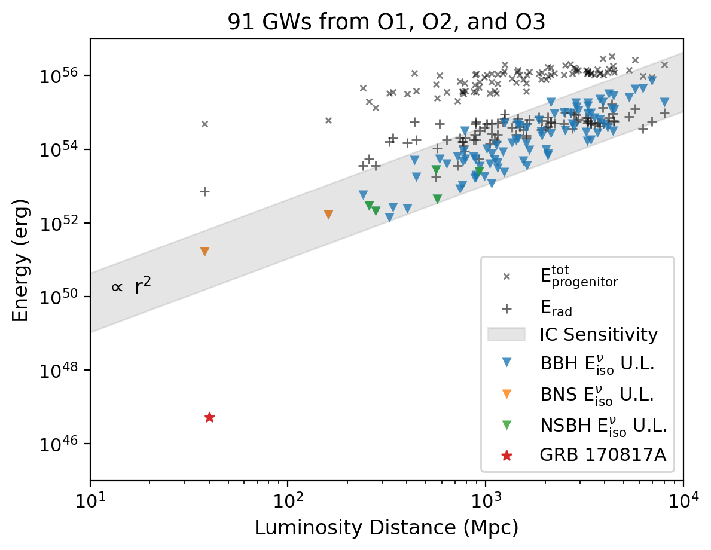
Upper limits on neutrino emission: the first 91 GWs
IceCube, ApJ Letters 898 (2020) L10
IceCube, ApJ 944:80 (2023)
Comparison of bolometric isotropic-equivalent energy in gravitational waves, gamma rays, and neutrino upper limits
Notes:
https://physicstoday.scitation.org/doi/10.1063/PT.3.4090
The rate of change of the frequency depends only on one parameter: the chirp mass. Once you know ℳℳ, you know how quickly the frequency is changing at any point in the evolution of the binary system. All binaries with the same ℳℳ will have, to leading order, the same chirping sweep from low frequency to high, although the corrections to equation 3 do introduce a dependence on the individual masses of the stars. The chirp time, 𝐺ℳ/𝑐3Gℳ/c3, characterizes how rapidly ΩΩ changes due to gravitational-wave emission.
Abstract
Using the IceCube Neutrino Observatory, we search for high-energy neutrino emission coincident with compact binary mergers observed by the LIGO and Virgo gravitational-wave (GW) detectors during their first and second observing runs. We present results from two searches targeting emission coincident with the sky localization of each GW event within a 1000 s time window centered around the reported merger time. One search uses a model-independent unbinned maximum-likelihood analysis, which uses neutrino data from IceCube to search for pointlike neutrino sources consistent with the sky localization of GW events. The other uses the Low-Latency Algorithm for Multi-messenger Astrophysics, which incorporates astrophysical priors through a Bayesian framework and includes LIGO-Virgo detector characteristics to determine the association between the GW source and the neutrinos. No significant neutrino coincidence is seen by either search during the first two observing runs of the LIGO-Virgo detectors. We set upper limits on the time-integrated neutrino emission within the 1000 s window for each of the 11 GW events. These limits range from 0.02 to 0.7 . We also set limits on the total isotropic equivalent energy, E _{iso}, emitted in high-energy neutrinos by each GW event. These limits range from 1.7 × 10⁵¹ to 1.8 × 10⁵⁵ erg. We conclude with an outlook for LIGO-Virgo observing run O3, during which both analyses are running in real time.
S190405ar was retracted
S190421ar: 3% Terrestrial (1e-8 Hz FAR)
S190426c: 24% MassGap, 14% terrestrial, 13% NSBH
S190510g: 42% BNS
S190513bm: 5% MassGap
S190517h: 2% MassGap
S190518bb: 25% Terrestrial (1e-8 Hz FAR)
S190518bb was retracted (28±15 Mpc BNS 75%)
S190519bj: 4% Terrestrial
S190521g 3% Terrestrial
1e-8 Hz * 3e7 sec = 0.3 false alarms per year = 1 false alarm every 3-4 months
2 total retractions
Using distances from LAL Inference when available, otherwise bayestar
As of May 21:
51 days / 13 GW = one every 4 days
13/51 days

Slide 9
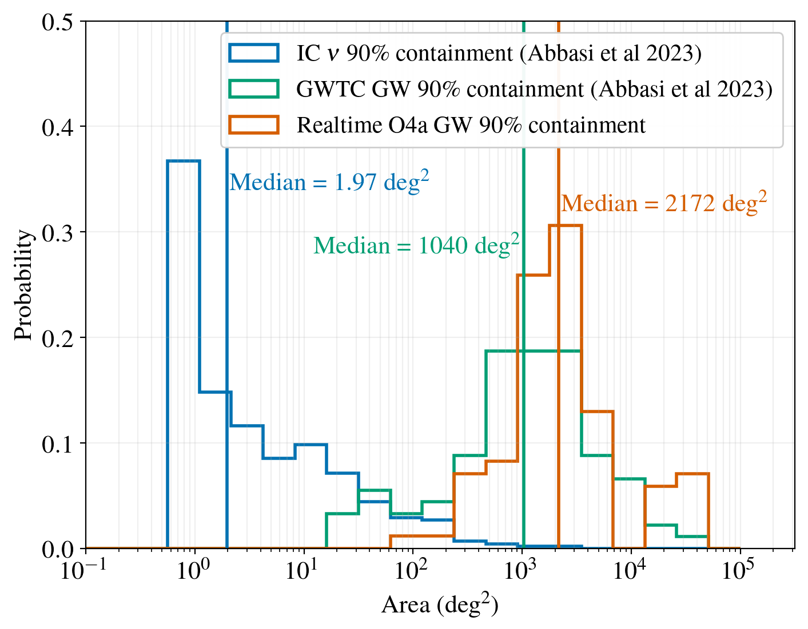
Neutrinos are localized to areas 10³ times smaller than gravitational waves
Rapid publication of neutrino directions spatially and temporally compatible with GW directions enables rapid search of a small area by other telescopes
Notes:
Comparison of 90% containment area for IceCube (GFU Online) events, previous gravitational wave transients (labeled GWTC, this includes events from O1 and O2 (GWTC1) and O3 (GWTC 2.1 and GWTC3)), and events during O4a. The distribution includes all non-retracted events from O4a and ER15 (engineering run prior to the start of O4). The median of the distribution for IceCube (GFU) events is 1000 times better localized than gravitational wave events during O4a, illustrating the importance of realtime follow-ups of these events by IceCube. The GW area histograms are calculated from the published skymaps, by finding the 90% credible region from the skymap. The GFU event histogram is calculated from MC events, using the angular error (scaled to 90% containment of the 2D Gaussian) for an E^-2 spectrum. The IC (blue) and GWTC (green) histograms are published in Abbasi et al 2023 ApJ 944 80.

Slide 10
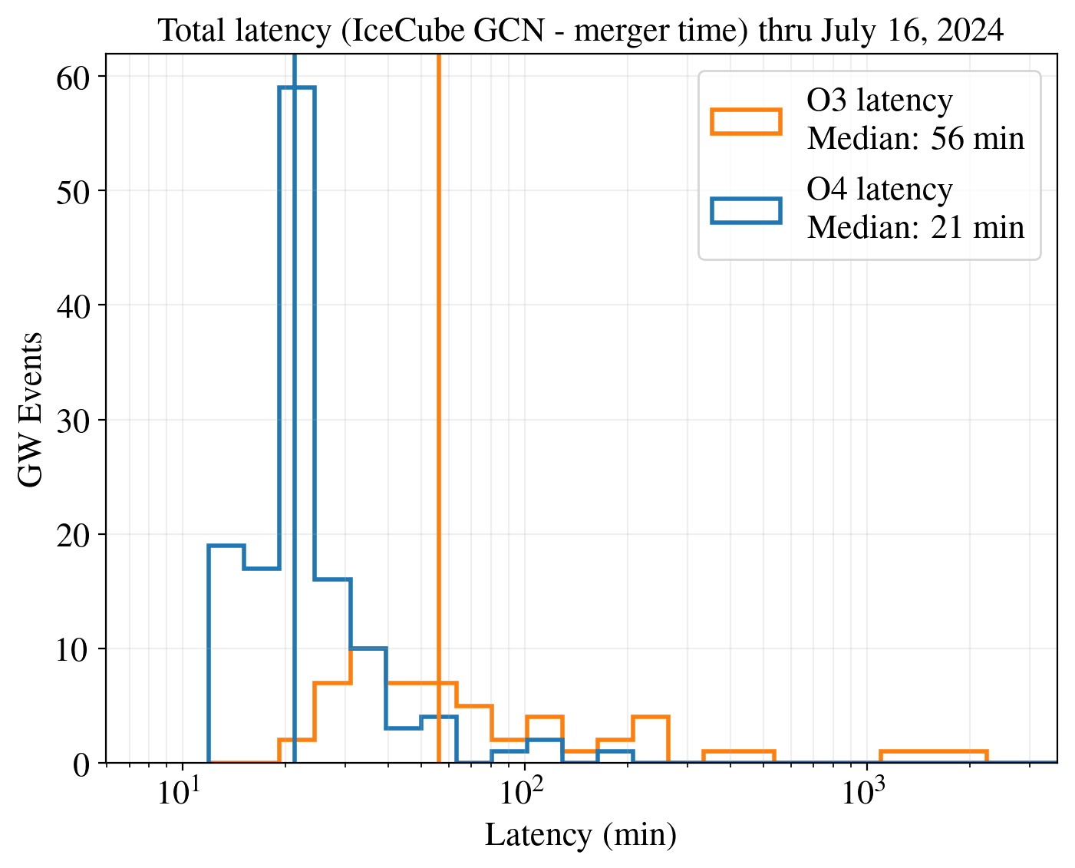
Real-time follow-up of O3 and O4 gravitational waves
O3 total (LVK + IceCube) latency median 56 minutes, with human in the loop
O4 total latency median 21 minutes, thanks to automation

Slide 11
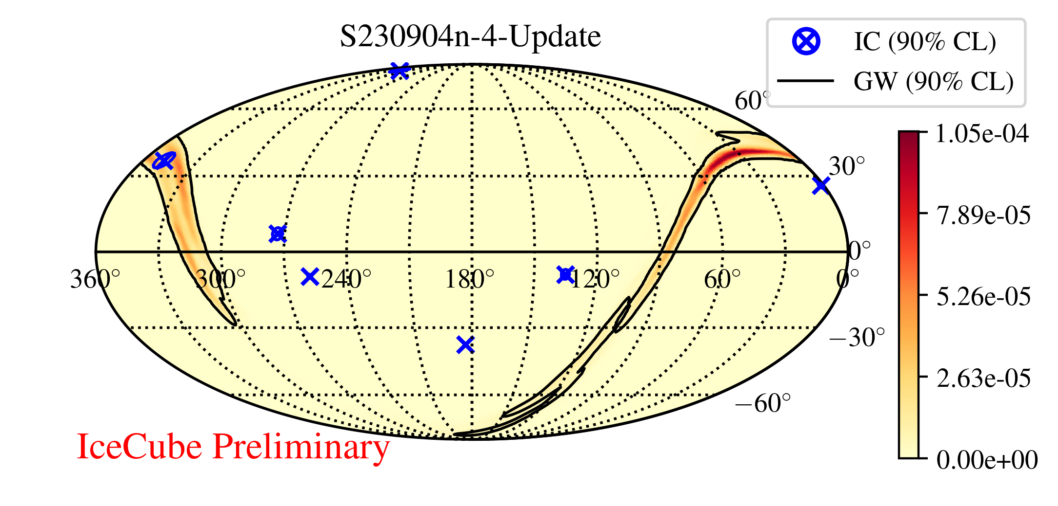
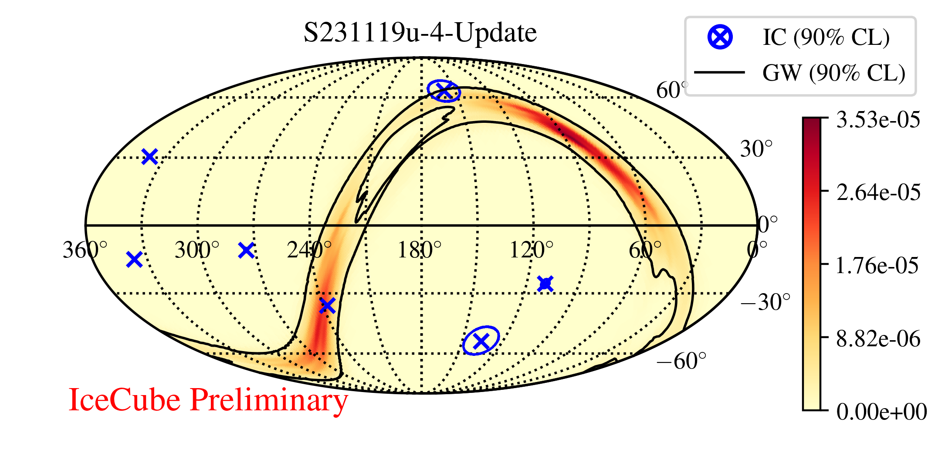
Example sky maps: most significant GW-neutrino associations so far
LLAMA (Bayesian)
p value 0.8%
UML (frequentist)
p value 0.8%
These p values are per-GW
(pre-trials; 91+122 GW)
Notes:
These are most significant across O1, O2, O3, and O4 through July 22
(TBC)
Distances from
https://gcn.nasa.gov/circulars/34629
1.1 ± 0.3 Gpc
https://gcn.nasa.gov/circulars/35146
6.6 ± 2.6 Gpc

Slide 12
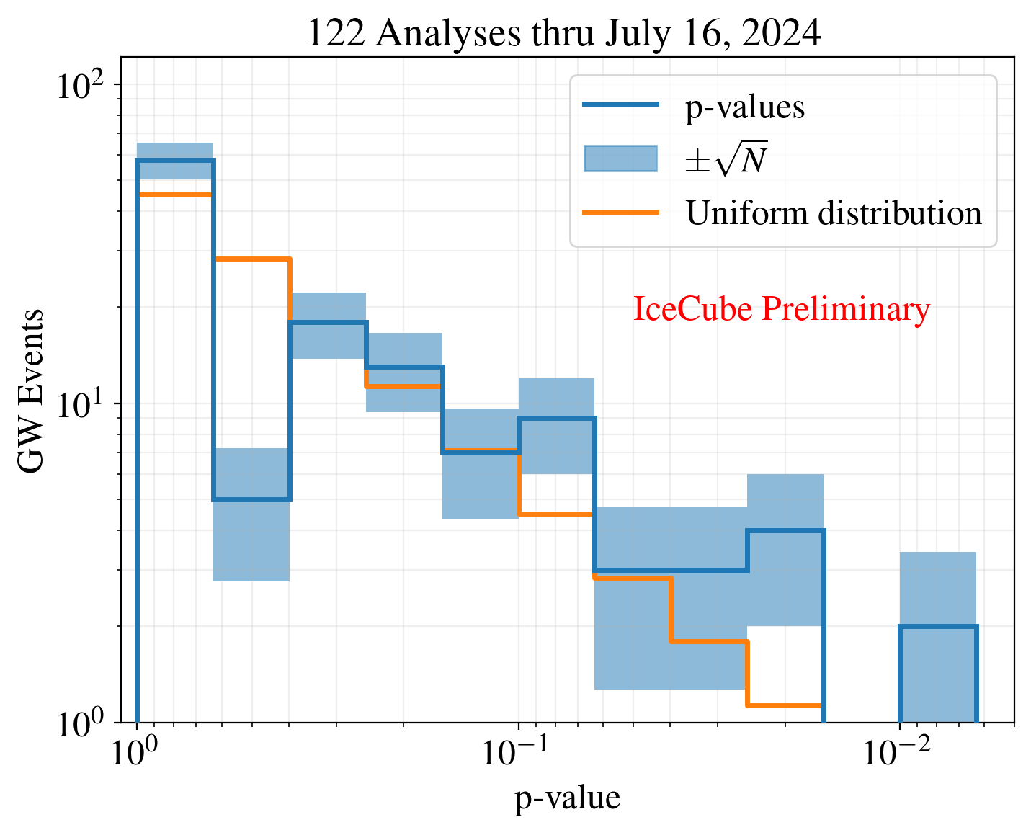
All 122 GW neutrino searches to date during O4
UML analysis
91 gravitational waves through O3 + 122 so far in O4 = 213 total
Background expectation is not uniform due to neutrino background event counting statistics

Slide 13
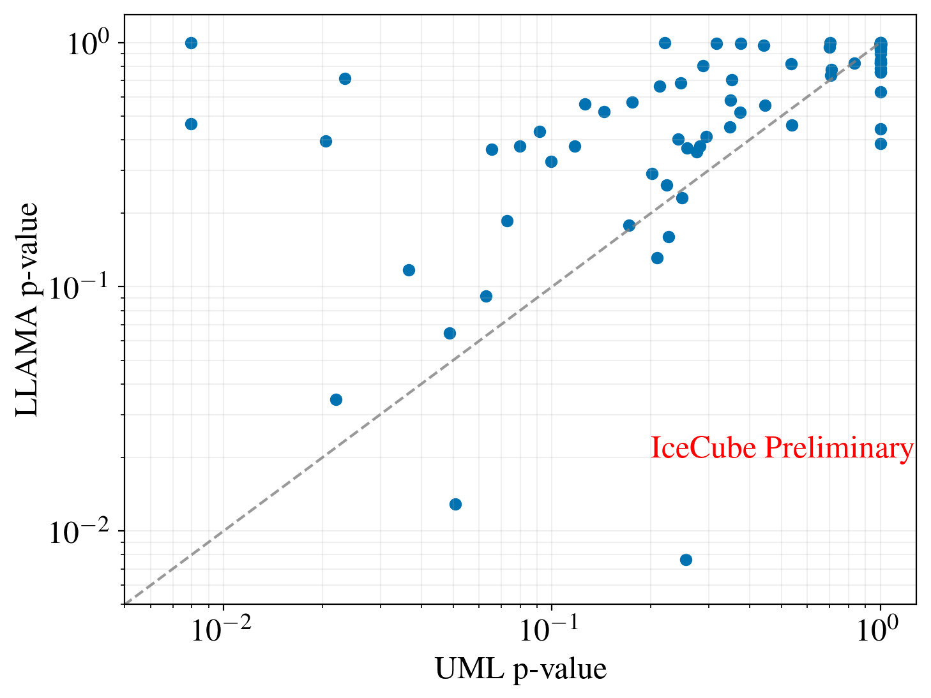
Complementary results from two analysis methods
Low-Latency Algorithm for Multi-messenger Astrophysics (LLAMA): Bayesian (including distance prior)
Un-binned Maximum Likelihood (UML): frequentist
Results shown for all 122 O4 GW through July 16, 2024

Slide 14
Searching for “low energy” GW-associated neutrinos using IceCube DeepCore
IceCube, ApJ 959 (2023) 96
Previous searches focused on 1 TeV-10 PeV neutrinos using the main IceCube array
This search uses IceCube DeepCore (dense inner array) for 10 GeV – 10 TeV neutrinos
Notes:
Figure 2. Flux upper limits obtained for the 90 GW events obtained in this
analysis (blue dashed). The corresponding flux upper limits obtained with the
high-energy neutrino follow-up analysis are also shown (orange solid; Aartsen
et al. 2020; Abbasi et al. 2023a). These limits are for a flux with a spectral index
of two. The energy ranges shown here are the central 90% energies contributing
to the flux limits at the decl. spanning the 90% probability regions of the GW
skymap. These energy ranges are computed for each decl. bin by calculating the
upper and lower energy limits of the data set at which the sensitivity degrades by
90%. Three GW events are highlighted here. These are GW151226 (the event
with the lowest pretrial p-value in this analysis), GW190425 (the only BNS event
with a pretrial p-value < 0.1), and GW170817 (first and only BNS event for
which the EM counterpart has been observed)

Slide 15
Searching for “low energy” GW-associated
neutrinos using IceCube DeepCore
IceCube, ApJ 959 (2023) 96
No evidence of signal found in 10 GeV – 1 TeV neutrino search
Upper limits now span 10 GeV – 10 PeV (and 4π sky)

Slide 16
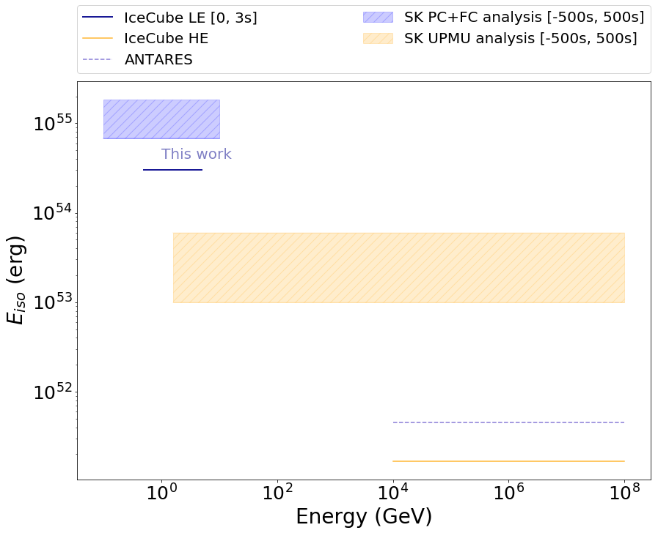
Even lower energies: 0.5–5 GeV
IceCube, 2105.13160
IceCube, 2307.16190 (ICRC)
Using coincident hit method instead of full event reconstruction
Upper limits now span 0.5 GeV – 10 PeV (and 4π sky)
Searching even lower, to MeV scale (same method as supernova neutrinos)

Slide 17
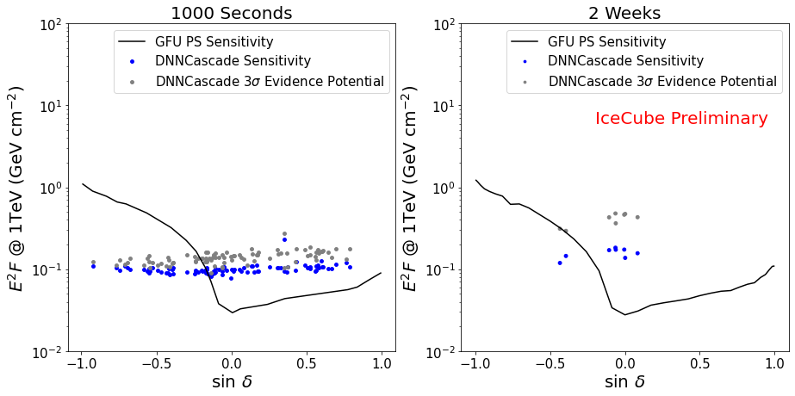
Opening the Southern sky with cascades
Same event selection (“DNN Cascades”) used to detect Galactic neutrinos
Better sensitivity than muon tracks in Southern sky (shown for E⁻²)
Notes:
Caption: Sensitivity and 3σ evidence potential given an injected power law spectrum with a 2.0 index for individual GWTC-2.1 and GWTC-3 gravitational wave candidate events marginalized over each skymap and plotted at the centroid declination compared to the GFU sensitivity to a point sources. The 1000 second time window is shown on the left and a 2 week time window on the right. One event in the 1000s time window has a significantly reduced sensitivity because IceCube livetime only covers about ~50% of the time window. PDF version: File:Gfu dnncascades sens comp pdf.pdf

Slide 18
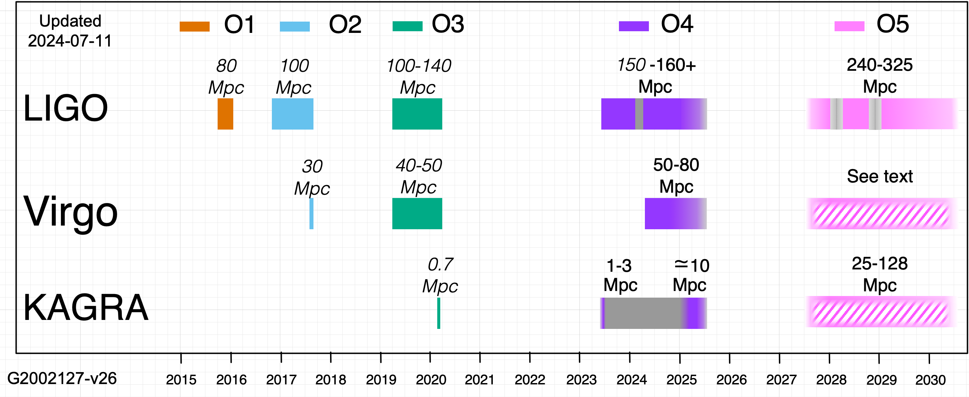
Continuing real-time LIGO/Virgo/KAGRA follow up throughout O4 (and beyond)
O4 planned to conclude June 9, 2025
Will continue to follow up each LVK open public alert (including BBH) and report results from both pipelines with low (~21 minute) latency
Analyzing low-significance (sub-threshold) as well as high-significance GW
We encourage other observers to follow up our coincident neutrino alerts!
Notes:
p-value > 0.1: automated GCN Notice with upper limits
0.01 < p-value < 0.1: automated GCN Notice with coincident neutrino information
p-value < 0.01: GCN Notice and GCN Circular with coincident neutrino information
+/-500 second search window for all GW; two-week search window for GW with NS

Slide 19
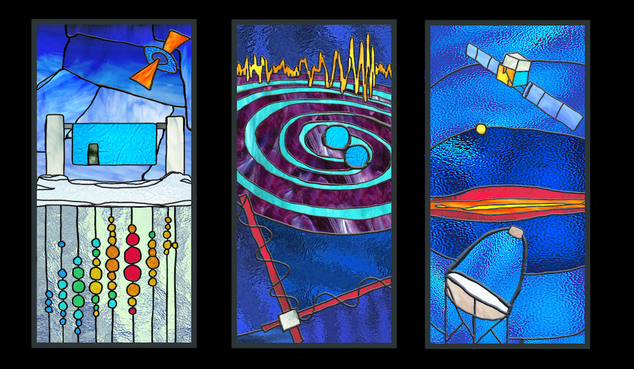
Conclusion and outlook
IceCube is searching for neutrinos from GW sources from MeV to EeV scale
Searches for neutrinos associated with BBH, BNS, NSBH, and unclassified bursts
Low (~21 minute) latency follow-up in O4: automated posting of results via GCN
Neutrinos localized to area 10³ times smaller than GW, supporting EM follow-up
Multi-messenger GW-photon and neutrino-photon sources have been detected: ready for GW-neutrino!

Slide 20
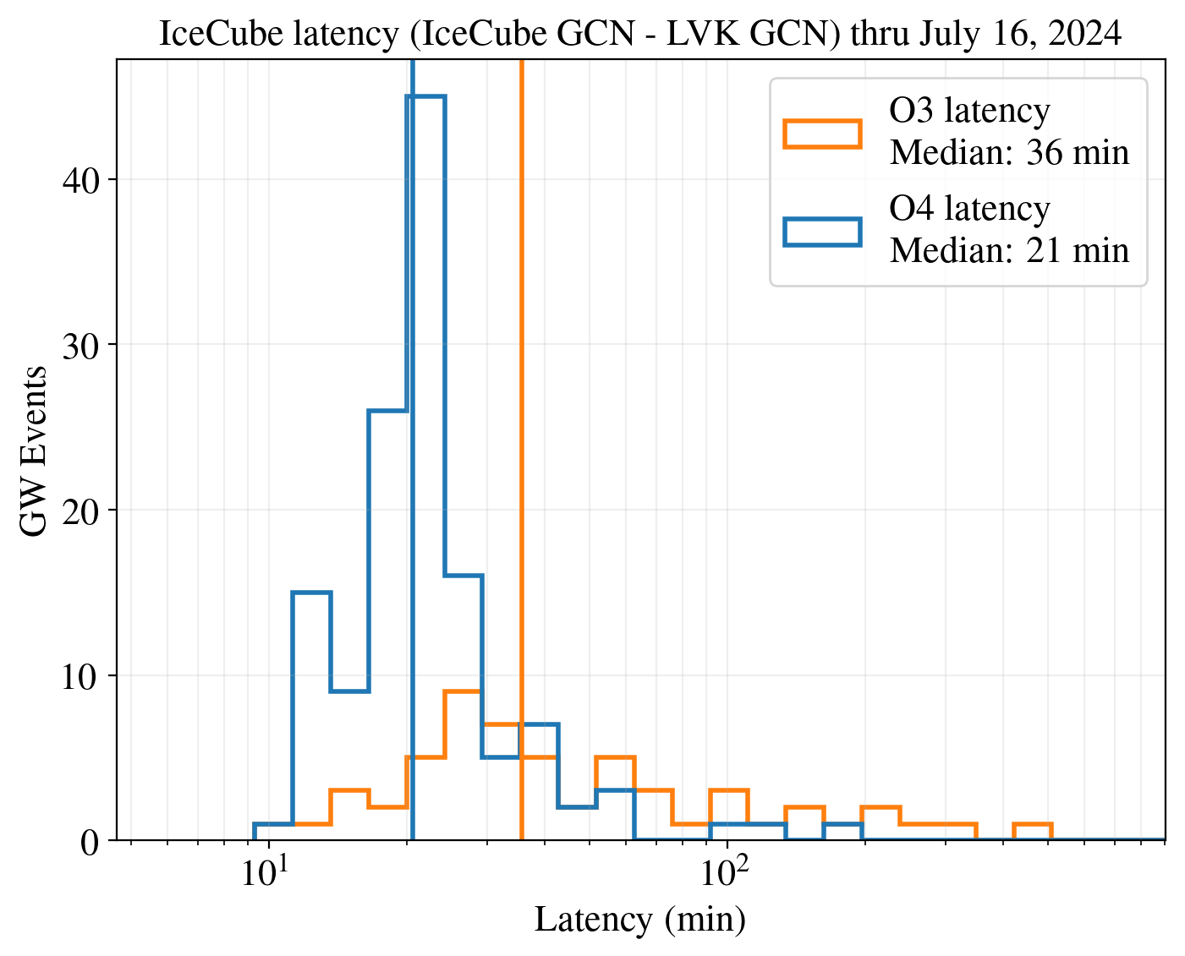
IceCube-only latency

Slide 21
Additional slides

Slide 22
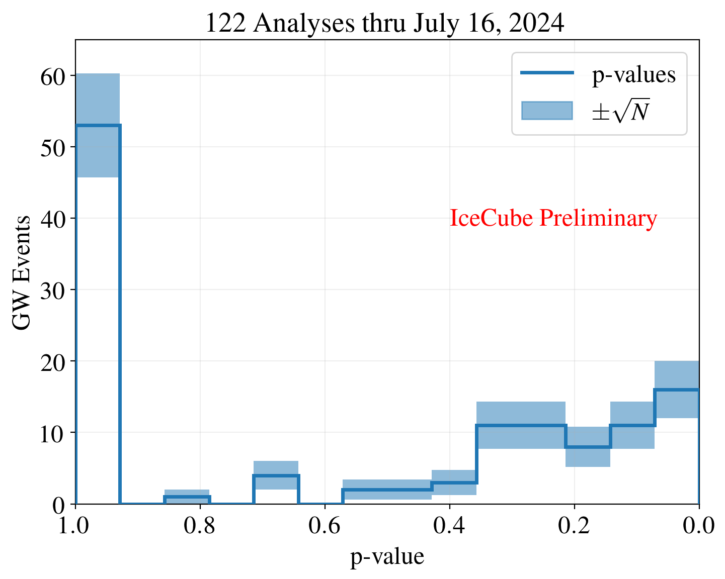
Cumulative p value distribution (linear scale)

Slide 23
An example GW analyzed in real time during O3
IceCube, ApJ Letters 898 (2020) L10
IceCube, ApJ 944:80 (2023)
7 neutrinos
within +/- 500 seconds
p-value = 0.010 Bayesian, 0.016 Frequentist
for this GW alone (pre-trials)
Coincident neutrino information published in real time
Followed up by Swift and others
Notes:
https://physicstoday.scitation.org/doi/10.1063/PT.3.4090
The rate of change of the frequency depends only on one parameter: the chirp mass. Once you know ℳℳ, you know how quickly the frequency is changing at any point in the evolution of the binary system. All binaries with the same ℳℳ will have, to leading order, the same chirping sweep from low frequency to high, although the corrections to equation 3 do introduce a dependence on the individual masses of the stars. The chirp time, 𝐺ℳ/𝑐3Gℳ/c3, characterizes how rapidly ΩΩ changes due to gravitational-wave emission.
Abstract
Using the IceCube Neutrino Observatory, we search for high-energy neutrino emission coincident with compact binary mergers observed by the LIGO and Virgo gravitational-wave (GW) detectors during their first and second observing runs. We present results from two searches targeting emission coincident with the sky localization of each GW event within a 1000 s time window centered around the reported merger time. One search uses a model-independent unbinned maximum-likelihood analysis, which uses neutrino data from IceCube to search for pointlike neutrino sources consistent with the sky localization of GW events. The other uses the Low-Latency Algorithm for Multi-messenger Astrophysics, which incorporates astrophysical priors through a Bayesian framework and includes LIGO-Virgo detector characteristics to determine the association between the GW source and the neutrinos. No significant neutrino coincidence is seen by either search during the first two observing runs of the LIGO-Virgo detectors. We set upper limits on the time-integrated neutrino emission within the 1000 s window for each of the 11 GW events. These limits range from 0.02 to 0.7 . We also set limits on the total isotropic equivalent energy, E _{iso}, emitted in high-energy neutrinos by each GW event. These limits range from 1.7 × 10⁵¹ to 1.8 × 10⁵⁵ erg. We conclude with an outlook for LIGO-Virgo observing run O3, during which both analyses are running in real time.
S190405ar was retracted
S190421ar: 3% Terrestrial (1e-8 Hz FAR)
S190426c: 24% MassGap, 14% terrestrial, 13% NSBH
S190510g: 42% BNS
S190513bm: 5% MassGap
S190517h: 2% MassGap
S190518bb: 25% Terrestrial (1e-8 Hz FAR)
S190518bb was retracted (28±15 Mpc BNS 75%)
S190519bj: 4% Terrestrial
S190521g 3% Terrestrial
1e-8 Hz * 3e7 sec = 0.3 false alarms per year = 1 false alarm every 3-4 months
2 total retractions
Using distances from LAL Inference when available, otherwise bayestar
As of May 21:
51 days / 13 GW = one every 4 days
13/51 days

Slide 24
We follow up each LVK GW sky map revision
(preliminary, initial, update, …)
Same example (GW 190728_064510)
Notes:
https://physicstoday.scitation.org/doi/10.1063/PT.3.4090
The rate of change of the frequency depends only on one parameter: the chirp mass. Once you know ℳℳ, you know how quickly the frequency is changing at any point in the evolution of the binary system. All binaries with the same ℳℳ will have, to leading order, the same chirping sweep from low frequency to high, although the corrections to equation 3 do introduce a dependence on the individual masses of the stars. The chirp time, 𝐺ℳ/𝑐3Gℳ/c3, characterizes how rapidly ΩΩ changes due to gravitational-wave emission.
Abstract
Using the IceCube Neutrino Observatory, we search for high-energy neutrino emission coincident with compact binary mergers observed by the LIGO and Virgo gravitational-wave (GW) detectors during their first and second observing runs. We present results from two searches targeting emission coincident with the sky localization of each GW event within a 1000 s time window centered around the reported merger time. One search uses a model-independent unbinned maximum-likelihood analysis, which uses neutrino data from IceCube to search for pointlike neutrino sources consistent with the sky localization of GW events. The other uses the Low-Latency Algorithm for Multi-messenger Astrophysics, which incorporates astrophysical priors through a Bayesian framework and includes LIGO-Virgo detector characteristics to determine the association between the GW source and the neutrinos. No significant neutrino coincidence is seen by either search during the first two observing runs of the LIGO-Virgo detectors. We set upper limits on the time-integrated neutrino emission within the 1000 s window for each of the 11 GW events. These limits range from 0.02 to 0.7 . We also set limits on the total isotropic equivalent energy, E _{iso}, emitted in high-energy neutrinos by each GW event. These limits range from 1.7 × 10⁵¹ to 1.8 × 10⁵⁵ erg. We conclude with an outlook for LIGO-Virgo observing run O3, during which both analyses are running in real time.
S190405ar was retracted
S190421ar: 3% Terrestrial (1e-8 Hz FAR)
S190426c: 24% MassGap, 14% terrestrial, 13% NSBH
S190510g: 42% BNS
S190513bm: 5% MassGap
S190517h: 2% MassGap
S190518bb: 25% Terrestrial (1e-8 Hz FAR)
S190518bb was retracted (28±15 Mpc BNS 75%)
S190519bj: 4% Terrestrial
S190521g 3% Terrestrial
1e-8 Hz * 3e7 sec = 0.3 false alarms per year = 1 false alarm every 3-4 months
2 total retractions
Using distances from LAL Inference when available, otherwise bayestar
As of May 21:
51 days / 13 GW = one every 4 days
13/51 days
IceCube-GW coincidences have been followed up by Swift, JVLA, HAWC, ...

Slide 25
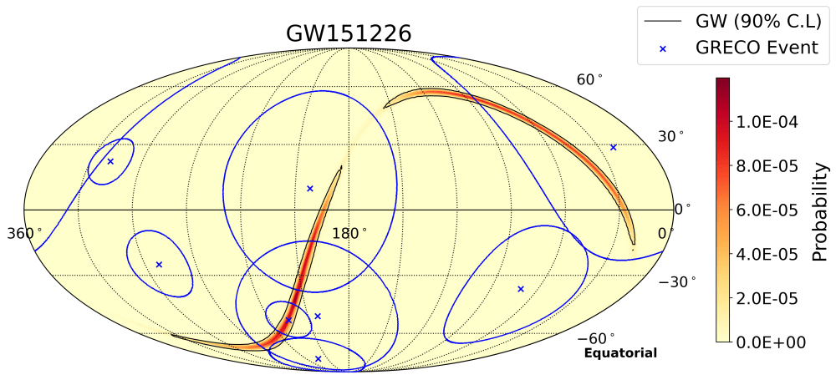
Searching for 10 GeV-1 TeV neutrinos
IceCube, ApJ 959 (2023) 96
Previous searches focused on 1 TeV-10 PeV neutrinos using the main IceCube array
New search uses IceCube DeepCore (denser inner array) for 10 GeV – 10 TeV neutrinos

Slide 26
Preliminary IceCube-GW GCN Notice format
Shaded: included if p<0.1
Parameter | Description | Comment
TITLE | GCN NOTICE
NOTICE_DATE | [date] | UTC
NOTICE_TYPE | IceCube_GW_Coinc | notice type name
STREAM | ## | standard
GW_EVENT_NAME | [lvk_name] | From LVK, GW event followed up
GW_GCN_NOTICE_NUM | [notice_id] | notice id from GW detectors
T_MERGER | [trigger_time] | UTC
T_START | [tstart] | UTC; start time of the search (trigger -500s)
T_STOP | [tstop] | UTC; stop time of the search (trigger +500s)
N_EVENTS_COINC | [num_events] | number of IceCube events in spatial and temporal coincidence with the GW map
OVERALL_P_GEN_TRANSIENT | [pval_uml] | overall p-value for UML followup
OVERALL_P_BAYESIAN | [pval_llama] | overall p-value for LLAMA followup
OVERALL_SIG_GEN_TRANSIENT | [sig_uml] | significance for UML followup
OVERALL_SIG_BAYESIAN | [sig_bayesian] | significance for LLAMA followup
COINC_EVENT_DT | [dt] | time offset (sec) of 1st coincident neutrino with respect to GW trigger
COINC_EVENT_RA | [ra] | RA of 1st coincident neutrino (deg)
COINC_EVENT_DEC | [dec] | declination of 1st coincident neutrino (deg)
COINC_EVENT_ANG_UNC | [ang_unc] | angular uncertainty of track event: 90% containment (deg)
COINC_EVENT_P_GEN_TRANSIENT | [pval_uml] | event p-value for 1st coincident neutrino with UML
COINC_EVENT_P_BAYESIAN | [pval_llama] | event p-value for 1st coincident neutrino with LLAMA
SENS_LOW | [lowSens] | Lowest value of point source sensitivity assuming an E^-2 spectrum (E^2 dN/dE) within the GW map localization (GeV cm^-2)
SENS_HIGH | [highSens] | Highest value of point source sensitivity assuming an E^-2 spectrum (E^2 dN/dE) within the GW map localization (GeV cm^-2)
COMMENTS | 2 searches for track-like muon neutrino events detected by IceCube consistent with the GW localization in a time window of 1000s
COMMENTS | (1) generic transient search with unbinned maximum likelihood
COMMENTS | (2) Bayesian approach assuming a binary merger scenario and accounting for priors such as GW source distance
COMMENTS | M. G. Aartsen et al 2020 ApJL 898 L10 ; Abbasi et al. arXiv:2208.09532 (2022)
COMMENTS | The position error is statistical only, there is no systematic added.

Slide 27
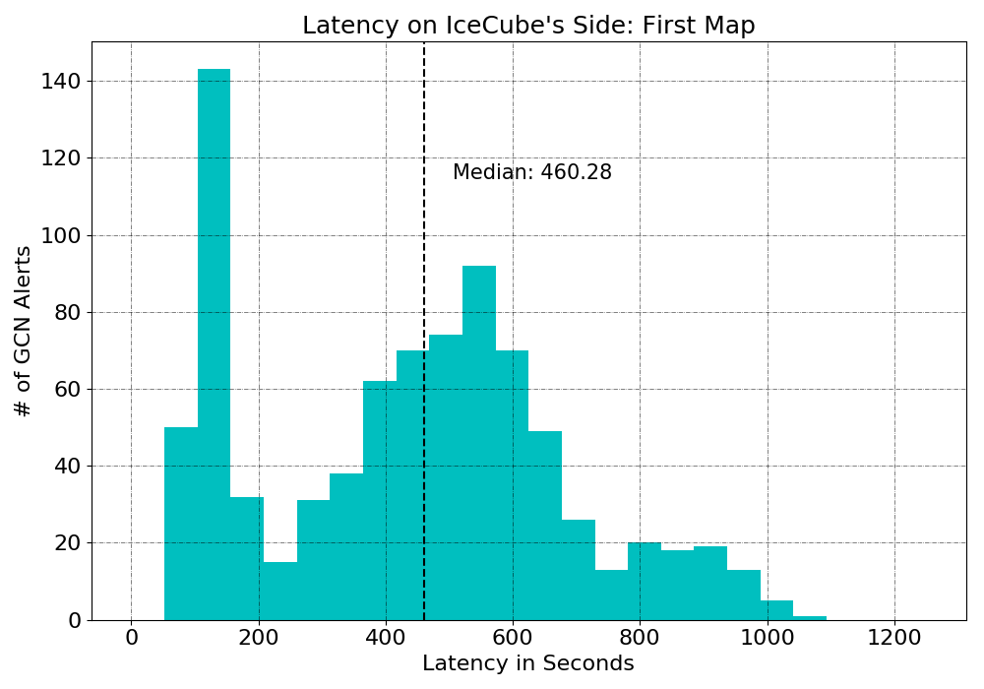
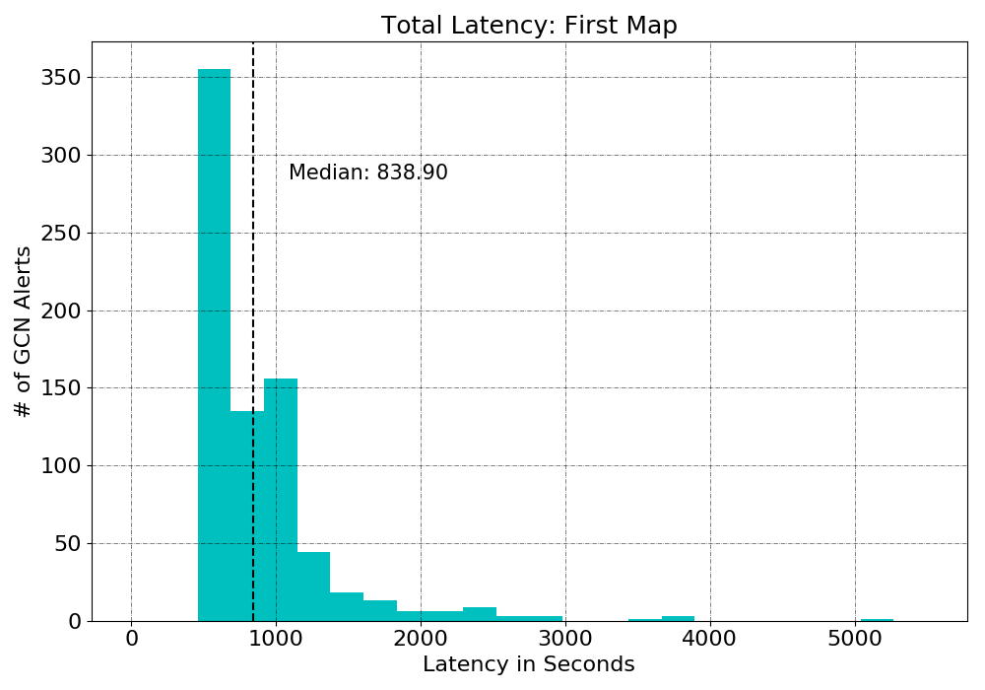
GCN
Alert
Code
Finishes
Merger
LVK Processes
IceCube Runs Code

Slide 28
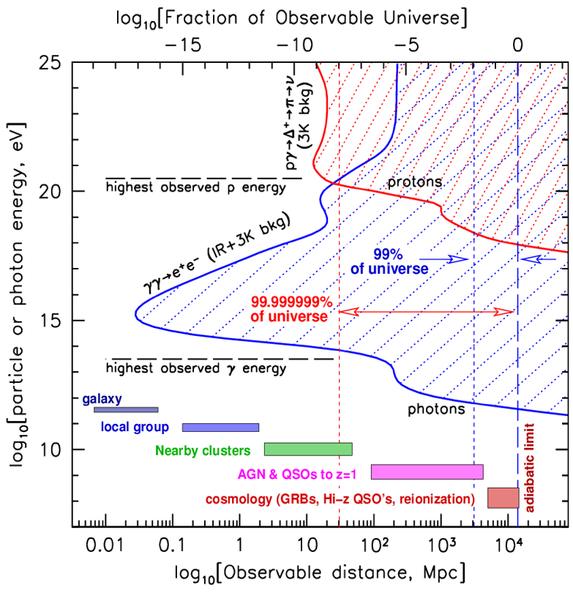
Neutrinos see to great energies and distances
100 EeV
1 TeV
P. Gorham
Notes:
Redshift of 0.1 tau=1 for 1 TeV
z = 0.01: 40 Mpc
z = 0.1: 400 Mpc
z = 1: 4 Gpc
TODO: Z burst back of envelope

Slide 29
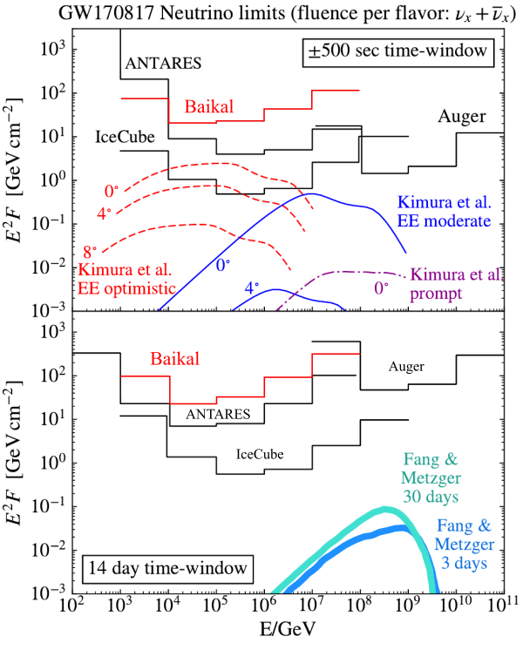
ANTARES, Auger, GVD, IceCube analysis of BNS merger GW 170817
No neutrino events associated with GW170817A found in cascade search within ± 500 seconds or +14 days
Assuming E⁻² and equal fluence in all flavors, upper limits at 90% have been
derived on the neutrino fluence from
GW170817 for each energy decade.
GVD, JETP Lett. 108 (2018) no.12, 787-790

Slide 30
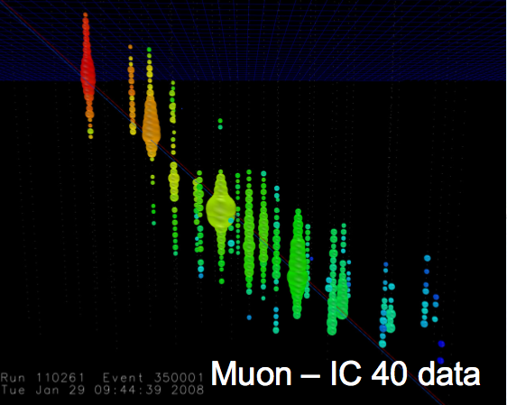
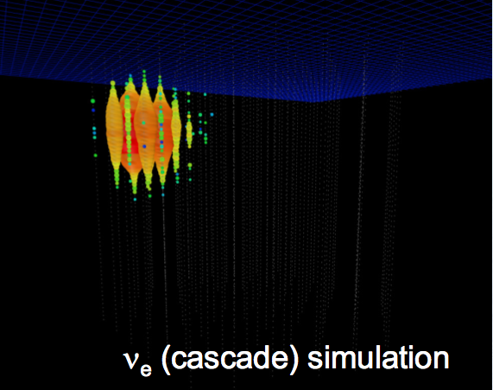
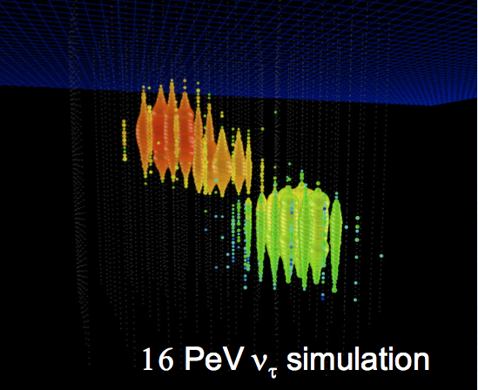
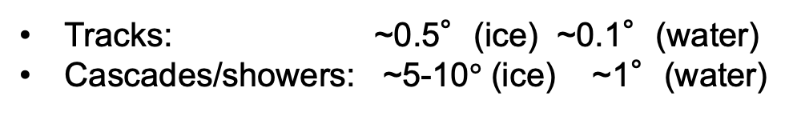
Interaction channels and flavor identification
Muon (experimental data)
Muon neutrino
+ Straight track,
points to neutrino source,
angular resolution ~1°
- Cosmic-ray muon background
Electron neutrino
+ Good energy resolution
- Cascade, ideally in detector
- Poor angular resolution
Tau neutrino
+ Double bang signature,
low background
+ Pointing capability
- Low rate
Tracks: ~0.5°(ice) ~0.1°(water)
Cascades/showers: ~5-10$°$ (ice) ~1°(water)
Notes:
Tau decay length vs. energy
Muon is IC 40 data
Cascade is simulation
Nu tau is simulation
Why electron travels less far than muon?
Showers quickly (brem) because mass << muon
Approximate (to confirm):
50 m per PeV

Slide 31
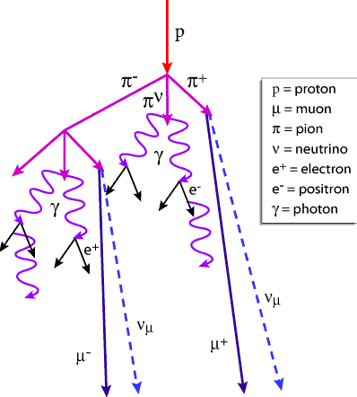
Signals and backgrounds in neutrino telescopes
Rates for a km³ telescope
Atmospheric muons: 70 billion per year
Atmospheric neutrinos: one in ~10⁶
Astrophysical neutrinos: one in ~10⁹
Notes:
Francis: 550 cosmic neutrinos in the Aachen analysis on a background of 340,000
Waxman-Bahcall is scaled by 3/2 (why?)
Atmospheric neutrino production:
Cosmic rays produce muons, pions, kaons which decay to neutrinos
Toward horizon, more atmosphere column depth within which particles can decay before being absorbed by Earth
Prompt/charm: don’t need path length to decay

Slide 32
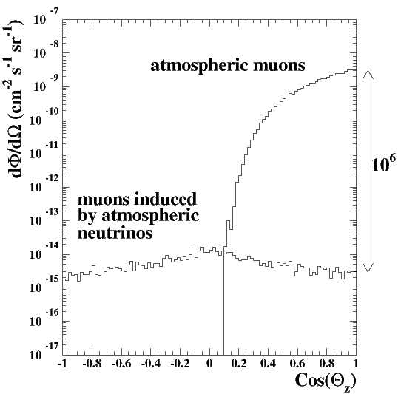
Signals and backgrounds in neutrino telescopes
Most events detected by neutrino telescopes are not astrophysical neutrinos
atmospheric μ ~70 billion / year / km³
atmospheric ν_{μ} → μ ~80 thousand / year / km³
astrophysical ν_{μ} → μ ~10 / year / km³ (above 200 TeV)
Background and signal differ in spectrum and angular distribution
energy distribution
angular distribution
conventional
atmospheric
atmospheric muons
astrophysical
atmospheric neutrinos
prompt atmospheric
cosmogenic
up-going
down-going
Notes:
Francis: 550 cosmic neutrinos in the Aachen analysis on a background of 340,000
Waxman-Bahcall is scaled by 3/2 (why?)
Atmospheric neutrino production:
Cosmic rays produce muons, pions, kaons which decay to neutrinos
Toward horizon, more atmosphere column depth within which particles can decay before being absorbed by Earth
Prompt/charm: don’t need path length to decay
80e3/70e9= 1e-6

Slide 33
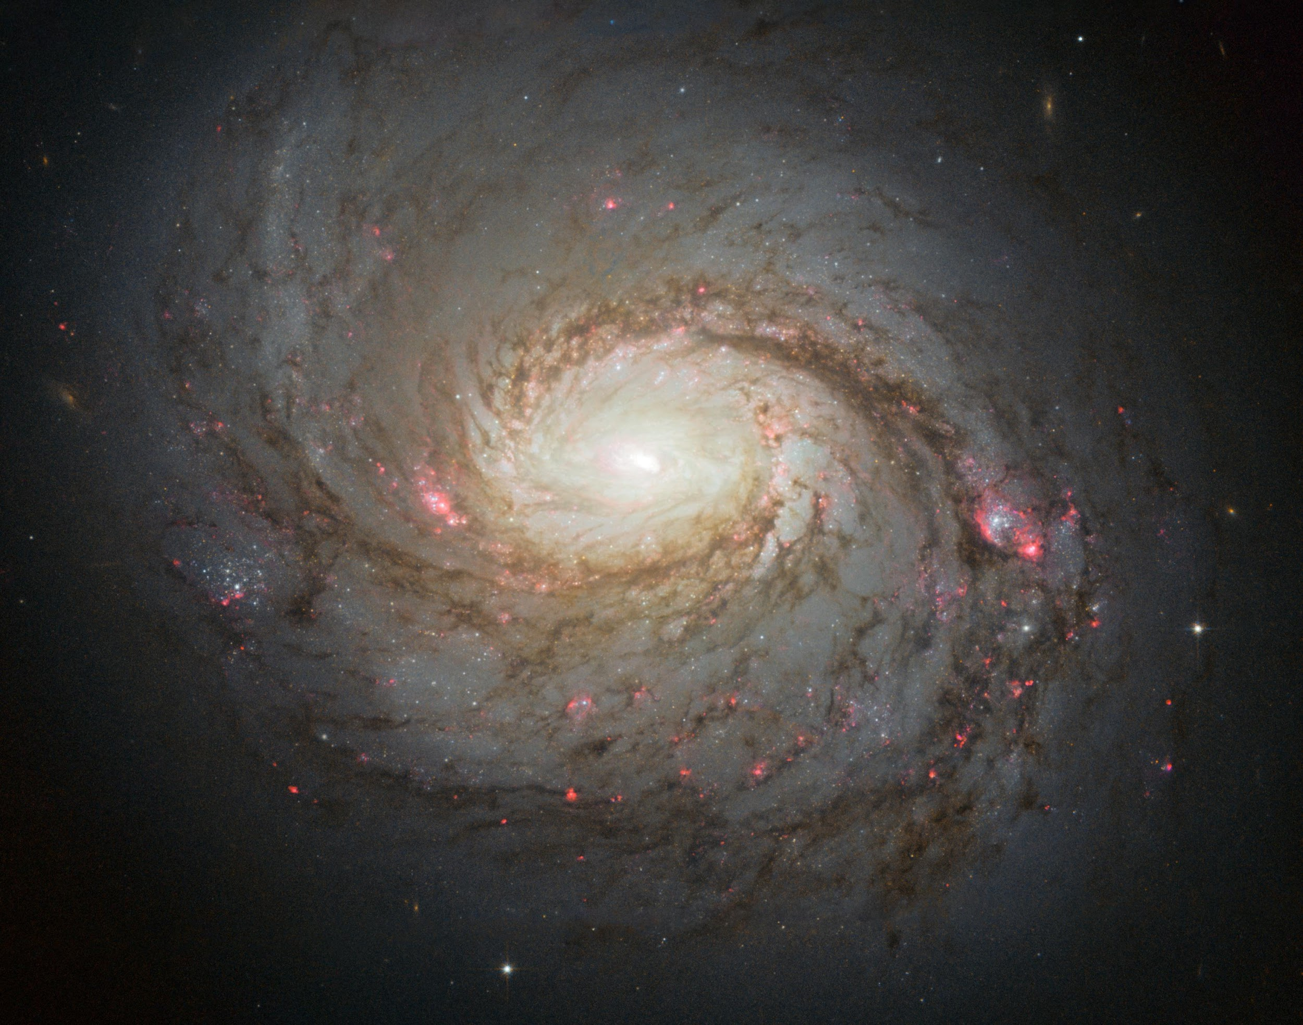
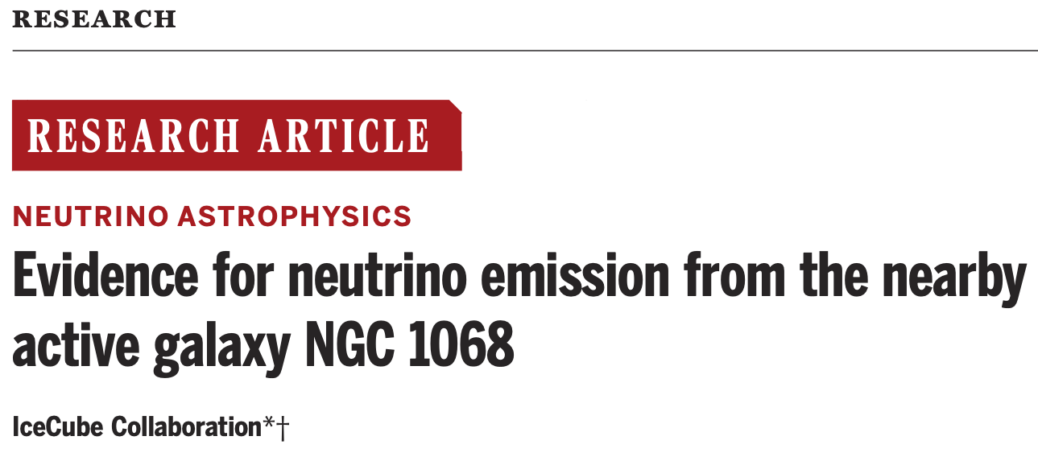

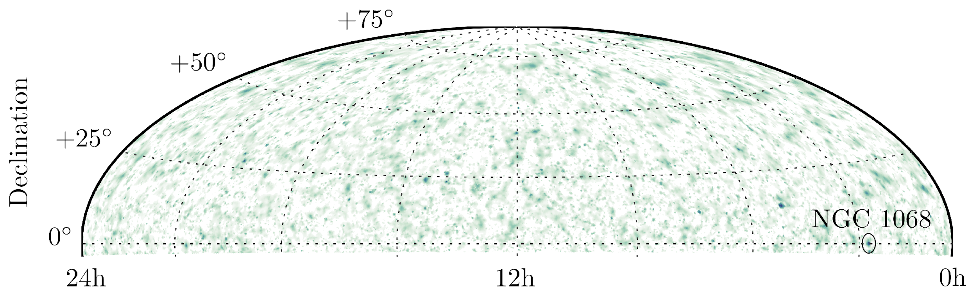
New paper published today
Right Ascension
Justin Vandenbroucke Neutrino and gamma-ray sources
33

Slide 34
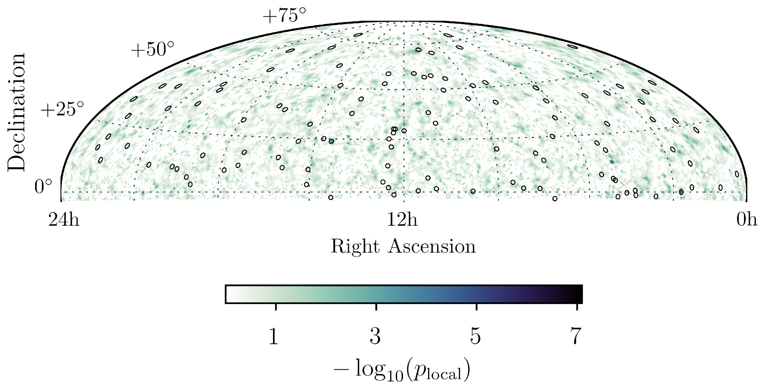
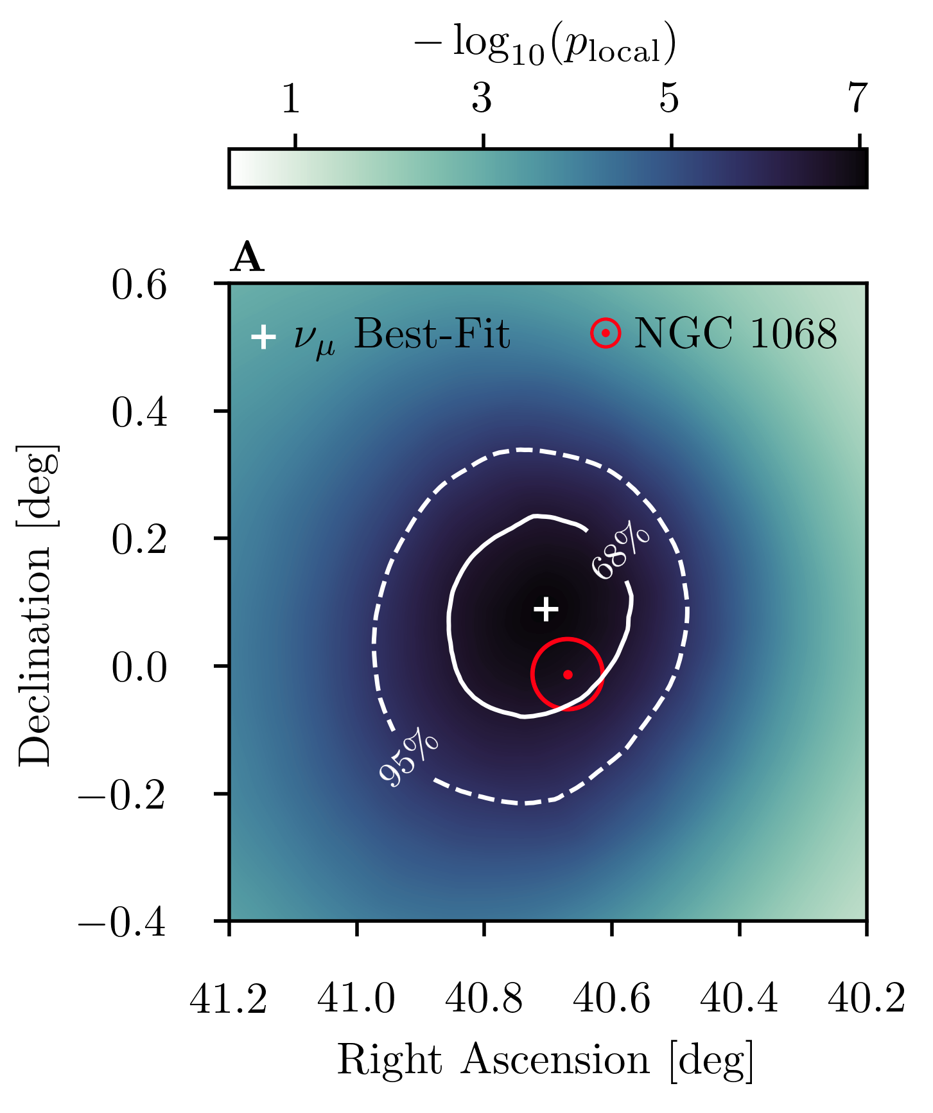
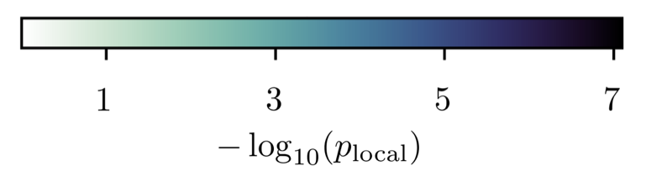

Evidence for neutrino emission from NGC 1068
Equatorial Coordinate System
NGC 1068 direction:
79 (+22, -20) astrophysical neutrino events
Spectral index = 3.2 ± 0.2
Significance 4.2 σ
Justin Vandenbroucke Neutrino and gamma-ray sources
34

Slide 35
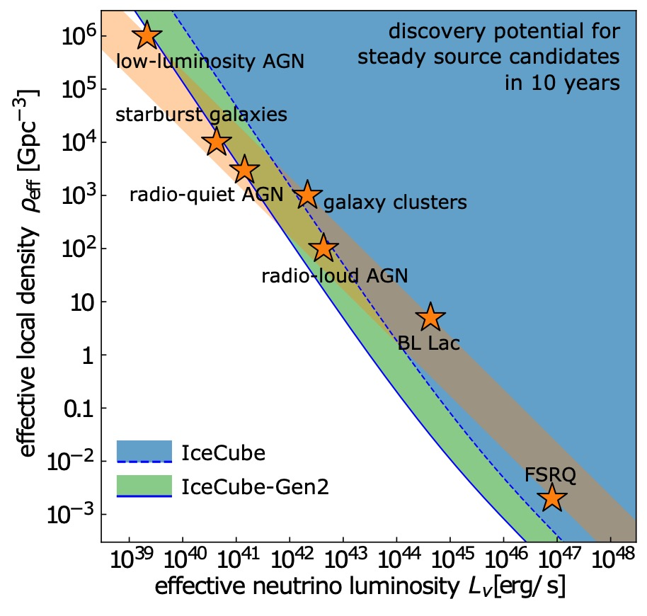
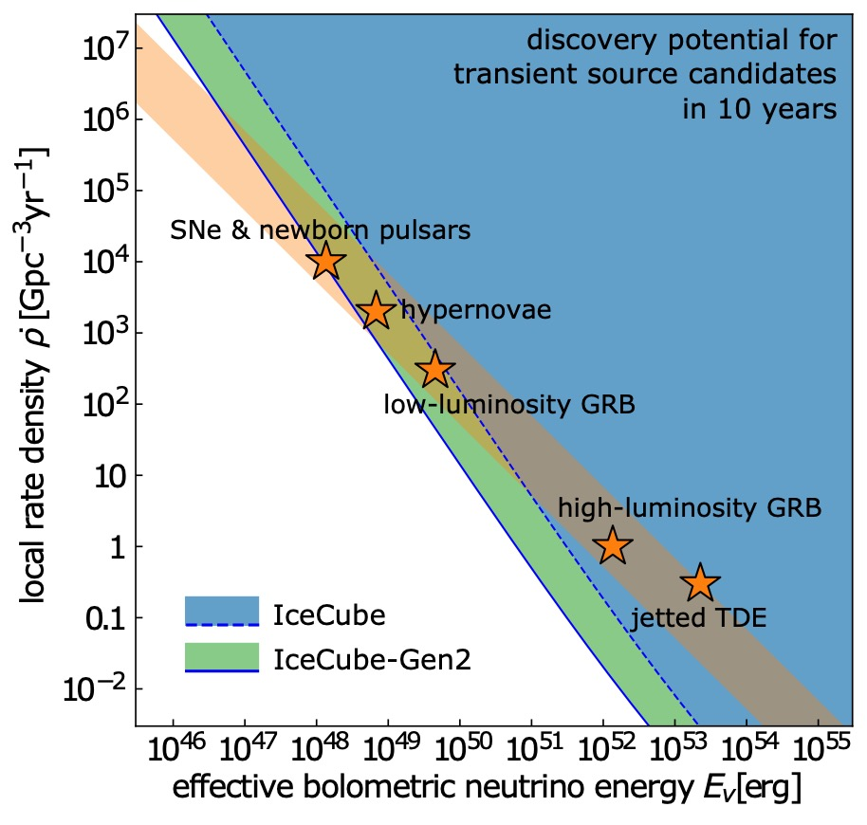
Many dim sources, or few bright sources?
If they are steady
or transient
many dim
few bright
“IceCube-Gen2: The Window to the Extreme Universe”
J. Phys. G: Nucl. Part. Phys. 48 060501 (2021)
Notes:
Comparison of the effective local density and luminosity of extragalactic neutrino source populations to the discovery potential of IceCube and IceCube-Gen2. We indicate several candidate populations (⭐) by the required neutrino luminosity to account for the full diffuse flux [48] (see also [111]). The orange band indicates the luminosity / density range that is compatible with the total observed diffuse neutrino flux. The lower (upper) edge of the band assumes rapid (no) redshift evolution. The shaded regions indicate Ice- Cube’s (blue, dashed line) and IceCube-Gen2’s (green, solid line) ability to discover one or more sources of the population. Right: The same comparison for transient neutrino sources parametrized by their local rate density and bolometric energy [113]. The ν μ + ν ̄ μ discovery potential for the closest source is based on 10 years of livetime (E2F
≃ 0.1 GeV/cm2 in the Northern Hemisphere [114]). Only the IceCube-Gen2 optical array has been considered for this figure.
Previous caption:
Left: Comparison of the diffuse neutrino emission (solid magenta band) to the effective local density and luminosity of extragalactic neutrino source populations. We indicate several candidate populations (⭐) by the required neutrino luminosity to account for the full diffuse flux [17] (see also [25]). The lower (upper) edge of the band assumes rapid (no) redshift evolution. The dark-blue-shaded region indicates IceCube’s discovery potential of the closest source of the population(E2φνμ+ν ̄μ ≃10−12TeV/cm2/sintheNorthernHemisphere[26]).Right:The same comparison for transient neutrino sources parametrized by their local density rate and bolometric energy [27]. The discovery potential of the closest source is based on 10 years of livetime (E2Fνμ+ν ̄μ ≃0.1GeV/cm2intheNorthernHemisphere[28]).
10^6 * 10^39 = 10^45
10^-3 * 10^48 = 10^45
Magenta band has slope -1
Alex, 4/19/22:
For very small densities (bottom of this plot), you expect it to scale linearly (the same way the diffuse band scales). One way to think about this is in the context of the alert followup analysis — you are sensitive so long as you have an expectation of getting at least a few alert events from the sample. That condition is met when you reach a certain constant local energy density (diagonal line on this plot)For higher densities, it's a little harder. It's closer to L^-3/2 (see eg. the 8yr paper that's explicit about it in the text in the upper right)
The logic for the higher density case is not as straightforward though, but it's probably best thought of in terms of stacking sensitivities. For a number of sources N your per-source sensitivity increases by a factor of N^1/2, so the total flux from the population goes like N^3/2
N \propto rho

Slide 36
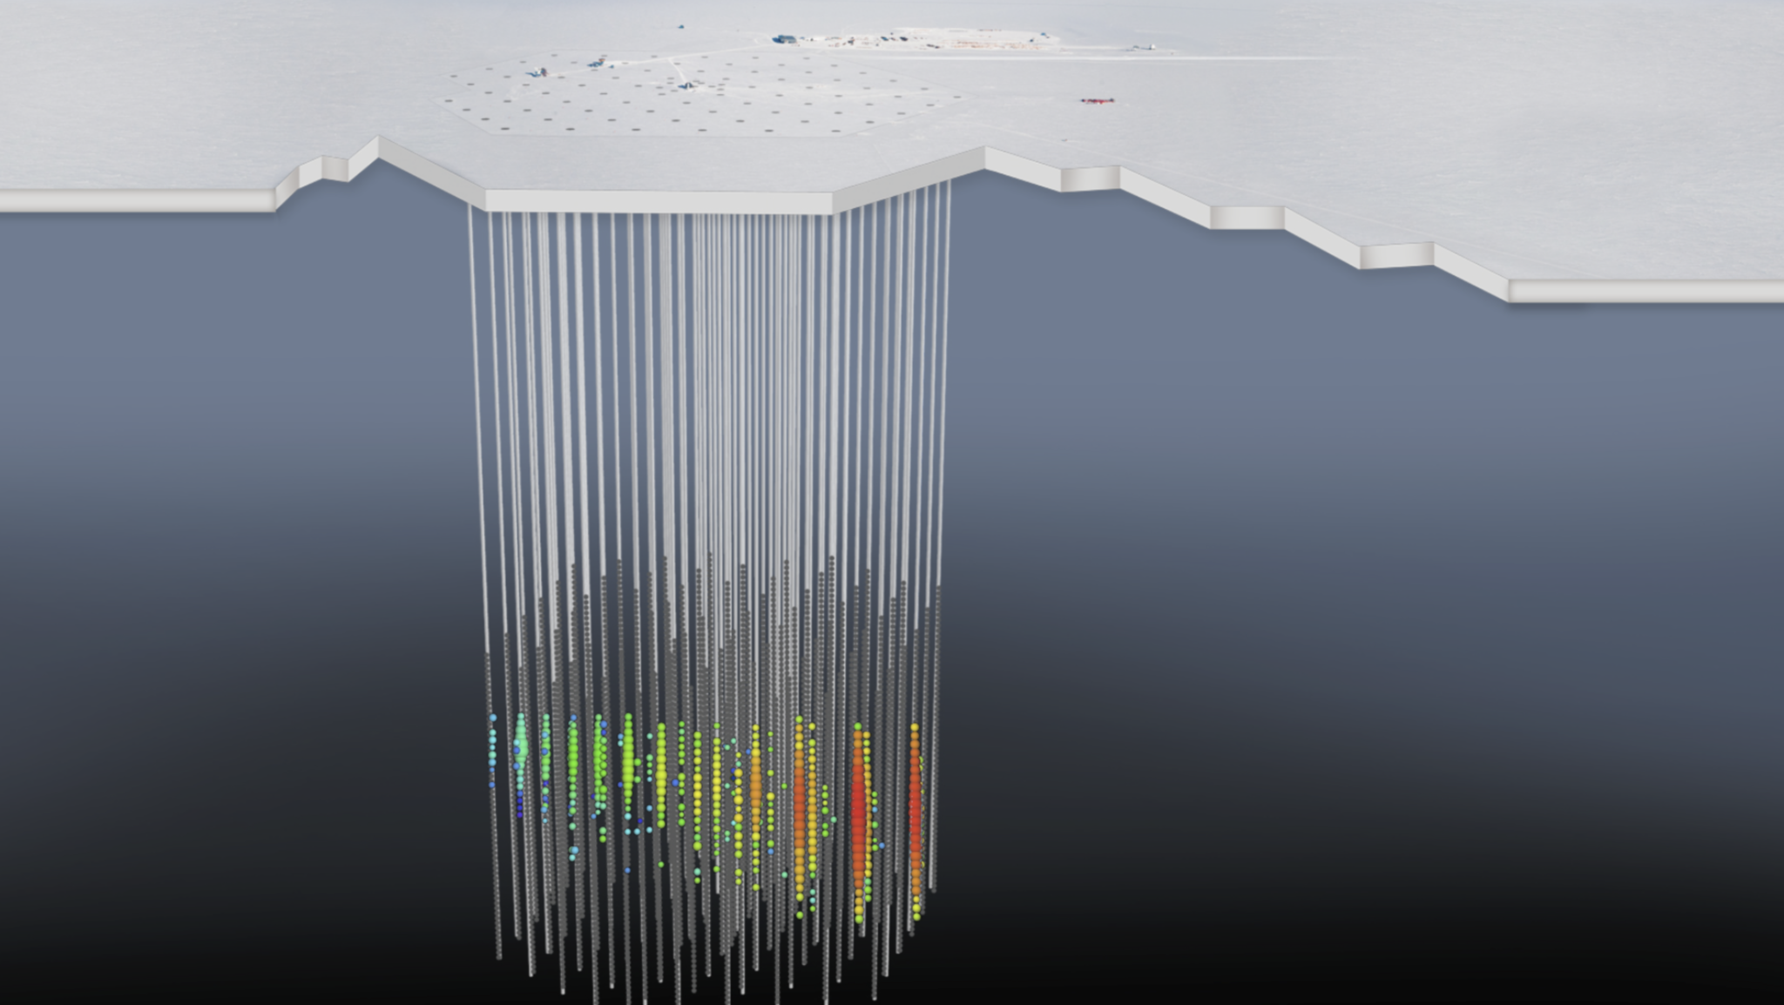
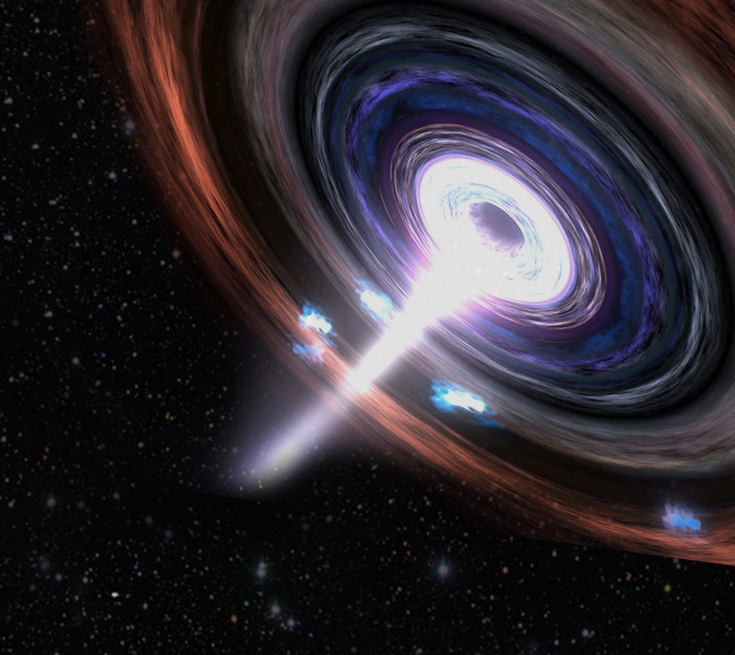
IceCube-170922A
A track with angular uncertainty ~1°
Declination +5.7°, neutrino energy ~290 TeV
Public alert 43 seconds after interaction
TXS 0506+056
(the galaxy from 4 billion years ago)
Notes:
Enu > 183 TeV at 90% CL
Deposited energy 24 TeV
August 17, 2017 at 12:41 UTC = 7:41am Central

Slide 37
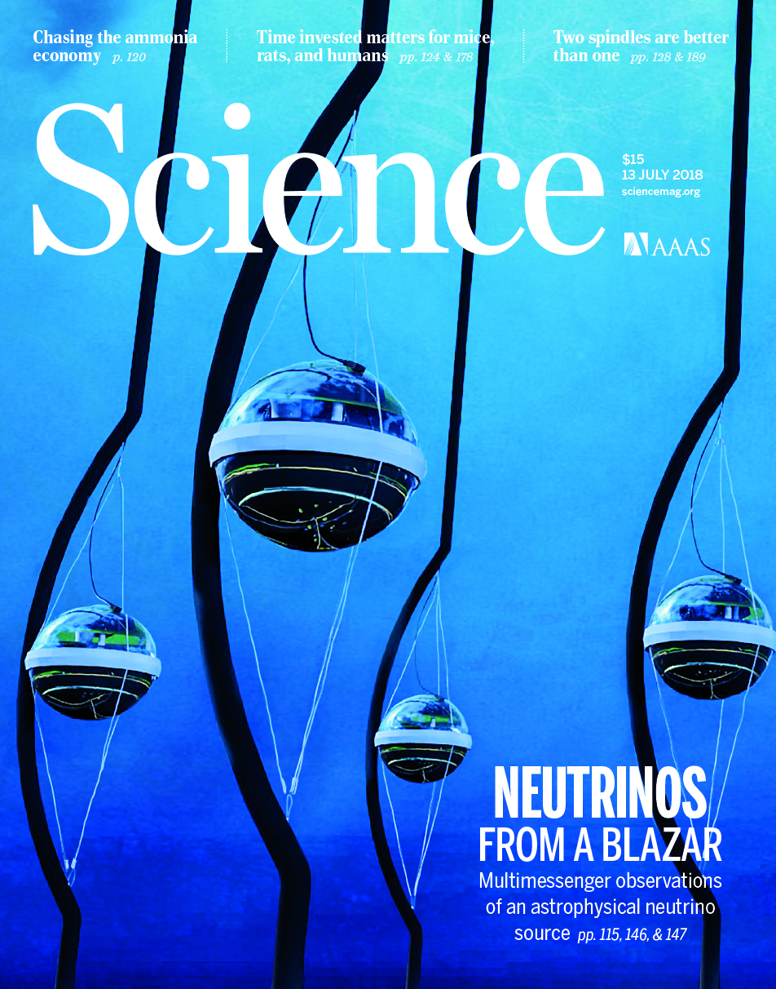
The galaxy that emitted gammas and neutrinos,
4 billion years ago: TXS 0506+056
“Multimessenger observations of a flaring blazar coincident with high-energy neutrino IceCube-170922A”
  3 𝜎 neutrino-gamma coincidence
“Neutrino emission from the direction of the blazar TXS 0506+056 prior to the IceCube-170922A alert”
  Neutrino flare in late 2014 – early 2015: 3.5 𝜎
IceCube, Science 361, 147-151 (2018)
IceCube et al., Science 361, eaat1378 (2018)
Notes:
Paper 1 coincidence significance: 3.0 sigma
First 7 years (excluding 170922A): 2.1 𝜎
First paper: 16 observatories collaborated

Slide 38
Gamma-ray burst 221009A: the brightest of all time
IceCube, ApJ 946:L26 (2023)
Highest ever measured gamma-ray peak flux and bolometric energy
IceCube neutrino search published within hours via GCN
Neutrino limits from MeV to PeV
Strong constraints on baryons in GRBs

