Slide 1
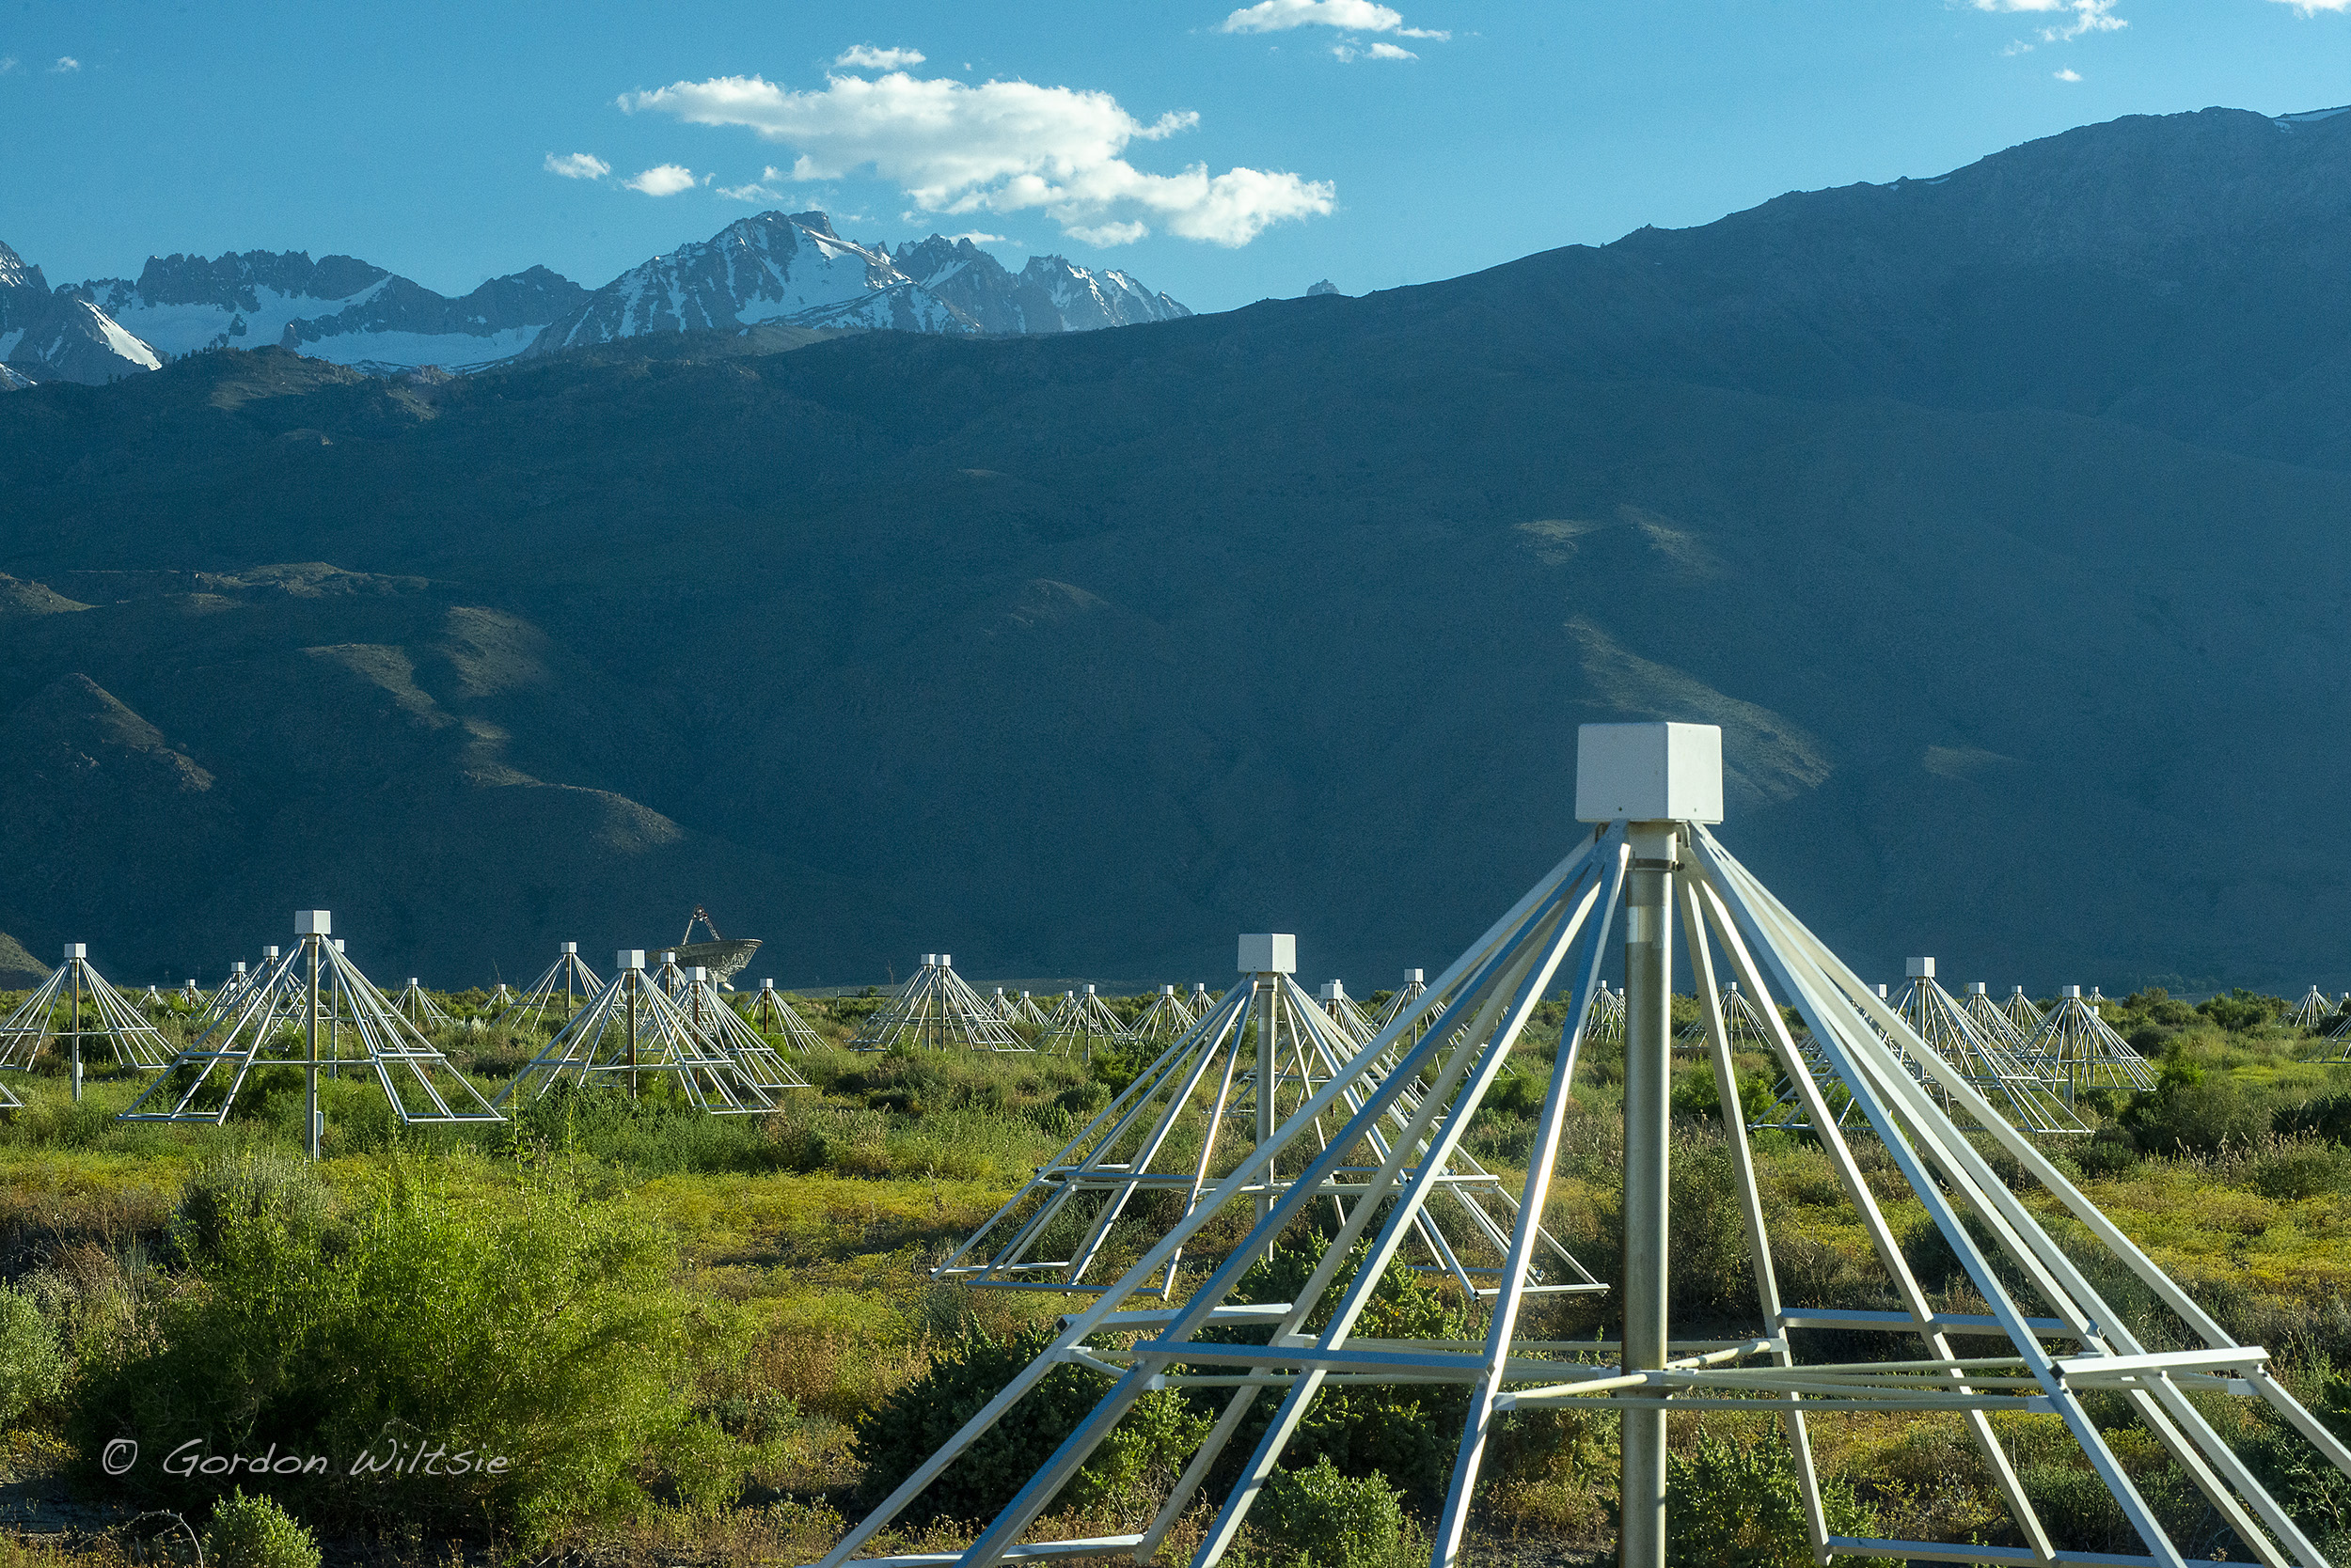
Standalone-radio cosmic ray detection at the OVRO-LWA
Kathryn Plant
1

Slide 2
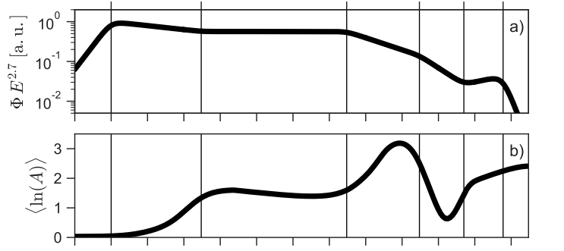
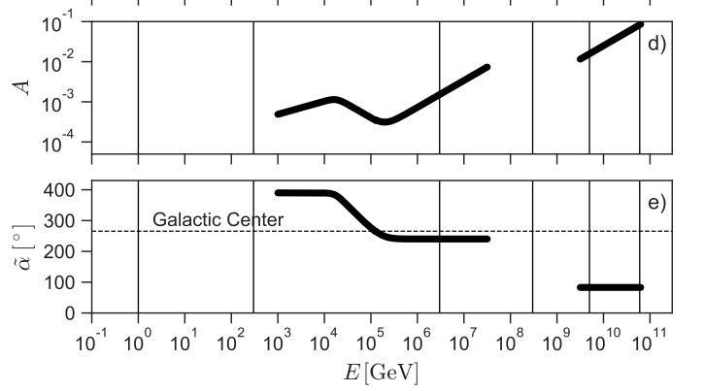
The OVRO-LWA will probe the Galactic to extragalactic transition.
a)
Energy Spectrum
Composition
b)
Energies Observable by OVRO-LWA
Adapted from Becker-Tjus and Merton 2017
Dipole amplitude
Anisotropy
c)
Dipole phase [degrees]
d)

Slide 3
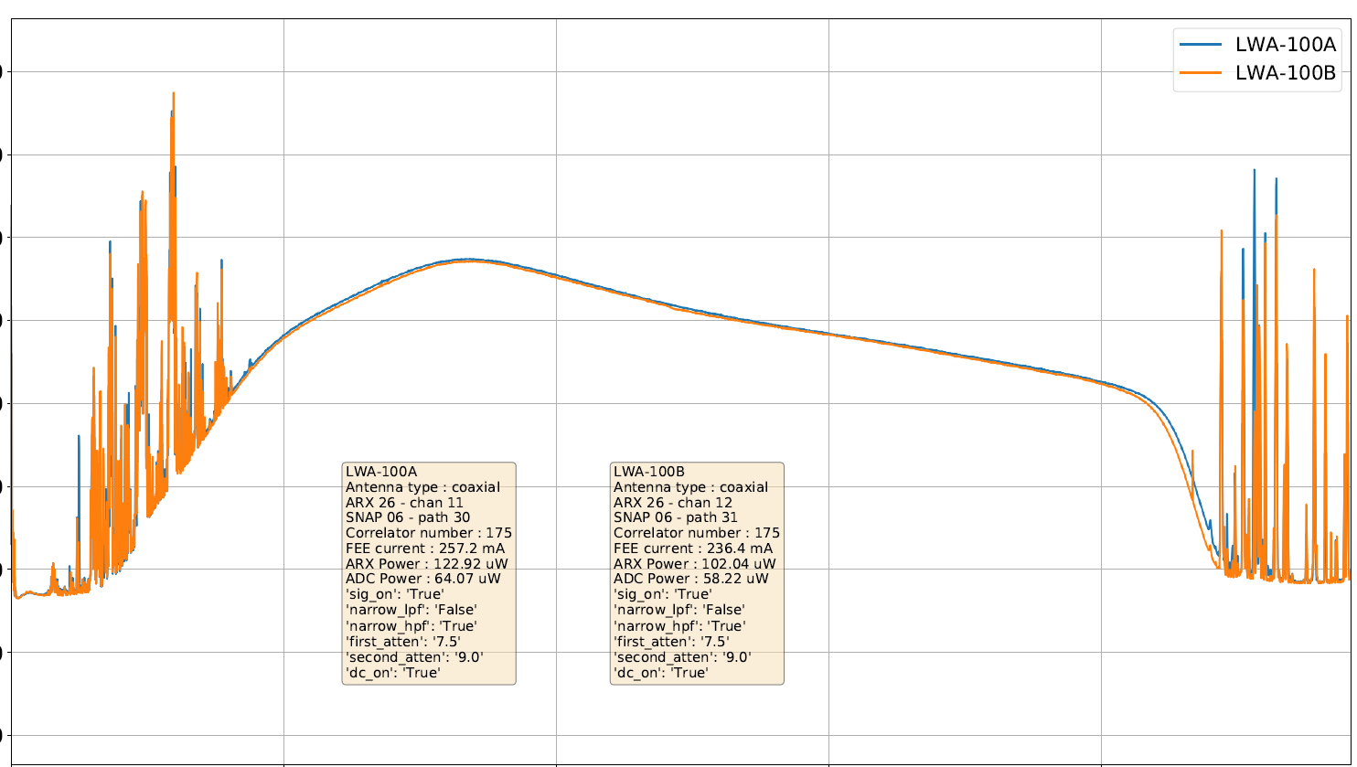
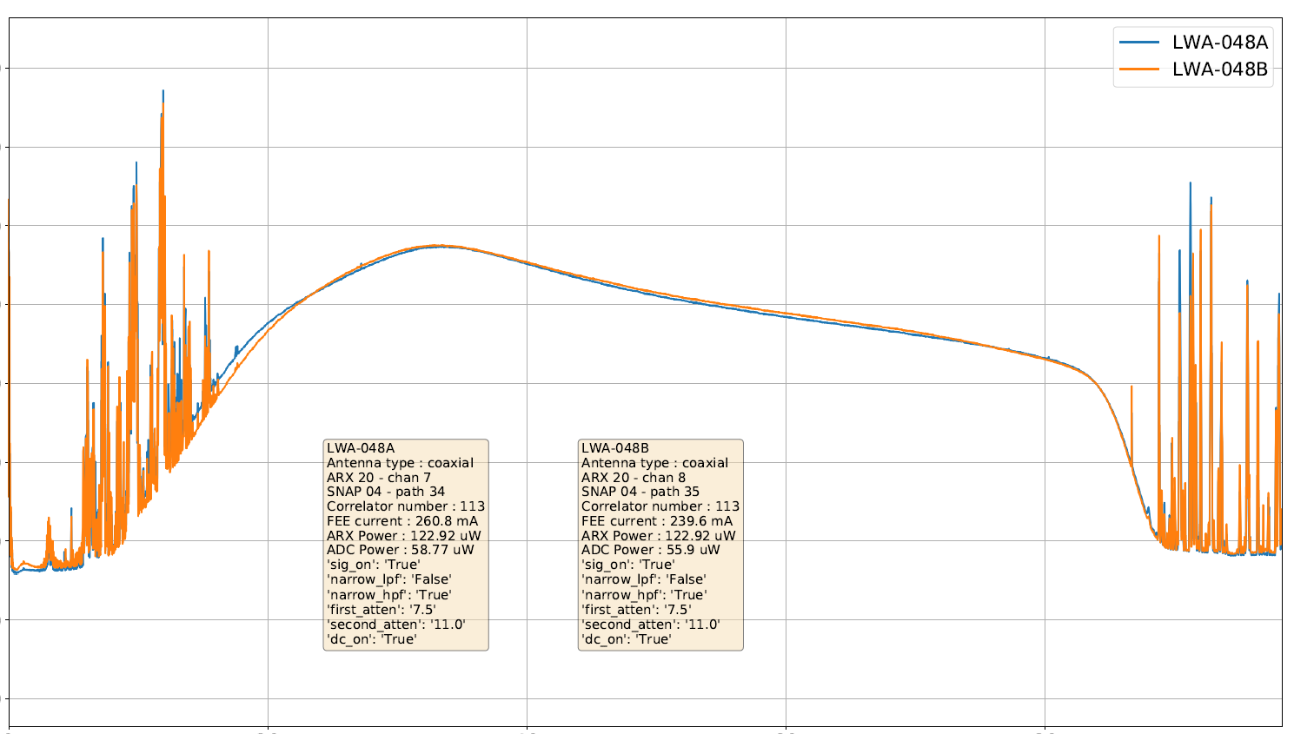
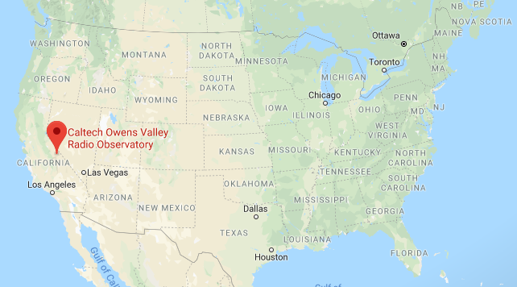
Introduction to the OVRO-LWA
-20
-30
-40
-50
Power [dBm]
-60
-70
-80
-90
-100
0
20
40
60
80
Frequency [MHz]
Extrasolar space weather, epoch of reionization, solar astronomy, cosmic rays and more

Slide 4
Array layout
352 dual-polarization dipoles
0.1
1
N-S position [km]
0
0.5
N-S position [km]
-0.1
Log signal-to-noise ratio
0
-0.1
0
0.1
E-W position [km]
-0.5
-1
-1.5
-1
-0.5
0
0.5
E-W position [km]

Slide 5
The OVRO-LWA underwent a major upgrade from 2019-2023.
Feature
Expansion: 288 → 352 dual polarization antennas 1.5 km →2.4 km longest baselines
Refurbish all front-end electronics
New RF over optical fiber modules
New analog receiver boards for better signal path isolation
All new digital signal processing electronics: opportunity for commensal cosmic ray search
Junction box
Simplified LWA signal path
Analog receiver electronics
ADC
Digital signal processing

Slide 6
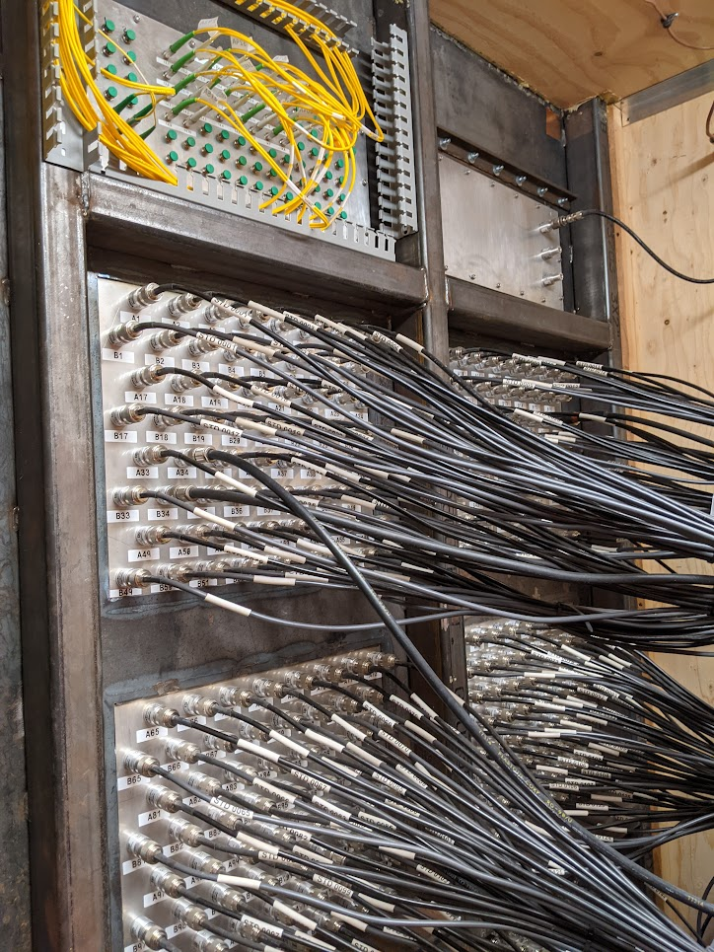
Bringing all signals to a central location is crucial to the cosmic ray detection strategy.
Requires a combination of:
Coaxial cable
RF over Fiber optics

Slide 7
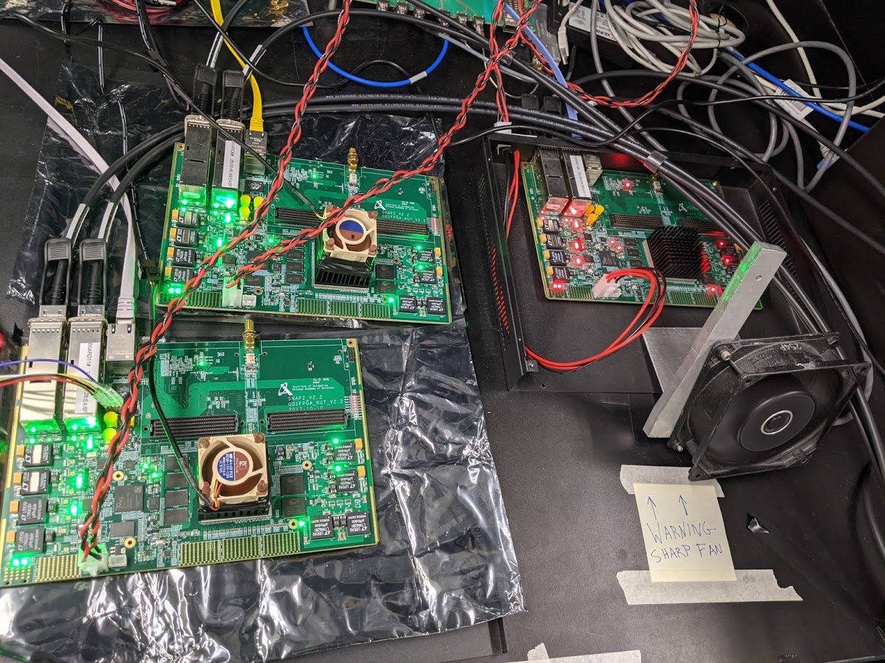
OVRO-LWA signal path
Electronics Shelter
x11
x44
x44
Junction box
Analog receiver boards
ADC board
SNAP2 board
x352
x352
40Gb switch
Cosmic ray threshold-coincidence trigger firmware runs alongside firmware for other observing modes.
Cosmic ray server
GPU correlator

Slide 8
My cosmic ray search strategy leverages the array layout.
a)
1
0.5
Array layout color-coded by FPGA
Distant antennas veto RFI.
N-S position [km]
0
-0.5
-1
-1.2 -0.8 -0.4 0 0.4
E-W position [km]

Slide 9
Data flow and detector dead time
FPGA
FPGA
Design challenges
Readout firmware strategy
Inter-FPGA communication
FPGA
FPGA
Waveform data
40 Gbit switch
FPGA
Trigger
CPU
FPGA
Control settings
1 Gbit switch
FPGA
Performance
Readout time: 0.7ms
Inter-FPGA communication time: 0.84 microsecond
Dead time for 20-40 Hz trigger rate: 1.3-2.7%
Veto dead time 4%
Total: 5-7%
FPGA
FPGA
FPGA
FPGA

Slide 10
Event Classification Software: Reject RFI & identify cosmic rays
Example dataset: 19 hours from 2 nights
April 29-30 & May 1-2
Summary statistics for each event
……………………………………………………….877365 events
Basic quality criteria
~1% pass
……………………………………………………….3368 events
Model fits
Spherical wavefront fit to arrival times
2D Gaussian fit to spatial distribution of SNR
Apply selection criteria on model fits
~0.1% pass
………………………………………………………4 candidate cosmic rays
Cosmic ray candidates

Slide 11
Example Event– Arrival time & signal to noise ratio
1
0.5
N-S position [km]
0
Log SNR
-0.5
-1
-1.5
-1
-0.5
0
0.5
E-W position [km]

Slide 12
Example cosmic ray candidate 21-Feb-2024
E-W polarization
1.0
16
Gaussian fit RMS residual ~ 1.18
0.5
12
Measured SNR
N-S Position [km]
Best fit 2D Gaussian Model SNR
0.0
8
Measured SNR
Residual
0.8
16
16
-0.5
4
14
14
2
0.4
12
12
N-S Position [km]
10
10
0
-1.0
0
0.0
8
8
-2
1.5 1.0 -0.5 0 0.5
E-W Position [km]
-0.4
6
6
-0.8 -0.4 0
-0.8 -0.4 0
-0.8 -0.4 0
E-W Position [km]
E-W Position [km]
E-W Position [km]
SNR=(Peak of Hilbert envelope)/rms
Mean SNR of background noise ~3.8

Slide 13
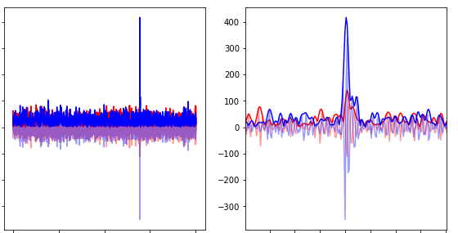
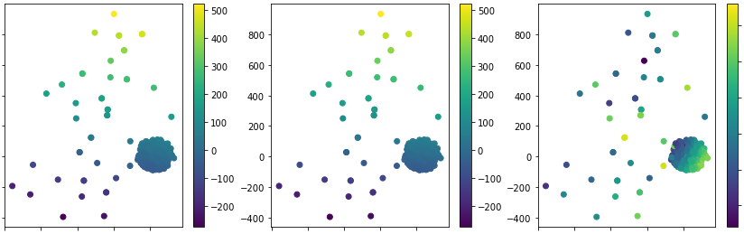
ction azimuth 189.999 +- 0.22 degree Gaussian semimajor axis azimuth 18.133 +- 1.604 degree Arrival direction ZA 63.655 +- 0.397 degree Gaussian aspect ratio 2.276 +- 0.129
Example cosmic ray candidate 21-Feb-2024
Waveform of highest-SNR antenna
400
--E-W polarization
--N-S polarization
Best-fit arrival direction:
Azimuth 190.0 +- 0.2 degrees
Zenith angle 63.7 +- 0.4 degrees
200
Voltage [ADC units]
0
-200
Measured relative arrival times
Best fit spherical wavefront model arrival times
0
2000
4000
2700
2800
Residual
Time [clock cycles]
0.8
15
400
400
10
0.4
200
200
5
N-S Position [km]
0
0.0
0
0
-5
-0.4
-200
-200
-10
-0.8 -0.4 0
-0.8 -0.4 0
-0.8 -0.4 0
E-W Position [km]
E-W Position [km]
E-W Position [km]

Slide 14
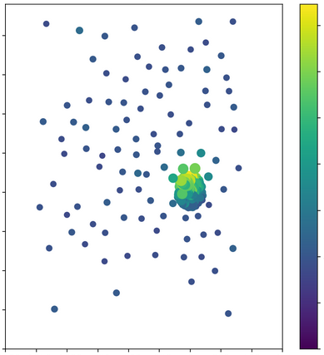
Example cosmic ray candidate 01-May-2024
E-W polarization
1.0
14
Gaussian fit RMS residual ~ 0.92
12
0.5
10
Measured SNR
8
Best fit 2D Gaussian Model SNR
N-S Position [km]
0.0
6
Measured SNR
Residual
0.2
14
14
-0.5
4
1
12
12
2
0.1
0
N-S Position [km]
10
10
-1.0
0
0.0
8
8
-1
1.5 1.0 -0.5 0 0.5
E-W Position [km]
-0.1
6
6
-0.1 0 1.0
-0.1 0 1.0
-0.1 0 1.0
E-W Position [km]
E-W Position [km]
E-W Position [km]

Slide 15
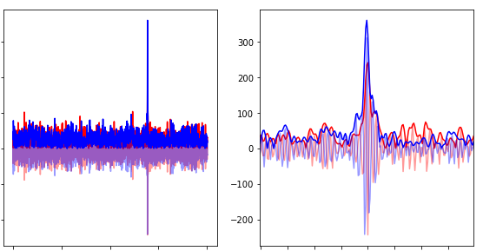
Example cosmic ray candidate 01-May-2024
Waveform of highest-SNR antenna
300
--E-W polarization
--N-S polarization
Best-fit arrival direction:
Azimuth 52.0 +- 0.2 degrees
Zenith angle 33.4 +- 0.1 degree
200
100
Voltage [ADC units]
0
-100
-200
Measured relative arrival times
Best fit spherical wavefront model arrival times
0
2000
4000
2700
2800
Residual
Time [clock cycles]
0.2
0.1
40
40
4
0.0
0
2
N-S Position [km]
0
0
-0.1
-40
-40
-2
-0.1 0 1.0
-0.1 0 1.0
-0.1 0 1.0
E-W Position [km]
E-W Position [km]
E-W Position [km]

Slide 16
Next steps
Refine calibration
X-max reconstruction
Explore interferometric reconstruction
Cross-comparison with muon detector

Slide 17
Conclusions
The standalone-radio cosmic ray detector for the OVRO-LWA is complete and cosmic ray searching has begun.
Detector dead time 5-7%
Detailed spatial sampling of cosmic ray footprints supports goals of precise air shower reconstruction, and testing interferometric techniques.

Slide 18
Extra slides

Slide 19
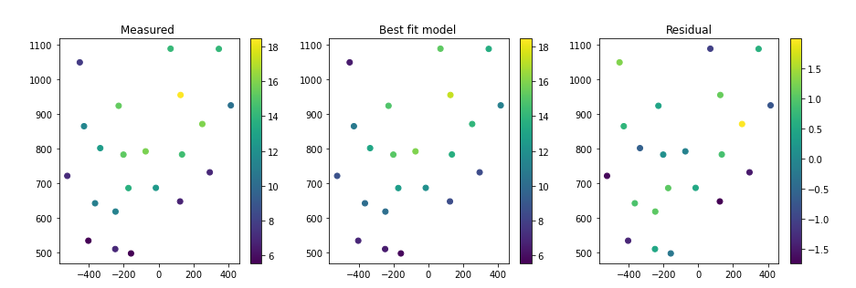
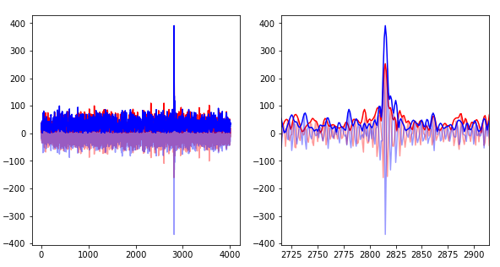
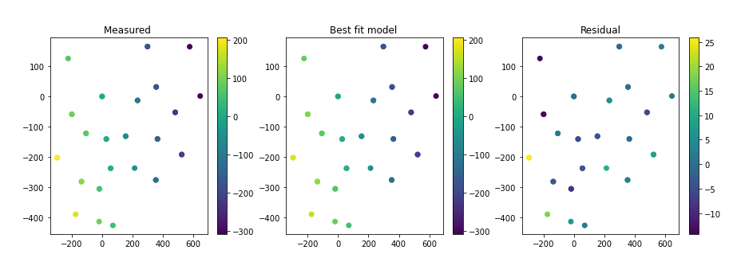
01-May-2024
2D Gaussian
Arrival direction

Slide 20
Summary of cosmic ray system design goals
Observable | Instrument Functional Requirement
Band-limited radio impulse | 5ns time resolution, 1ns timing synchronization
Polarized emission | Search 2 polarizations
Beamed emission | Subsets of antennas can trigger full-array readout
Expected flux: 5 events per day over OVRO-LWA core | Detector dead time <10%
Engineering constraint | Instrument Functional Requirement
Total data rate of OVRO-LWA is ~terabit per second | Buffer data, and trigger readout
Array spans 2.4 km | Buffer should be 20 microseconds to sample background before event

Slide 21
Cosmic ray composition measurements are the key.
Only accessible via ground-based experiments
Observable by
OVRO-LWA
Individual sources may have rigidity-dependent cutoff energies.
Hence shifts in composition are clues to shifts in source classes.
9 10 11 12 13 14 15 16 17 18 19 20
Schroeder 2019
log (E/eV)

