Slide 1



Improving air-shower observations with the Surface Array Enhancement - Results from a Prototype Station
Megha Venugopal for the IceCube Collaboration
ARENA 2024, Chicago

Slide 2

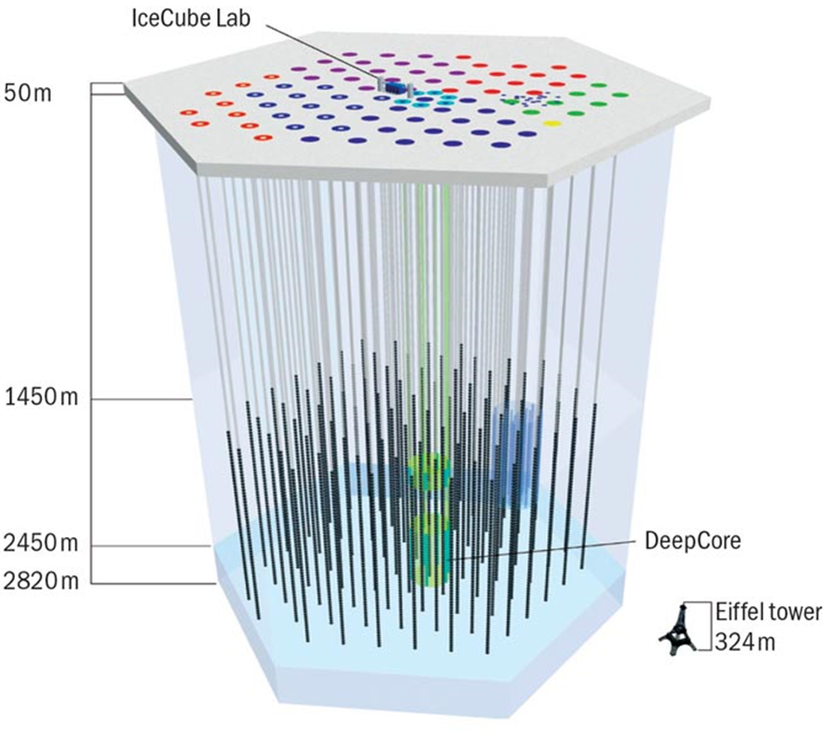
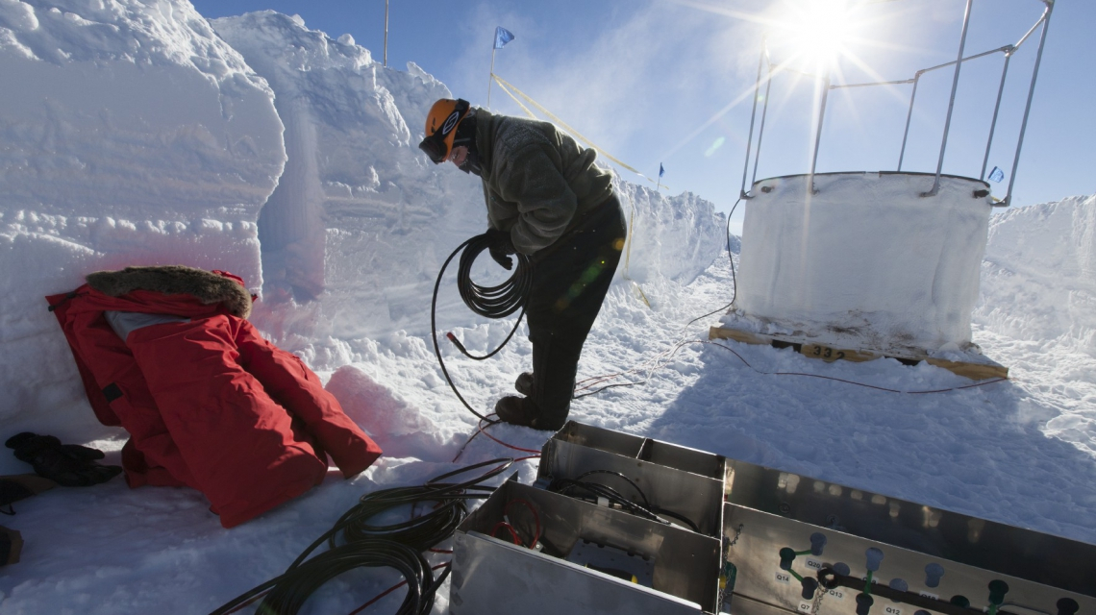
IceCube and IceTop
IceCube is a km³ detector in ice detecting neutrinos and atmospheric muons
IceTop is a km² surface array for cosmic ray research and also serves as a veto for IceCube neutrino research.
Deployment of an IceTop tank

Slide 3
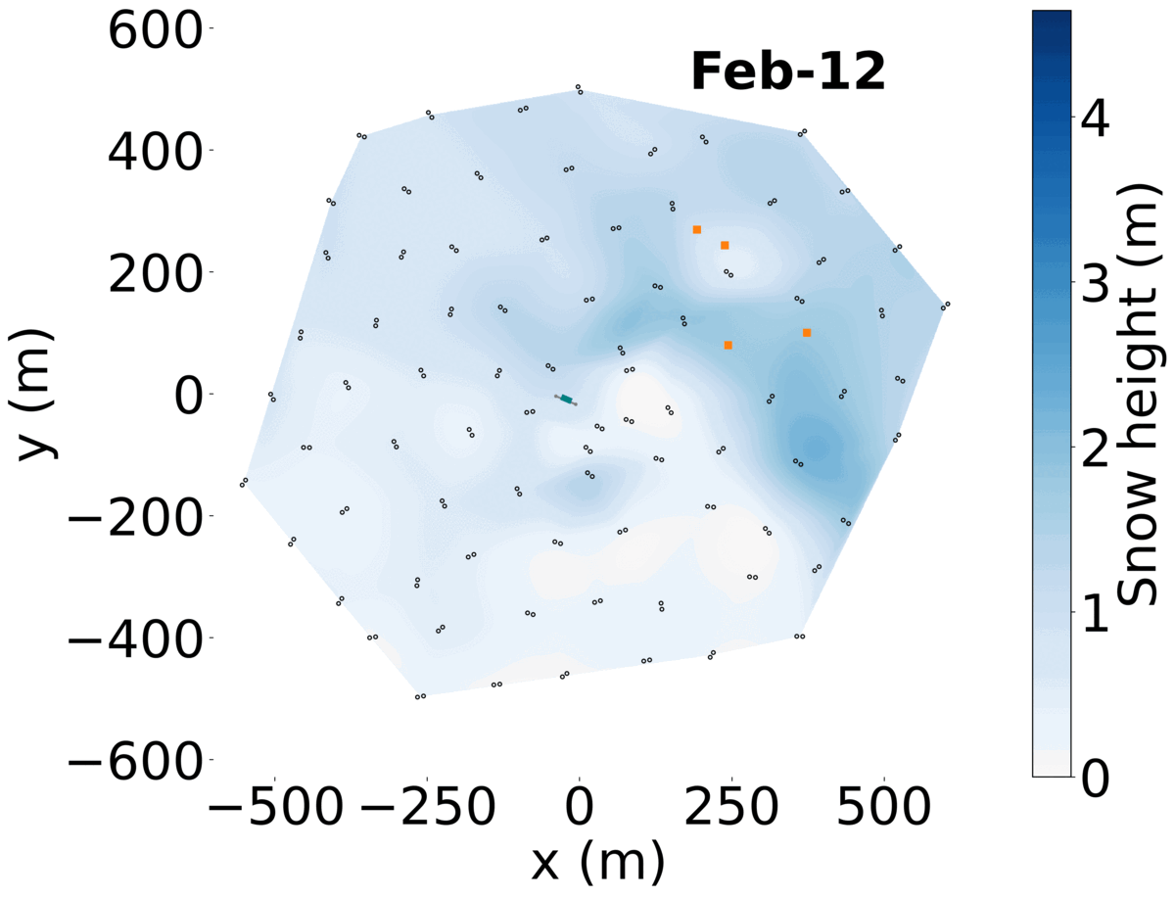

IceTop
Plot credit: J. Saffer
Snow accumulation over time on IceTop
Rising snow accumulation driven by winds
Reduced efficiency detecting low energy cosmic rays
Higher uncertainty in air-shower reconstruction

Slide 4
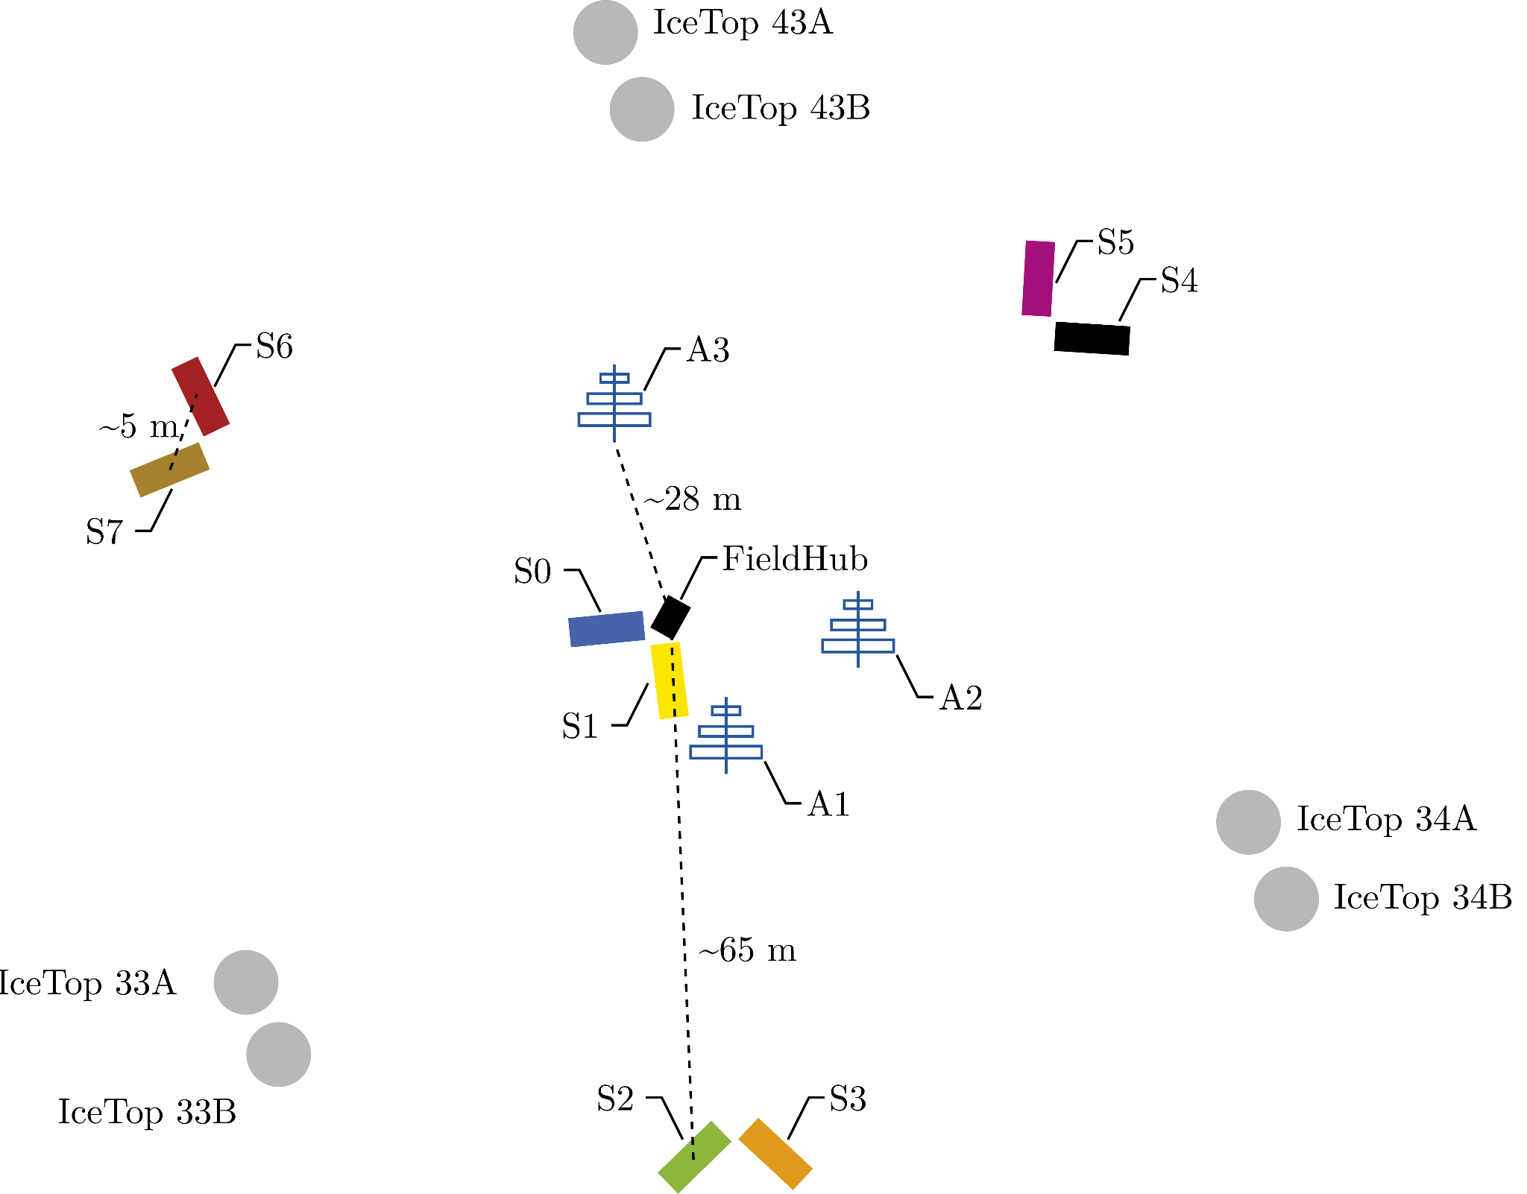
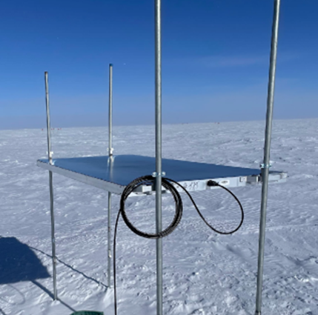
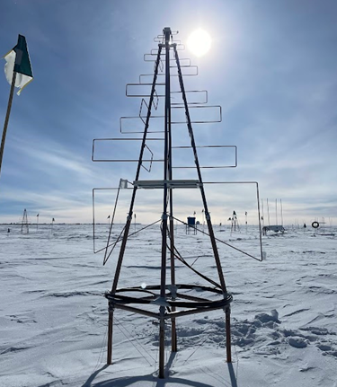
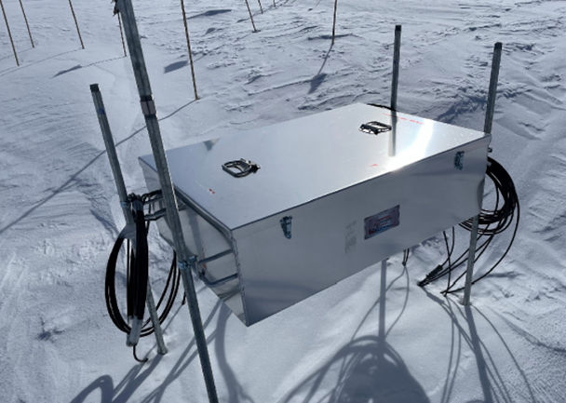
The prototype station of the Surface Array Enhancement
Scintillator
LPDA Antenna
Layout of the Prototype Station
2 types of detectors -
  3 antennas and 8 scintillation detectors per station
  Easy to elevate and cost-effective
Radio operational band 70-350 MHz
Deployed in 2020, upgraded in 2023
Central DAQ

Slide 5
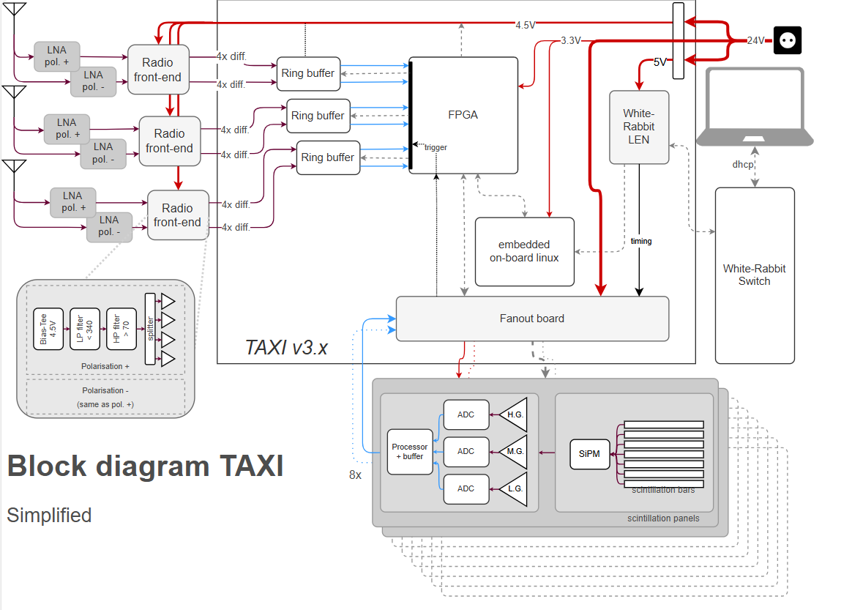
The Data Acquisition of the SAE

Slide 6


The Data Acquisition of the SAE
Radio
Radio trigger condition >6 scintillators hit in 1 µs
Scintillator

Slide 7
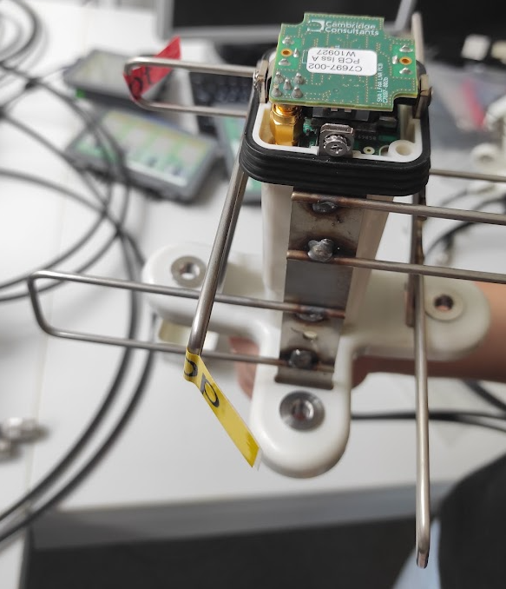
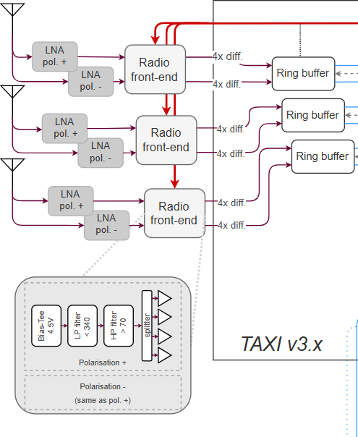

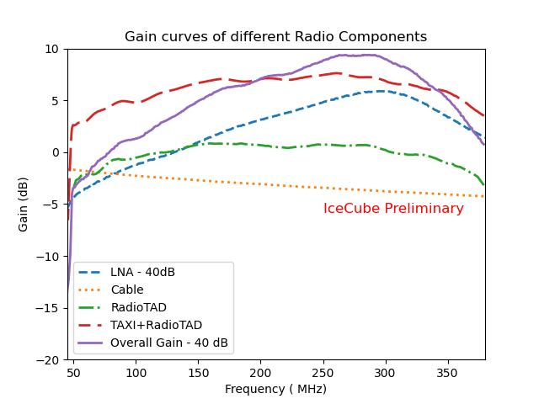
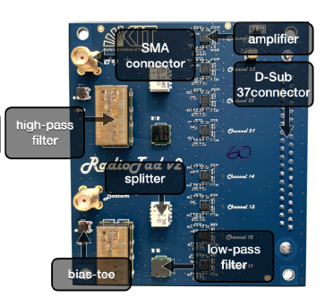
Radio signal chain
Low-Noise Amplifier
TAXI 3.2
RadioTAD

Slide 8
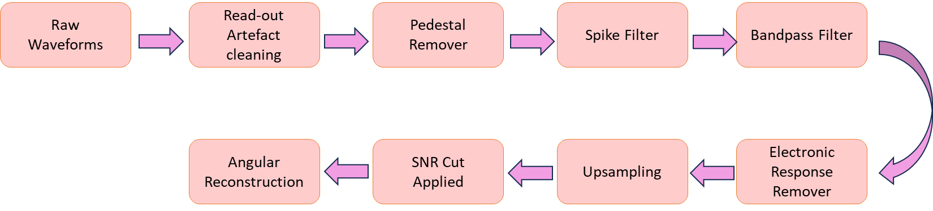
Air shower identification with the Prototype Station
Dataset : Jan - Jun 2022 (4 months considered) due to differences in data taking
Radio coincidence identified with IceTop and scintillation panels - in a 2µs window during processing.
Cleaned for artefacts and RFI, filtered to 100-230 MHz, electronic response removed
SNR cut computed from background data to reject 95% background per antenna
Signal required in all 3 antennas
Background is recorded with a fixed rate trigger.
95% of background for each antenna is rejected by checking the SNR distribution.

Slide 9
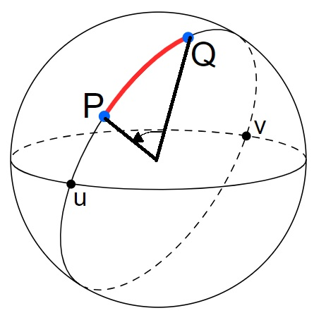
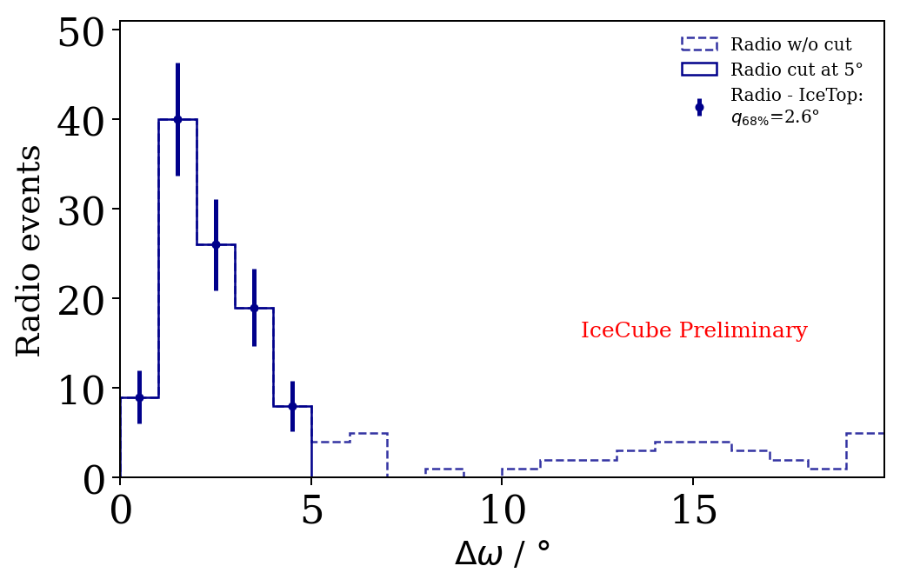
Difference in opening angle w.r.t IceTop
Δω
Cut when opening angle between the direction reconstructed by IceTop and radio Δω ≥ 5°
Total number of events after cut with the SNR method= 104 (341 total identified events after SNR cut.)

Slide 10
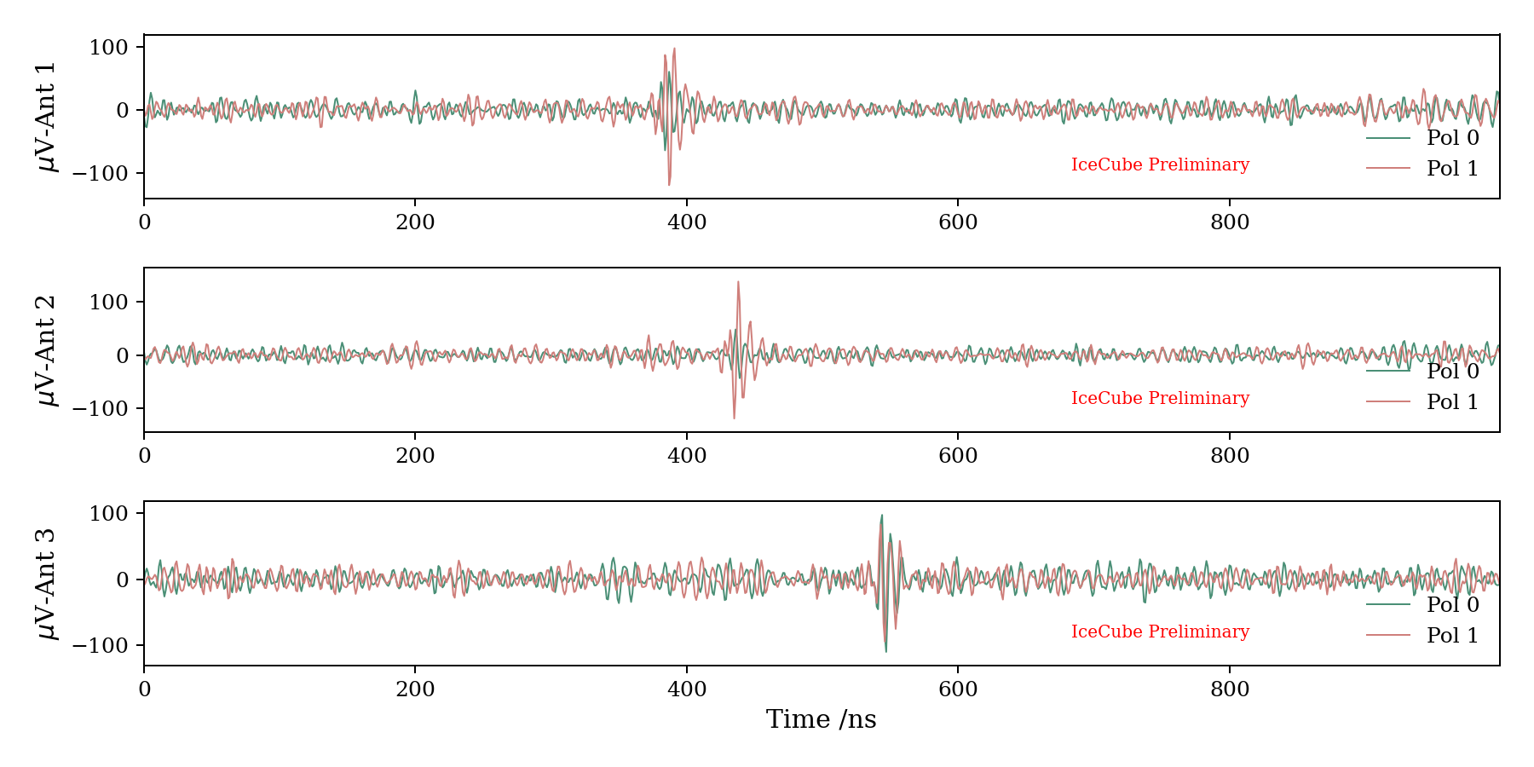
Example air-shower event in radio

Slide 11
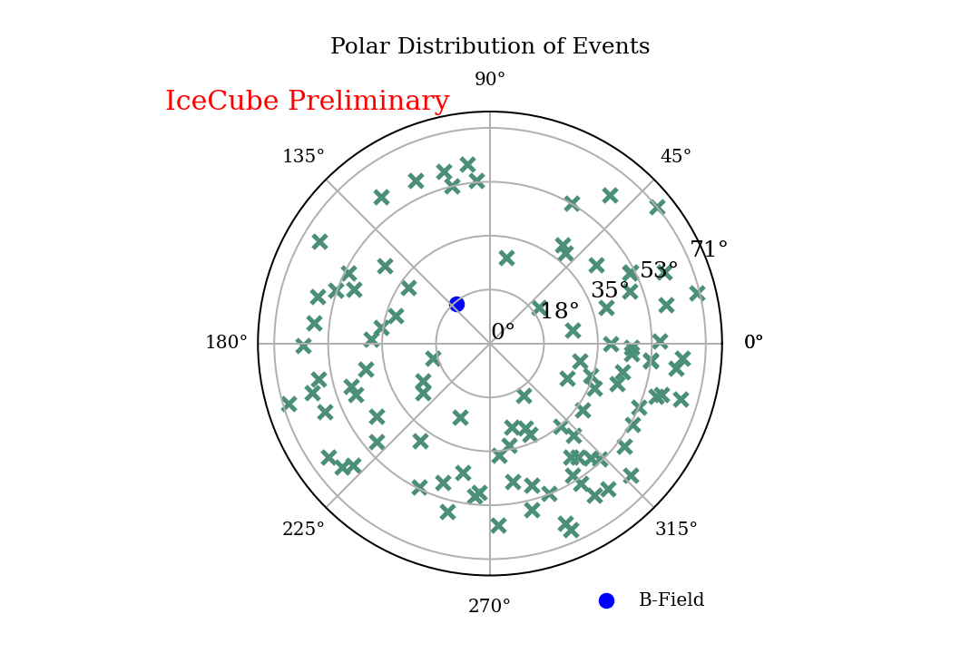
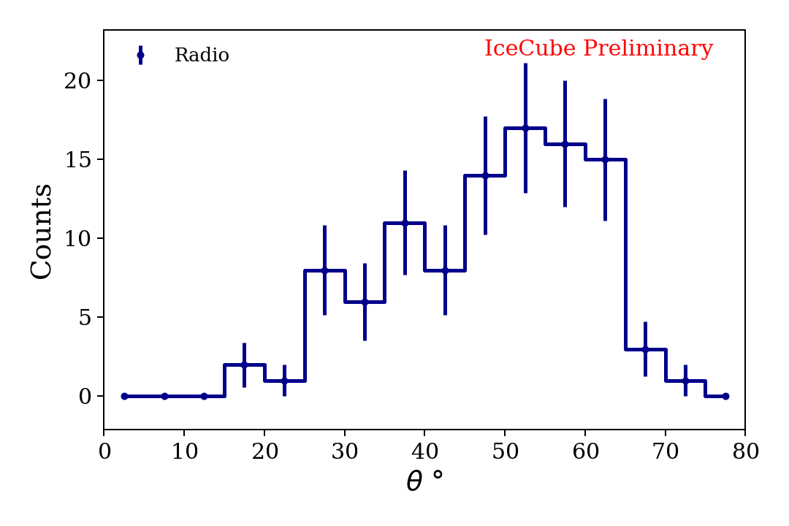
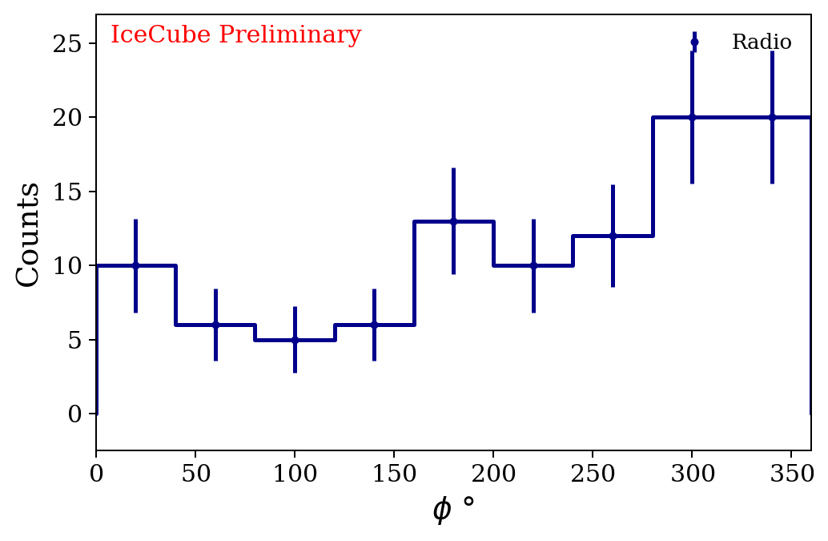
Distribution of all radio events in the sky

Slide 12
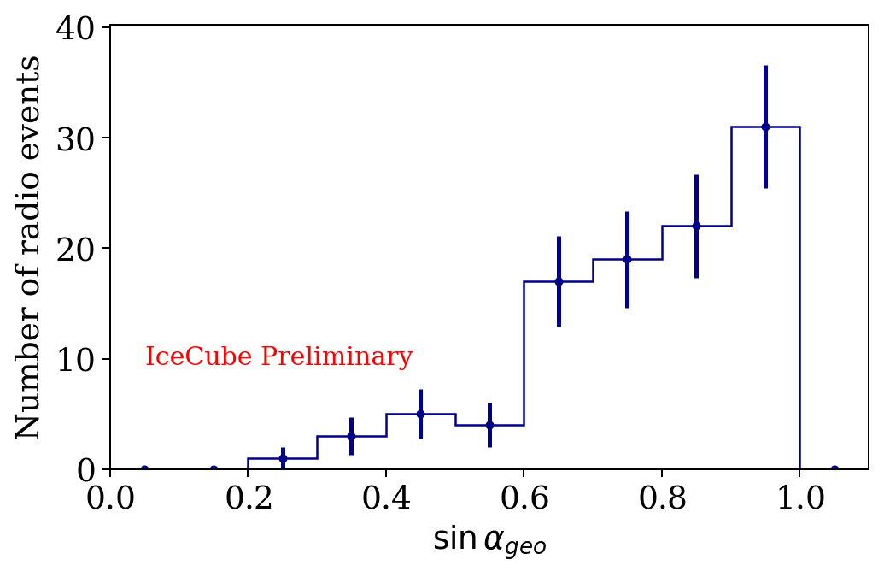
Scaling of radio events with the geomagnetic angle
Larger radio signal with increasing geomagnetic angle - we see more events as expected;

Slide 13
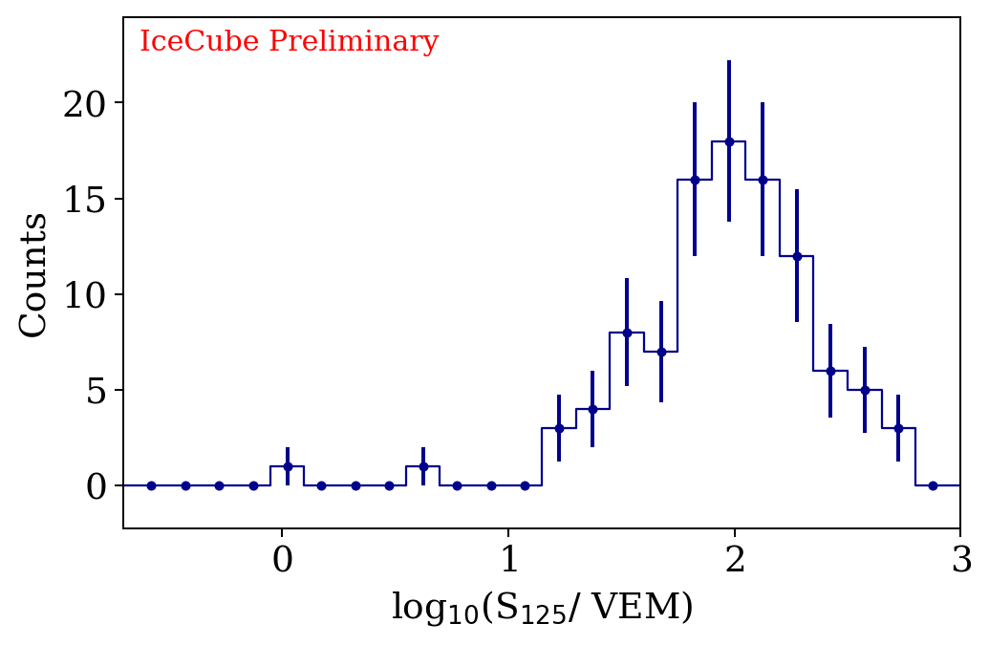
S125 Distribution of all events
S₁₂₅ - energy proxy for IceTop
  Calibrated for quasi-vertical showers
  1 VEM ~ 1PeV
S₁₂₅ corresponds to an LDF value taken at the reference distance of 125 m from the shower axis.

Slide 14
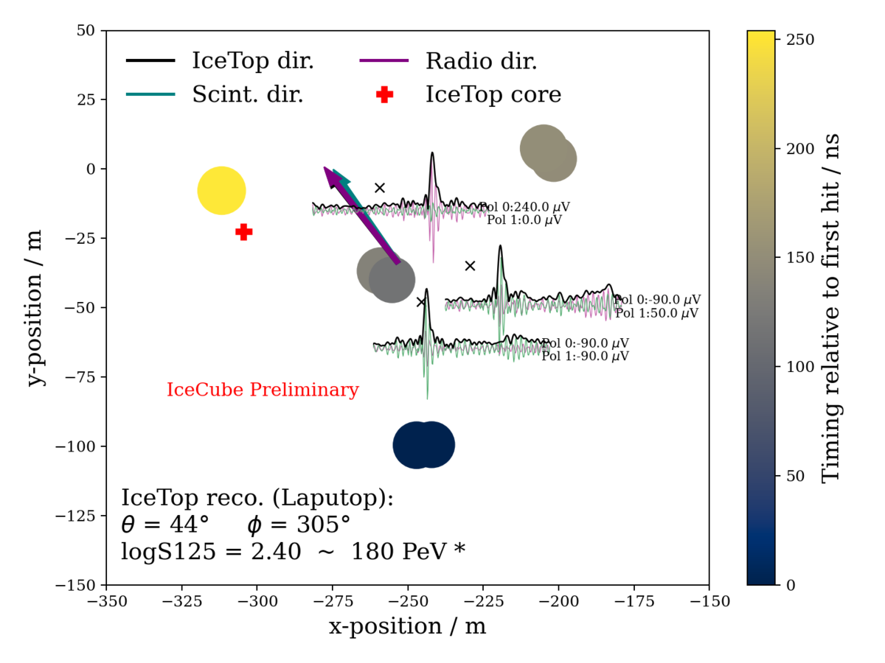
Example 3-fold coincidence events with core reconstructed in IceTop footprint
Blobs show scintillator charge and timing
Arrows indicate reconstructed directions by different detectors
Red plus sign indicates core reconstructed with IceTop.

Slide 15
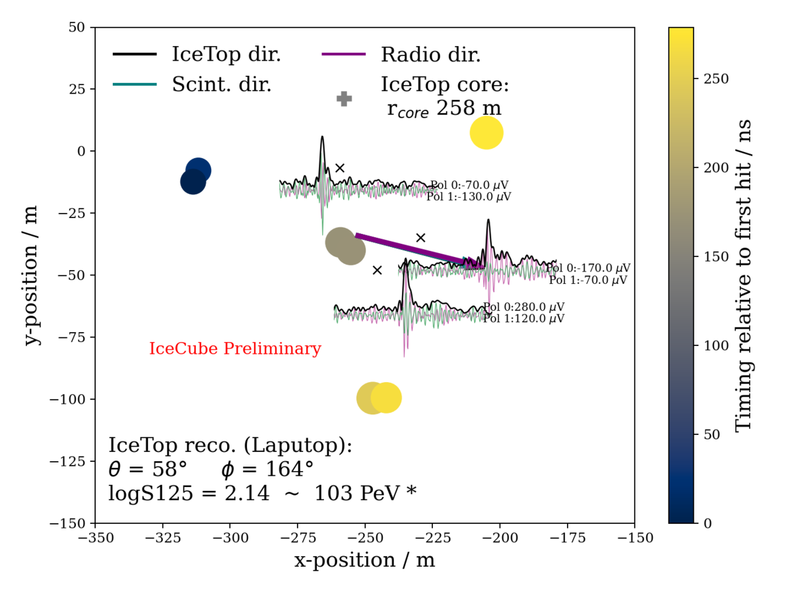
Example 3-fold coincidence events with core reconstructed outside IceTop footprint
Blobs show scintillator charge and timing
Arrows indicate reconstructed directions by different detectors
Grey plus sign indicates core reconstructed with IceTop lying outside IceTop footprint..

Slide 16
Conclusion
Outlook
The antennas at the Pole are the first operating in a 70 - 350 MHz and the analysis is carried out in the 100 - 280 MHz.
The radio antennas of the prototype station at the Pole are fully functional and detecting air showers continuously with energies starting from 10 PeV.
We have detected over 100 events in a 4 month time period.
.
The surface enhancement will be a unique detector capable of giving insights into cosmic ray science with its multi-detector systems.
The station layout is used in the design of the IceCube-Gen2 surface array with a footprint increase by a factor of 8 over IceTop.

Slide 17
Thank you!

Slide 18
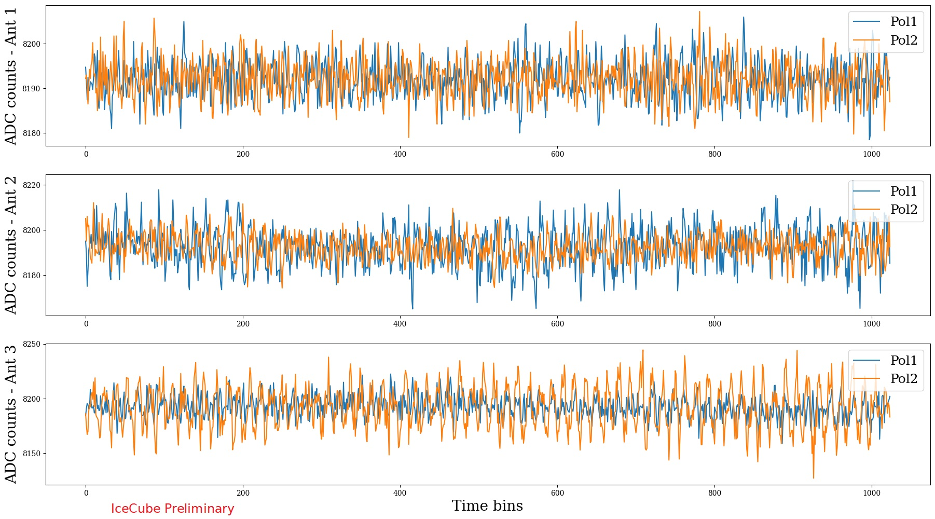
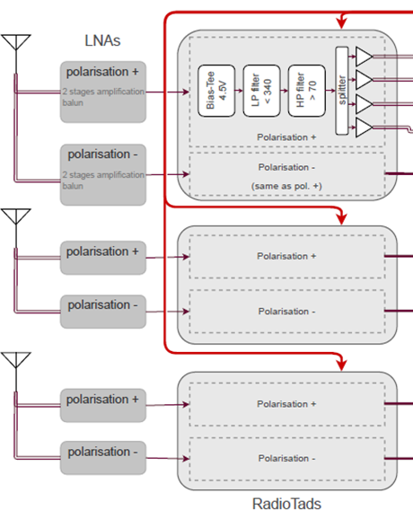
Average background traces as measured by the DAQ
TAXI 3.2
Measured in 3 antennas over 2 polarizations
Averaged over one day

Slide 19
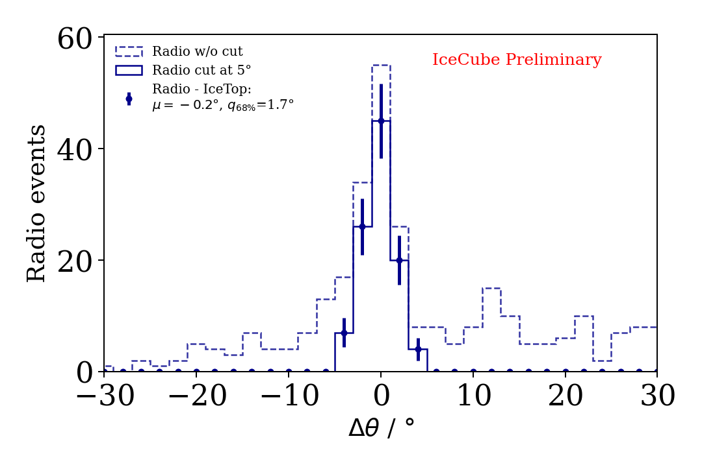
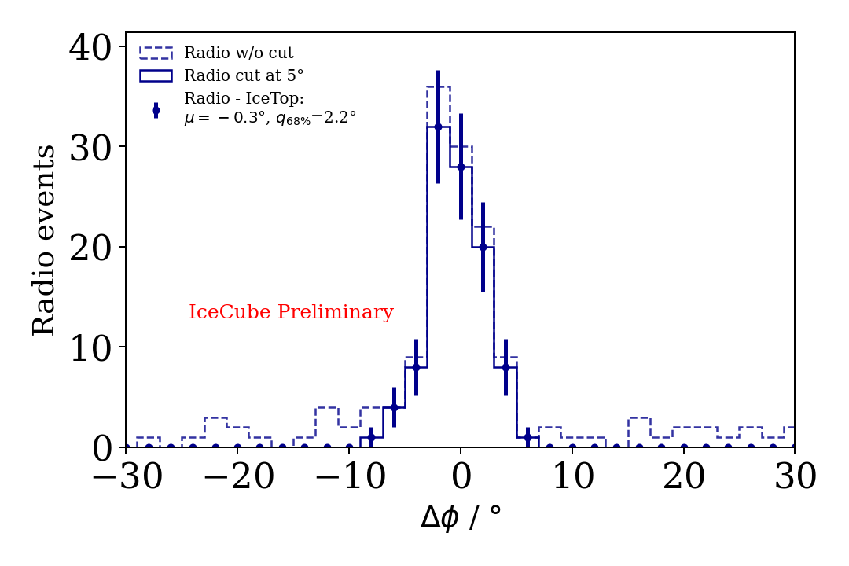
Difference in reconstructed zenith and azimuth w.r.t IceTop

Slide 20
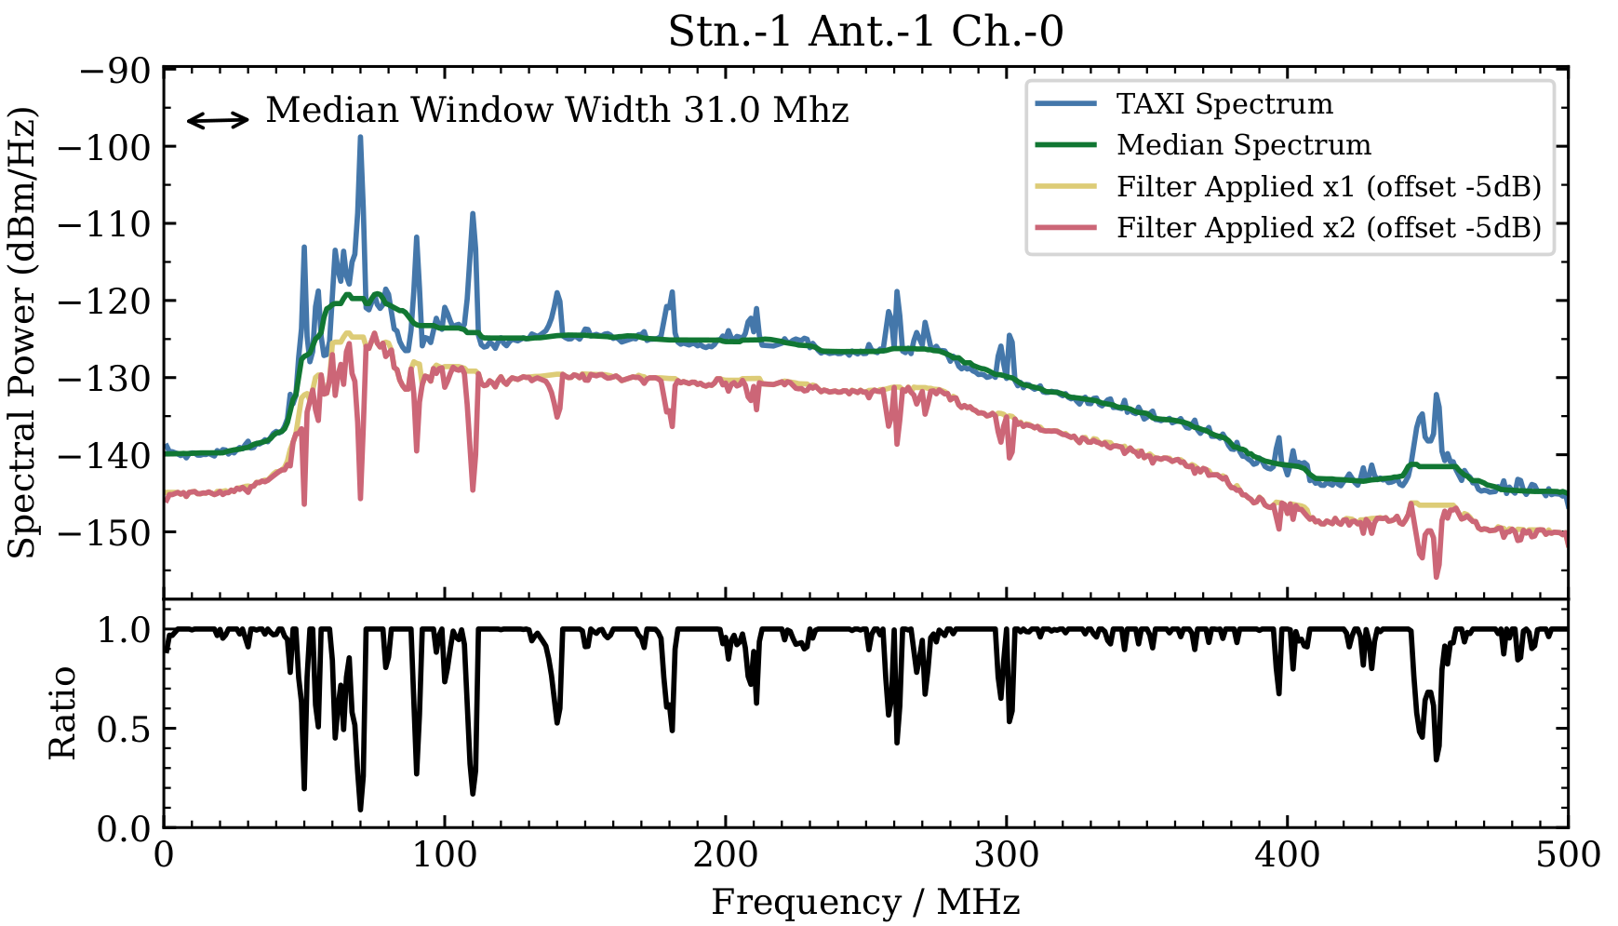
Spike Filter for RFI cleaning

Slide 21
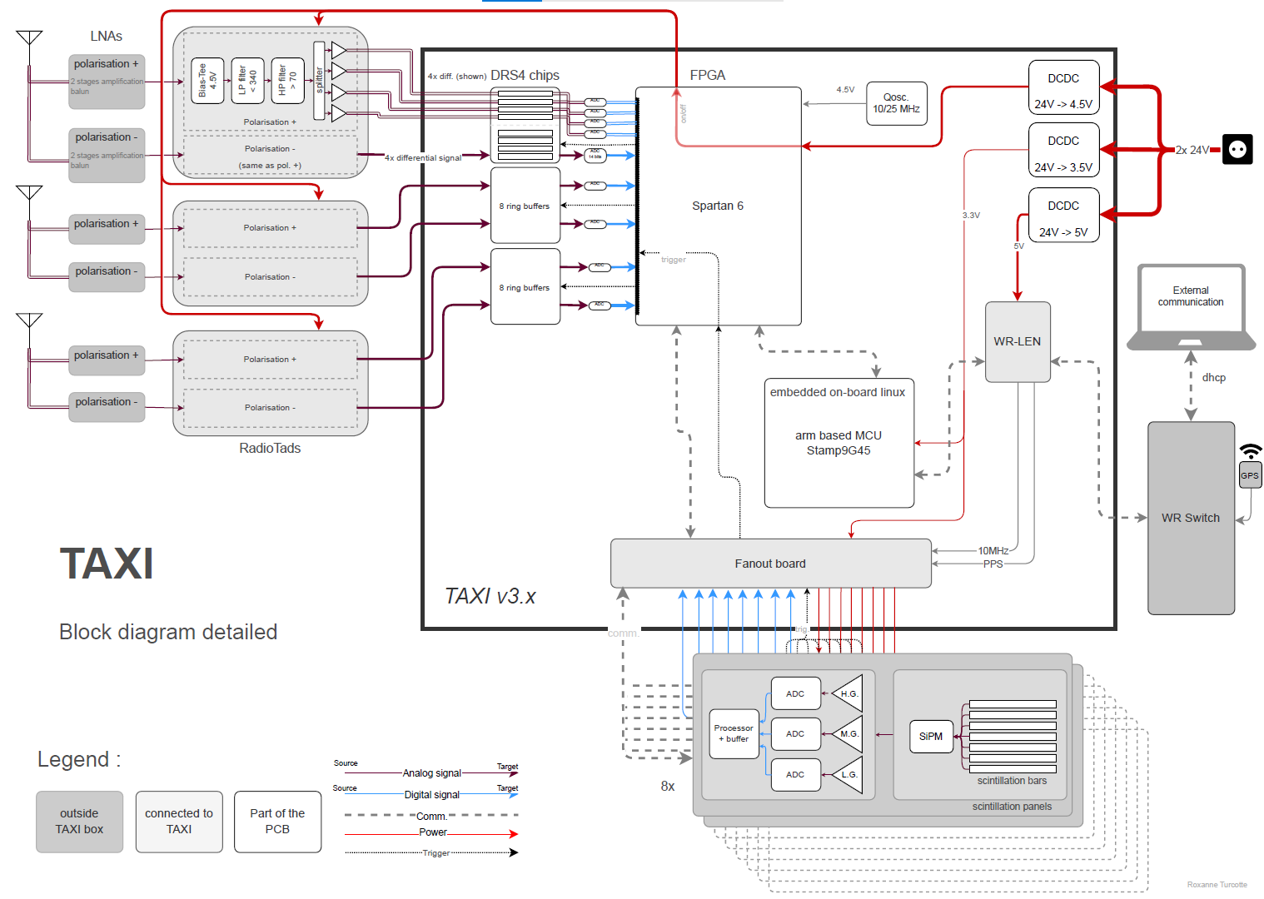
The Data Acquisition of the SAE (detailed)

Slide 22
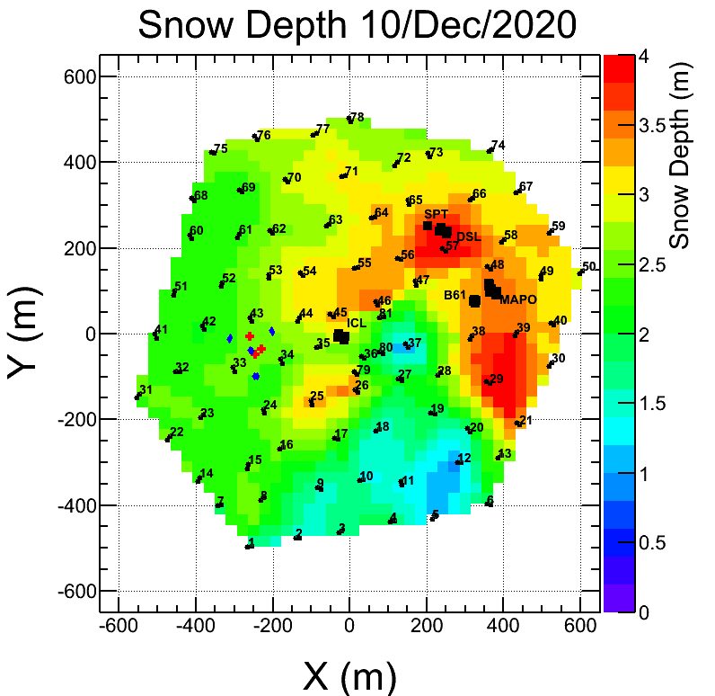
Snow accumulation and the location of the prototype station

Slide 23
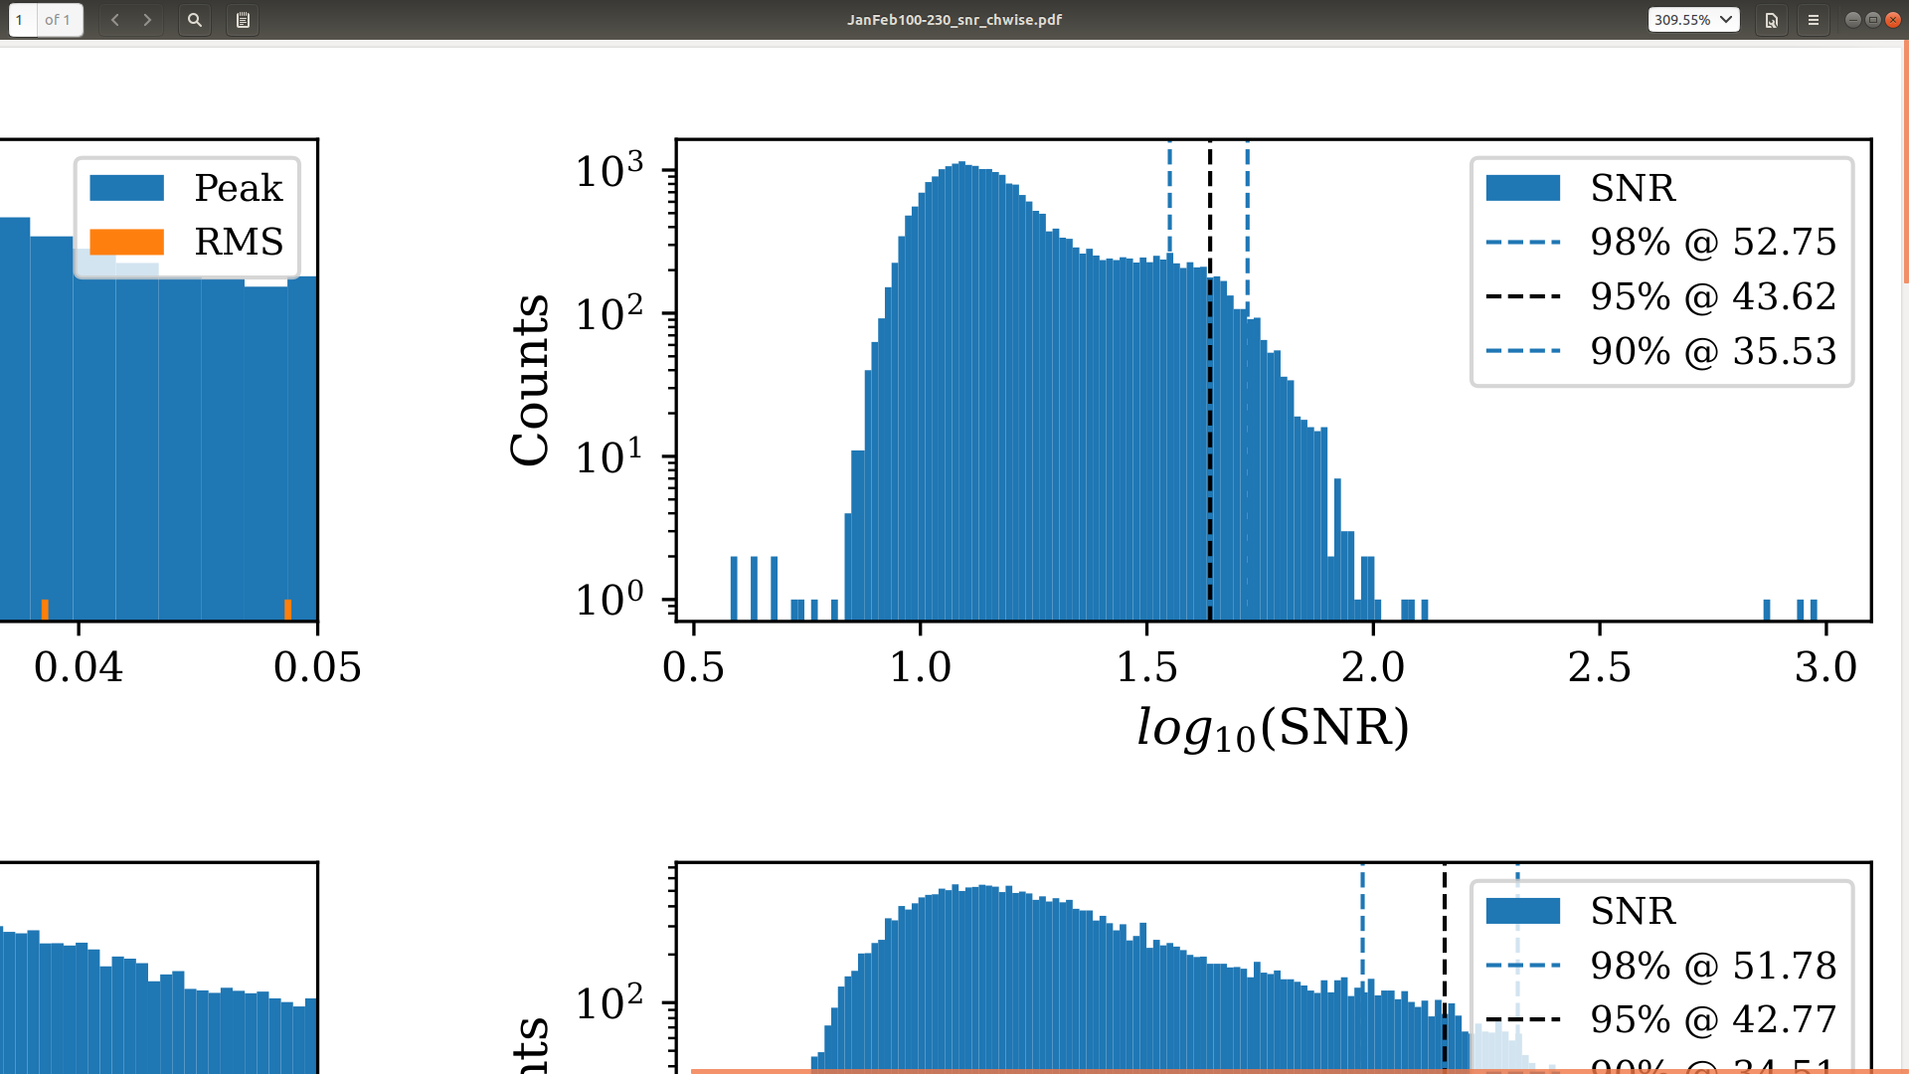
SNR distribution of Antenna 1

Slide 24
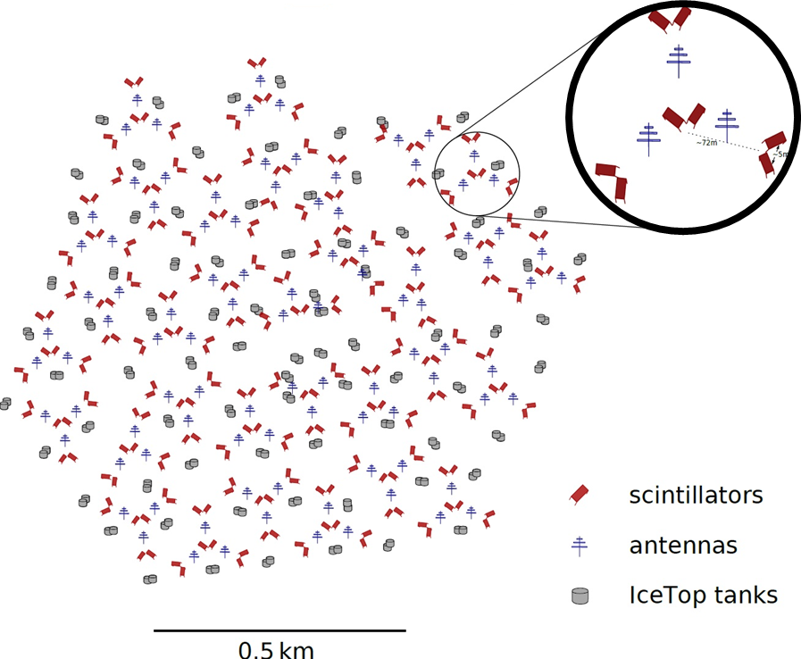
Actual proposed layout of the enhancement and a single station

Slide 25
