Slide 1
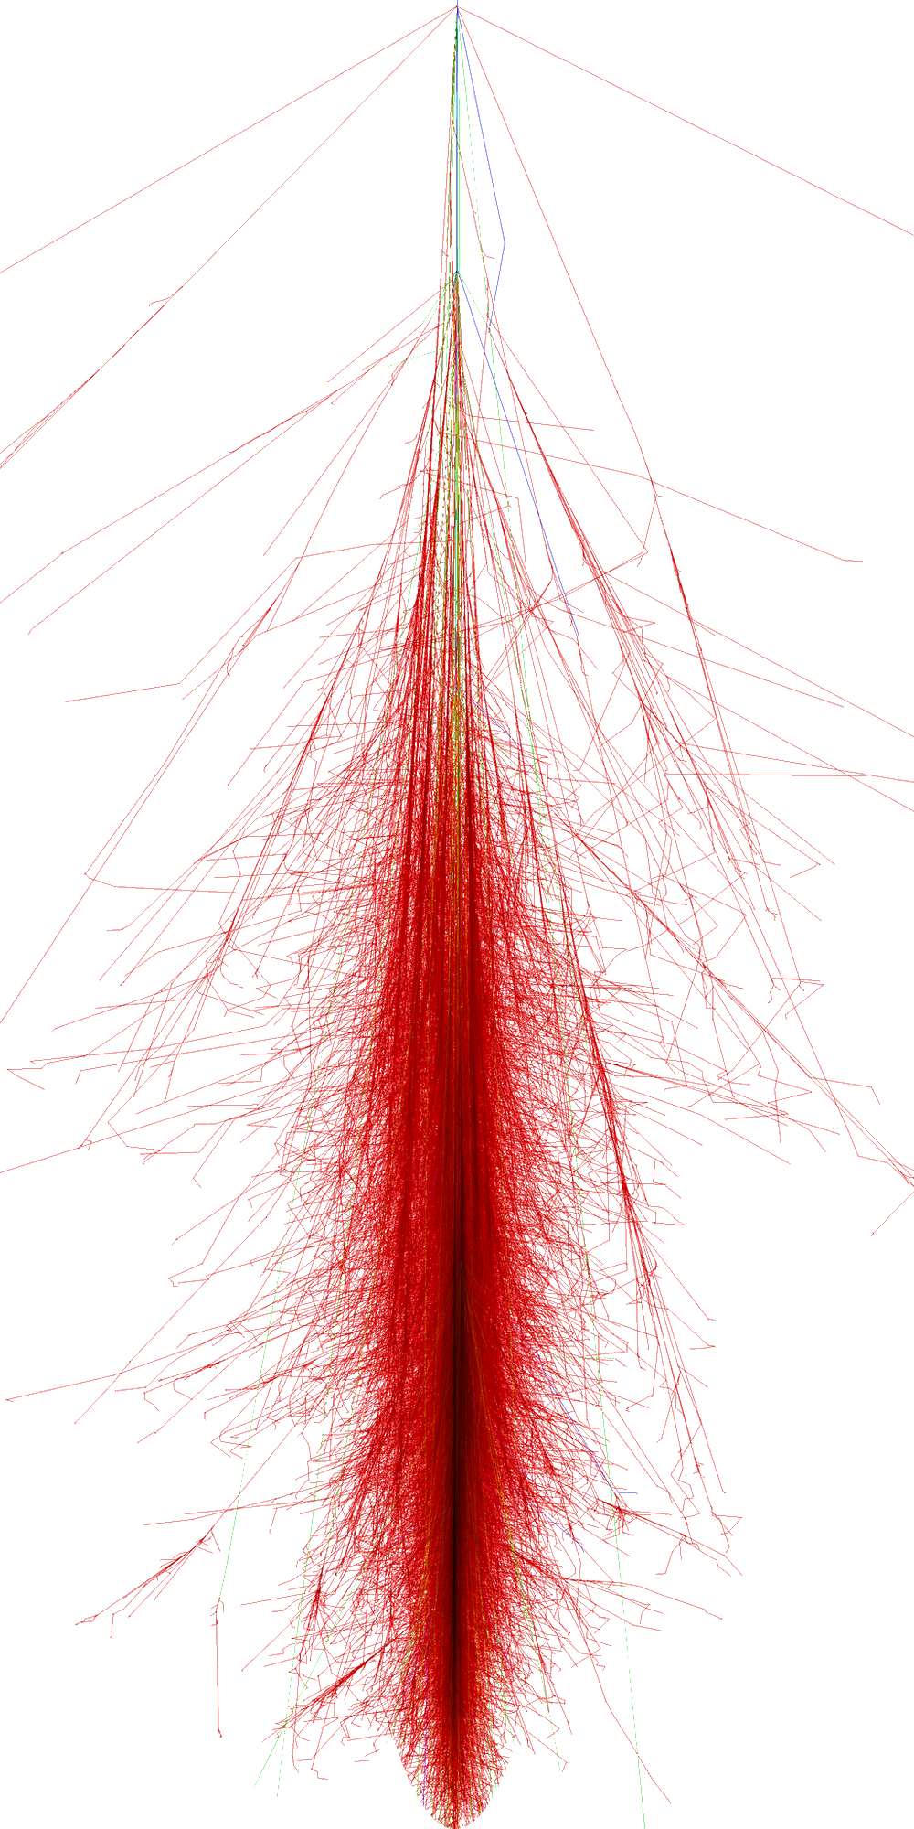
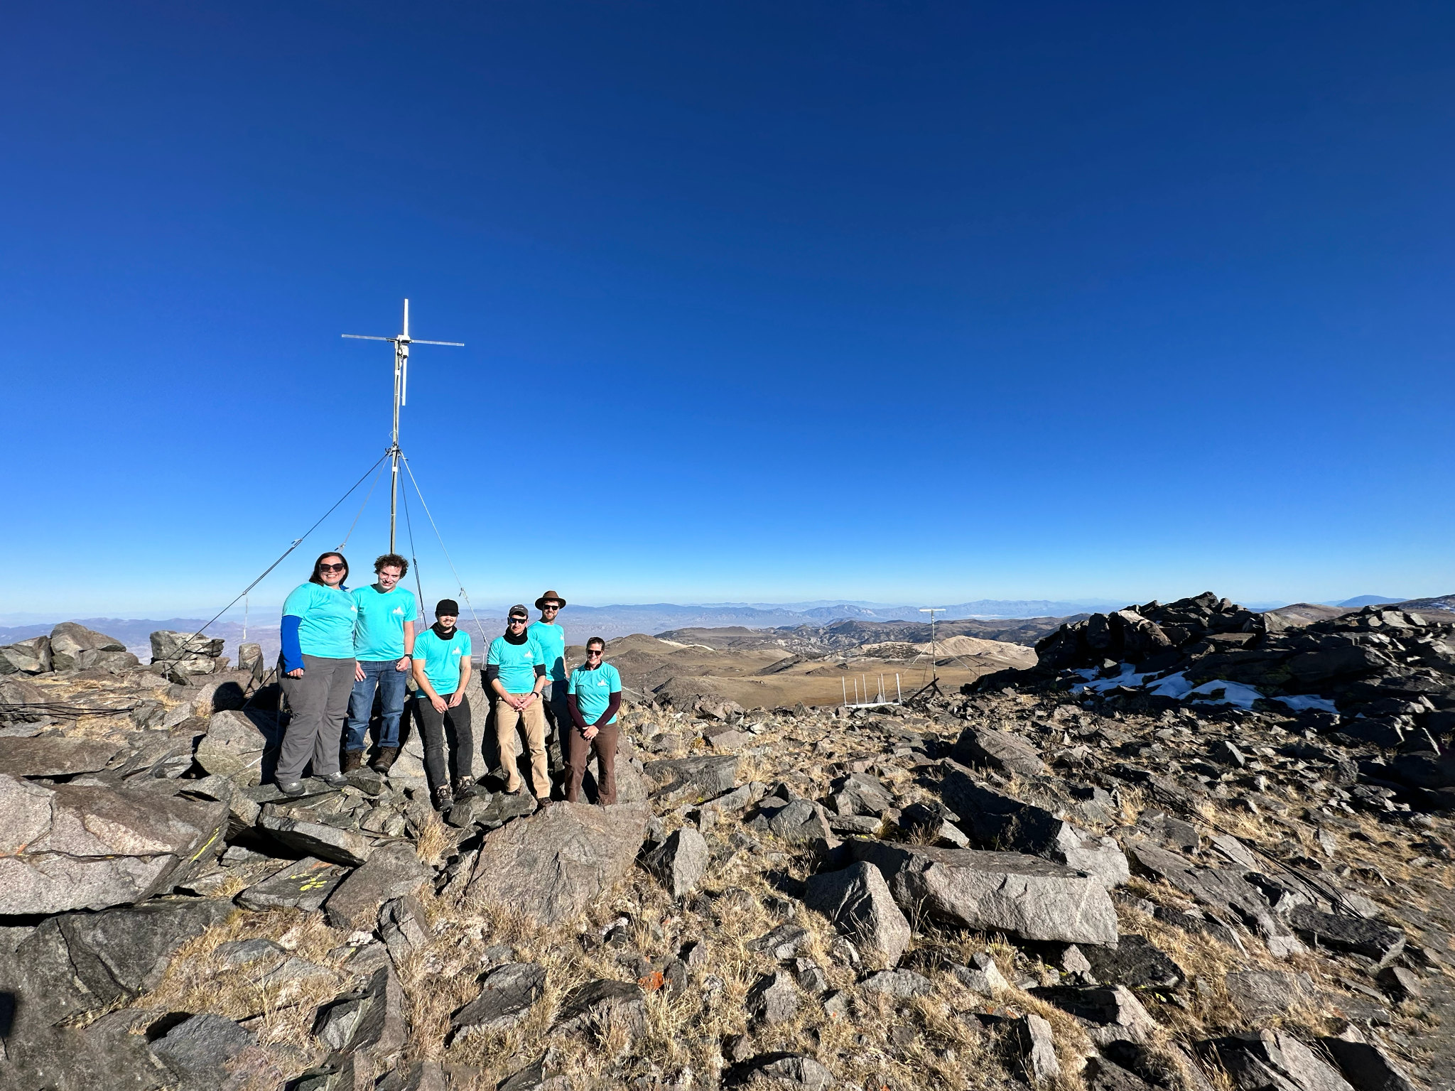
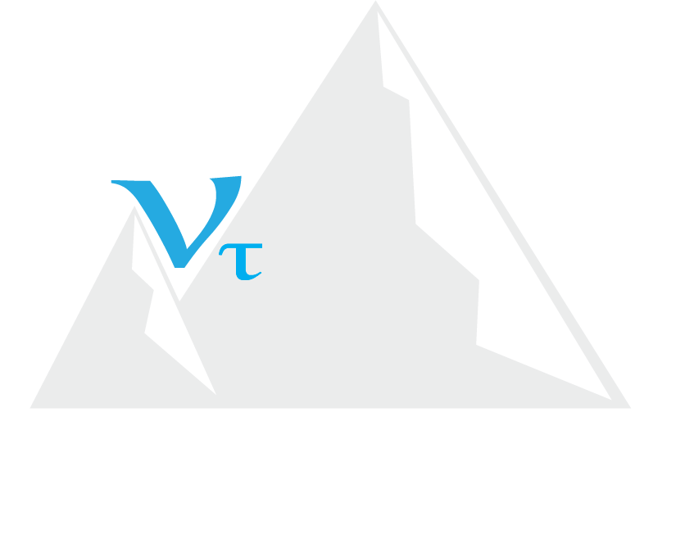
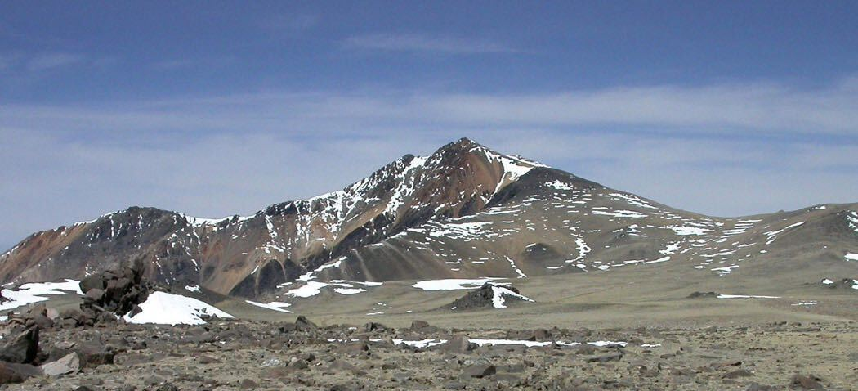
Searching for Cosmic Rays with the BEACON Prototype
Zachary Martin
On Behalf of the BEACON Collaboration
White Mountain Research Center
ARENA 2024
Notes:
- Name
- Title

Slide 2
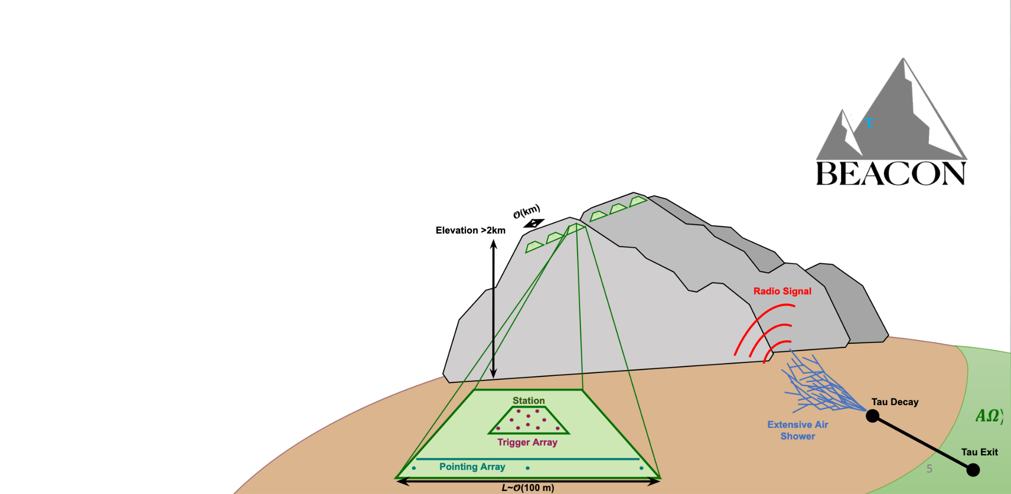
Overview
Goal → Validate full instrument neutrino sensitivity
BEACON Prototype

Slide 3
Overview
Goal → Validate full instrument neutrino sensitivity How → Verify cosmic ray (CR) air shower radio flux
BEACON Prototype
Cosmic Ray

Slide 4
Overview
Goal → Validate full instrument neutrino sensitivity How → Verify cosmic ray (CR) air shower radio flux
BEACON Prototype
Presenting
2021 prototype CR search demonstrates capabilities to trigger on impulsive events (D. Southall)
RF-only CR search improvements in progress (A. Zeolla)
2023 upgrades introduced independent scintillator array
Coincident scintillator and RF CR search in progress to optimize RF-only trigger+search
Cosmic Ray

Slide 5
BEACON 2021 Prototype
What are we working with?

Slide 6
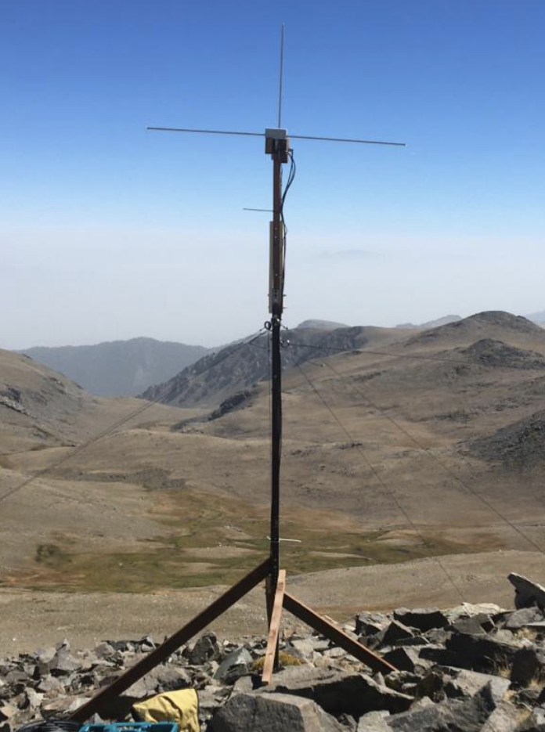
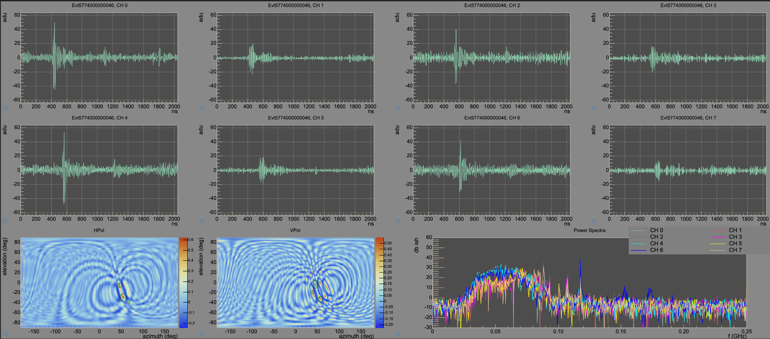
BEACON 2021 Prototype
What are we working with?
- 2.4 km prominence at White Mountain Research Station, CA
- Array of 4 Cross-Polarized Dipole Antennas (@ 30 - 80 MHz)
arXiv:2206.09660
“Monutau” Cosmin Deaconu (UChicago)

Slide 7
BEACON 2021 Prototype
What are we working with?
- 2.4 km prominence at White Mountain Research Station, CA
- Array of 4 Cross-Polarized Dipole Antennas (@ 30 - 80 MHz) - Phased array RF triggers (Power+Direction thresholds) → CR search with RF only (+Forced clock triggers for backgrounds)
arXiv:2206.09660
ARA DAQ
“Monutau” Cosmin Deaconu (UChicago)

Slide 8
RF Events & Simulation
What do we expect?
Notes:
What do we expect

Slide 9
RF Events & Simulation
What do we expect?
Expected RF event distribution obtained from Monte Carlo simulations using Cranberry
Cranberry¹:
Filters and Amplifiers
Waveforms
Shower Geometries
Radio Emission Model
Antenna Array and Trigger Model
Acceptance
Events at the Detector
Geomagnetic (+ Askaryan ) Electric Fields from ZHAireS²
Crossed Dipole from XFdtd³
Beam Model and Power-Sum Trigger
Cosmic Ray Flux⁴
1) Nucl. Instrum. Methods Phys. Res. A 953, 163086
3) remcom.com
2) Astroparticle Physics 35 (2012) 325-341
4) Auger ICRC 2017
Notes:
What do we expect

Slide 10
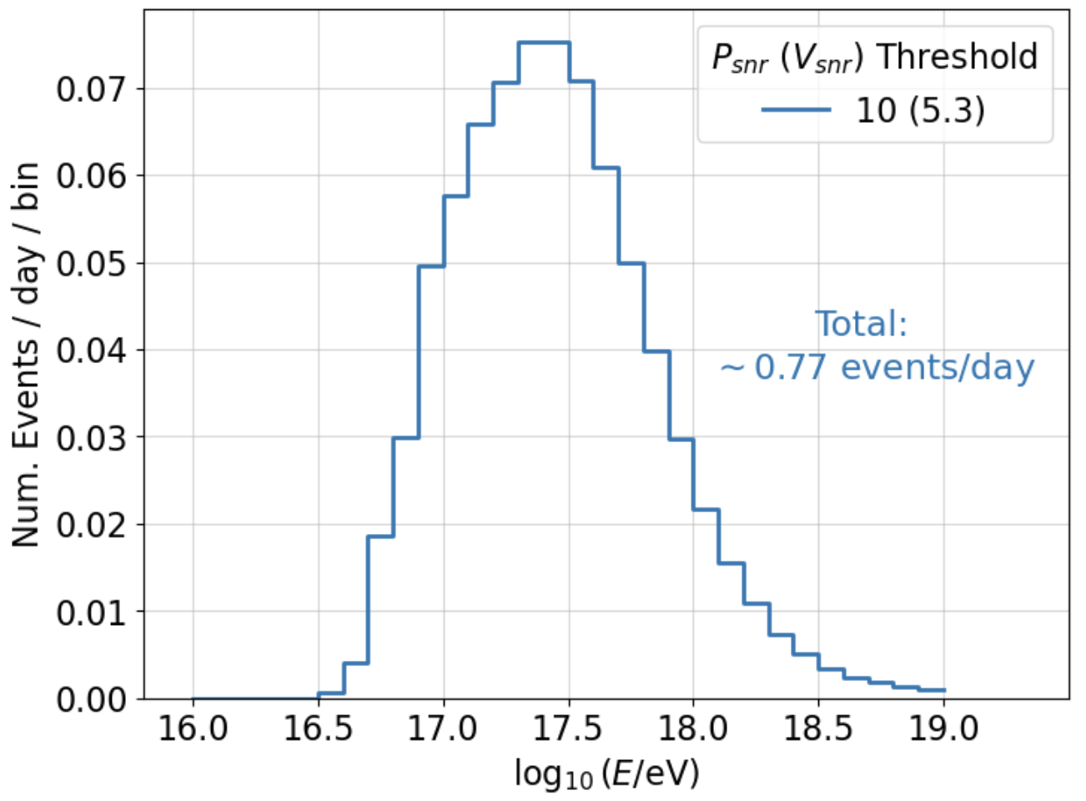
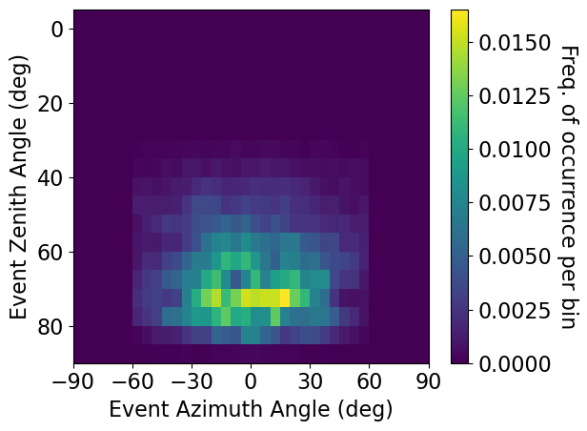
RF Events & Simulation
What do we expect?
Expected CR Distributions from Simulation
Expected RF event distribution obtained from Monte Carlo simulations using Cranberry
Cranberry¹:
Andrew Zeolla
(Deg From East)
Most Events are Highly-Inclined
Filters and Amplifiers
Waveforms
Shower Geometries
Radio Emission Model
Antenna Array and Trigger Model
Acceptance
Events at the Detector
Geomagnetic (+ Askaryan ) Electric Fields from ZHAireS²
Crossed Dipole from XFdtd³
Beam Model and Power-Sum Trigger
Cosmic Ray Flux⁴
1) Nucl. Instrum. Methods Phys. Res. A 953, 163086
3) remcom.com
2) Astroparticle Physics 35 (2012) 325-341
4) Auger ICRC 2017
Notes:
What do we expect

Slide 11
Impulsive Events Search
What was found?
Notes:
What did we find?
After hand inspection of cut-passing events, only 36 candidates left, and only 1 cosmic-ray like. So need developments on cosmic-ray identification

Slide 12
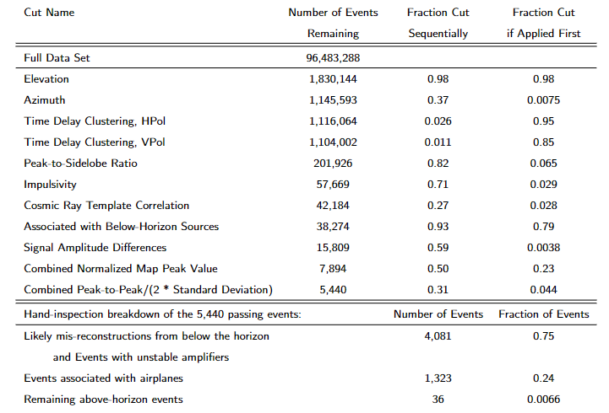
Impulsive Events Search
What was found?
112 days of data (expecting ~80 CR)
Dan Southall (UChicago)
Notes:
What did we find?
After hand inspection of cut-passing events, only 36 candidates left, and only 1 cosmic-ray like. So need developments on cosmic-ray identification

Slide 13
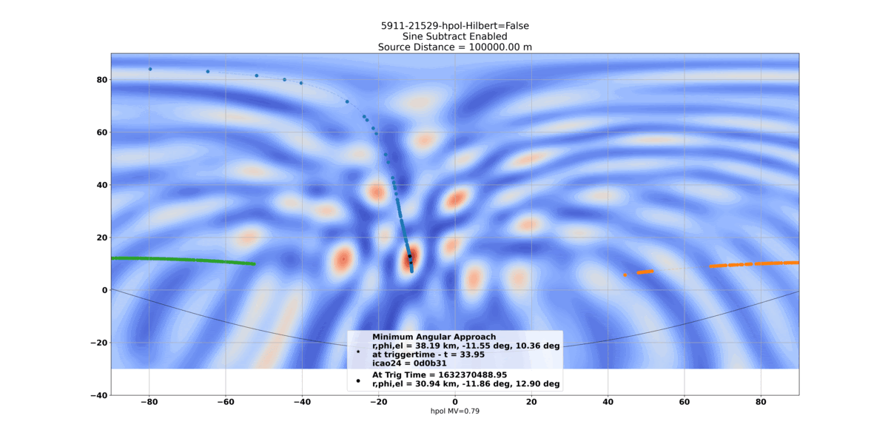
Impulsive Events Search
What was found?
112 days of data (expecting ~80 CR)
Airplane tracking data obtained from: Bringing up OpenSky: A large-scale ADS-B sensor network for research Matthias Schäfer, Martin Strohmeier, Vincent Lenders, Ivan Martinovic, Matthias Wilhelm ACM/IEEE International Conference on Information Processing in Sensor Networks, April 2014
Elevation
Azimuth
Dan Southall (UChicago)
Notes:
What did we find?
After hand inspection of cut-passing events, only 36 candidates left, and only 1 cosmic-ray like. So need developments on cosmic-ray identification

Slide 14
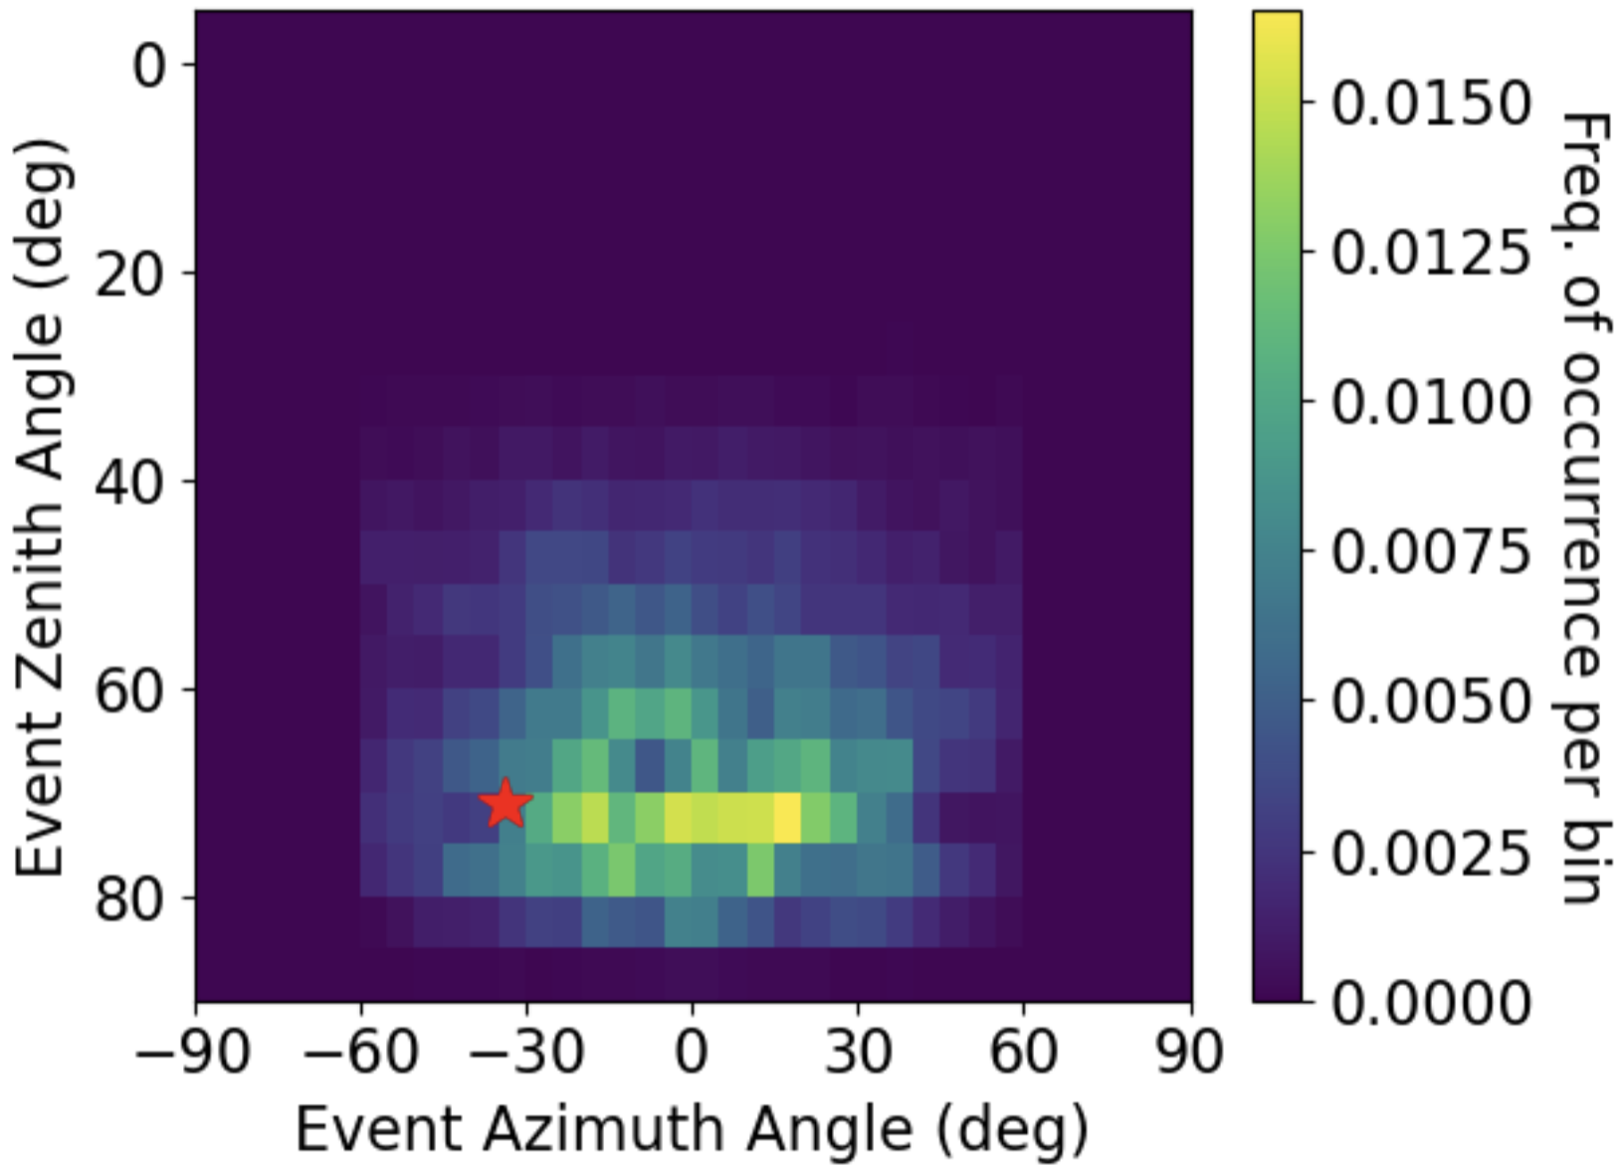
Impulsive Events Search
What was found?
112 days of data (expecting ~80 CR)
Airplane tracking data obtained from: Bringing up OpenSky: A large-scale ADS-B sensor network for research Matthias Schäfer, Martin Strohmeier, Vincent Lenders, Ivan Martinovic, Matthias Wilhelm ACM/IEEE International Conference on Information Processing in Sensor Networks, April 2014
Elevation
Azimuth
Cosmic-ray candidate event identified (by-eye)
Dan Southall (UChicago)
Notes:
What did we find?
After hand inspection of cut-passing events, only 36 candidates left, and only 1 cosmic-ray like. So need developments on cosmic-ray identification

Slide 15
Improving CR Search from RF Using CNNs
How to do better?
Notes:
How can we do better?

Slide 16
Improving CR Search from RF Using CNNs
How to do better?
General Example of CNN Layer Structure
Convolutional Neural Networks (CNN) are deep learning models that can extract features of datasets based on weighted parameters determined from training
Has been applied to Time Series Classification (TSC) many times already (health care, earthquake detection, finance, etc.)
Z. Wang, W. Yan, T. Oates arXiv:1611.06455
Notes:
How can we do better?

Slide 17
Improving CR Search from RF Using CNNs
How to do better?
General Example of CNN Layer Structure
Convolutional Neural Networks (CNN) are deep learning models that can extract features of datasets based on weighted parameters determined from training
Has been applied to Time Series Classification (TSC) many times already (health care, earthquake detection, finance, etc.)
So, CNN can be trained with CR simulations & triggered RF data to classify data groups: Force-triggered events (noise) RF-triggered events (background) Cosmic rays (simulated)
Z. Wang, W. Yan, T. Oates arXiv:1611.06455
Notes:
How can we do better?

Slide 18
CR Search Flow and Results (WIP)

Slide 19
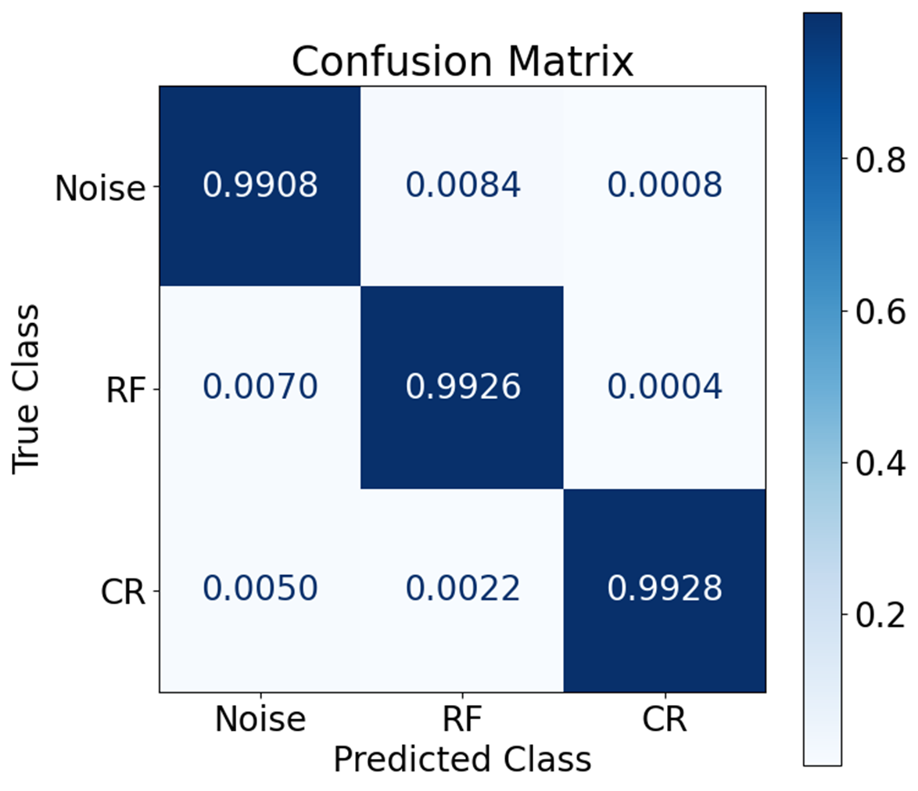
CR Search Flow and Results (WIP)
CNN Classification
RF vs CR-like
Training: 20,000 Events per class Validation: 5,000 Events per class
Andrew Zeolla (PennState)

Slide 20
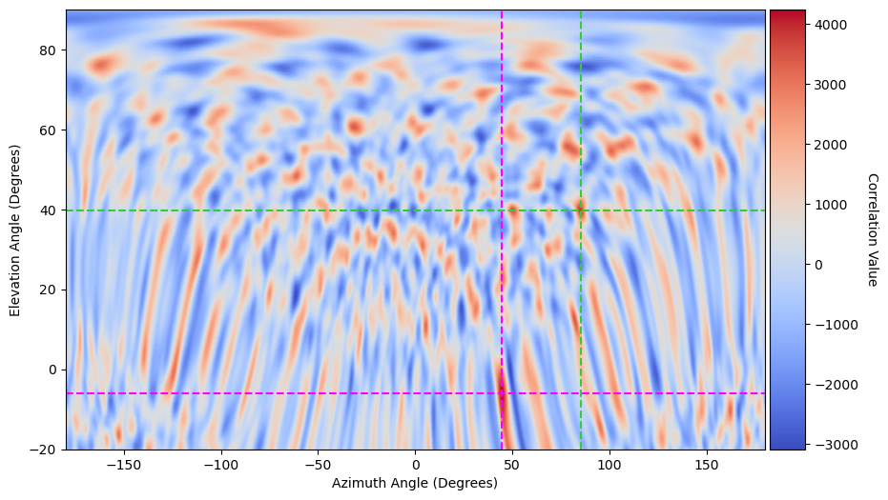
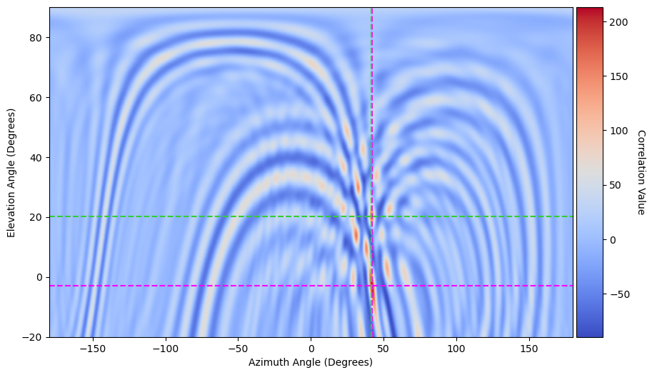
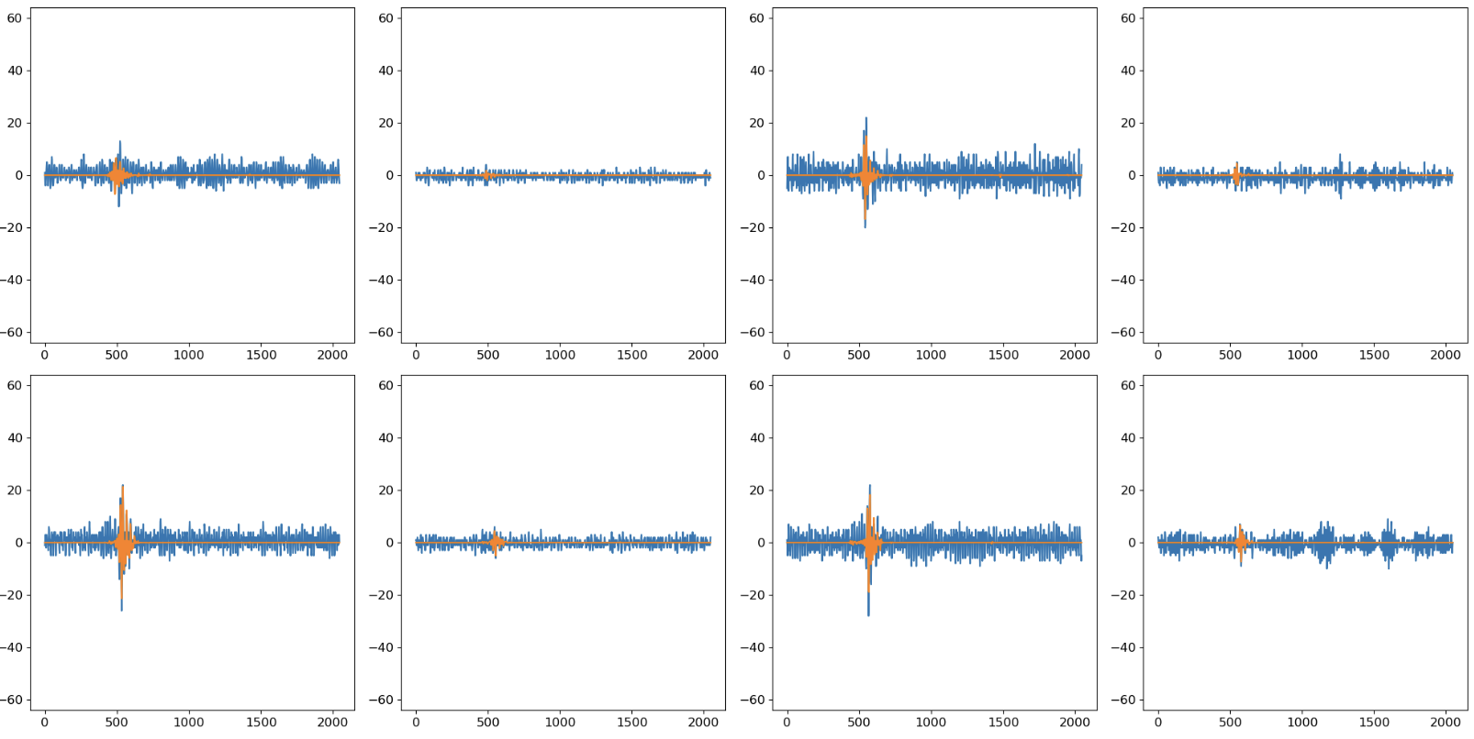
CR Search Flow and Results (WIP)
CNN Classification
CNN Denoiser
Event Reconstruction
RF vs CR-like
Noise Subtraction
Pointing with Waveform Correlation
High Noise
Suppressed Noise
Training: 20,000 Events per class Validation: 5,000 Events per class
Blue: Raw Waveform Orange: CNN Denoised Waveform
Andrew Zeolla (PennState)

Slide 21
CR Search Flow and Results (WIP)
CNN Classification
CNN Denoiser
Event Reconstruction
Zenith & Azimuth Cuts
RF vs CR-like
Noise Subtraction
Pointing with Waveform Correlation
30 < Zen < 85 -60 < Az < 60
High Noise
Suppressed Noise
Training: 20,000 Events per class Validation: 5,000 Events per class
Blue: Raw Waveform Orange: CNN Denoised Waveform
Andrew Zeolla (PennState)

Slide 22
CR Search Flow and Results (WIP)
CNN Classification
CNN Denoiser
Event Reconstruction
Zenith & Azimuth Cuts
Temporospatial Cuts (?)
???
Cosmic Ray Population
RF vs CR-like
Noise Subtraction
Pointing with Waveform Correlation
30 < Zen < 85 -60 < Az < 60
Clustering
How did the CNN do? What features are not handled by the CNN? (WIP)
High Noise
Suppressed Noise
Training: 20,000 Events per class Validation: 5,000 Events per class
Blue: Raw Waveform Orange: CNN Denoised Waveform
Andrew Zeolla (PennState)

Slide 23
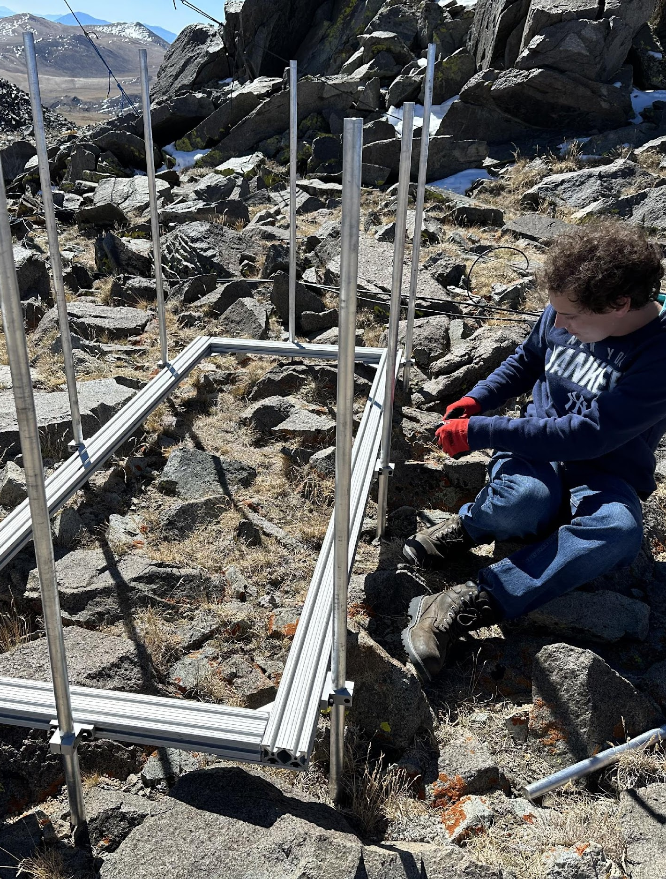
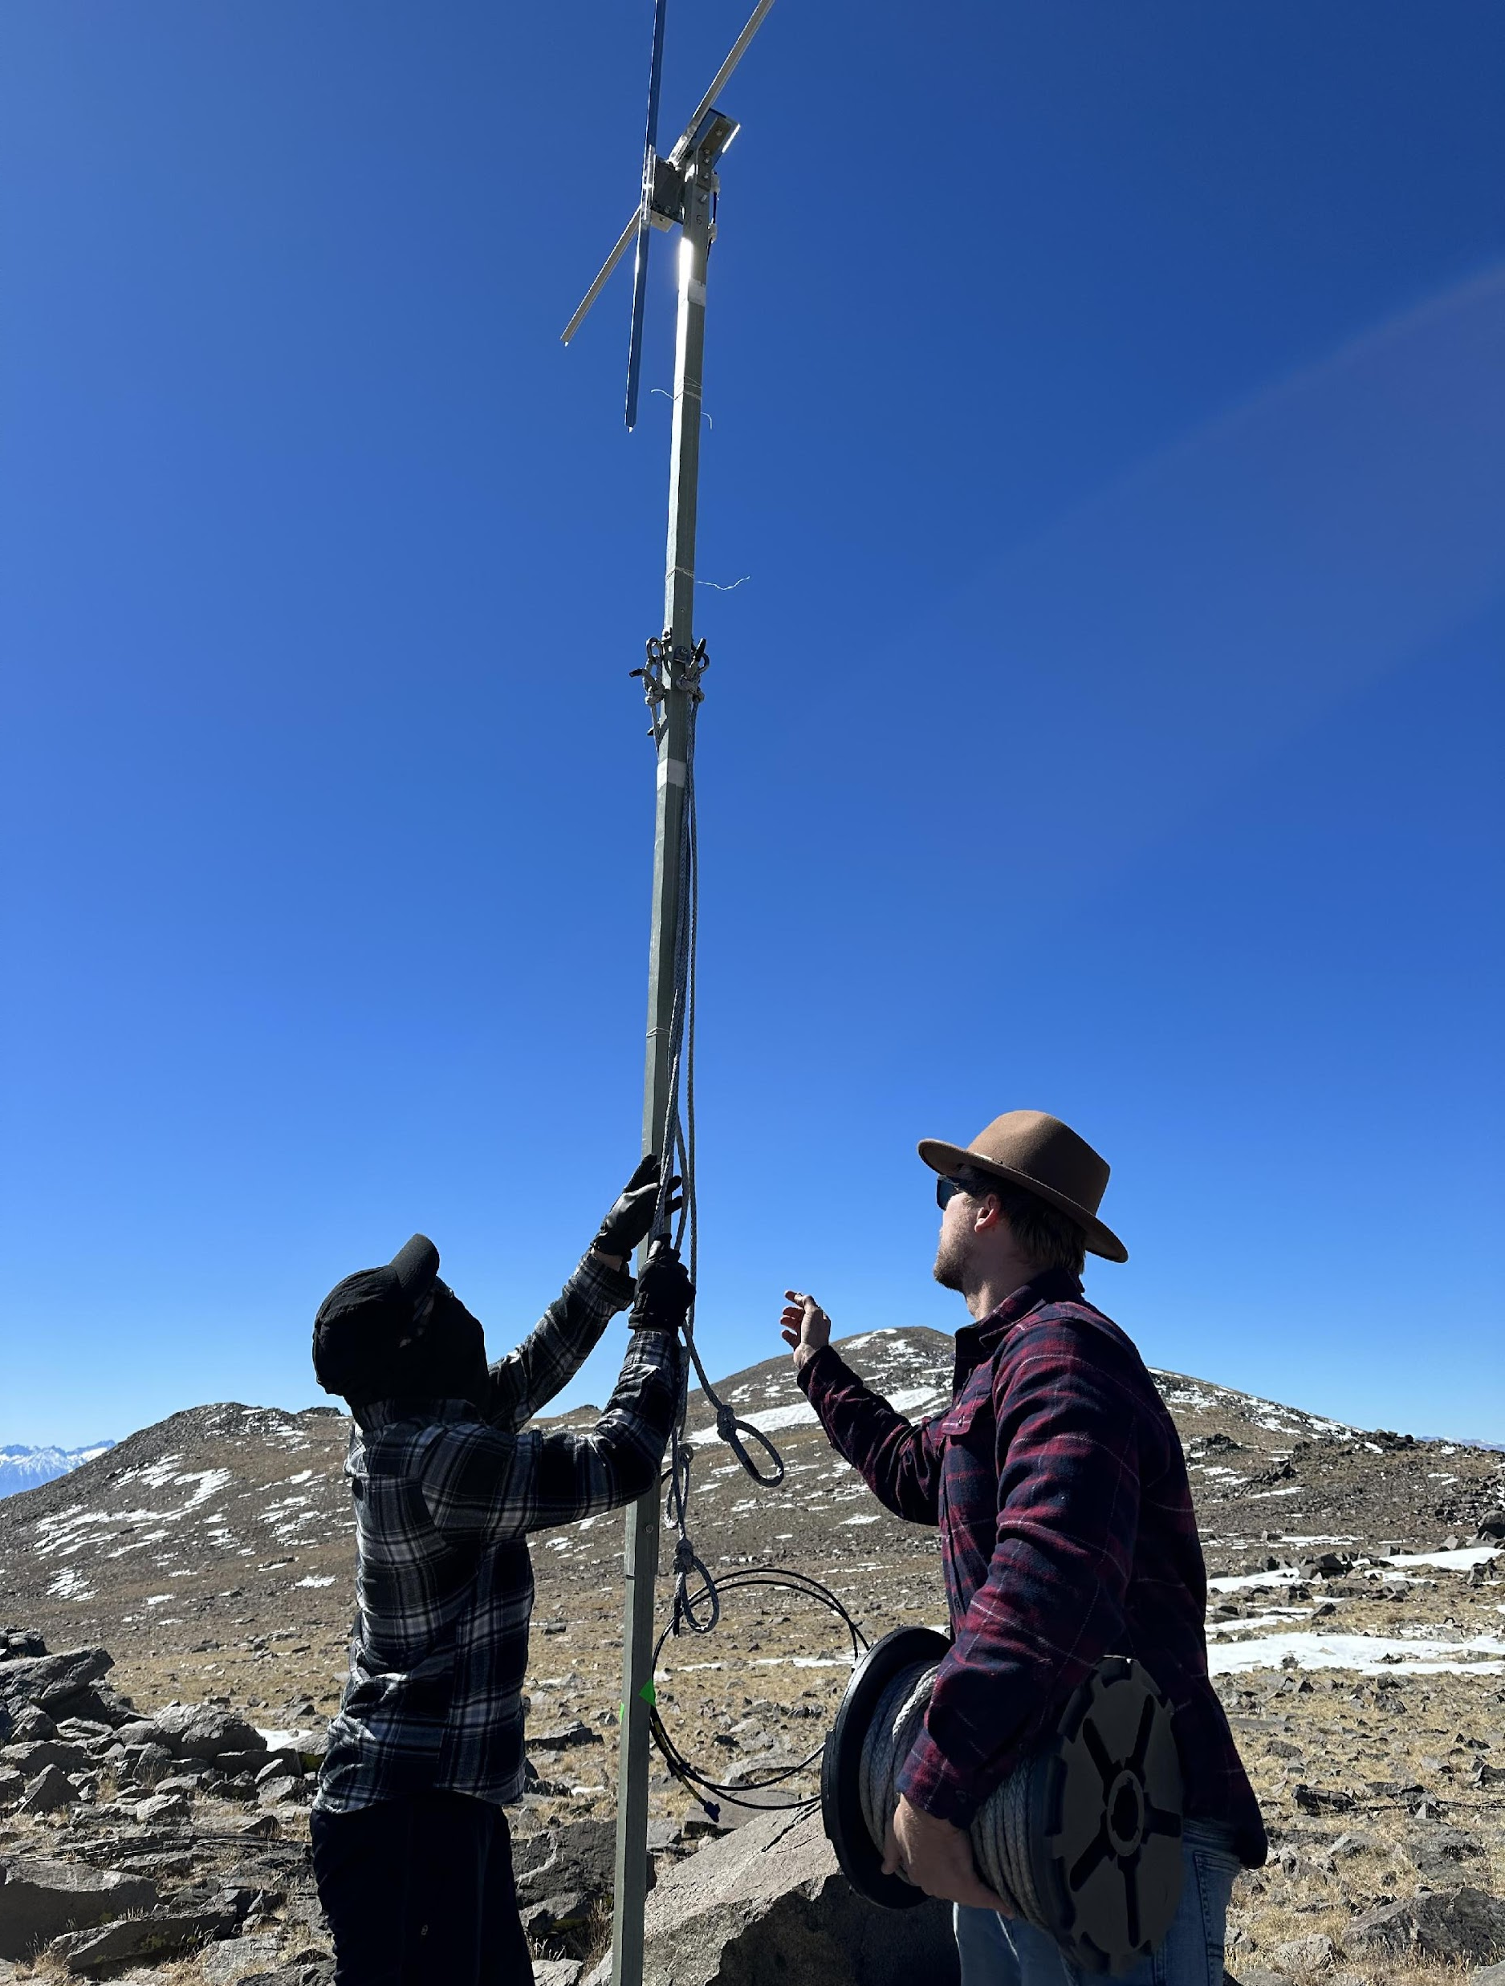
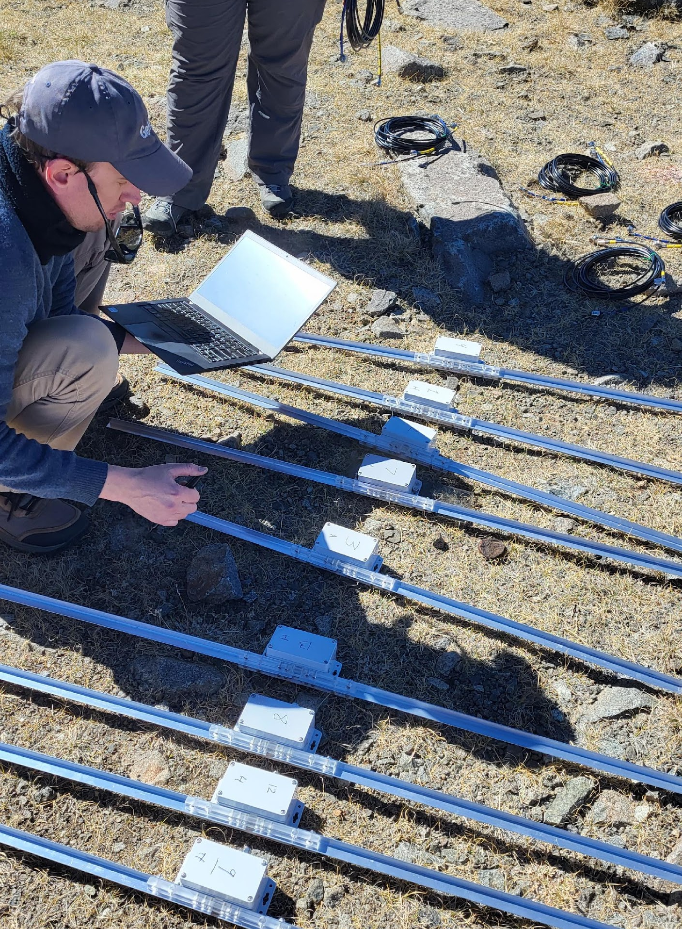
BEACON 2023 Upgrades

Slide 24
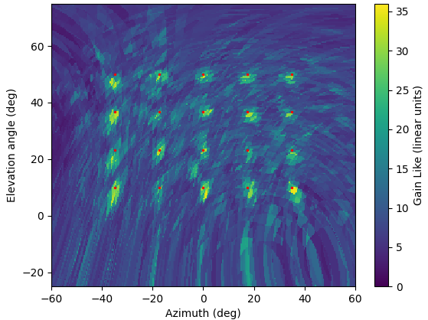
2023 Improved Antennas & DAQ
Antennas - 4 antennas → 6 antennas (improved sensitivity & reconstruction) - Side-mounted T-bar tines (greater strength)
Beamforming Map
Ryan Krebs (PennState)

Slide 25
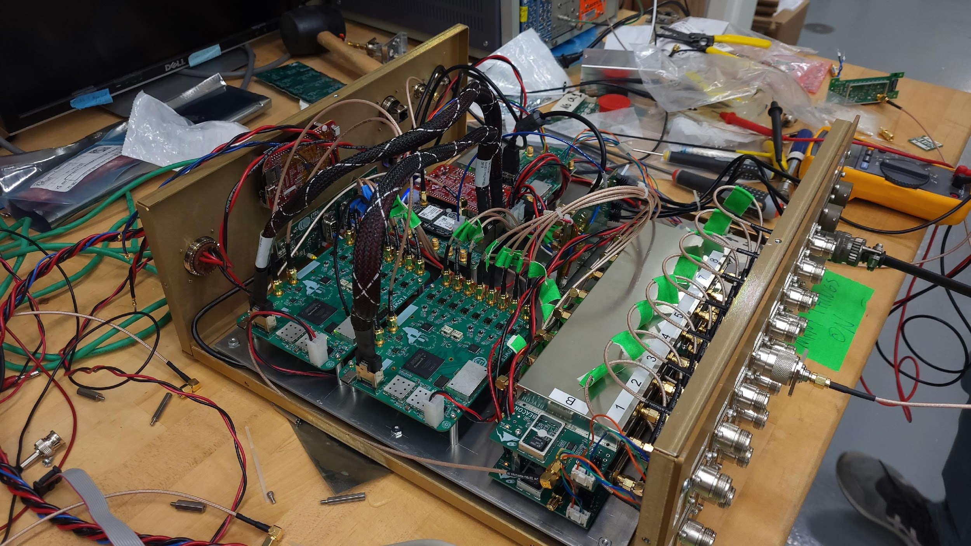
2023 Improved Antennas & DAQ
Antennas - 4 antennas → 6 antennas (improved sensitivity & reconstruction) - Side-mounted T-bar tines (greater strength)
DAQ - 8 channels → 16 channels - Modular FLOWER boards: - 8 ch/board, 500 GSa/s, onboard FPGA for phased array triggering - Coincidence & Beamforming triggers
Beamforming Map
Ryan Krebs (PennState)
Eric Oberla (UChicago)

Slide 26
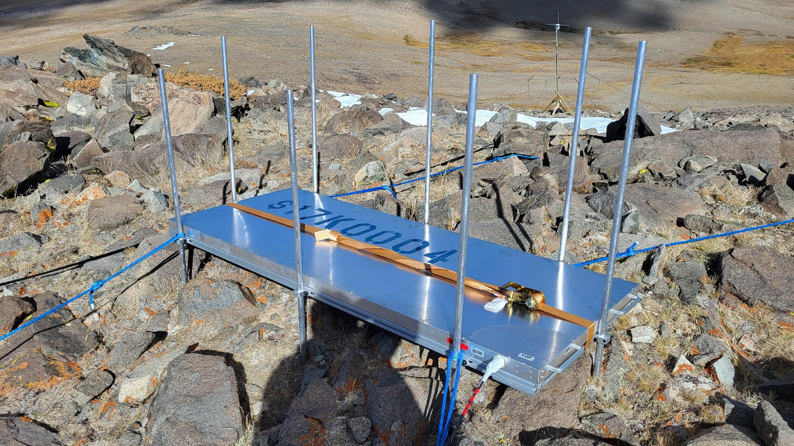
2023 Independent Scintillator Array
- New independent detector array of scintillators - CR population from muon flux - Verifies CR detection to assist RF trigger optimization
Notes:
Order of magnitude every 0.75 exponent increase, so 16.75=2, 17.5=1, 18.25=0, 19=-1

Slide 27
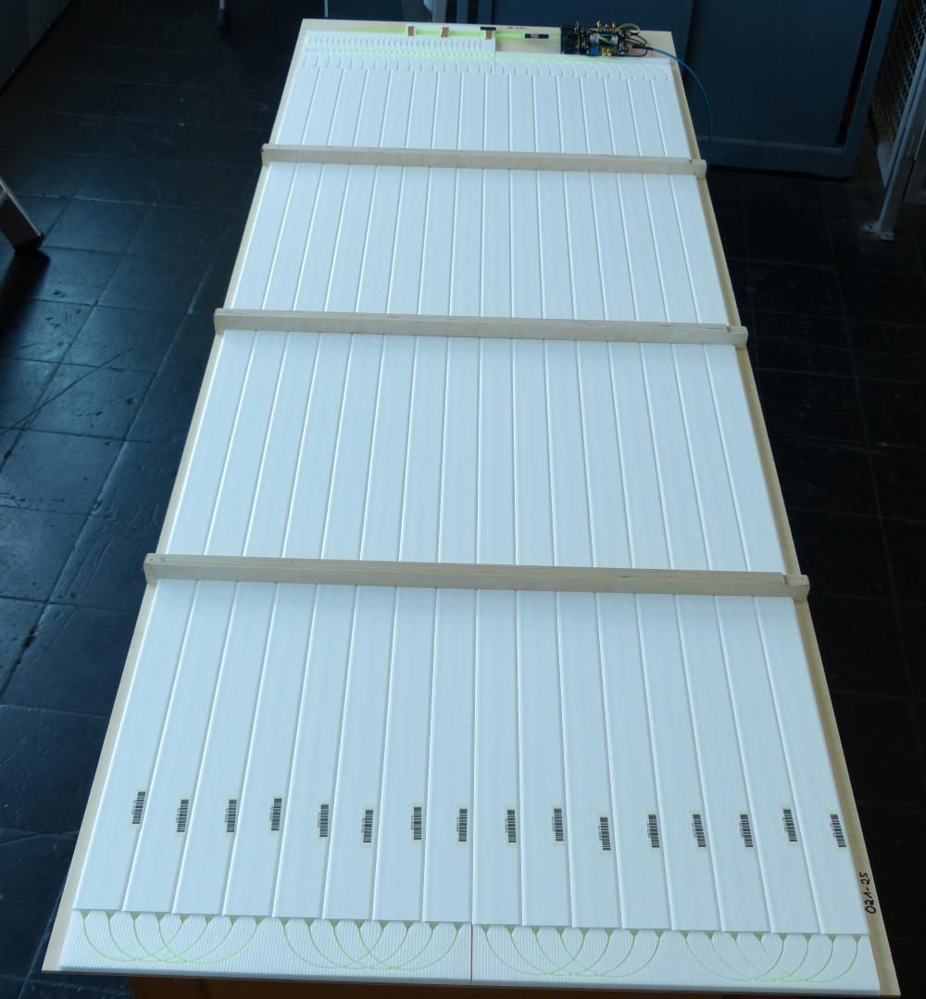
2023 Independent Scintillator Array
- New independent detector array of scintillators - CR population from muon flux - Verifies CR detection to assist RF trigger optimization
- Produced by KIT & DESY, and are the analog readout version of IceScint planned for IceTop (PoS(ICRC2017)401)
Scint Panels (B. Hoffmann, M. Oehler) IceCube Collaboration
Notes:
Order of magnitude every 0.75 exponent increase, so 16.75=2, 17.5=1, 18.25=0, 19=-1

Slide 28
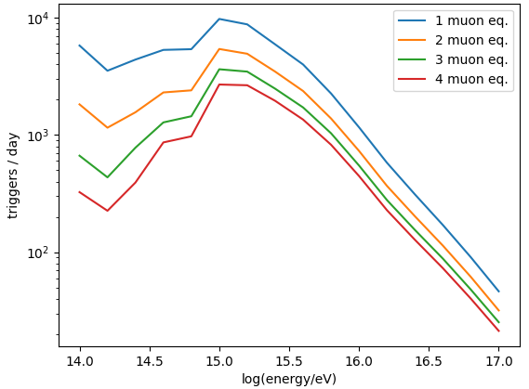
2023 Independent Scintillator Array
Scint Trigger Rate Distribution
- New independent detector array of scintillators - CR population from muon flux - Verifies CR detection to assist RF trigger optimization
- Produced by KIT & DESY, and are the analog readout version of IceScint planned for IceTop (PoS(ICRC2017)401)
Katie Mulrey (Nijmegen U., IMAPP)
CORSIKA + GEANT-4 particle simulations give order of magnitude estimate trigger rate
Expect 0.1-100 scint events per day in RF-sensitive energy region (extrapolating to 10¹⁹eV)
Scint Panels (B. Hoffmann, M. Oehler) IceCube Collaboration
Notes:
Order of magnitude every 0.75 exponent increase, so 16.75=2, 17.5=1, 18.25=0, 19=-1

Slide 29
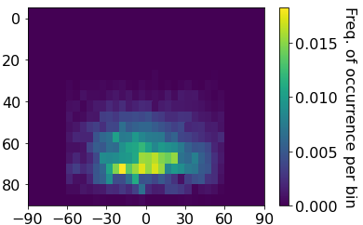
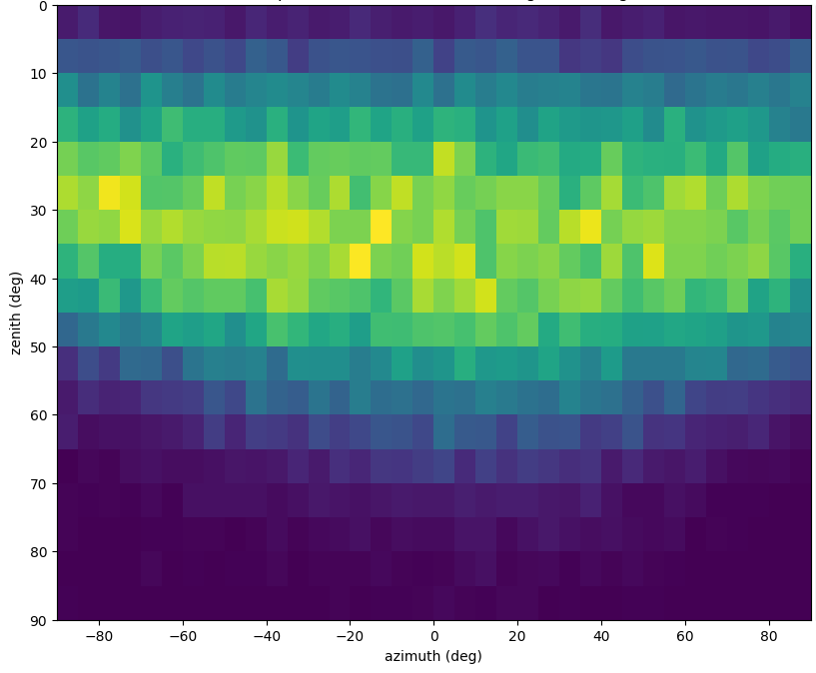
RF-Scint Expectations
Simulated RF Event Distribution
Preliminary Scintillator Event Distribution

Slide 30
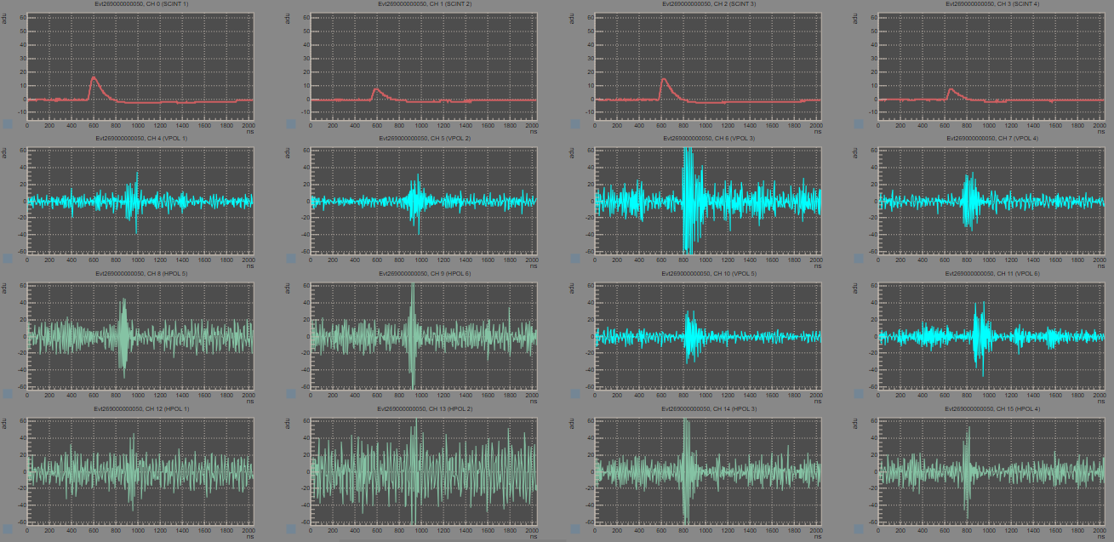
RF-Scint Expectations
Simulated RF Event Distribution
Preliminary Scintillator Event Distribution
RF-Scint event overlap population depend on many aspects: - High energy events - Detector directional sensitivities - RF vs Muon flux distributions
(Example Scint-RF coincidence, but not a CR)

Slide 31
RF-Scint Expectations
Simulated RF Event Distribution
Preliminary Scintillator Event Distribution
RF-Scint event overlap population depend on many aspects: - High energy events - Detector directional sensitivities - RF vs Muon flux distributions
Scintillator implementation into Cranberry simulations will give an expected coincident event rate in both detectors (WIP)
(Example Scint-RF coincidence, but not a CR)

Slide 32
Scintillator CR Search for RF Optimization

Slide 33
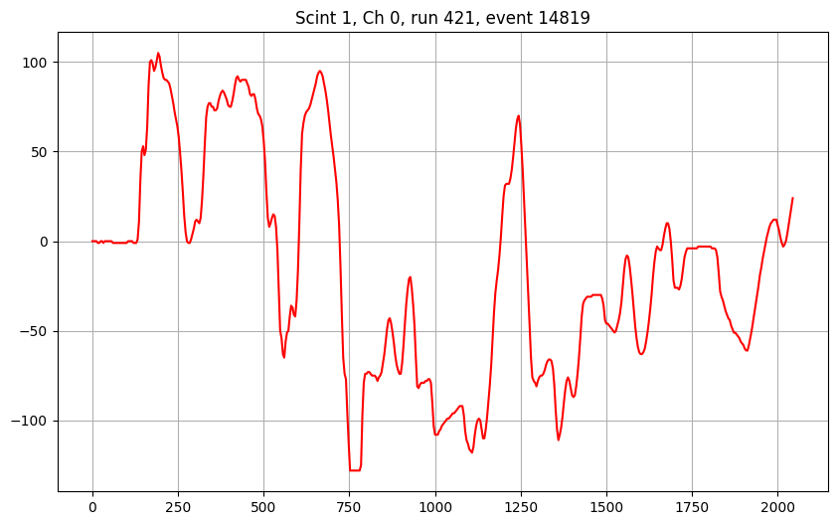
Scintillator CR Search for RF Optimization
Scint Quality Cuts

Slide 34
Scintillator CR Search for RF Optimization
Scint Quality Cuts
Scint Characteristic Cuts
- Max Voltage - Peaks - Temporospatial Clustering - etc.

Slide 35
Scintillator CR Search for RF Optimization
Scint Quality Cuts
Scint Characteristic Cuts
Scint Reconstruction
Scint Zenith/Azimuth Cuts
- Max Voltage - Peaks - Temporospatial Clustering - etc.

Slide 36
Scintillator CR Search for RF Optimization
Scint Quality Cuts
Scint Characteristic Cuts
Scint Reconstruction
Scint Zenith/Azimuth Cuts
???
Scint CR Population
- Max Voltage - Peaks - Temporospatial Clustering - etc.

Slide 37
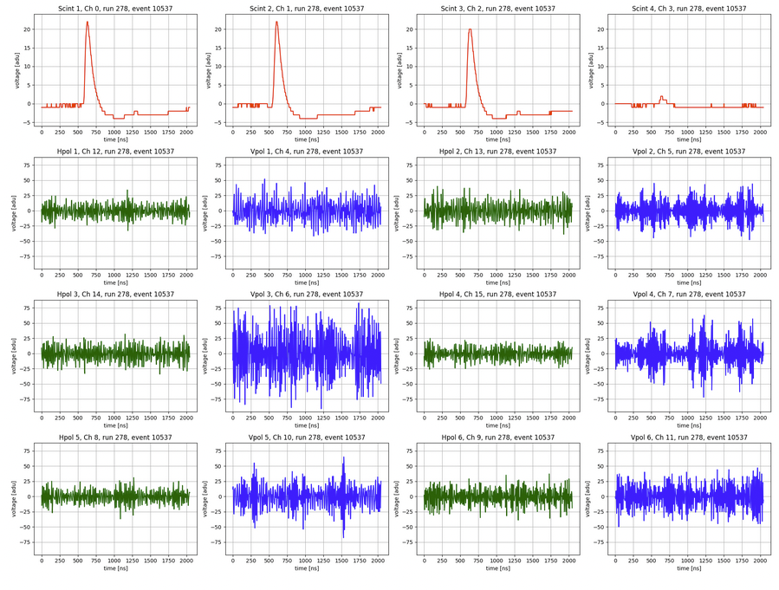
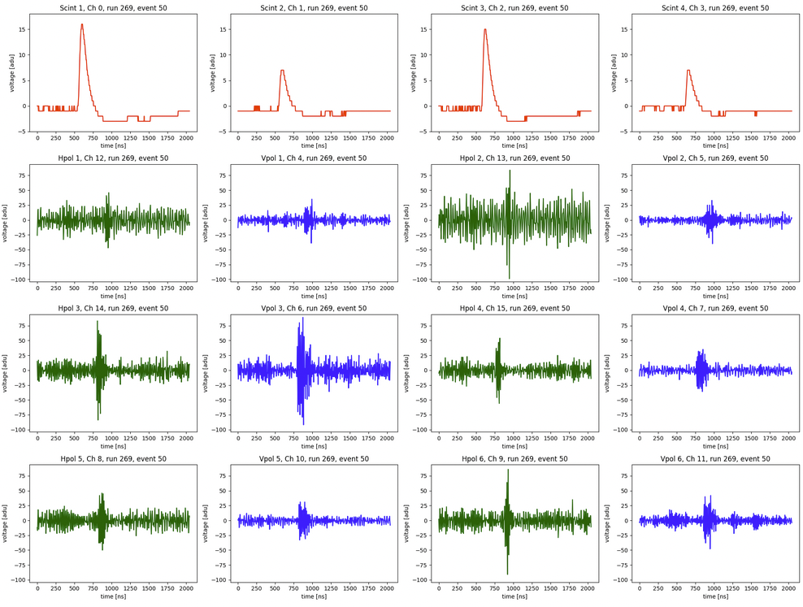
Scintillator CR Search for RF Optimization
Scint Quality Cuts
Scint Characteristic Cuts
Scint Reconstruction
Scint Zenith/Azimuth Cuts
???
Scint CR Population
- Max Voltage - Peaks - Temporospatial Clustering - etc.
Conservative RF cuts
???
Scint-RF CR Population

Slide 38
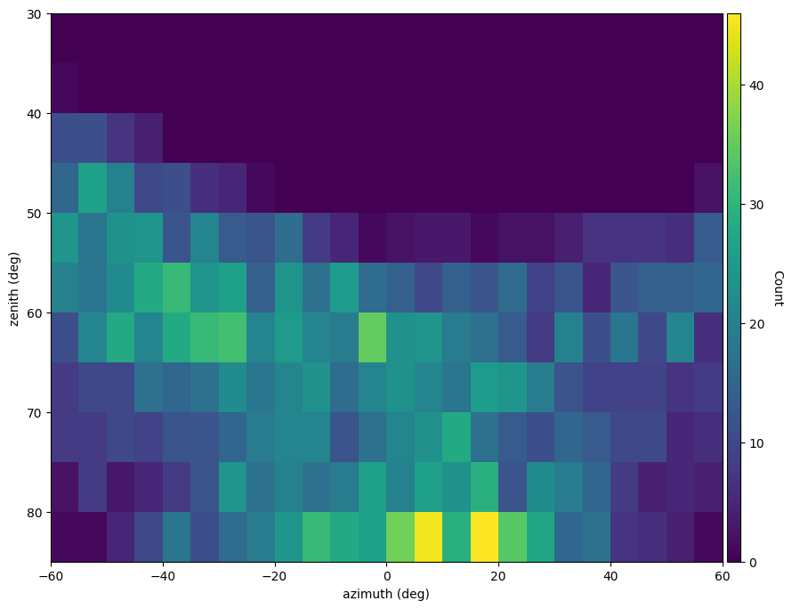
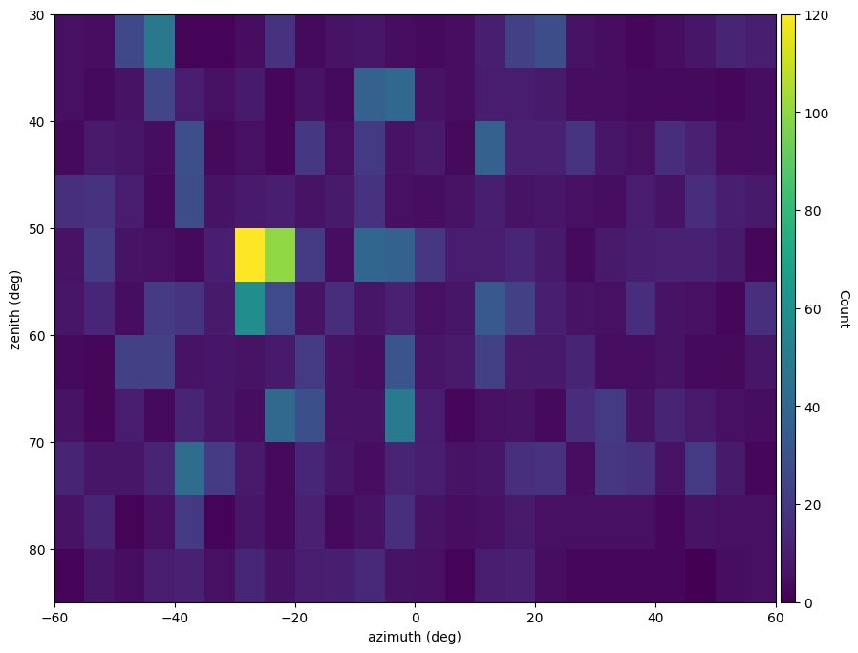
Preliminary Results
Preliminary Scint & RF cuts result in a few events out of ~70 days of data
Event Distributions in Scint & RF after only scint-based cuts
Scint
RF
Preliminary

Slide 39
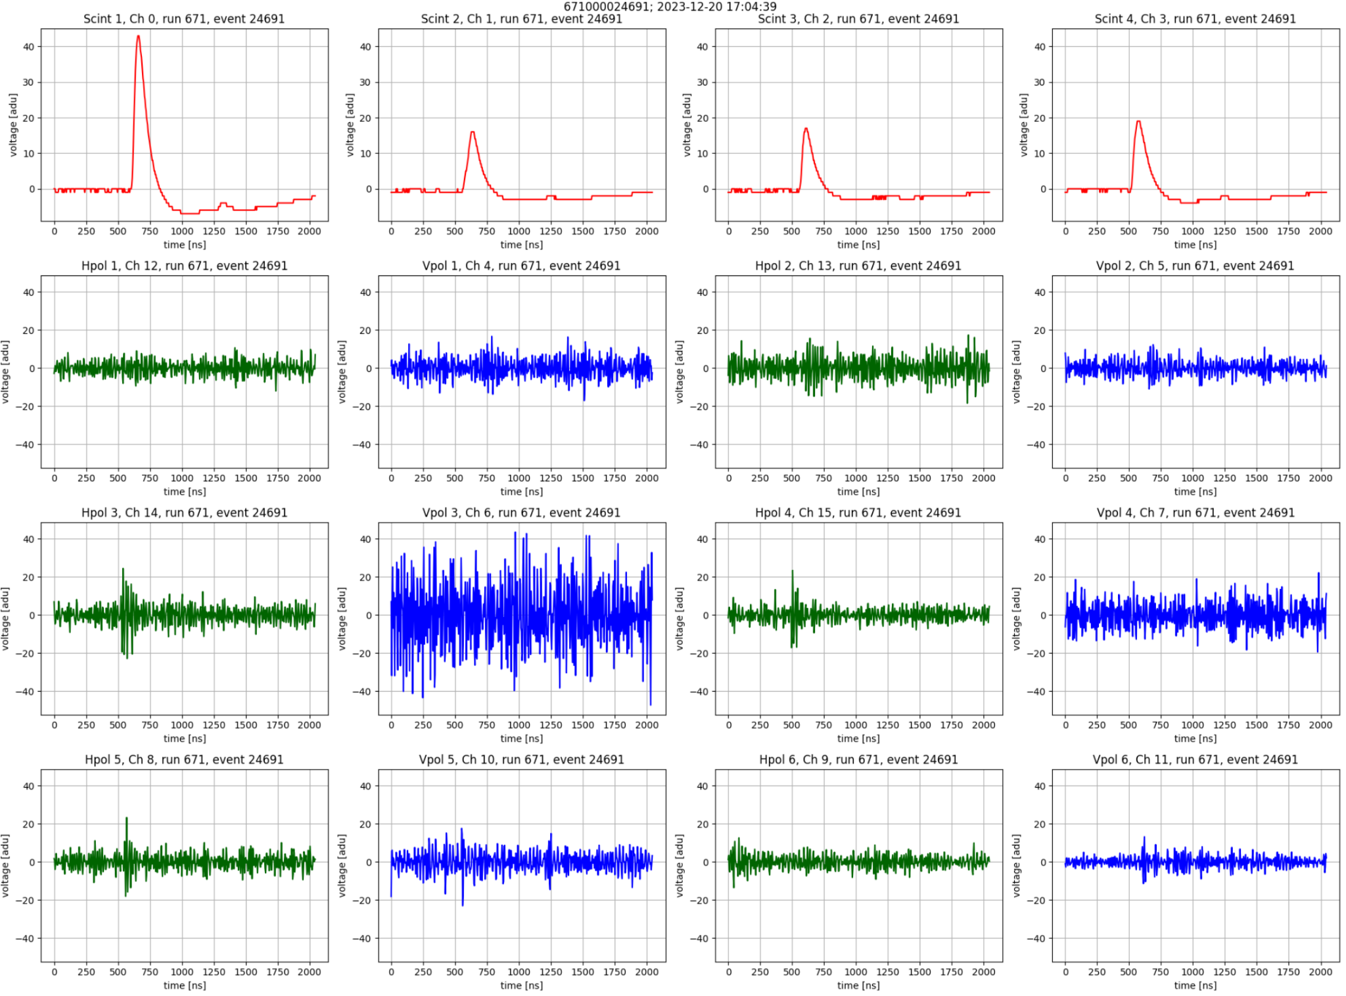
Preliminary Results
Preliminary Scint & RF cuts result in a few events out of ~70 days of data
Not a confirmed CR (WIP)
Event Distributions in Scint & RF after only scint-based cuts
Scint
RF
Preliminary

Slide 40
Preliminary Results
Preliminary Scint & RF cuts result in a few events out of ~70 days of data
Future: - Confirm CR in RF using sims - Iterate on analysis accuracy (backgrounds) - Optimize RF search w/ RF-Scint CRs
Not a confirmed CR (WIP)
Event Distributions in Scint & RF after only scint-based cuts
Scint
RF
Preliminary

Slide 41
Summary
BEACON prototype sensitive to impulse events / CRs
CR search will verify full BEACON sensitivity to 𝜈’s
WIP for search improvements using RF
WIP using independent scintillator array CR search to optimize RF-only search & trigger
White Mountain Research Center
ARENA 2024
Notes:
- Name
- Title

Slide 42
Thank you!
White Mountain Research Center
ARENA 2024
Notes:
- Name
- Title

Slide 43
Backup/Extra Slides

Slide 44
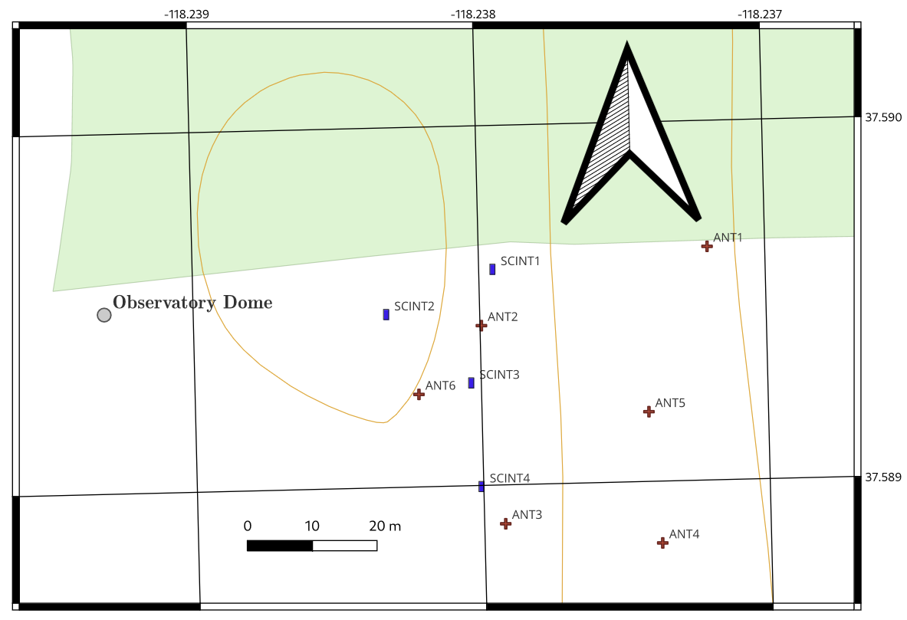
Orientation
(+ Az)
(0,0,0)
East (0° Az)

Slide 45
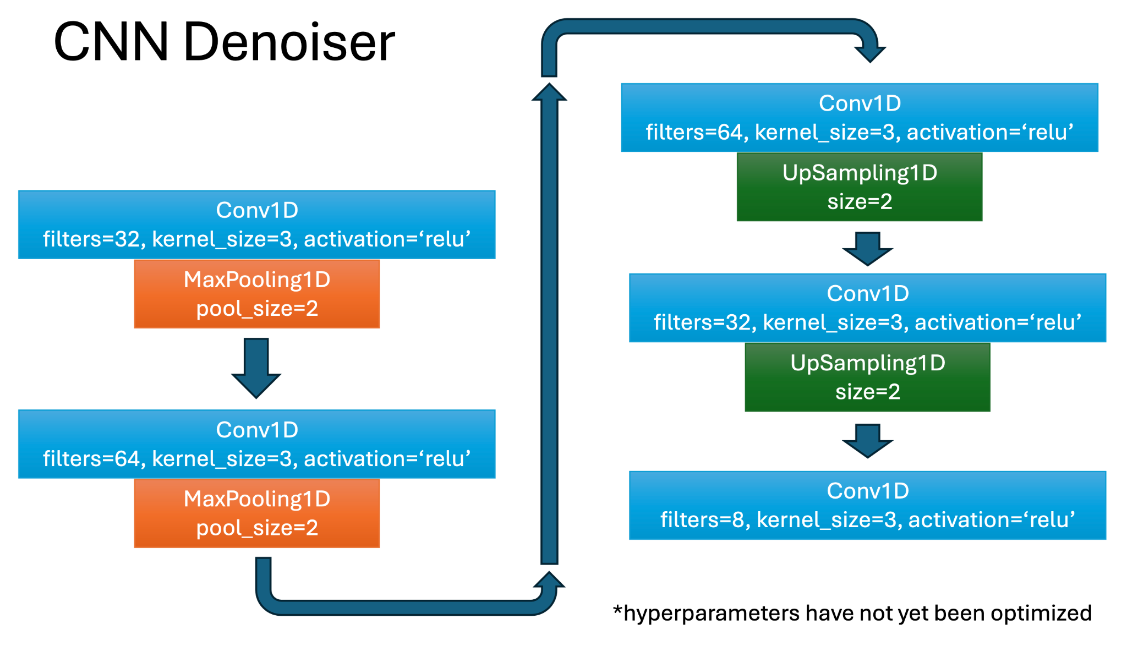
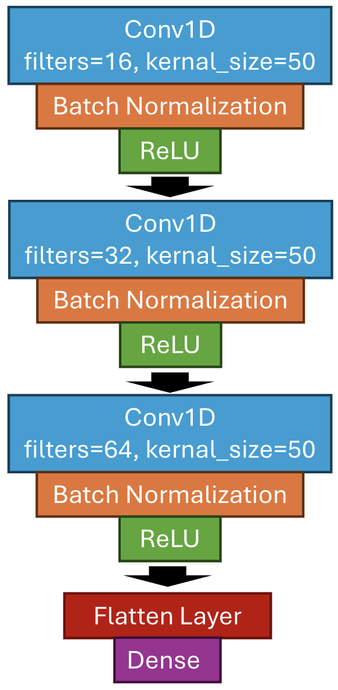
CNN Structures
CNN Classifier
Andrew Zeolla

Slide 46
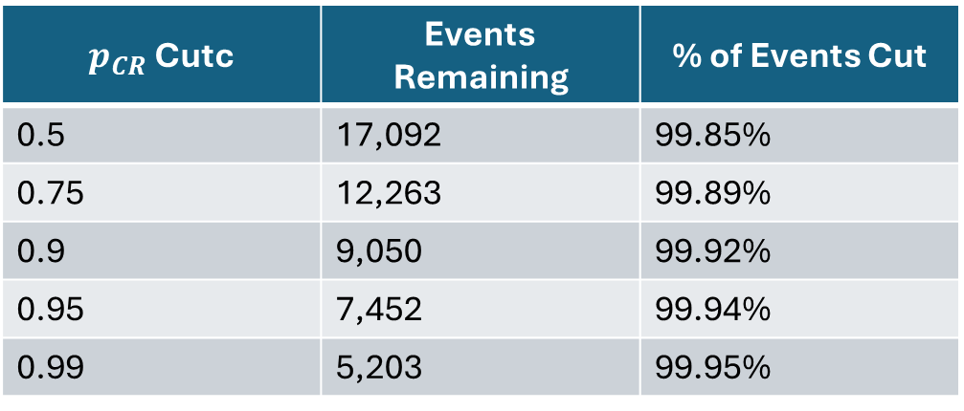
CNN Classification Cut
Andrew Zeolla

Slide 47
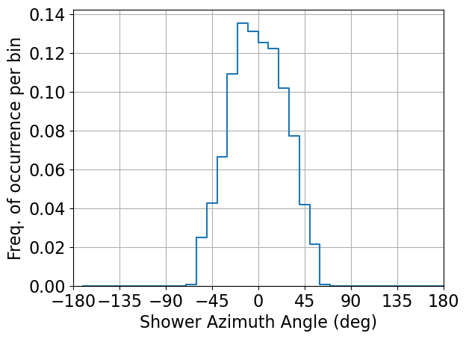
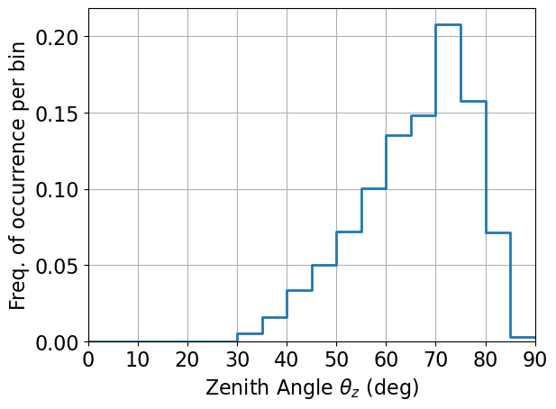
RF (Simulated) 1D Distributions
Andrew Zeolla

Slide 48
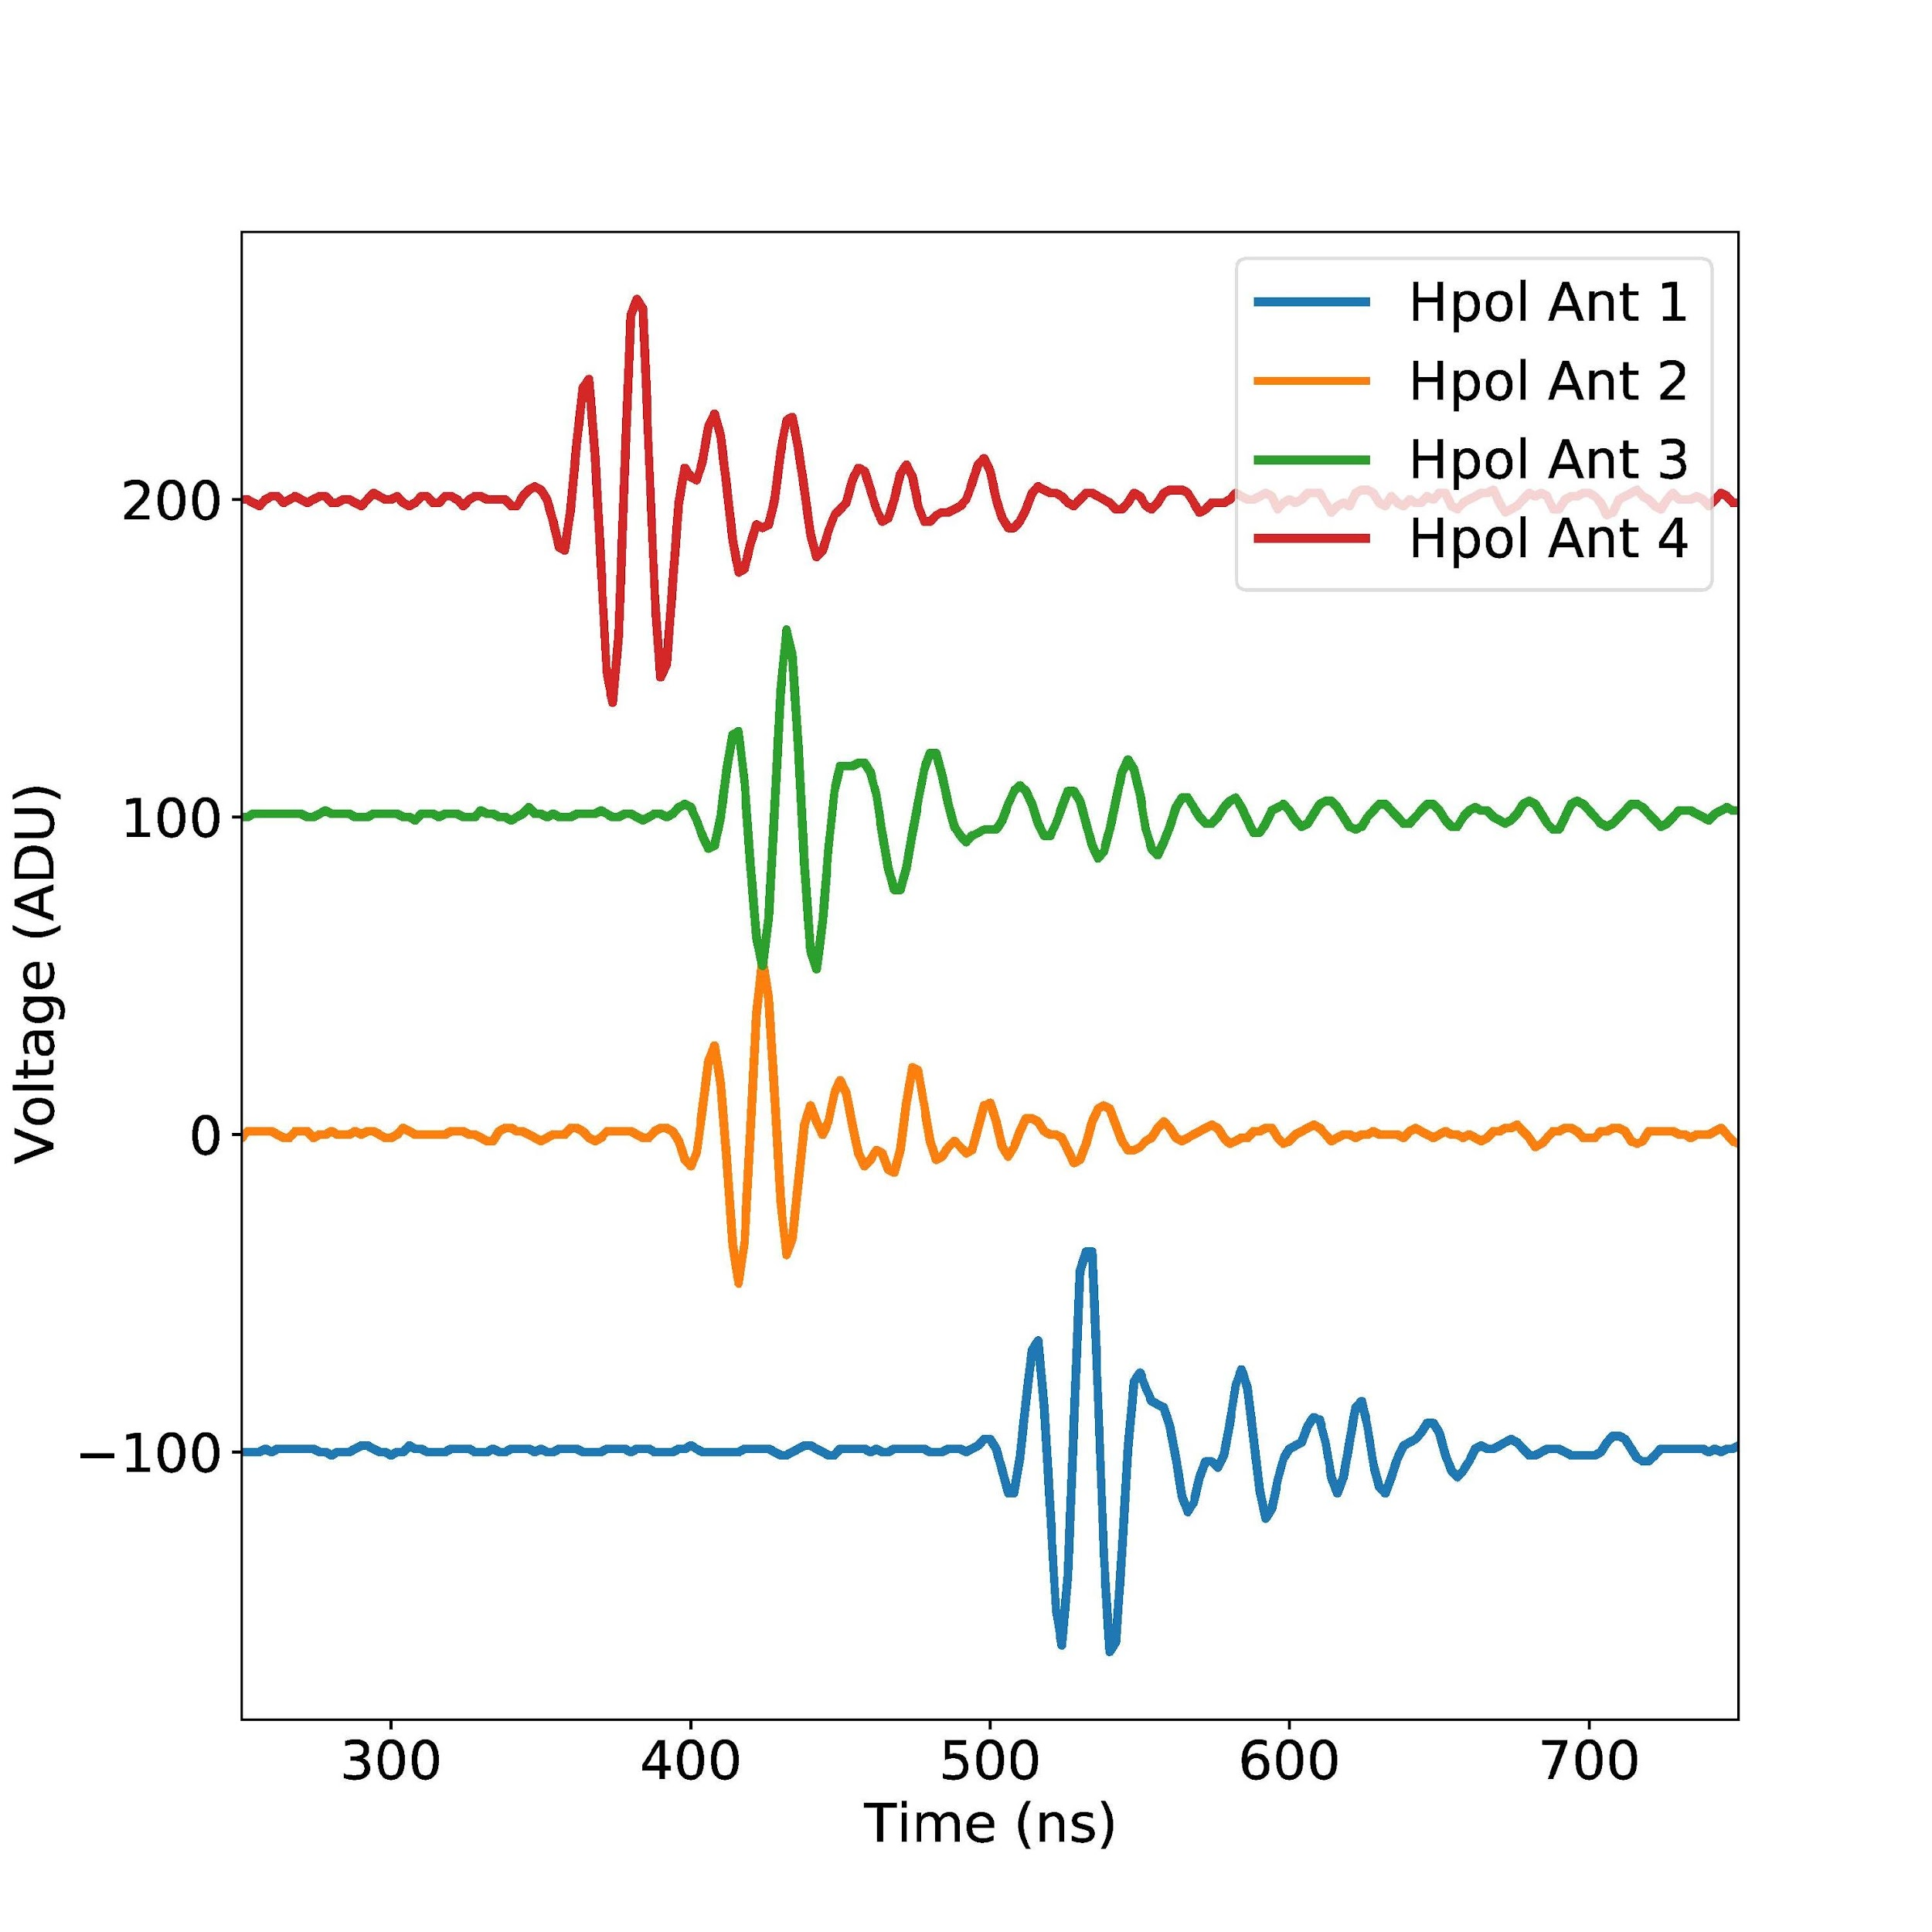
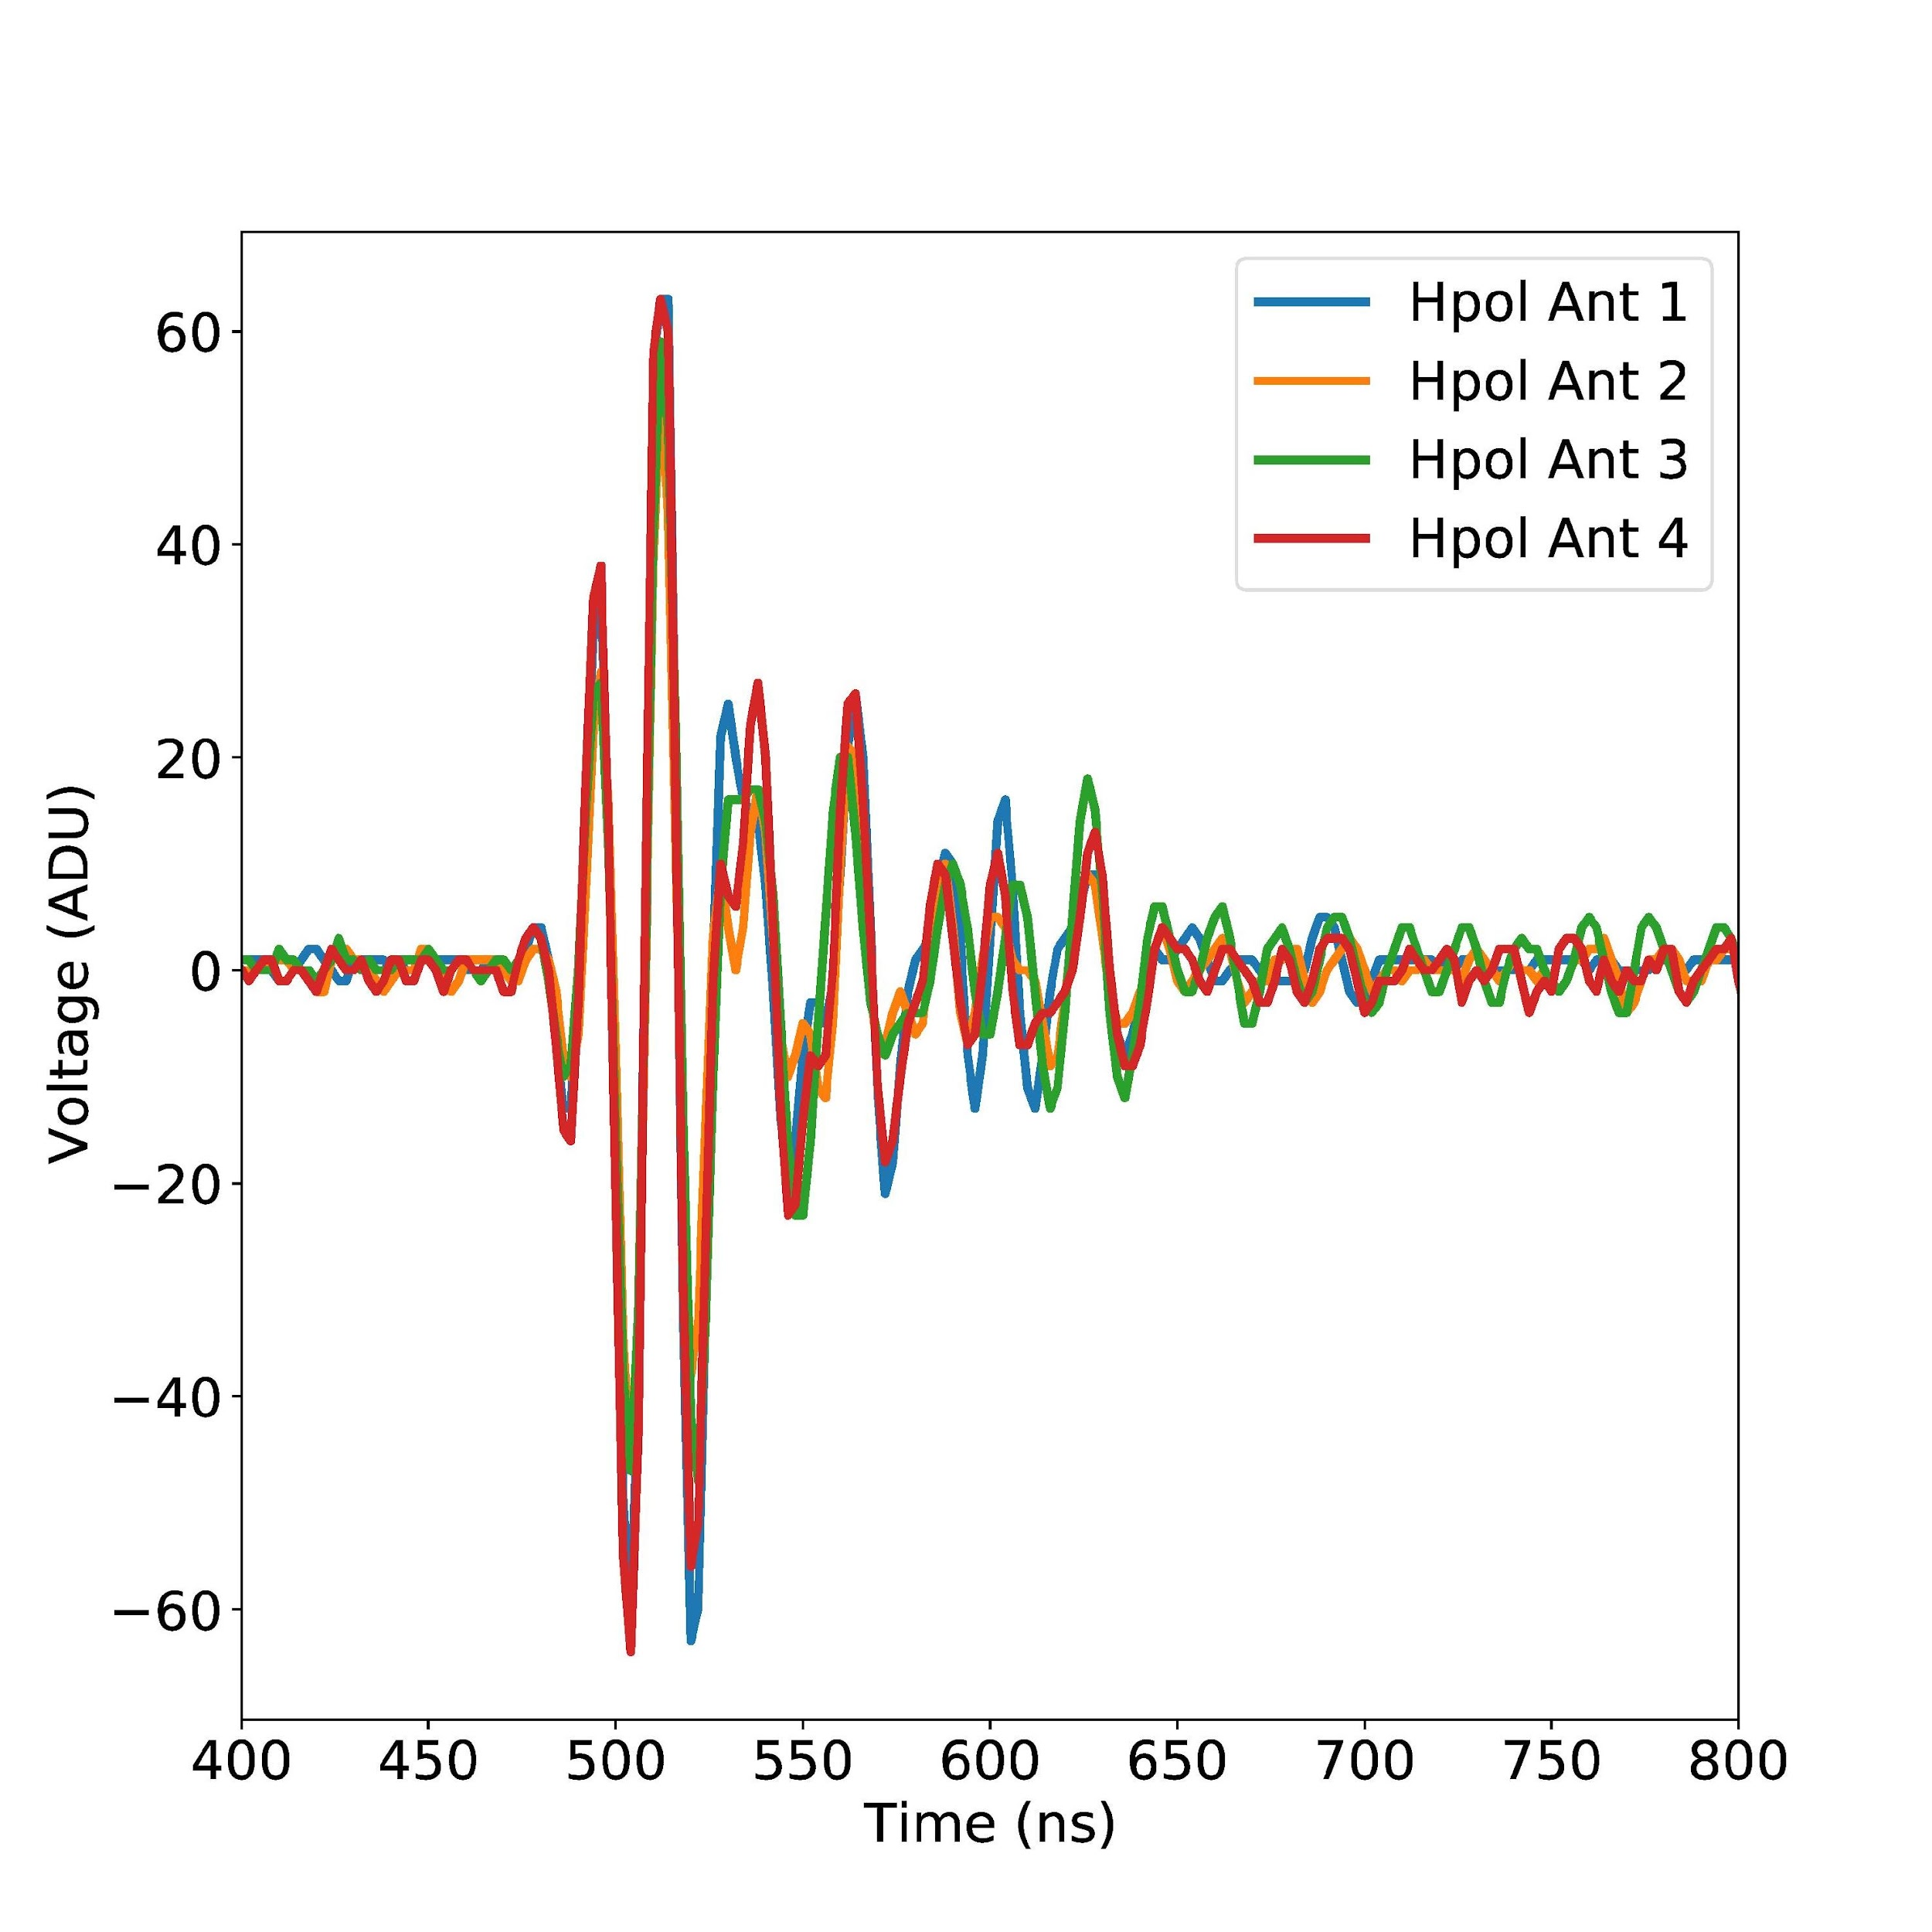
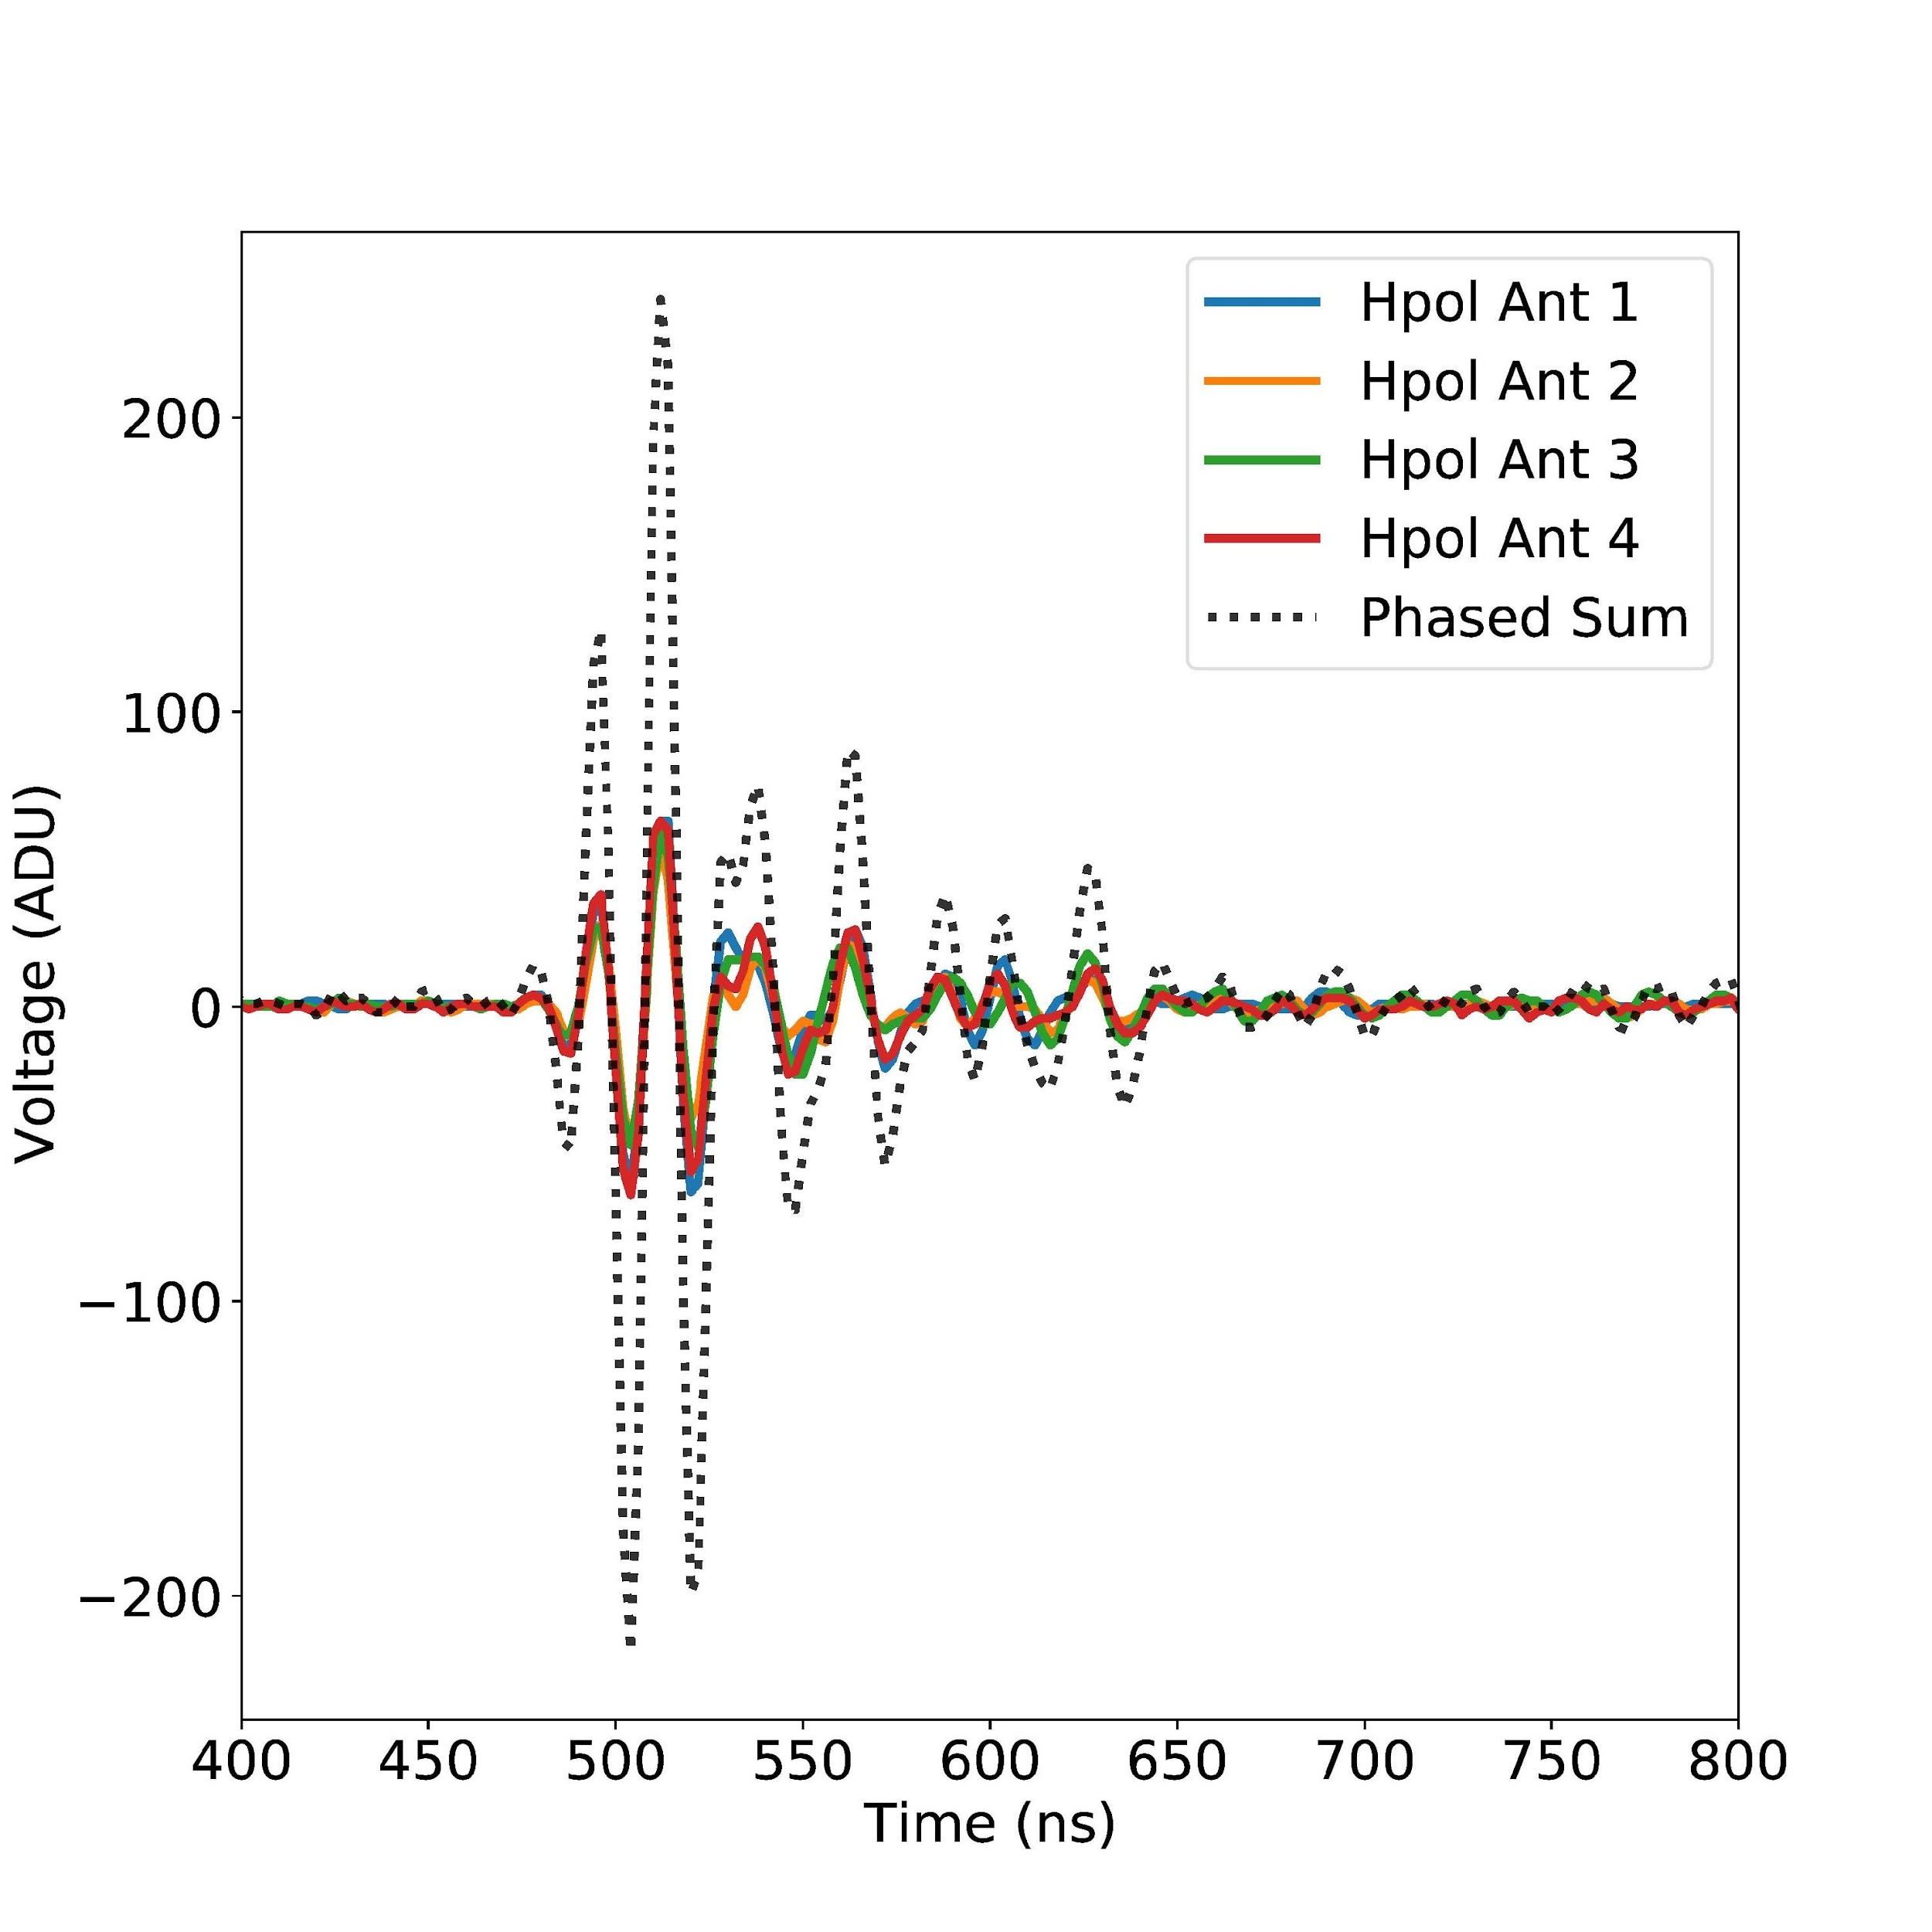
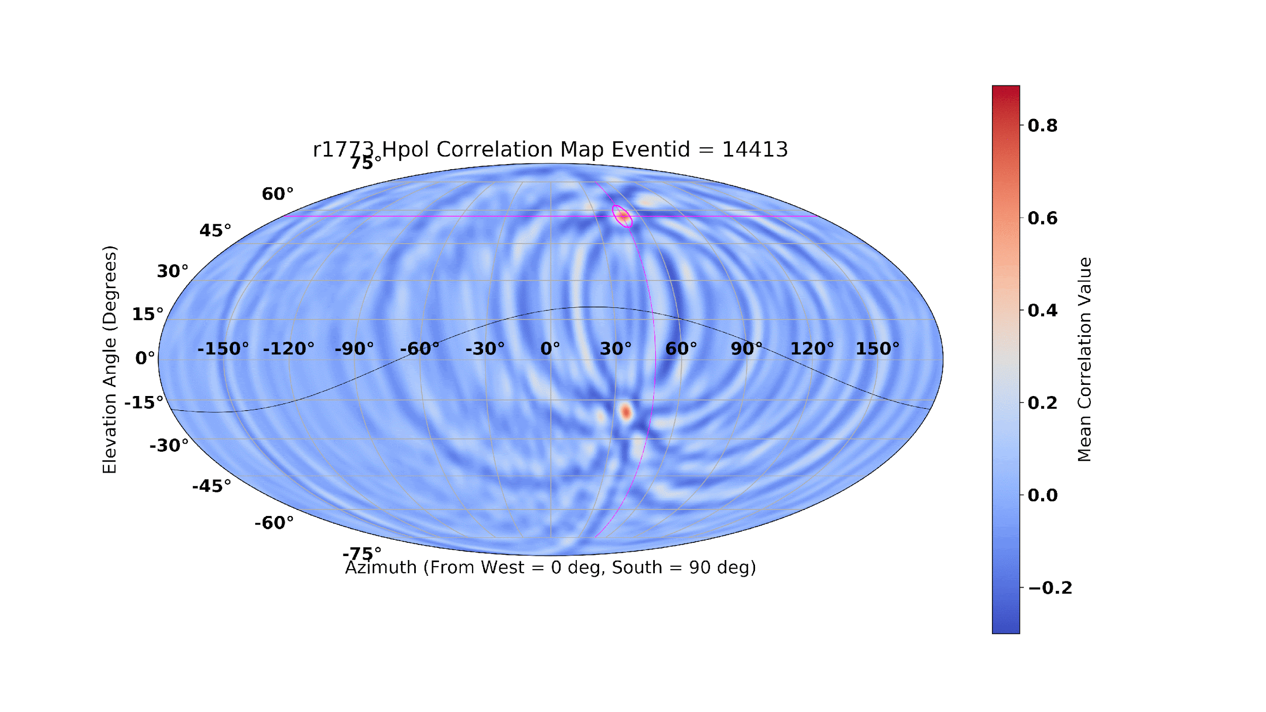
RF Pointing
Received Signals
Aligned Signals
Geometry
Antenna Array
Path Length Difference
Source
Coherently Summed
Pointing

Slide 49
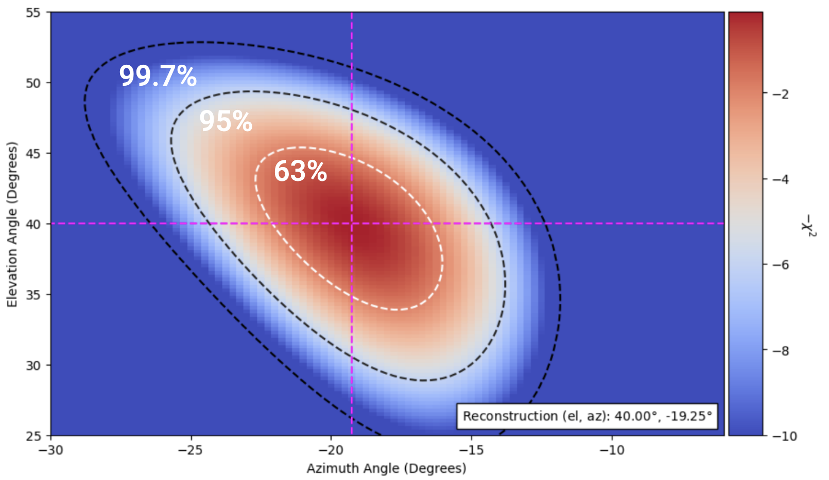
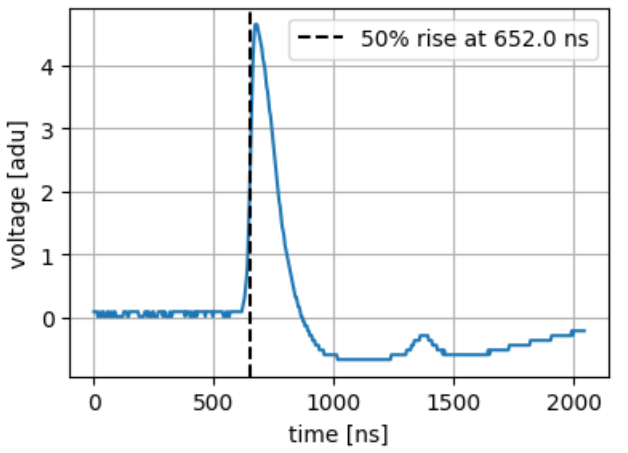
Scint Pointing
Likelihood curves give confidence intervals: exp(-ꭓ²/2)
Minimizes 3 or 4 scints fitted to a plane wave
Method: t_{meas,ij}(θ, φ) = 50% rise time
x3 or x4 waveforms

Slide 50
Cuts
~70 days of data Scints - Scint Triggered (4 scints) - χ²(θ,φ) < 1 - 10 ADU <= Vmax <= 120 ADU (max 127) - 1 <= Peaks <= 4 - 30 < zenith < 85; -60 < Az < 60 - RF: Recon dist < 20 deg; SNR > 5; Pulse within 200ns
Not a confirmed CR (WIP)
Event Distributions in Scint & RF after only scint-based cuts
Scint
RF
Preliminary

